Slide 1
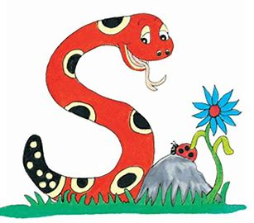
Jolly Grammar 1-18

Slide 2
Spelling Test 17

Slide 3
bus

Slide 4
bus
pot

Slide 5
bus
pot
swim

Slide 6
bus
pot
swim
cube

Slide 7
bus
pot
swim
cube
tune

Slide 8
bus
pot
swim
cube
tune
6. used

Slide 9
bus
pot
swim
cube
tune
6. used
7. excuse

Slide 10
bus
pot
swim
cube
tune
6. used
7. excuse
8. little

Slide 11
bus
pot
swim
cube
tune
6. used
7. excuse
8. little
9. down

Slide 12
bus
pot
swim
cube
tune
6. used
7. excuse
8. little
9. down
10. useless

Slide 13
Let’s revise
Present and
Past.

Slide 14
I talk.
I smile.
I hop.

Slide 15
I talk. → I talked.
I smile.
I hop.

Slide 16
I talk. → I talked.
I smile. → I smiled.
I hop.

Slide 17
I talk. → I talked.
I smile. → I smiled.
I hop.

Slide 18
I talk. → I talked.
I smile. → I smiled.
I hop. → I hopped.

Slide 19
Present
today

Slide 20
Past
yesterday
Present
today

Slide 21
Past
yesterday
Present
today
Future
tomorrow

Slide 22
Past
yesterday
Present
today
Future
tomorrow
I talk
I cook
I listen
I skate
I walk

Slide 23
Past
yesterday
Present
today
Future
tomorrow
I talked
I
I
I
I
I talk
I cook
I listen
I skate
I walk

Slide 24
Past
yesterday
Present
today
Future
tomorrow
I talked
I
I
I
I
I talk
I cook
I listen
I skate
I walk
I shall talk
I
I
I
I

Slide 25
Past
yesterday
Present
today
Future
tomorrow
I talked
I cooked
I
I
I
I talk
I cook
I listen
I skate
I walk
I shall talk
I
I
I
I

Slide 26
Past
yesterday
Present
today
Future
tomorrow
I talked
I cooked
I listened
I
I
I talk
I cook
I listen
I skate
I walk
I shall talk
I
I
I
I

Slide 27
Past
yesterday
Present
today
Future
tomorrow
I talked
I cooked
I listened
I skated
I
I talk
I cook
I listen
I skate
I walk
I shall talk
I
I
I
I

Slide 28
Past
yesterday
Present
today
Future
tomorrow
I talked
I cooked
I listened
I skated
I walked
I talk
I cook
I listen
I skate
I walk
I shall talk
I
I
I
I

Slide 29
Past
yesterday
Present
today
Future
tomorrow
I talked
I cooked
I listened
I skated
I walked
I talk
I cook
I listen
I skate
I walk
I shall talk
I shall cook
I
I
I

Slide 30
Past
yesterday
Present
today
Future
tomorrow
I talked
I cooked
I listened
I skated
I walked
I talk
I cook
I listen
I skate
I walk
I shall talk
I shall cook
I shall listen
I
I

Slide 31
Past
yesterday
Present
today
Future
tomorrow
I talked
I cooked
I listened
I skated
I walked
I talk
I cook
I listen
I skate
I walk
I shall talk
I shall cook
I shall listen
I shall skate
I

Slide 32
Past
yesterday
Present
today
Future
tomorrow
I talked
I cooked
I listened
I skated
I walked
I talk
I cook
I listen
I skate
I walk
I shall talk
I shall cook
I shall listen
I shall skate
I shall walk

Slide 33
Past
yesterday
Present
today
Future
tomorrow
I play
you
he
she
it
we
you
they

Slide 34
Past
yesterday
Present
today
Future
tomorrow
I play
you
he
she
it
we
you
they

Slide 35
Past
yesterday
Present
today
Future
tomorrow
I play
you play
he
she
it
we
you
they

Slide 36
Past
yesterday
Present
today
Future
tomorrow
I play
you play
he plays
she
it
we
you
they

Slide 37
Past
yesterday
Present
today
Future
tomorrow
I play
you play
he plays
she plays
it
we
you
they

Slide 38
Past
yesterday
Present
today
Future
tomorrow
I play
you play
he plays
she plays
it plays
we
you
they

Slide 39
Past
yesterday
Present
today
Future
tomorrow
I play
you play
he plays
she plays
it plays
we play
you
they

Slide 40
Past
yesterday
Present
today
Future
tomorrow
I play
you play
he plays
she plays
it plays
we play
you play
they

Slide 41
Past
yesterday
Present
today
Future
tomorrow
I play
you play
he plays
she plays
it plays
we play
you play
they play

Slide 42
Past
yesterday
Present
today
Future
tomorrow
I played
you
he
she
it
we
you
they
I play
you play
he plays
she plays
it plays
we play
you play
they play

Slide 43
Past
yesterday
Present
today
Future
tomorrow
I played
you played
he played
she played
it played
we played
you played
they played
I play
you play
he plays
she plays
it plays
we play
you play
they play

Slide 44
Past
yesterday
Present
today
Future
tomorrow
I played
you played
he played
she played
it played
we played
you played
they played
I play
you play
he plays
she plays
it plays
we play
you play
they play
I shall/will play
you
he
she
it
we
you
they

Slide 45
Past
yesterday
Present
today
Future
tomorrow
I played
you played
he played
she played
it played
we played
you played
they played
I play
you play
he plays
she plays
it plays
we play
you play
they play
I shall/will play
you will play
he will play
she will play
it will play
we will play
you will play
they will play

Slide 46
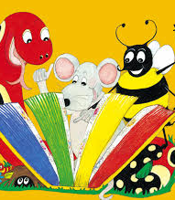
Activity page

Slide 47
Write some sentences about
what you did yesterday.
I did my P.E class.
I joined a piano contest.
I went to a hospital.
I caught a grasshopper.

Slide 48
Write some sentences about
what you will do tomorrow.
I will join my Karate lesson.
I will have an English lesson.
I will play the piano for thirty minutes.

Slide 49
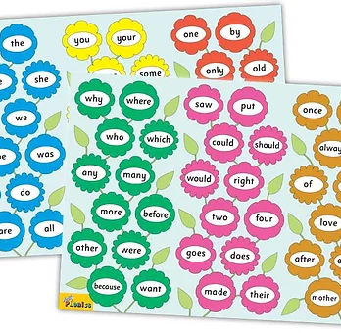
Tricky Words
3rd set

Slide 50
whale
/w/

Slide 51
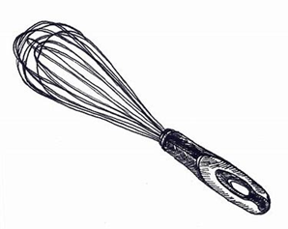
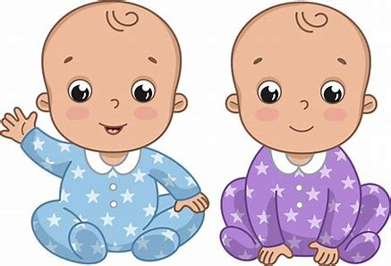
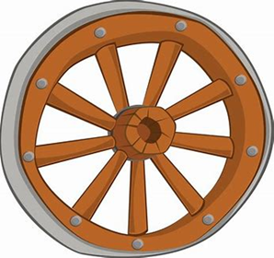
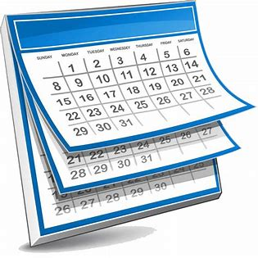
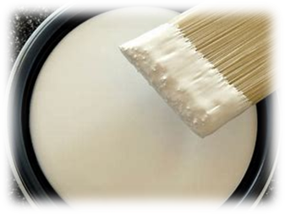
whale
whisper
whisk
did
cut
twin
whale
wheel
white
whisper
what
when
whenever
wheel
whenever
whizz
white
when
which
whisker

Slide 52
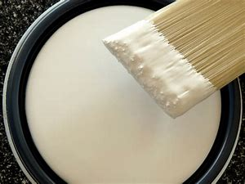
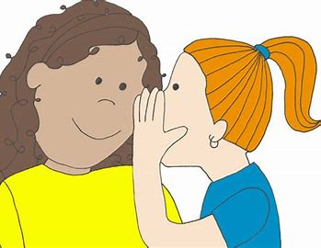
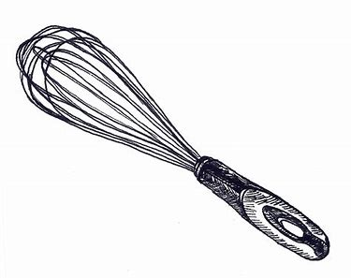
whale
wheel
white
whisper
whisk
which
whisker
whenever
whizz

Slide 53
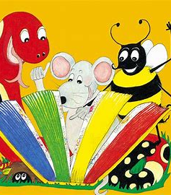
Dictation

Slide 54
when

Slide 55
when 2. whisk

Slide 56
when 2. whisk 3. whizz

Slide 57
when 2. whisk 3. whizz
4. which

Slide 58
when 2. whisk 3. whizz
4. which 5. whale

Slide 59
when 2. whisk 3. whizz
4. which 5. whale 6. whisker

Slide 60
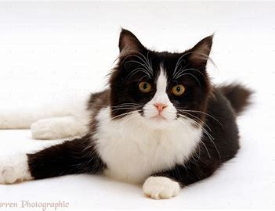
when 2. whisk 3. whizz
4. which 5. whale 6. whisker
7. My cat is black and white.

Slide 61
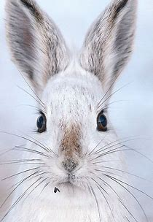
when 2. whisk 3. whizz
4. which 5. whale 6. whisker
7. My cat is black and white.
8. The rabbit has long whiskers.

Slide 62
when 2. whisk 3. whizz
4. which 5. whale 6. whisker
7. My cat is black and white.
8. The rabbit has long whisker.
9. What did you whisper?

Slide 63
Thank you! See you next time.

