Slide 1
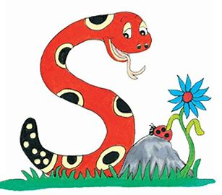
Jolly Grammar 1-17

Slide 2
Spelling Test 16

Slide 3
cod

Slide 4
cod
lot

Slide 5
cod
lot
snap

Slide 6
cod
lot
snap
bone

Slide 7
cod
lot
snap
bone
nose

Slide 8
cod
lot
snap
bone
nose
6. home

Slide 9
cod
lot
snap
bone
nose
6. home
7. globe

Slide 10
cod
lot
snap
bone
nose
6. home
7. globe
8. live

Slide 11
cod
lot
snap
bone
nose
6. home
7. globe
8. live
9. give

Slide 12
cod
lot
snap
bone
nose
6. home
7. globe
8. live
9. give
10. tadpole

Slide 13
Let’s revise
Short Vowels.

Slide 14
Short Vowels

Slide 15
Short Vowels
a e i o u

Slide 16
Let’s revise
Present and Past Tense.

Slide 17
Today I wish.
Yesterday, I wished.

Slide 18
Today I wish.
Yesterday, I wished.
present tense
past tense

Slide 19
Today, I talk.
Today, I smile.

Slide 20
Today, I talk.
Yesterday,
Today, I smile.
Yesterday,

Slide 21
Today, I talk.
Yesterday, I talked.
Today, I smile.
Yesterday,

Slide 22
Today, I talk.
Yesterday, I talked.
Today, I smile.
Yesterday, I smiled.

Slide 23
Let’s Learn Doubling Rule.

Slide 24
I talk.
I smile.
I hop.

Slide 25
I talk. → I talked.
I smile.
I hop.

Slide 26
I talk. → I talked.
I smile. → I smiled.
I hop.

Slide 27
I talk. → I talked.
I smile. → I smiled.
I hop.

Slide 28
I talk. → I talked.
I smile. → I smiled.
I hop. → I hopped.

Slide 29
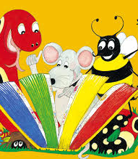
Activity page

Slide 30
bat
rip
hug
hop
nod
wag
pat
peg
hum

Slide 31
bat
batted
rip
hug
hop
nod
wag
pat
peg
hum

Slide 32
bat
batted
rip
ripped
hug
hop
nod
wag
pat
peg
hum

Slide 33
bat
batted
rip
ripped
hug
hugged
hop
nod
wag
pat
peg
hum

Slide 34
bat
batted
rip
ripped
hug
hugged
hop
hopped
nod
wag
pat
peg
hum

Slide 35
bat
batted
rip
ripped
hug
hugged
hop
hopped
nod
nodded
wag
pat
peg
hum

Slide 36
bat
batted
rip
ripped
hug
hugged
hop
hopped
nod
nodded
wag
wagged
pat
peg
hum

Slide 37
bat
batted
rip
ripped
hug
hugged
hop
hopped
nod
nodded
wag
wagged
pat
patted
peg
hum

Slide 38
bat
batted
rip
ripped
hug
hugged
hop
hopped
nod
nodded
wag
wagged
pat
patted
peg
pegged
hum

Slide 39
bat
batted
rip
ripped
hug
hugged
hop
hopped
nod
nodded
wag
wagged
pat
patted
peg
pegged
hum
hummed

Slide 40
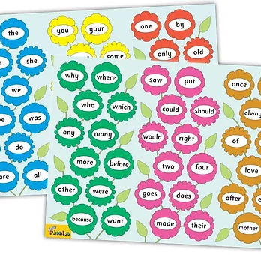
Tricky Words
3rd set

Slide 41
tune
/ue/

Slide 42
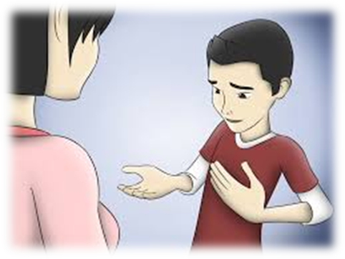
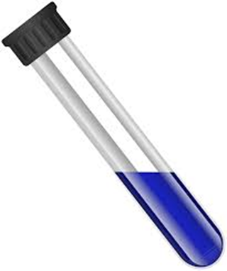
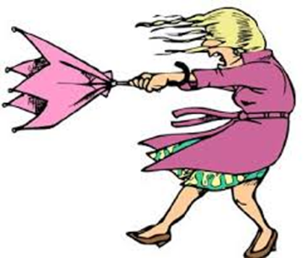
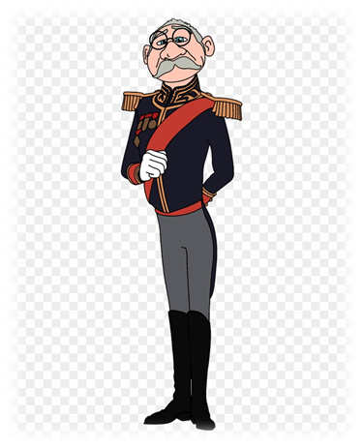
cube
excuse
tube
bus
pot
swim
cube
tune
used
excuse
little
down
useless
tune
useless
rule
used
use
duke

Slide 43
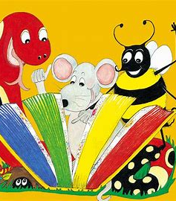
Dictation

Slide 44
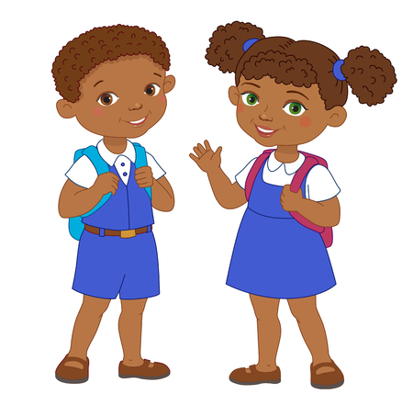
us

Slide 45
us 2. use

Slide 46
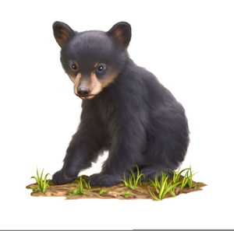
us 2. use 3. cub

Slide 47
us 2. use 3. cub
4. cube

Slide 48
us 2. use 3. cub
4. cube 5. tube

Slide 49
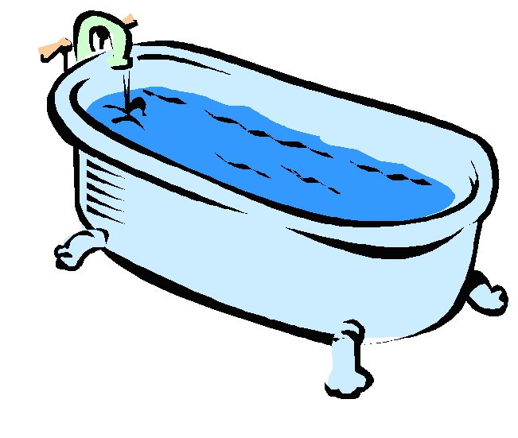
us 2. use 3. cub
4. cube 5. tube 6. tub

Slide 50
us 2. use 3. cub
4. cube 5. tube 6. tub
7. They broke a rule.

Slide 51
us 2. use 3. cub
4. cube 5. tube 6. tub
7. They broke a rule.
8. Soon we will see the duke.

Slide 52
us 2. use 3. cub
4. cube 5. tube 6. tub
7. They broke a rule.
8. Soon we will see the duke.
9. The girl played a tune.

Slide 53
Thank you! See you next time.

