Slide 1
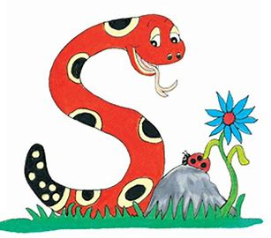
Jolly Grammar 1-15

Slide 2
Spelling Test 14

Slide 3
ran

Slide 4
ran
hat

Slide 5
ran
hat
scar

Slide 6
ran
hat
scar
came

Slide 7
ran
hat
scar
came
grape

Slide 8
ran
hat
scar
came
grape
6. name

Slide 9
ran
hat
scar
came
grape
6. name
7. cake

Slide 10
ran
hat
scar
came
grape
6. name
7. cake
8. only

Slide 11
ran
hat
scar
came
grape
6. name
7. cake
8. only
9. old

Slide 12
ran
hat
scar
came
grape
6. name
7. cake
8. only
9. old
10. baseball

Slide 13
Let’s revise
Verbs.

Slide 14
Mum drives a car.
We live in Kitakyushu.

Slide 15
Mum drives a car.
We live in Kitakyushu.

Slide 16
Mum drives a car.
We live in Kitakyushu.

Slide 17
Let’s revise
Pronouns.

Slide 18
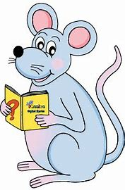
I
you
he
she
it
we
you
they

Slide 19
Let’s conjugate
Verbs.

Slide 20
I
you
he
she
it
we
you
they
eat

Slide 21
I
you
he
she
it
we
you
they
eat
eat

Slide 22
I
you
he
she
it
we
you
they
eat
eat
eats

Slide 23
I
you
he
she
it
we
you
they
eat
eat
eats
eats

Slide 24
I
you
he
she
it
we
you
they
eat
eat
eats
eats
eats

Slide 25
I
you
he
she
it
we
you
they
eat
eat
eats
eats
eats
eat

Slide 26
I
you
he
she
it
we
you
they
eat
eat
eats
eats
eats
eat
eat

Slide 27
I
you
he
she
it
we
you
they
eat
eat
eats
eats
eats
eat
eat
eat

Slide 28
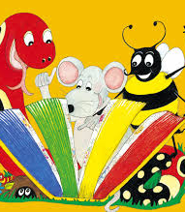
Activity page

Slide 29
he
she
it
I
you
you
they
we

Slide 30
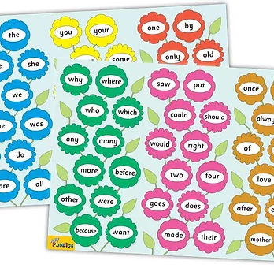
Tricky Words
3rd set

Slide 31
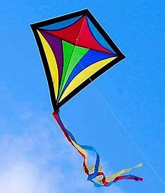
kite
/ie/

Slide 32
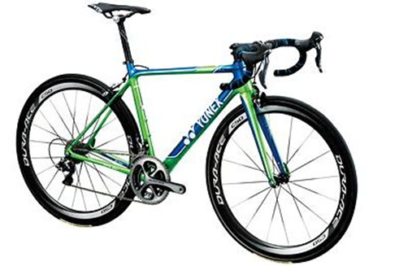
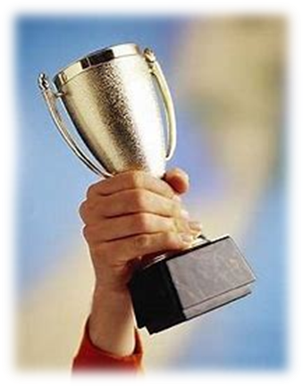
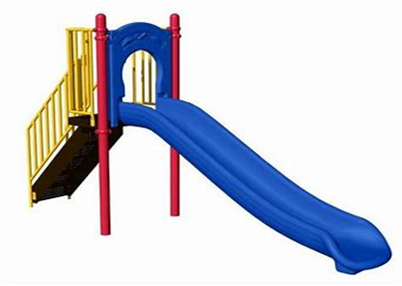
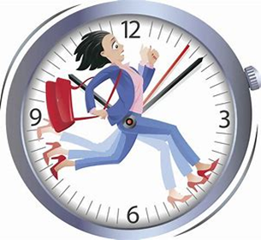
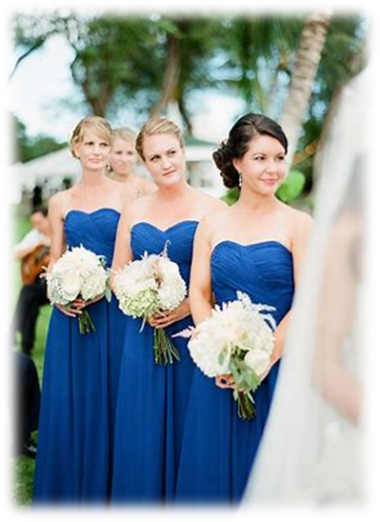
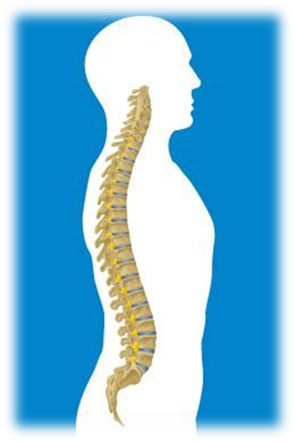
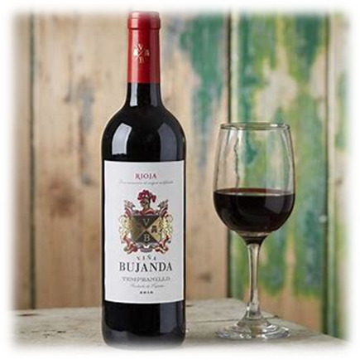
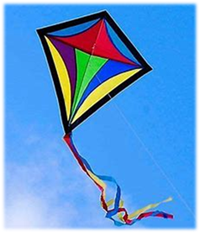
bike
prize
slide
six
pad
smell
bike
time
smile
prize
like
have
bridesmaid
time
bridesmaid
spine
smile
wine
kite

Slide 33
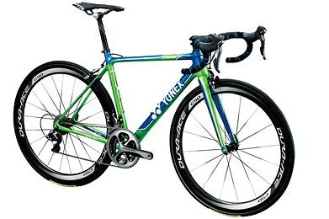
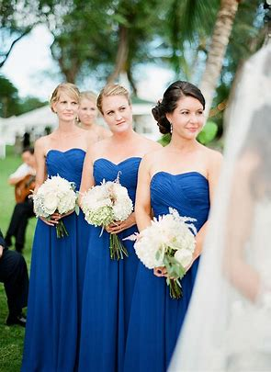
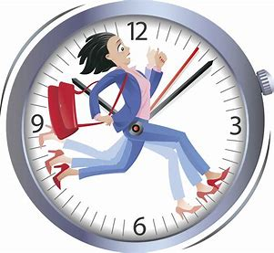
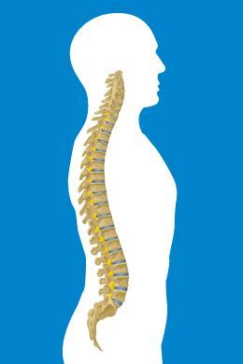
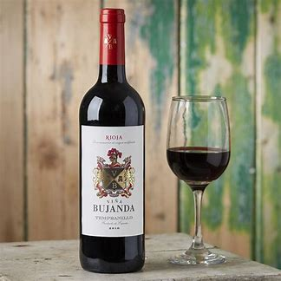
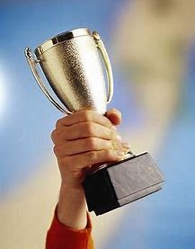
time
kite
smile
bike
prize
bridesmaid
wine
like
slide
spine

Slide 34
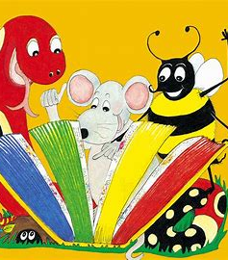
Dictation

Slide 35
wine

Slide 36
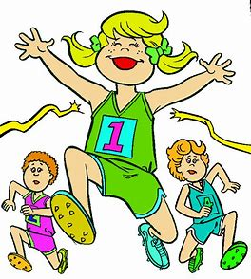
wine 2. win

Slide 37
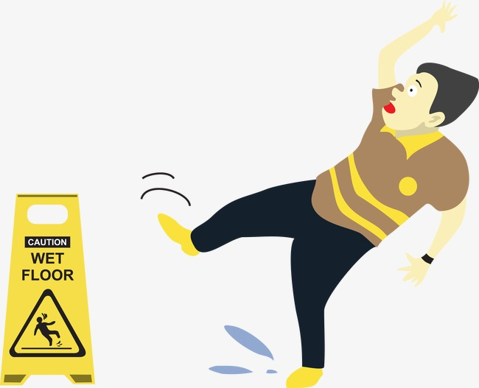
wine 2. win 3. slid

Slide 38
wine 2. win 3. slid
4. slide

Slide 39
wine 2. win 3. slid
4. slide 5. spine

Slide 40
wine 2. win 3. slid
4. slide 5. spine 6. spin

Slide 41
wine 2. win 3. slid
4. slide 5. spine 6. spin
7. I like my prize.

Slide 42
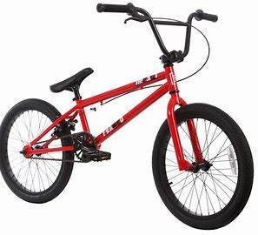
wine 2. win 3. slid
4. slide 5. spine 6. spin
7. I like my prize.
8. She has red bike.

Slide 43
wine 2. win 3. slid
4. slide 5. spine 6. spin
7. I like my prize.
8. She has red bike.
9. They had a kite.

Slide 44
Thank you! See you next time.

