Slide 1
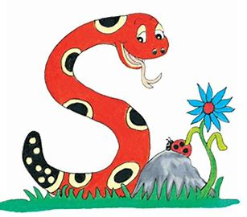
Jolly Grammar 1-14

Slide 2
Spelling Test 13

Slide 3
sad

Slide 4
sad
let

Slide 5
sad
let
trip

Slide 6
sad
let
trip
blue

Slide 7
sad
let
trip
blue
orange

Slide 8
sad
let
trip
blue
orange
6. grey

Slide 9
sad
let
trip
blue
orange
6. grey
7. black

Slide 10
sad
let
trip
blue
orange
6. grey
7. black
8. one

Slide 11
sad
let
trip
blue
orange
6. grey
7. black
8. one
9. by

Slide 12
sad
let
trip
blue
orange
6. grey
7. black
8. one
9. by
10. colour

Slide 13
Let’s revise
Proper nouns,
Common nouns
and Pronouns.

Slide 14
The bees play football.
Bill kicks the ball.
He scores a goal.

Slide 15
The bees play football.
Bill kicks the ball.
He scores a goal.

Slide 16
The bees play football.
Bill kicks the ball.
He scores a goal.

Slide 17
The bees play football.
Bill kicks the ball.
He scores a goal.

Slide 18
Let’s learn
Verbs.

Slide 19
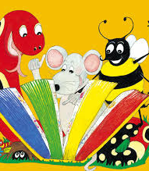
Activity page

Slide 20
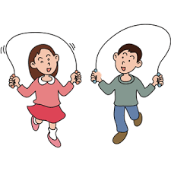
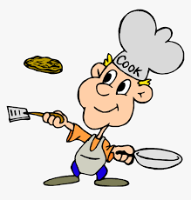
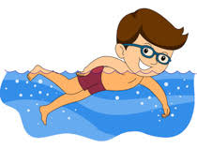

Slide 21
to cook

Slide 22
to cook
to skip

Slide 23
to cook
to swim
to skip

Slide 24
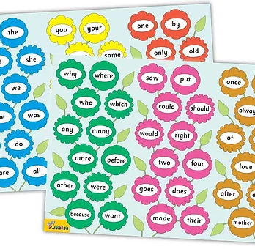
Tricky Words
3rd set

Slide 25
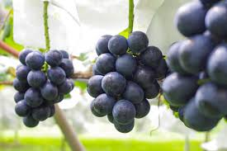
grape
/ai/

Slide 26
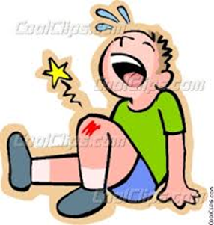
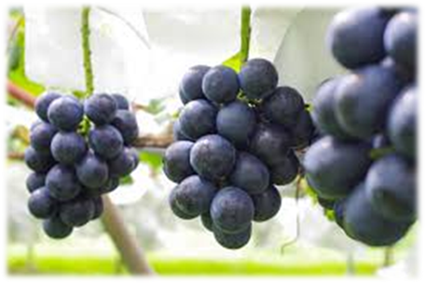
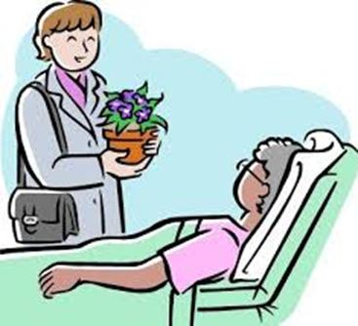
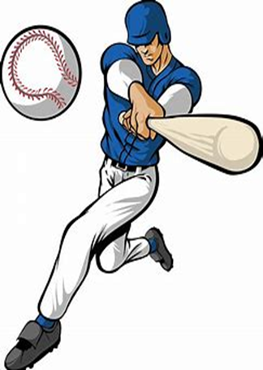
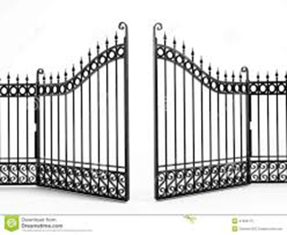
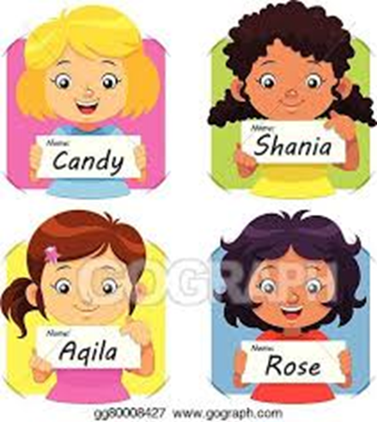
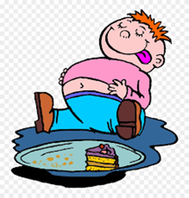
grape
cake
scrape
ran
hat
scar
came
grape
name
cake
only
old
baseball
came
baseball
gate
late
name
ate

Slide 27
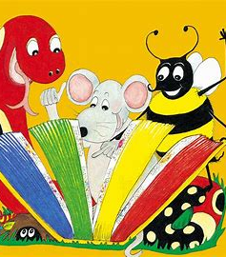
Dictation

Slide 28
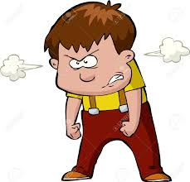
mad

Slide 29
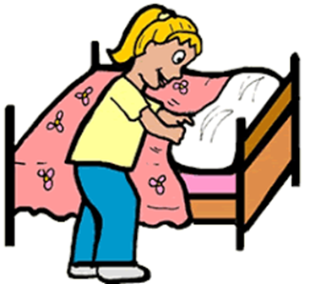
mad 2. made

Slide 30
mad 2. made 3. at

Slide 31
mad 2. made 3. at
4. ate

Slide 32
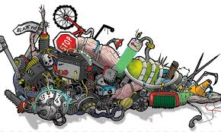
mad 2. made 3. at
4. ate 5. scrap

Slide 33
mad 2. made 3. at
4. ate 5. scrap 6. scrape

Slide 34
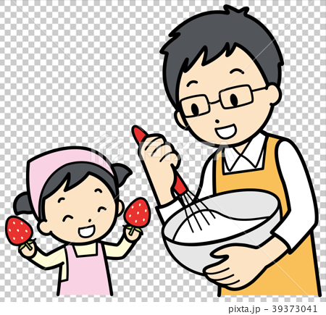
mad 2. made 3. at
4. ate 5. scrap 6. scrape
7. Dad made a cake.

Slide 35
mad 2. made 3. at
4. ate 5. scrap 6. scrape
7. Dad made a cake.
8. The gate is open.

Slide 36
mad 2. made 3. at
4. ate 5. scrap 6. scrape
7. Dad made a cake.
8. The gate is open.
9. She was late.

Slide 37
Thank you! See you next time.

