Slide 1
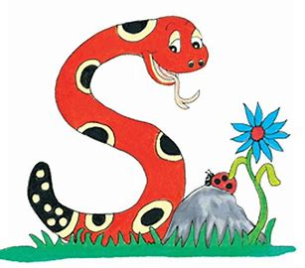
Jolly Grammar 1-13

Slide 2
Spelling Test 12

Slide 3
bed

Slide 4
bed
wet

Slide 5
bed
wet
prod

Slide 6
bed
wet
prod
holly

Slide 7
bed
wet
prod
holly
party

Slide 8
bed
wet
prod
holly
party
6. story

Slide 9
bed
wet
prod
holly
party
6. story
7. happy

Slide 10
bed
wet
prod
holly
party
6. story
7. happy
8. so

Slide 11
bed
wet
prod
holly
party
6. story
7. happy
8. so
9. my

Slide 12
bed
wet
prod
holly
party
6. story
7. happy
8. so
9. my
10. family

Slide 13
Alphabetical Order &

Slide 14
A B C D E
F G H I J K L M
N O P Q R S
T U V W X Y Z

Slide 15
A B C D E
F G H I J K L M
N O P Q R S
T U V W X Y Z

Slide 16
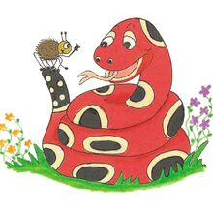
Activity page

Slide 17
Aa Bb Cc Dd Ee
Ff Gg Hh Ii Jj Kk Ll Mm
Nn Oo Pp Qq Rr Ss
Tt Uu Vv Ww Xx Yy Zz

Slide 18
Using Dictionary

Slide 19
Dictionaries tell you how a word is spelt and
what it means. Find each letter in the dictionary and write down the first word beginning with that letter.
Aa Gg
Nn Oo
Ss Zz

Slide 20
e a c

Slide 21
e a c
↓
a c e

Slide 22
k f m

Slide 23
k f m
↓
f k m

Slide 24
n s q

Slide 25
n s q
↓
n q s

Slide 26
z w v

Slide 27
z w v
↓
v w z

Slide 28
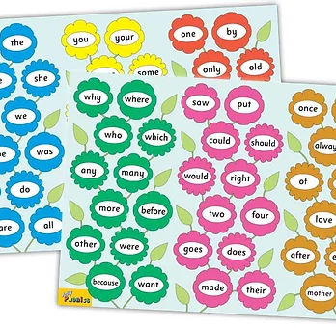
Tricky Words
3rd set

Slide 29
Vowels

Slide 30
Vowels
Short vowels
/a/ /e/ /i/ /o/ /u/

Slide 31
Vowels
Short vowels
/a/ /e/ /i/ /o/ /u/
Long vowels
/ai/ /ee/ /ie/ /oa/ /ue/

Slide 32
Vowels
Short vowels
/a/ /e/ /i/ /o/ /u/
Long vowels
/ai/ /ee/ /ie/ /oa/ /ue/
<or> <oo> <ou> <oi> <er> <ar>

Slide 33
nut
wet
hum
fig
fez
bit
fox
cod
yam
tug
map

Slide 34
sky
ride
cake
toe
home
tune
week
reed
toad
soap
tie

Slide 35
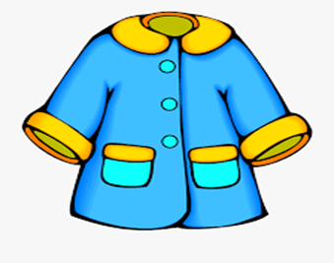
trip
grey
pain
coat
sad
let
trip
blue
orange
grey
black
one
by
colour
blue
black
deep
rescue
orange
colour
lie
coin

Slide 36
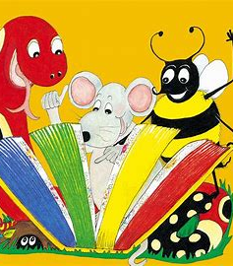
Dictation

Slide 37
pain

Slide 38
pain 2. deep

Slide 39
pain 2. deep 3. lie

Slide 40
pain 2. deep 3. lie
4. coat

Slide 41
pain 2. deep 3. lie
4. coat 5. rescue

Slide 42
pain 2. deep 3. lie
4. coat 5. rescue 6. coin

Slide 43
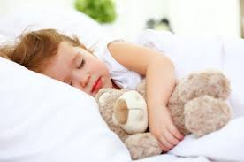
pain 2. deep 3. lie
4. coat 5. rescue 6. coin
7. She sleeps in a bed.

Slide 44
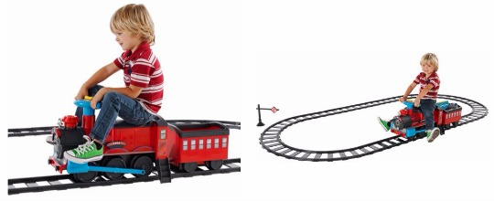
pain 2. deep 3. lie
4. coat 5. rescue 6. coin
7. She sleeps in a bed.
8. We sat on the train.

Slide 45
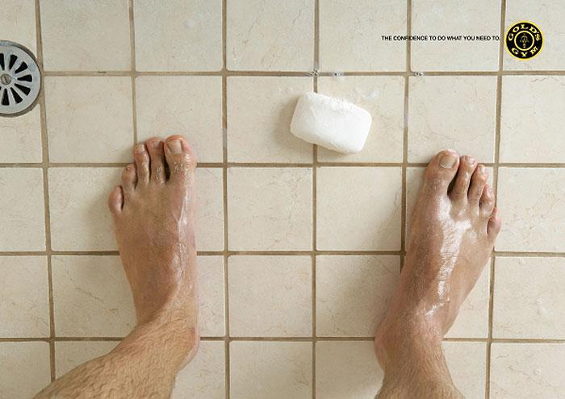
pain 2. deep 3. lie
4. coat 5. rescue 6. coin
7. She sleeps in a bed.
8. We sat on the train.
9. The soap fell
on the ground.

Slide 46
Thank you! See you next time.

