Slide 1
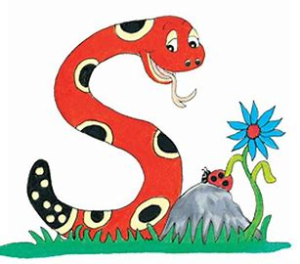
Jolly Grammar 1-12

Slide 2
Spelling Test 11

Slide 3
hop

Slide 4
hop
fit

Slide 5
hop
fit
grin

Slide 6
hop
fit
grin
duck

Slide 7
hop
fit
grin
duck
neck

Slide 8
hop
fit
grin
duck
neck
6. clock

Slide 9
hop
fit
grin
duck
neck
6. clock
7. lick

Slide 10
hop
fit
grin
duck
neck
6. clock
7. lick
8. go

Slide 11
hop
fit
grin
duck
neck
6. clock
7. lick
8. go
9. no

Slide 12
hop
fit
grin
duck
neck
6. clock
7. lick
8. go
9. no
10. broomstick

Slide 13
Initial Consonant Blends

Slide 14
fr dr cr sm
sk
sp
gl
st
gr
sl
fl
bl
sw cl tr sn

Slide 15
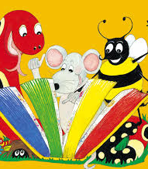
Activity page

Slide 16
fr dr cr sm
sk
sp
gl
st
gr
sl
fl
bl
sw cl tr sn

Slide 17
fr dr cr sm
sk
sp
gl
st
grin
gr
sl
fl
bl
sw cl tr sn

Slide 18
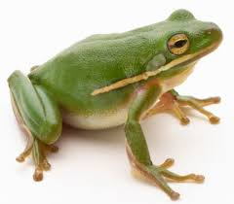
fr dr cr sm
sk
sp
gl
st
gr
sl
fl
bl
sw cl tr sn

Slide 19
fr dr cr sm
sk
sp
gl
st
frog
gr
sl
fl
bl
sw cl tr sn

Slide 20
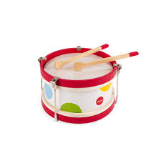
fr dr cr sm
sk
sp
gl
st
gr
sl
fl
bl
sw cl tr sn

Slide 21
fr dr cr sm
sk
sp
gl
st
drum
gr
sl
fl
bl
sw cl tr sn

Slide 22
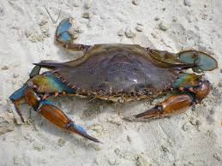
fr dr cr sm
sk
sp
gl
st
gr
sl
fl
bl
sw cl tr sn

Slide 23
fr dr cr sm
sk
sp
gl
st
crab
gr
sl
fl
bl
sw cl tr sn

Slide 24
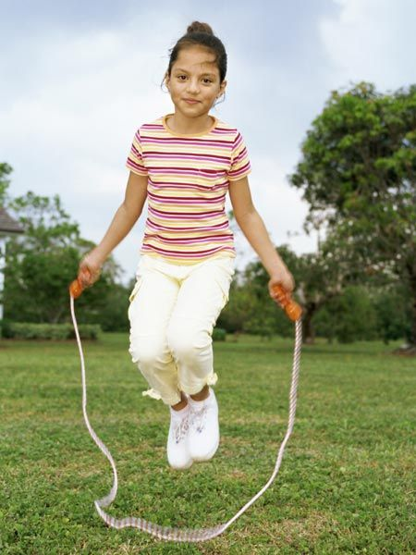
fr dr cr sm
sk
sp
gl
st
gr
sl
fl
bl
sw cl tr sn

Slide 25
fr dr cr sm
sk
sp
gl
st
skip
gr
sl
fl
bl
sw cl tr sn

Slide 26
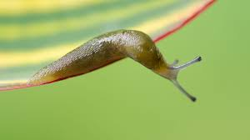
fr dr cr sm
sk
sp
gl
st
gr
sl
fl
bl
sw cl tr sn

Slide 27
fr dr cr sm
sk
sp
gl
st
slug
gr
sl
fl
bl
sw cl tr sn

Slide 28
fr dr cr sm
sk
sp
gl
st
gr
sl
fl
bl
sw cl tr sn

Slide 29
fr dr cr sm
sk
sp
gl
st
flag
gr
sl
fl
bl
sw cl tr sn

Slide 30
fr dr cr sm
sk
sp
gl
st
gr
sl
fl
bl
sw cl tr sn

Slide 31
fr dr cr sm
sk
sp
gl
st
tree
gr
sl
fl
bl
sw cl tr sn

Slide 32
fr dr cr sm
sk
sp
gl
st
gr
sl
fl
bl
sw cl tr sn

Slide 33
fr dr cr sm
sk
sp
gl
st
star
gr
sl
fl
bl
sw cl tr sn

Slide 34
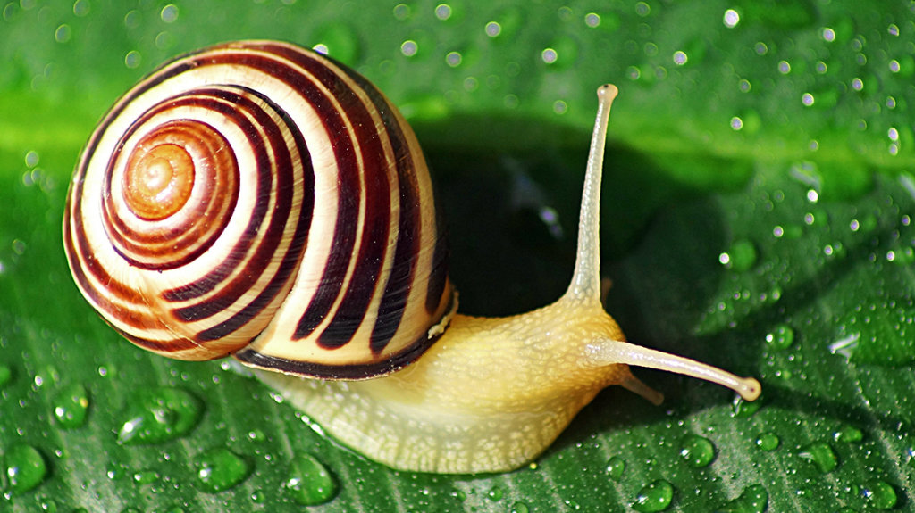
fr dr cr sm
sk
sp
gl
st
gr
sl
fl
bl
sw cl tr sn

Slide 35
fr dr cr sm
sk
sp
gl
st
snail
gr
sl
fl
bl
sw cl tr sn

Slide 36
fr dr cr sm
sk
sp
gl
st
gr
sl
fl
bl
sw cl tr sn

Slide 37
fr dr cr sm
sk
sp
gl
st
swing
gr
sl
fl
bl
sw cl tr sn

Slide 38
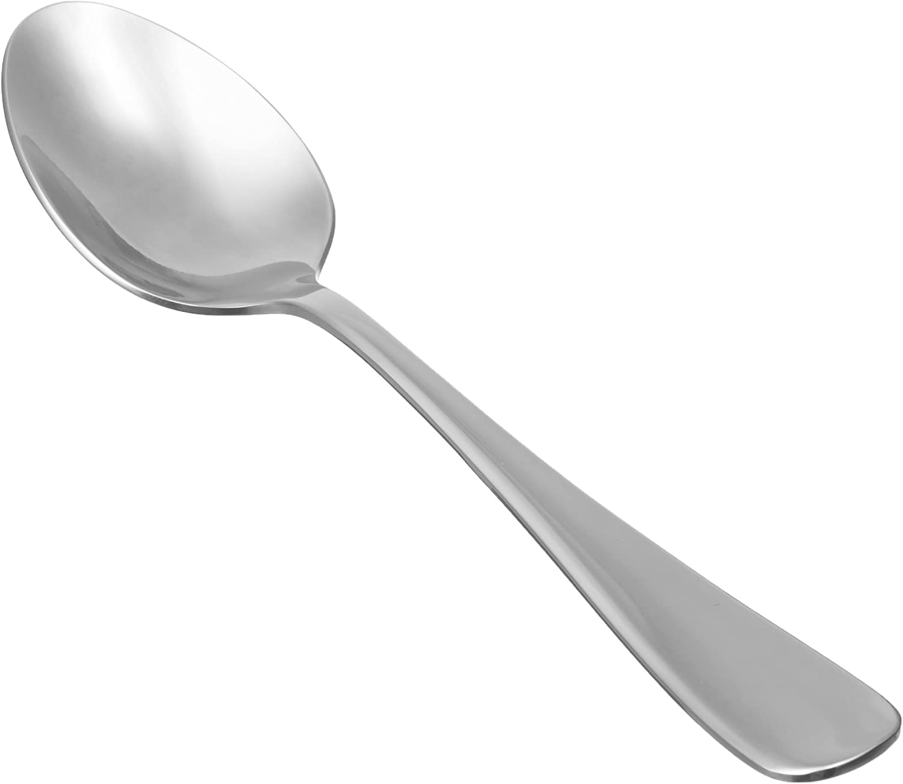
fr dr cr sm
sk
sp
gl
st
gr
sl
fl
bl
sw cl tr sn

Slide 39
fr dr cr sm
sk
sp
gl
st
spoon
gr
sl
fl
bl
sw cl tr sn

Slide 40
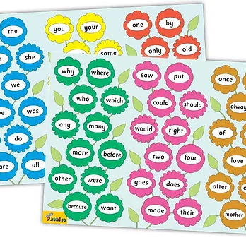
Tricky Words
2nd set

Slide 41
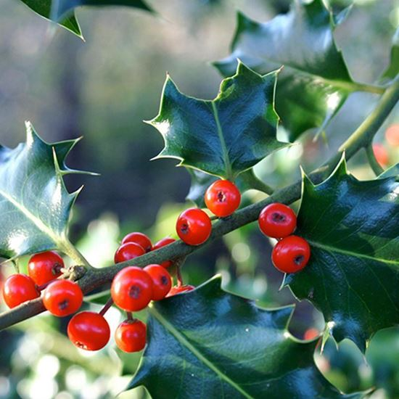
holly
/ee/

Slide 42
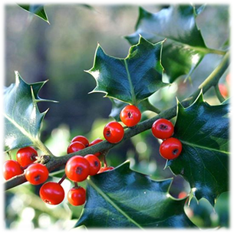
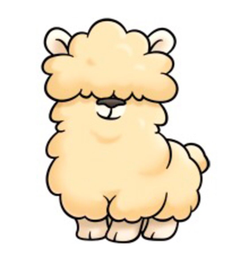
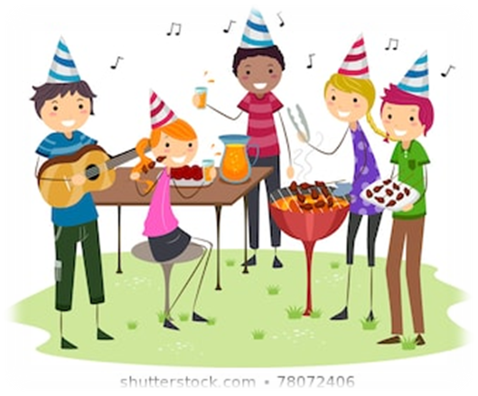
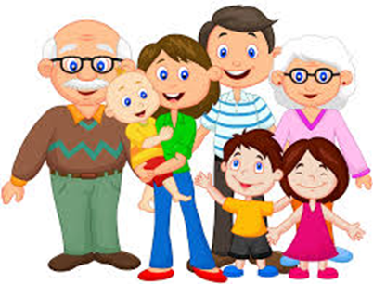
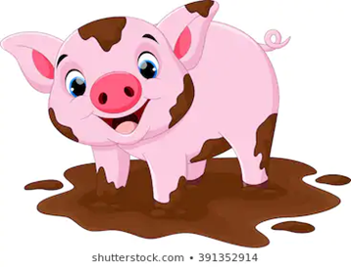
holly
happy
fluffy
sleepy
bed
wet
prod
holly
party
story
happy
so
my
family
party
family
fuzzy
frosty
story
silly
mucky

Slide 43
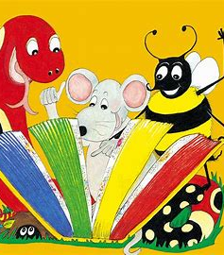
Dictation

Slide 44
silly

Slide 45
silly 2. fluffy

Slide 46
silly 2. fluffy 3. fuzzy

Slide 47
silly 2. fluffy 3. fuzzy
4. mucky

Slide 48
silly 2. fluffy 3. fuzzy
4. mucky 5. sleepy

Slide 49
silly 2. fluffy 3. fuzzy
4. mucky 5. sleepy 6. frosty

Slide 50
silly 2. fluffy 3. fuzzy
4. mucky 5. sleepy 6. frosty
7. It was a very funny story.

Slide 51
silly 2. fluffy 3. fuzzy
4. mucky 5. sleepy 6. frosty
7. It was a very funny story.
8. Sally has a party.

Slide 52
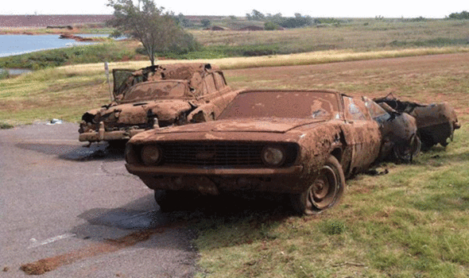
silly 2. fluffy 3. fuzzy
4. mucky 5. sleepy 6. frosty
7. It was a very funny story.
8. Sally has a party.
9. The car was rusty
and mucky.

Slide 53
Thank you! See you next time.

