Slide 1
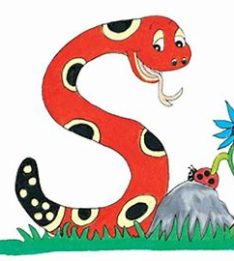
Jolly Grammar 1-11

Slide 2
Spelling Test 10

Slide 3
ox

Slide 4
ox
run

Slide 5
ox
run
from

Slide 6
ox
run
from
buzz

Slide 7
ox
run
from
buzz
cross

Slide 8
ox
run
from
buzz
cross
6. less

Slide 9
ox
run
from
buzz
cross
6. less
7. miss

Slide 10
ox
run
from
buzz
cross
6. less
7. miss
8. there

Slide 11
ox
run
from
buzz
cross
6. less
7. miss
8. there
9. they

Slide 12
ox
run
from
buzz
cross
6. less
7. miss
8. there
9. they
10. crossroads

Slide 13
Initial Consonant Blends

Slide 14
drum

Slide 15
drum
●
●
●
●

Slide 16
drum
●
●

Slide 17
fr dr cr sm
sk
sp
gl
st
gr
sl
fl
bl
sw cl tr sn

Slide 18
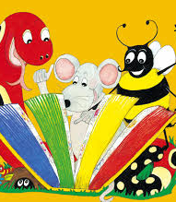
Activity page

Slide 19
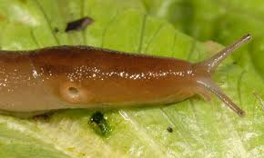
fr dr cr sm
sk
sp
gl
st
ug
gr
sl
fl
bl
sw cl tr sn

Slide 20
fr dr cr sm
sk
sp
gl
st
sl ug
gr
sl
fl
bl
sw cl tr sn

Slide 21
fr dr cr sm
sk
sp
gl
st
og
gr
sl
fl
bl
sw cl tr sn

Slide 22
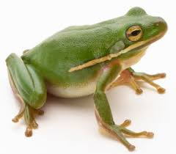
fr dr cr sm
sk
sp
gl
st
fr og
gr
sl
fl
bl
sw cl tr sn

Slide 23
fr dr cr sm
sk
sp
gl
st
ab
gr
sl
fl
bl
sw cl tr sn

Slide 24
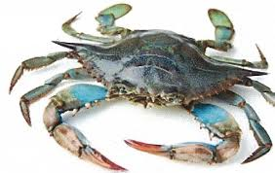
fr dr cr sm
sk
sp
gl
st
cr ab
gr
sl
fl
bl
sw cl tr sn

Slide 25
fr dr cr sm
sk
sp
gl
st
ub
gr
sl
fl
bl
sw cl tr sn

Slide 26
fr dr cr sm
sk
sp
gl
st
cl ub
gr
sl
fl
bl
sw cl tr sn

Slide 27
fr dr cr sm
sk
sp
gl
st
in
gr
sl
fl
bl
sw cl tr sn

Slide 28
fr dr cr sm
sk
sp
gl
st
sk in
gr
sl
fl
bl
sw cl tr sn

Slide 29
fr dr cr sm
sk
sp
gl
st
ee
gr
sl
fl
bl
sw cl tr sn

Slide 30
fr dr cr sm
sk
sp
gl
st
tr ee
gr
sl
fl
bl
sw cl tr sn

Slide 31
fr dr cr sm
sk
sp
gl
st
ing
gr
sl
fl
bl
sw cl tr sn

Slide 32
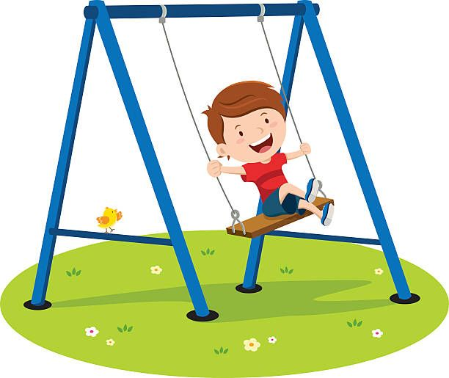
fr dr cr sm
sk
sp
gl
st
sw ing
gr
sl
fl
bl
sw cl tr sn

Slide 33
fr dr cr sm
sk
sp
gl
st
ape
gr
sl
fl
bl
sw cl tr sn

Slide 34
fr dr cr sm
sk
sp
gl
st
gr ape
gr
sl
fl
bl
sw cl tr sn

Slide 35
fr dr cr sm
sk
sp
gl
st
ider
gr
sl
fl
bl
sw cl tr sn

Slide 36
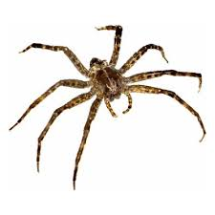
fr dr cr sm
sk
sp
gl
st
sp ider
gr
sl
fl
bl
sw cl tr sn

Slide 37
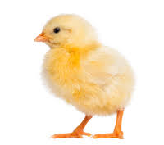
chick

Slide 38
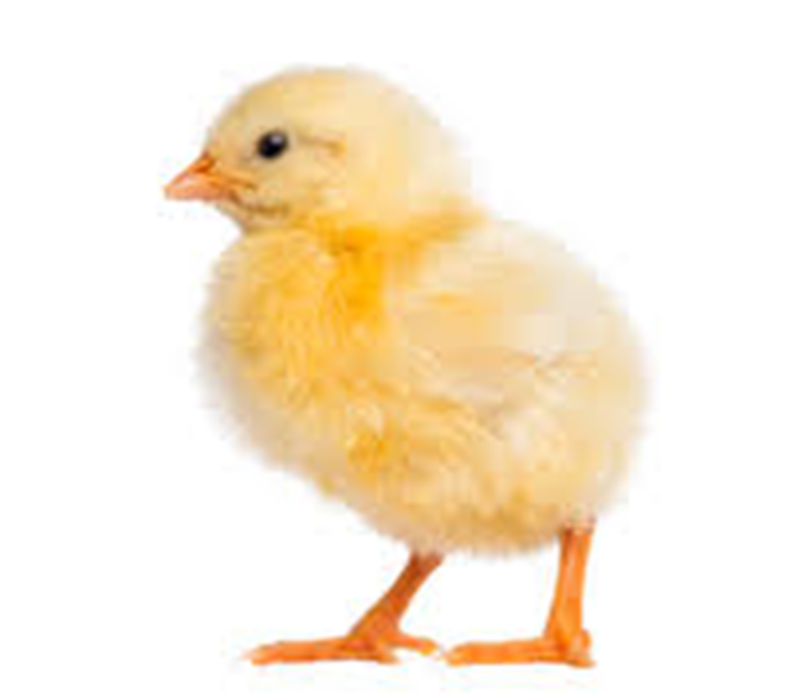
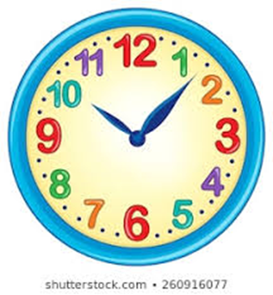
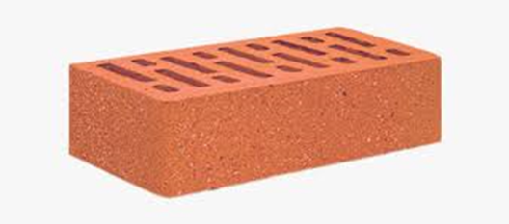
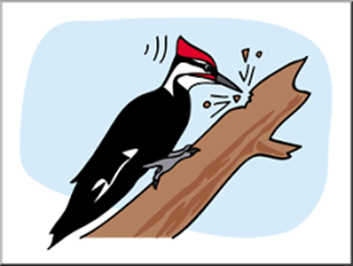
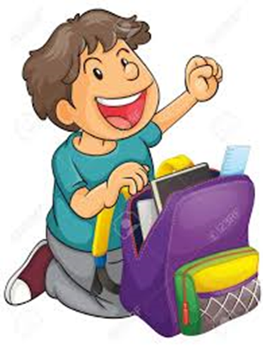
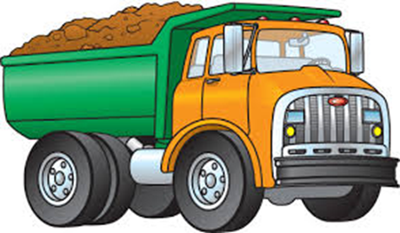
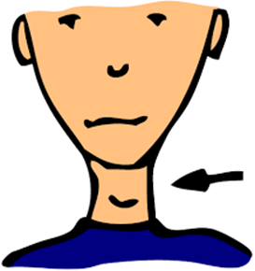
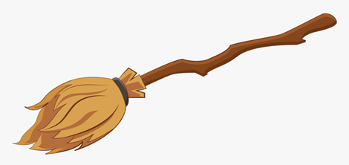
chick
clock
brick
peck
hop
fit
grin
duck
neck
clock
lick
go
no
broomstick
duck
lick
pack
truck
luck
neck
broomstick
block

Slide 39
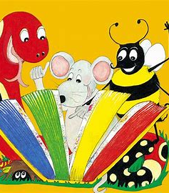
Dictation

Slide 40
pack

Slide 41
pack 2. luck

Slide 42
pack 2. luck 3. peck

Slide 43
pack 2. luck 3. peck
4. brick

Slide 44
pack 2. luck 3. peck
4. brick 5. block

Slide 45
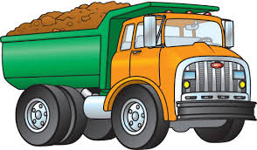
pack 2. luck 3. peck
4. brick 5. block 6. truck

Slide 46
pack 2. luck 3. peck
4. brick 5. block 6. truck
7. Pack your bag.

Slide 47
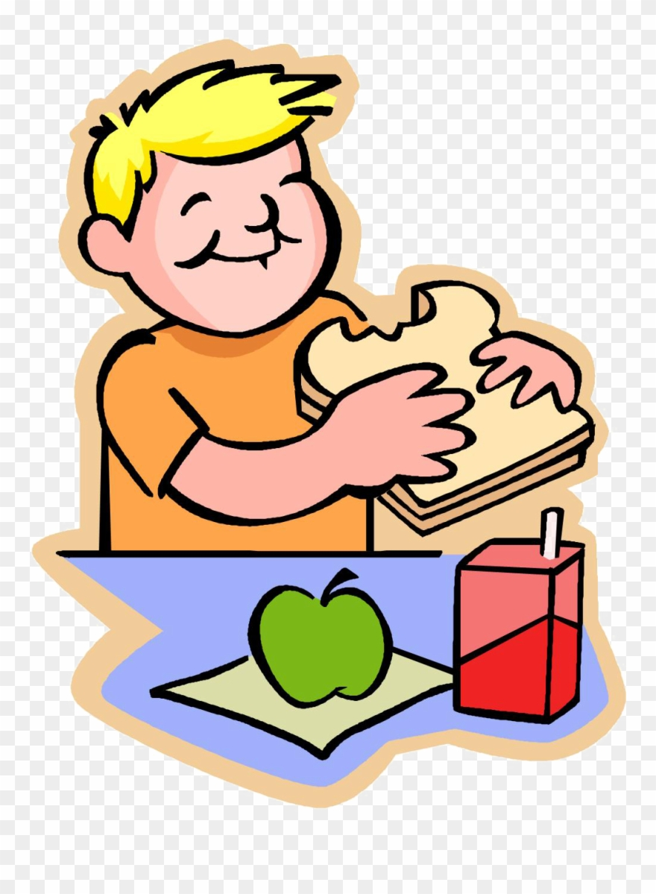
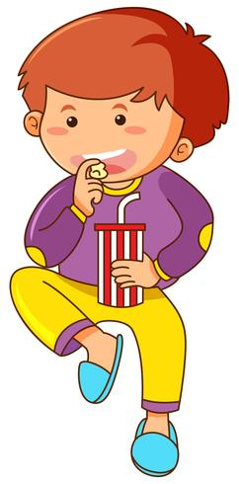
pack 2. luck 3. peck
4. brick 5. block 6. truck
7. Pack your bag.
8. The boys had a quick snack.

Slide 48
pack 2. luck 3. peck
4. brick 5. block 6. truck
7. Pack your bag.
8. The boys had a quick snack.
9. This will bring you luck.

Slide 49
Thank you! See you next time.

