Slide 1
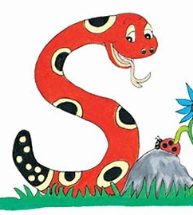
Jolly Grammar 1-10

Slide 2
Spelling Test 9

Slide 3
red

Slide 4
red
win

Slide 5
red
win
drum

Slide 6
red
win
drum
will

Slide 7
red
win
drum
will
bell

Slide 8
red
win
drum
will
bell
6. doll

Slide 9
red
win
drum
will
bell
6. doll
7. skull

Slide 10
red
win
drum
will
bell
6. doll
7. skull
8. said

Slide 11
red
win
drum
will
bell
6. doll
7. skull
8. said
9. here

Slide 12
red
win
drum
will
bell
6. doll
7. skull
8. said
9. here
10. windmill

Slide 13
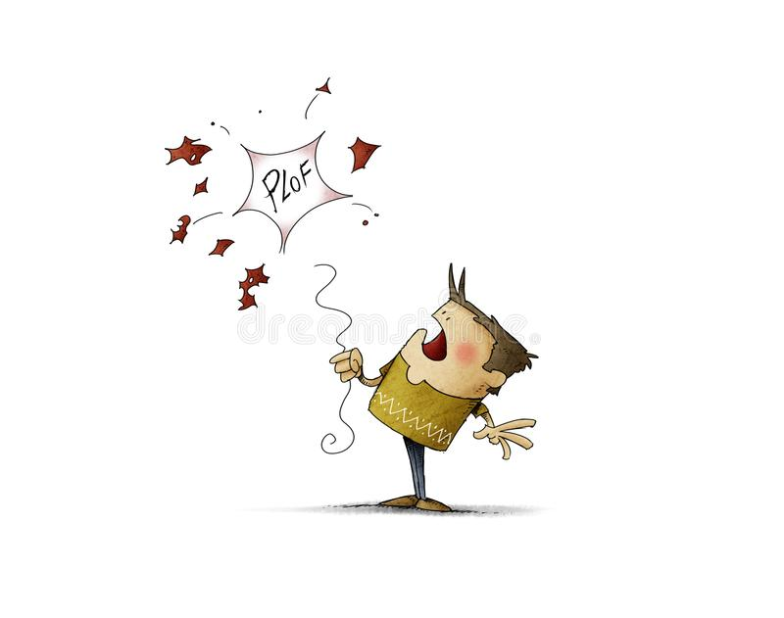
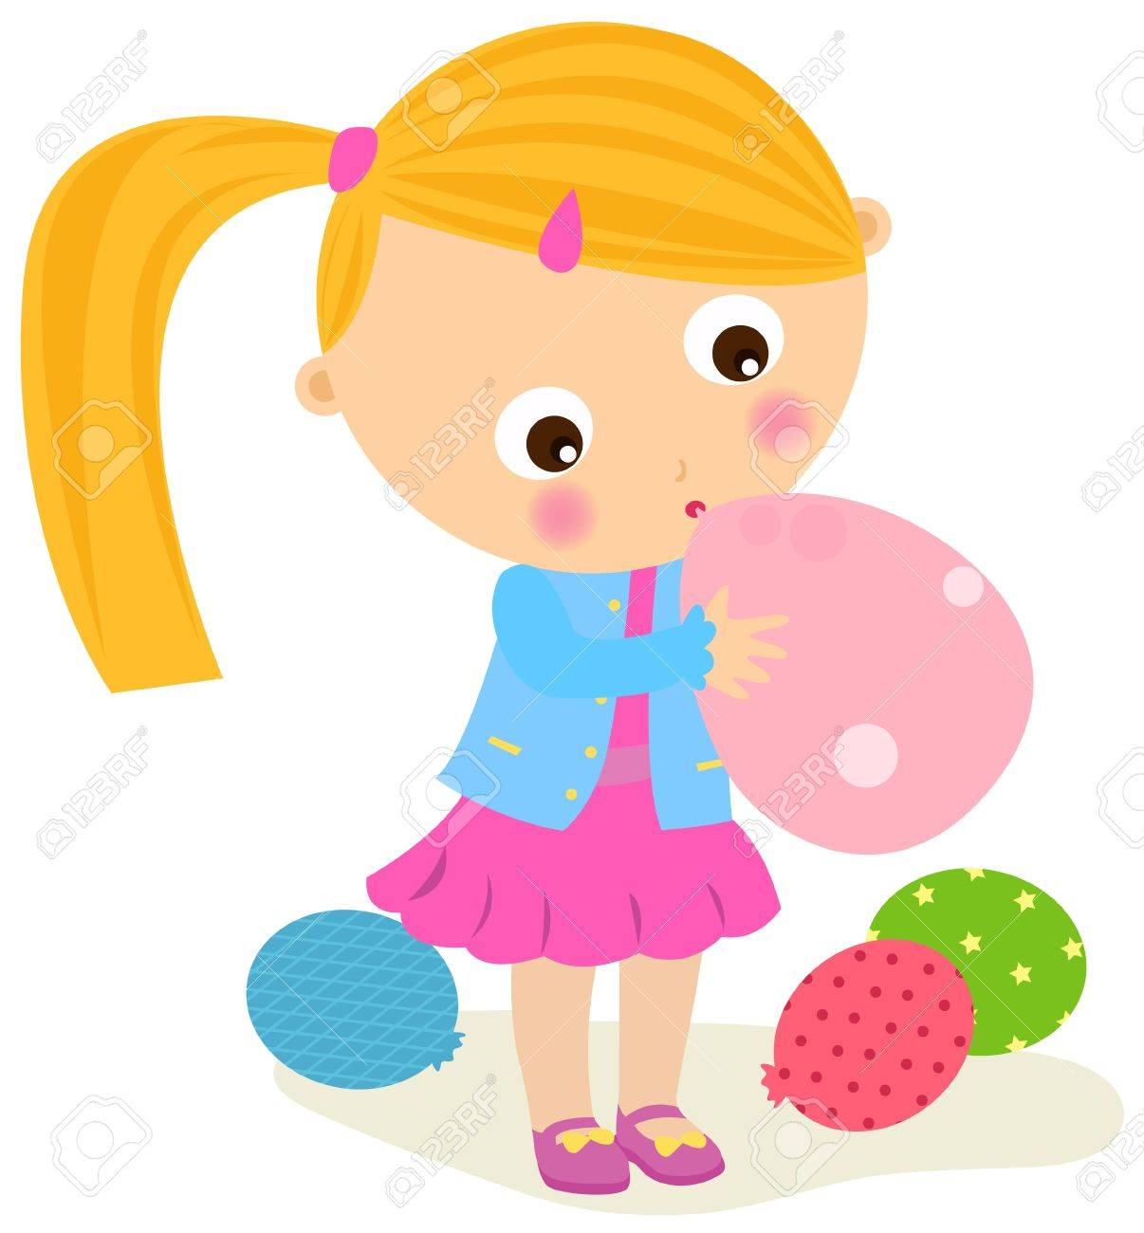
Peter’s Birthday Party
Peter was having a birthday party.
Peter wanted to blow up some balloons.
Peter blew too hard and
burst one of the balloons.
Peter’s sister laughed.
Peter’s sister helped
Peter to blow up some more balloons.

Slide 14
Peter’s Birthday Party
Peter was having a birthday party.
He wanted to blow up some balloons.
Peter blew too hard and
burst one of the balloons.
Peter’s sister laughed.
Peter’s sister helped
Peter to blow up some more balloons.

Slide 15
Peter’s Birthday Party
Peter was having a birthday party.
He wanted to blow up some balloons.
He blew too hard and
burst one of the balloons.
Peter’s sister laughed.
Peter’s sister helped
Peter to blow up some more balloons.

Slide 16
Peter’s Birthday Party
Peter was having a birthday party.
He wanted to blow up some balloons.
He blew too hard and
burst one of the balloons.
Peter’s sister laughed.
She helped
Peter to blow up some more balloons.

Slide 17
Peter’s Birthday Party
Peter was having a birthday party.
He wanted to blow up some balloons.
He blew too hard and
burst one of the balloons.
Peter’s sister laughed.
She helped
him to blow up some more balloons.

Slide 18
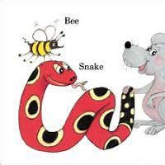
Pronouns
with
Big Book

Slide 19
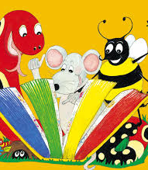
Activity page

Slide 20
I
you
Singular Pronouns
he
she
it
Plural Pronouns
we
you
they

Slide 21
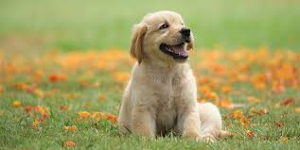
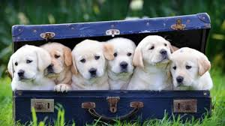
dog
dogs
singular
plural

Slide 22
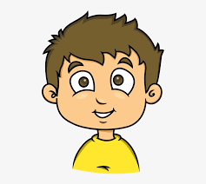
I
you
Singular Pronouns
he
she
it
Plural Pronouns
we
you
they

Slide 23
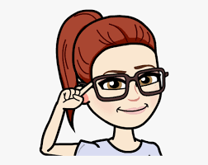
I
you
Singular Pronouns
he
she
it
Plural Pronouns
we
you
they

Slide 24
I
you
Singular Pronouns
he
she
it
Plural Pronouns
we
you
they

Slide 25
I
you
Singular Pronouns
he
she
it
Plural Pronouns
we
you
they

Slide 26
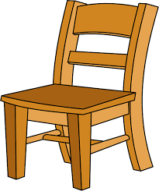
I
you
Singular Pronouns
he
she
it
Plural Pronouns
we
you
they

Slide 27
I
you
Singular Pronouns
he
she
it
Plural Pronouns
we
you
they

Slide 28
I
you
Singular Pronouns
he
she
it
Plural Pronouns
we
you
they

Slide 29
I
you
Singular Pronouns
he
she
it
Plural Pronouns
we
you
they

Slide 30
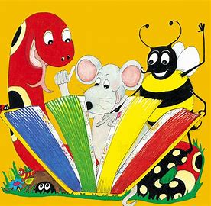
Tricky Words

Slide 31
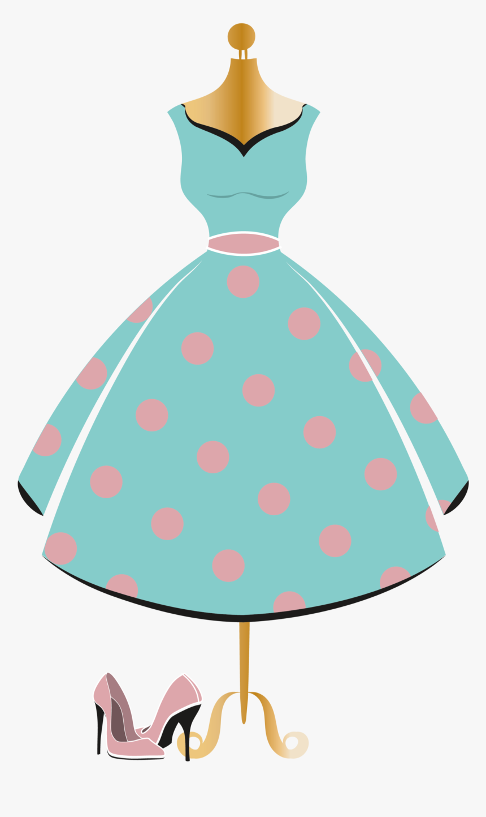
dress
buzz

Slide 32
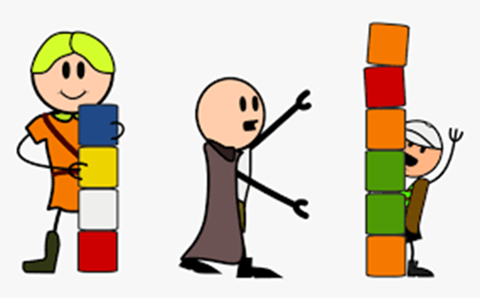
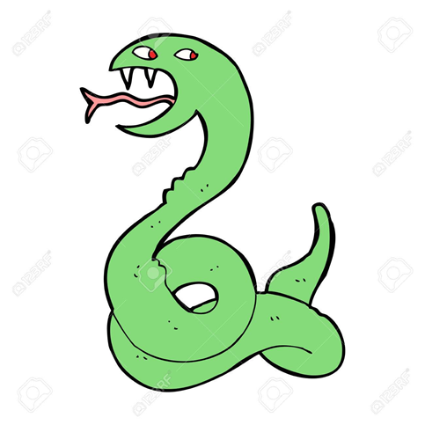
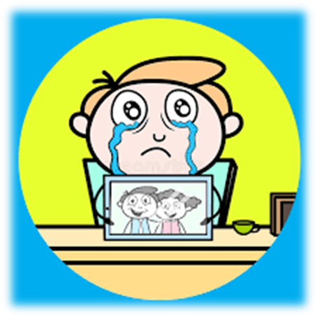
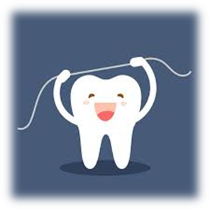
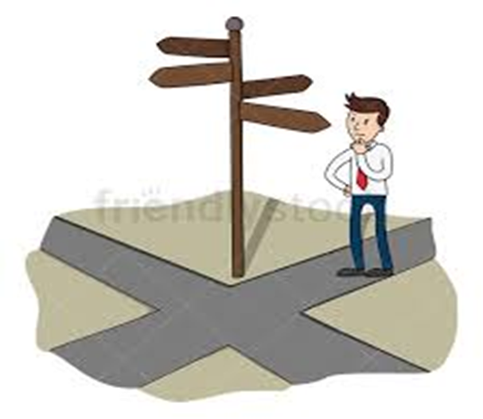
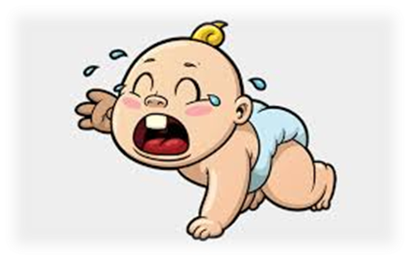
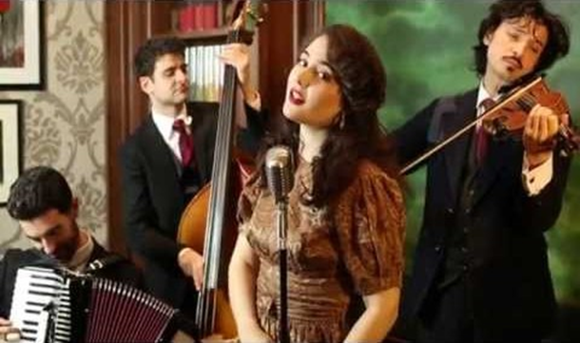
dress
less
hiss
press
ox
run
from
buzz
cross
less
miss
there
they
crossroad
miss
floss
buzz
cross
crossroad
jazz
fuss

Slide 33
Dictation

Slide 34
hiss

Slide 35
hiss 2. buzz

Slide 36
hiss 2. buzz 3. fuss

Slide 37
hiss 2. buzz 3. fuss
4. jazz

Slide 38
hiss 2. buzz 3. fuss
4. jazz 5. cross

Slide 39
hiss 2. buzz 3. fuss
4. jazz 5. cross 6. press

Slide 40
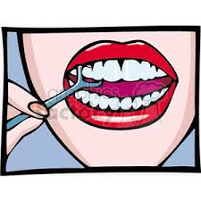
hiss 2. buzz 3. fuss
4. jazz 5. cross 6. press
7. You can floss your teeth.

Slide 41
hiss 2. buzz 3. fuss
4. jazz 5. cross 6. press
7. You can floss your teeth.
8. She must press the bell.

Slide 42
hiss 2. buzz 3. fuss
4. jazz 5. cross 6. press
7. You can floss your teeth.
8. She must press the bell.
9. I will miss you.

Slide 43
Thank you! See you next time.

