Slide 1
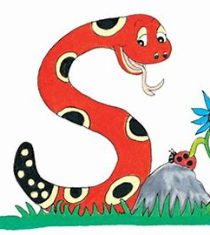
Jolly Grammar 1-9

Slide 2
Spelling Test 8

Slide 3
up

Slide 4
up
man

Slide 5
up
man
crab

Slide 6
up
man
crab
off

Slide 7
up
man
crab
off
cliff

Slide 8
up
man
crab
off
cliff
6. stiff

Slide 9
up
man
crab
off
cliff
6. stiff
7. cuff

Slide 10
up
man
crab
off
cliff
6. stiff
7. cuff
8. come

Slide 11
up
man
crab
off
cliff
6. stiff
7. cuff
8. come
9. some

Slide 12
up
man
crab
off
cliff
6. stiff
7. cuff
8. come
9. some
10. stuffing

Slide 13
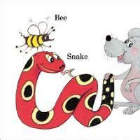
plurals

Slide 14
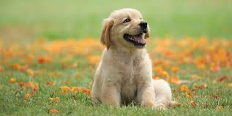

Slide 15
dog

Slide 16
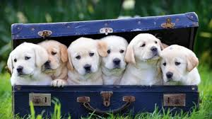
dog

Slide 17
dog
dogs

Slide 18
dog
dogs
singular

Slide 19
dog
dogs
singular
plural

Slide 20
cat rat flag hen ant
tree bird bun bed drum pen map leg doll van cloud duck bat car boat pet book sock truck train ball hat bead brick

Slide 21
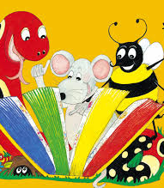
Activity page

Slide 22
hats
pens
dog
cars
cow
frog

Slide 23
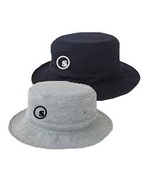
hats
pens
dog
cars
cow
frog

Slide 24
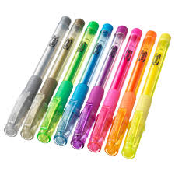
hats
pens
dog
cars
cow
frog

Slide 25
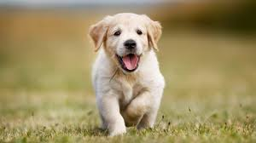
hats
pens
dog
cars
cow
frog

Slide 26
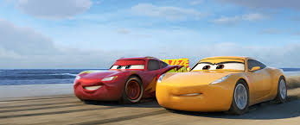
hats
pens
dog
cars
cow
frog

Slide 27
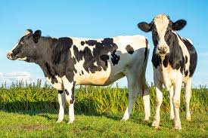
hats
pens
dog
cars
cow
frog

Slide 28
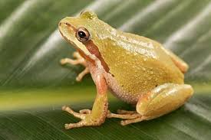
hats
pens
dog
cars
cow
frog

Slide 29
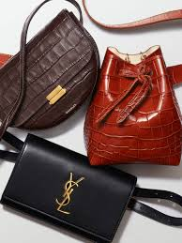
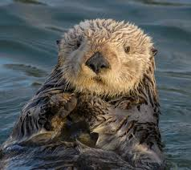
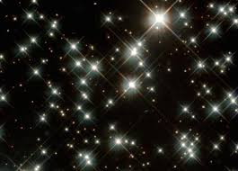
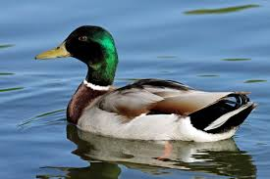
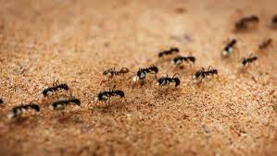
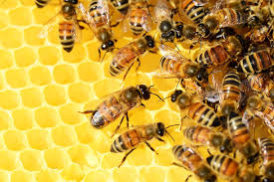

Slide 30
bags

Slide 31
bags
otter

Slide 32
bags
otter
stars

Slide 33
bags
otter
stars
duck

Slide 34
bags
otter
stars
duck
ants

Slide 35
bags
otter
stars
duck
ants
bees

Slide 36
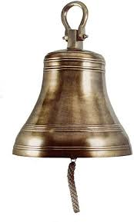
bell

Slide 37
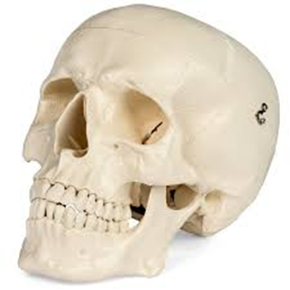
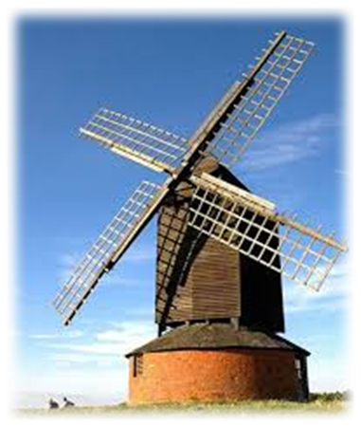
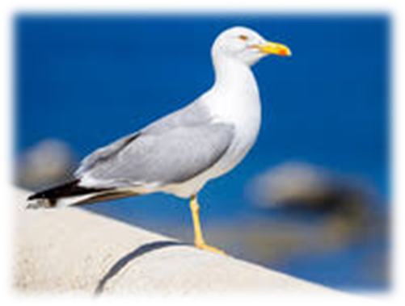
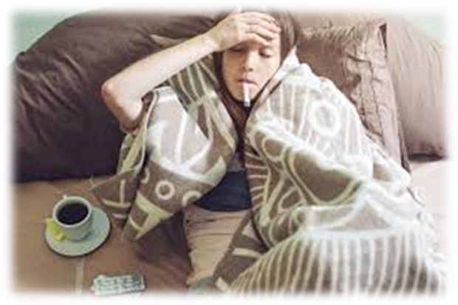
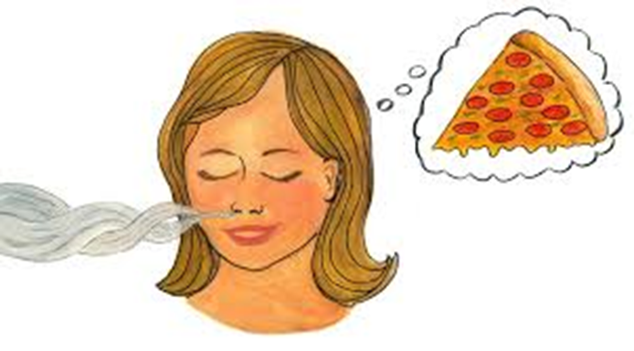
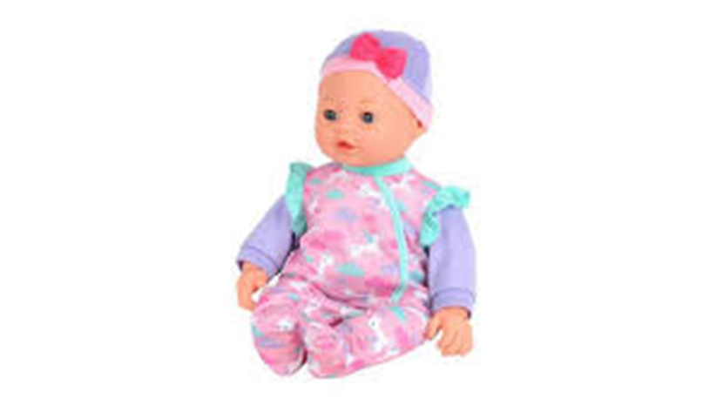
will
skull
tell
red
win
drum
will
bell
doll
skull
said
here
windmill
bell
windmill
gull
doll
ill
smell
drill

Slide 38
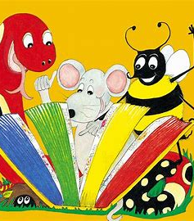
Dictation

Slide 39
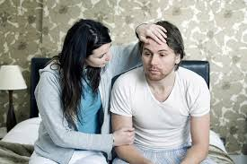
ill

Slide 40
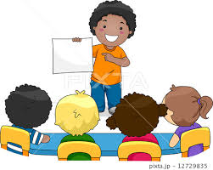
ill 2. tell

Slide 41
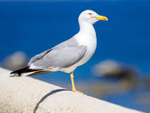
ill 2. tell 3. gull

Slide 42
ill 2. tell 3. gull
4. doll

Slide 43
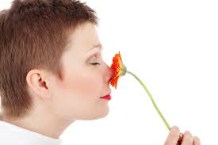
ill 2. tell 3. gull
4. doll 5. smell

Slide 44
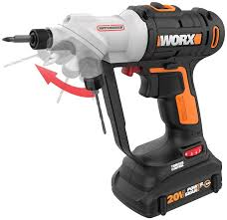
ill 2. tell 3. gull
4. doll 5. smell 6. drill

Slide 45
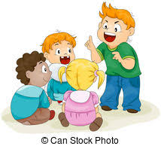
ill 2. tell 3. gull
4. doll 5. smell 6. drill
7. You must tell us all.

Slide 46
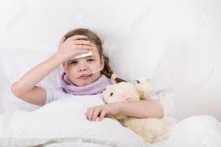
ill 2. tell 3. gull
4. doll 5. smell 6. drill
7. You must tell us all.
8. She fell ill.

Slide 47
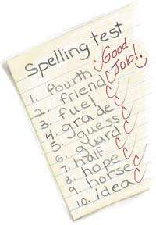
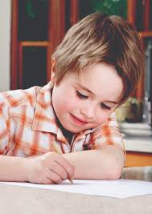
ill 2. tell 3. gull
4. doll 5. smell 6. drill
7. You must tell us all.
8. She fell ill.
9. He can spell well.

Slide 48
Thank you! See you next time.

