Slide 1
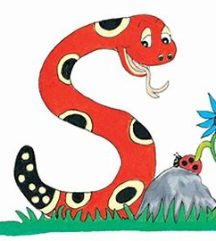
Jolly Grammar 1-8

Slide 2
Spelling Test 7

Slide 3
dog

Slide 4
dog
bran

Slide 5
dog
bran
Monday

Slide 6
dog
bran
Monday
Tuesday

Slide 7
dog
bran
Monday
Tuesday
Wednesday

Slide 8
dog
bran
Monday
Tuesday
Wednesday
6. Thursday

Slide 9
dog
bran
Monday
Tuesday
Wednesday
6. Thursday
7. Friday

Slide 10
dog
bran
Monday
Tuesday
Wednesday
6. Thursday
7. Friday
8. you

Slide 11
dog
bran
Monday
Tuesday
Wednesday
6. Thursday
7. Friday
8. you
9. your

Slide 12
dog
bran
Monday
Tuesday
Wednesday
6. Thursday
7. Friday
8. you
9. your
10. Saturday

Slide 13
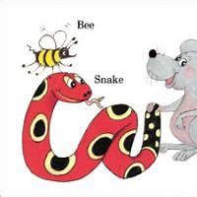
Short Vowels

Slide 14
Short vowels
a e i o u
Other letters are called
consonants.

Slide 15
An shark has an fin.

Slide 16
An shark has an fin.
↓
A shark has a fin.

Slide 17
An shark has an fin.
↓
A shark has a fin.
They saw a elephant at the zoo.

Slide 18
An shark has an fin.
↓
A shark has a fin.
They saw a elephant at the zoo.
↓
They saw an elephant at the zoo.

Slide 19
a or an ?

Slide 20
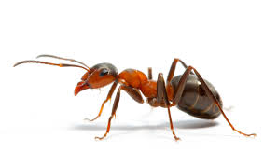

Slide 21
ant

Slide 22
an ant

Slide 23
a or an ?

Slide 24
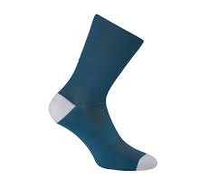

Slide 25
sock

Slide 26
a sock

Slide 27
a or an ?

Slide 28
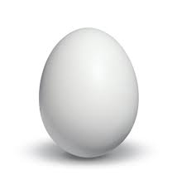

Slide 29
egg

Slide 30
an egg

Slide 31
a or an ?

Slide 32
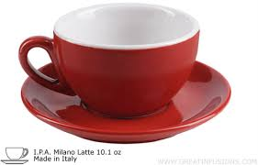

Slide 33
cup

Slide 34
a cup

Slide 35
a or an ?

Slide 36
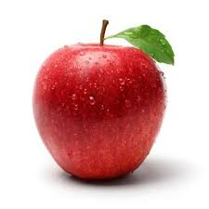

Slide 37
apple

Slide 38
an apple

Slide 39
a or an ?

Slide 40
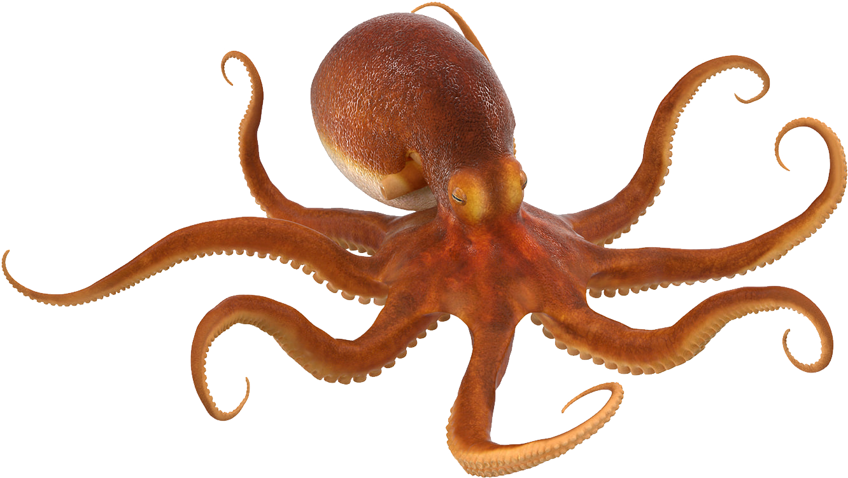
octopus

Slide 41
an octopus

Slide 42
a or an ?

Slide 43
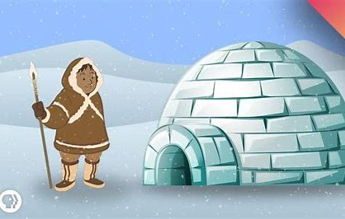

Slide 44
igloo

Slide 45
an igloo

Slide 46
a or an ?

Slide 47
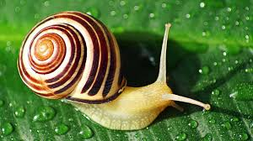

Slide 48
snail

Slide 49
a snail

Slide 50
a or an ?

Slide 51
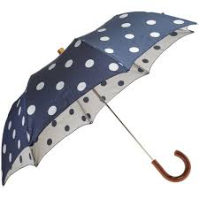

Slide 52
umbrella

Slide 53
an umbrella

Slide 54
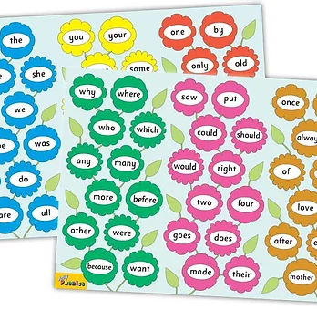
Tricky Words
^{2nd} set
Tricky Words

Slide 55
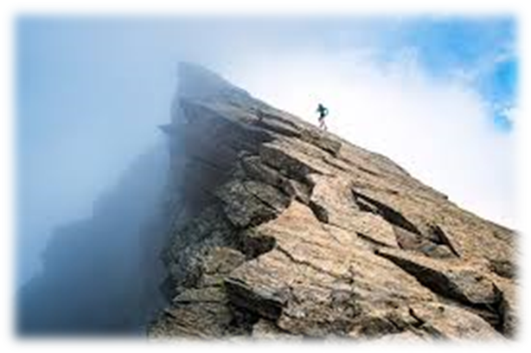
cliff

Slide 56
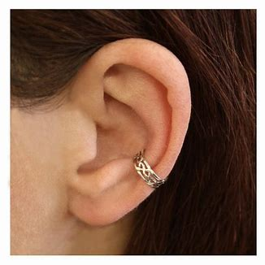
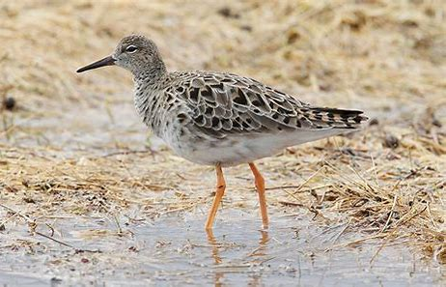
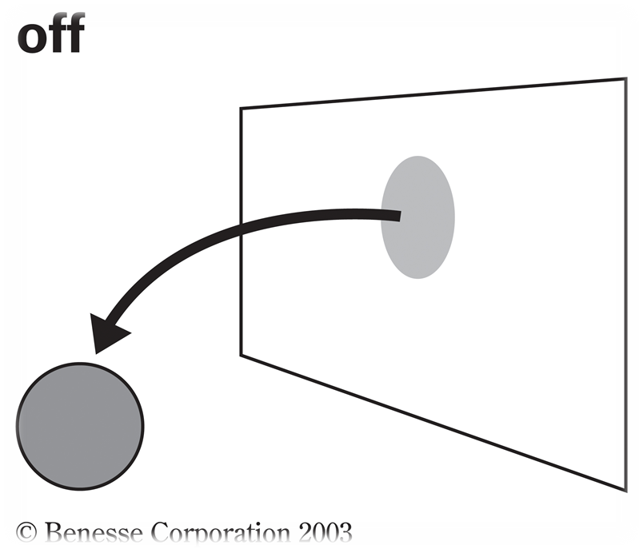
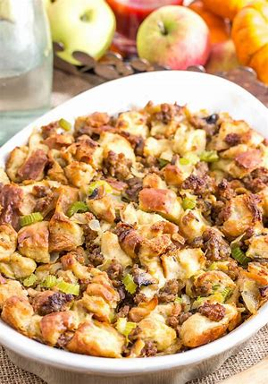
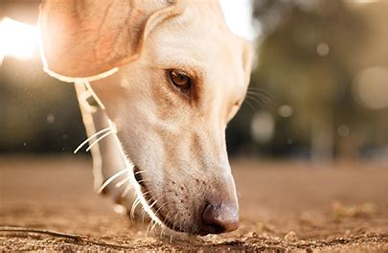
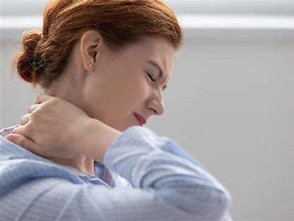
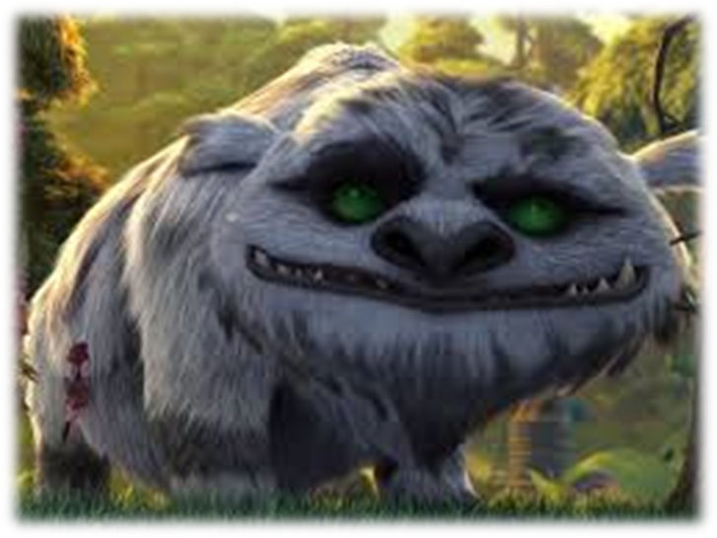
off
cuff
ruff
up
man
crab
off
cliff
stiff
cuff
come
some
stuffing
cliff
stuffing
sniff
stiff
gruff
huff

Slide 57
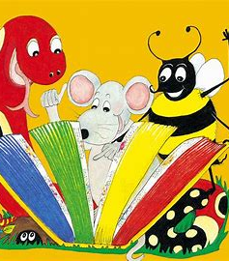
Dictation

Slide 58
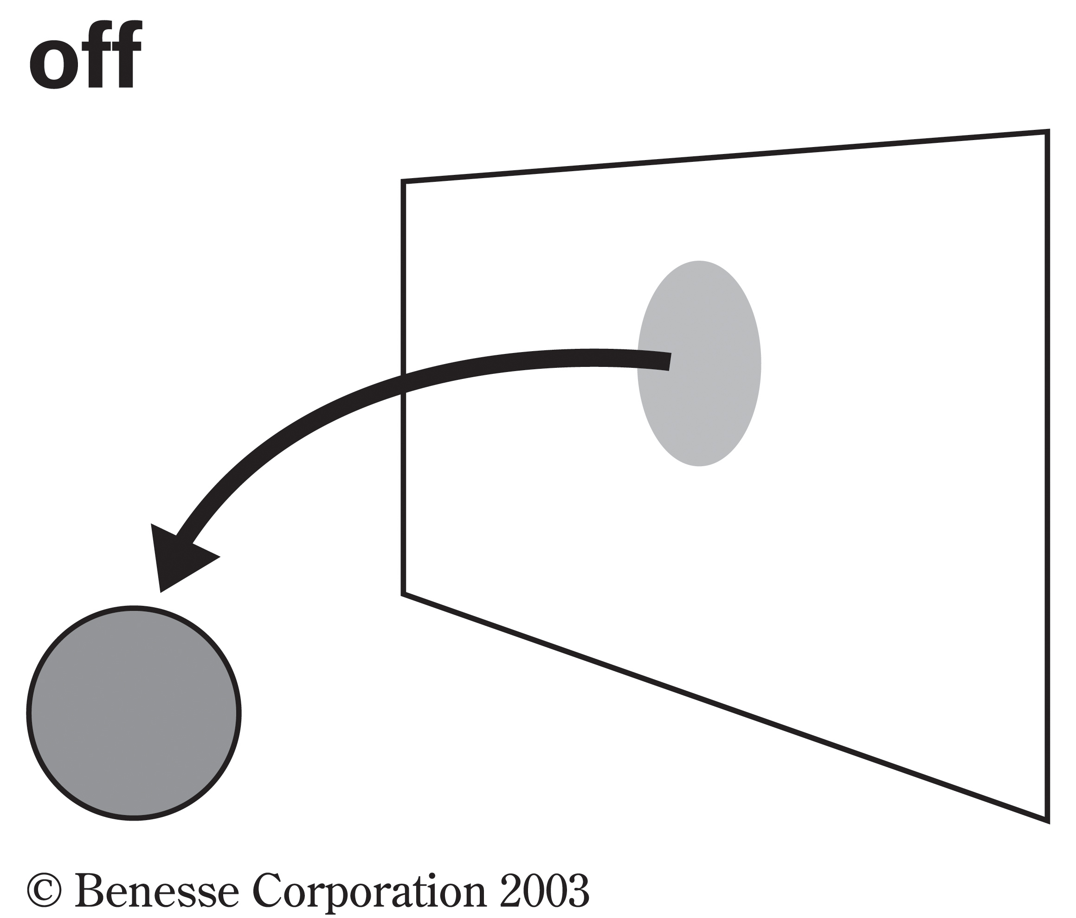
off

Slide 59
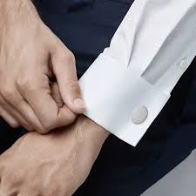
off 2. cuff

Slide 60
off 2. cuff 3. huff

Slide 61
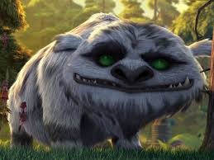
off 2. cuff 3. huff
4. gruff

Slide 62
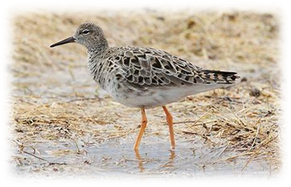
off 2. cuff 3. huff
4. gruff 5. ruff

Slide 63
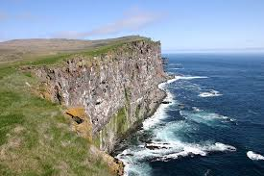
off 2. cuff 3. huff
4. gruff 5. ruff 6. cliff

Slide 64
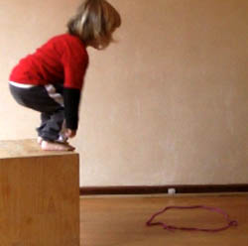
off 2. cuff 3. huff
4. gruff 5. ruff 6. cliff
7. He can jump off the step.

Slide 65
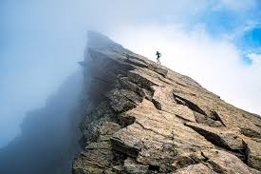
off 2. cuff 3. huff
4. gruff 5. ruff 6. cliff
7. He can jump off the step.
8. She ran up to the cliff.

Slide 66
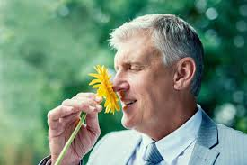
off 2. cuff 3. huff
4. gruff 5. ruff 6. cliff
7. He can jump off the step.
8. She ran up to the cliff.
9. We must not sniff.

Slide 67
Thank you! See you next time.

