Slide 1
Grammar 1-6

Slide 2
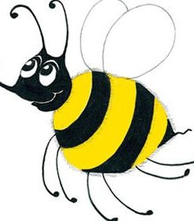
Spelling Test 5

Slide 3
on

Slide 4
on
but

Slide 5
on
but
plum

Slide 6
on
but
plum
quick

Slide 7
on
but
plum
quick
quiz

Slide 8
on
but
plum
quick
quiz
6. queen

Slide 9
on
but
plum
quick
quiz
6. queen
7. squid

Slide 10
on
but
plum
quick
quiz
6. queen
7. squid
8. to

Slide 11
on
but
plum
quick
quiz
6. queen
7. squid
8. to
9. do

Slide 12
on
but
plum
quick
quiz
6. queen
7. squid
8. to
9. do
10. squirrel

Slide 13
Common Nouns

Slide 14
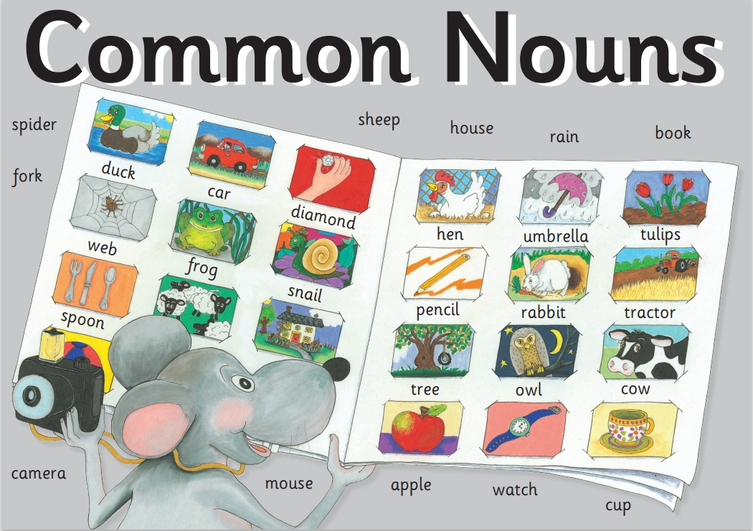

Slide 15
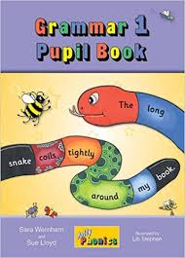
Activity Page:
Common Nouns

Slide 16
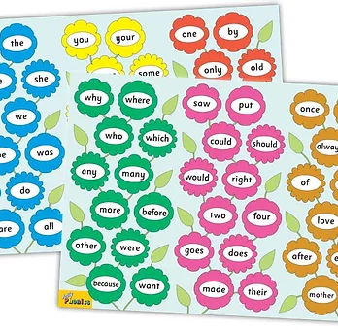
Tricky Words
^{1st} set

Slide 17
star
/ar/

Slide 18
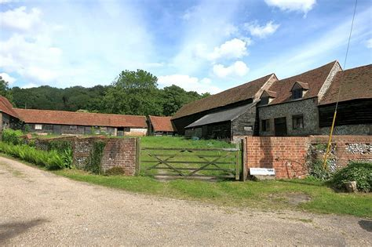
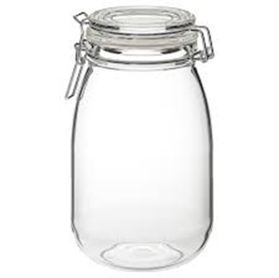
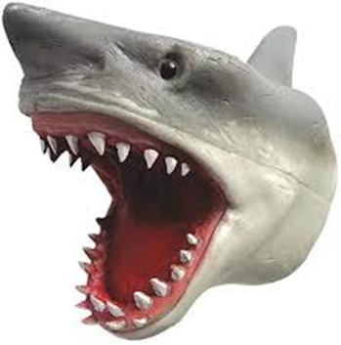
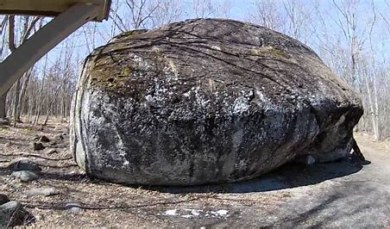
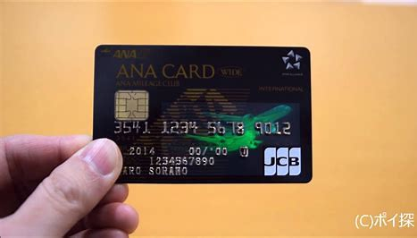
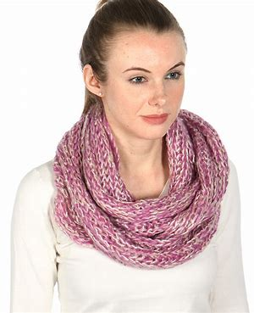
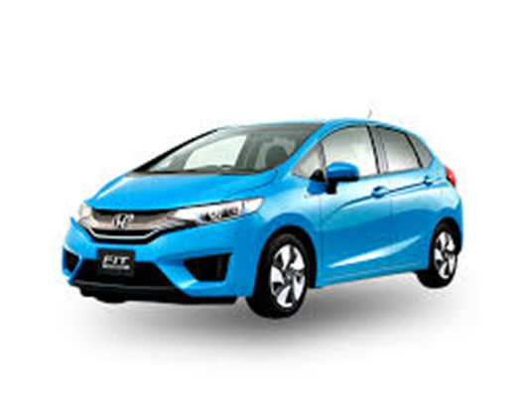
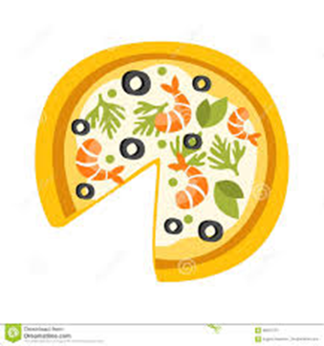
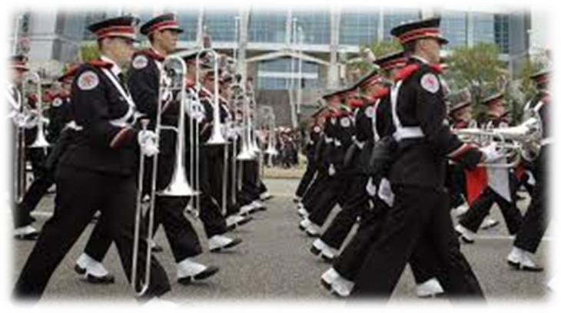
star
farmyard
start
at
yes
slug
arm
hard
scarf
card
are
all
farmyard
hard
card
jar
shark
scarf
car
part
march

Slide 19
Activity page

Slide 20
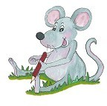
Dictation

Slide 21
car

Slide 22
car 2. jar

Slide 23
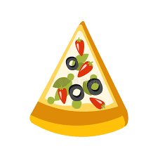
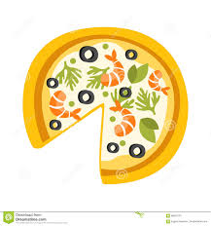
car 2. jar 3. part

Slide 24
car 2. jar 3. part
4. start

Slide 25
car 2. jar 3. part
4. start 5. shark

Slide 26
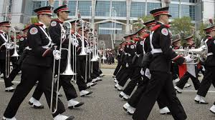
car 2. jar 3. part
4. start 5. shark 6. march

Slide 27
car 2. jar 3. part
4. start 5. shark 6. march
7. She has a red car.

Slide 28
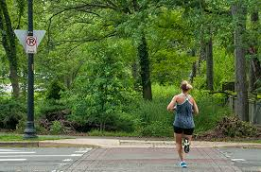
car 2. jar 3. part
4. start 5. shark 6. march
7. She has a red car.
8. I ran to the park.

Slide 29
car 2. jar 3. part
4. start 5. shark 6. march
7. She has a red car.
8. I ran to the park.
9. A shark has sharp teeth.

Slide 30
Thank you! See you next time.

