Slide 1
Grammar 1-3

Slide 2
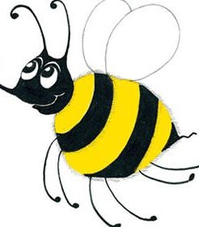
Spelling Test 2

Slide 3
if

Slide 4
if
hot

Slide 5
if
hot
blot

Slide 6
if
hot
blot
chips

Slide 7
if
hot
blot
chips
lunch

Slide 8
if
hot
blot
chips
lunch
6. chest

Slide 9
if
hot
blot
chips
lunch
6. chest
7. much

Slide 10
if
hot
blot
chips
lunch
6. chest
7. much
8. he

Slide 11
if
hot
blot
chips
lunch
6. chest
7. much
8. he
9. she

Slide 12
if
hot
blot
chips
lunch
6. chest
7. much
8. he
9. she
10. chicken

Slide 13
Correcting Sentences

Slide 14
the frog is green

Slide 15
the frog is green
The frog is green.

Slide 16
The cat ran up the.

Slide 17
The cat ran up the.
The cat ran up the tree.

Slide 18
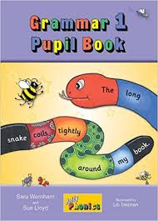
Activity Page:
Correcting Sentences

Slide 19
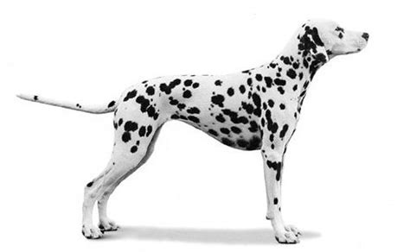
1.
the dog is spotty.

Slide 20
1.
the dog is spotty.
The dog is spotty.

Slide 21
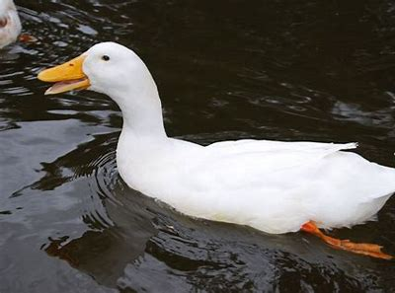
2.
The duck swims on the.

Slide 22
2.
The duck swims on the.
The duck swims on the
pond.

Slide 23
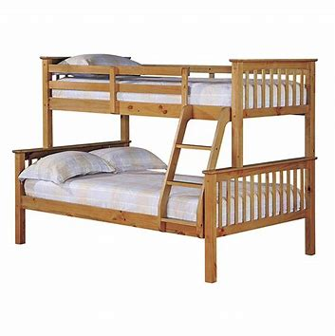
3.
I sleep in a bunk bed.

Slide 24
3.
I sleep in a bunk bed.
✔

Slide 25
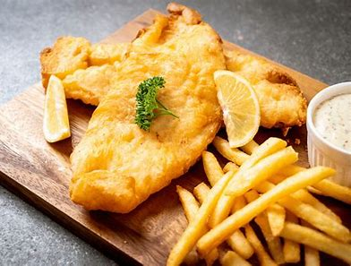
4.
i like fish and. chips

Slide 26
4.
i like fish and. chips
I like fish and chips.
I like fried eggs.

Slide 27
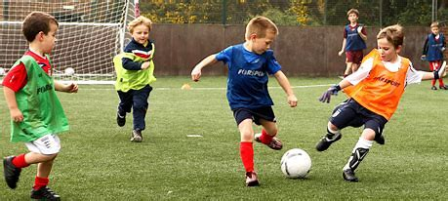
5.
He is playing football.
They are playing ball.

Slide 28
5.
He is playing football.
✔

Slide 29
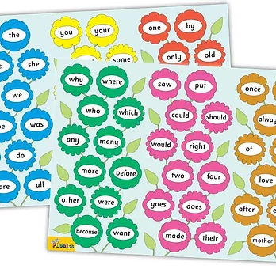
Tricky Words
^{1st} set

Slide 30
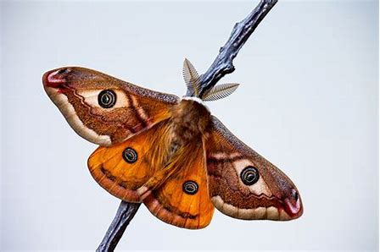
moth
/th/

Slide 31
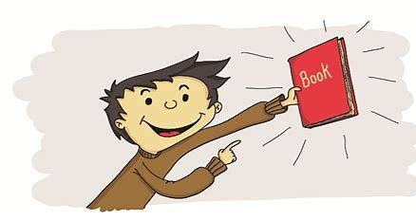
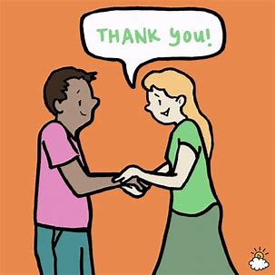
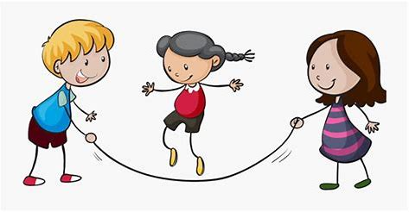
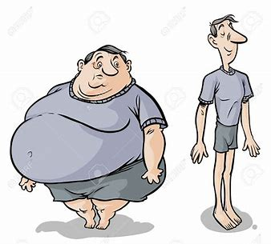
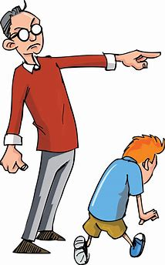
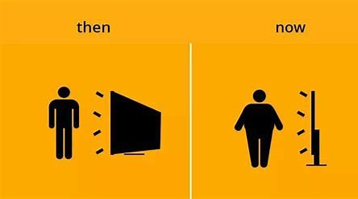
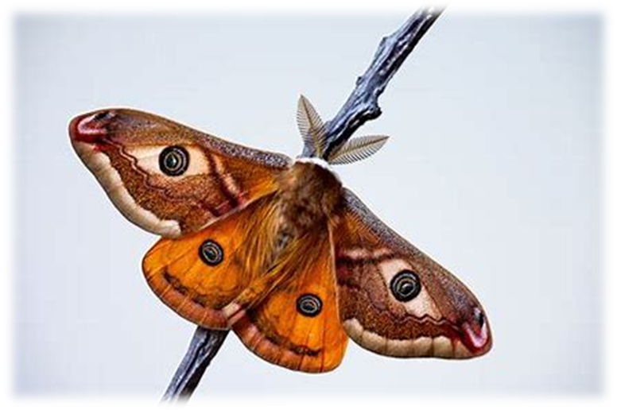
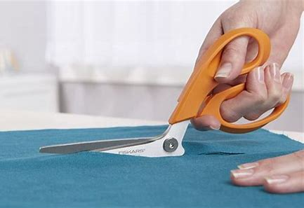
this
thank
thick
us
sad
flag
this
with
that
thank
me
we
thinking
with
thinking
thin
that
then
moth
cloth

Slide 32
Activity page

Slide 33
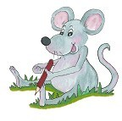
Dictation

Slide 34
this

Slide 35
this 2. then

Slide 36
this 2. then 3. with

Slide 37
this 2. then 3. with
4. thin

Slide 38
this 2. then 3. with
4. thin 5. think

Slide 39
this 2. then 3. with
4. thin 5. think 6. thick

Slide 40
this 2. then 3. with
4. thin 5. think 6. thick
7. That moth is big.

Slide 41
this 2. then 3. with
4. thin 5. think 6. thick
7. That moth is big.
8. He is thin.

Slide 42
this 2. then 3. with
4. thin 5. think 6. thick
7. That moth is big.
8. He is thin.
9. She cut the cloth.

Slide 43
Thank you! See you next time.

