Slide 1
Grammar 1-1

Slide 2
Rainbow Capitals

Slide 3
Aa Bb Cc Dd Ee
Ff Gg Hh Ii Jj Kk Ll Mm
Nn Oo Pp Qq Rr Ss
Tt Uu Vv Ww Xx Yy Zz

Slide 4
Activity Page:

Slide 5
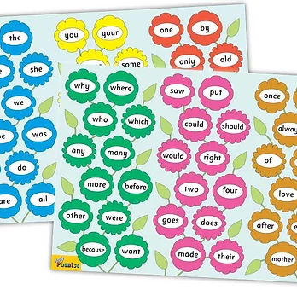
Tricky Words
^{1st} set

Slide 6
fish
/sh/

Slide 7
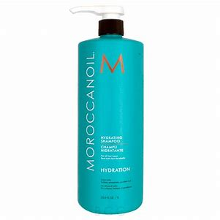
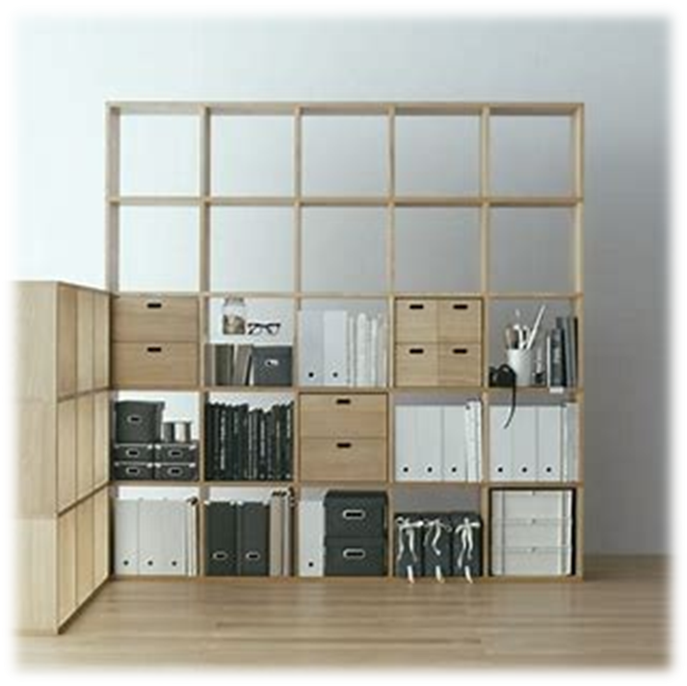
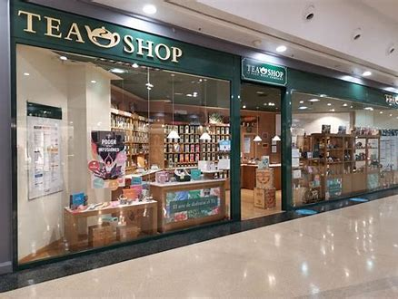
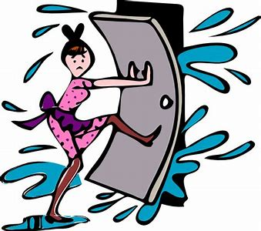
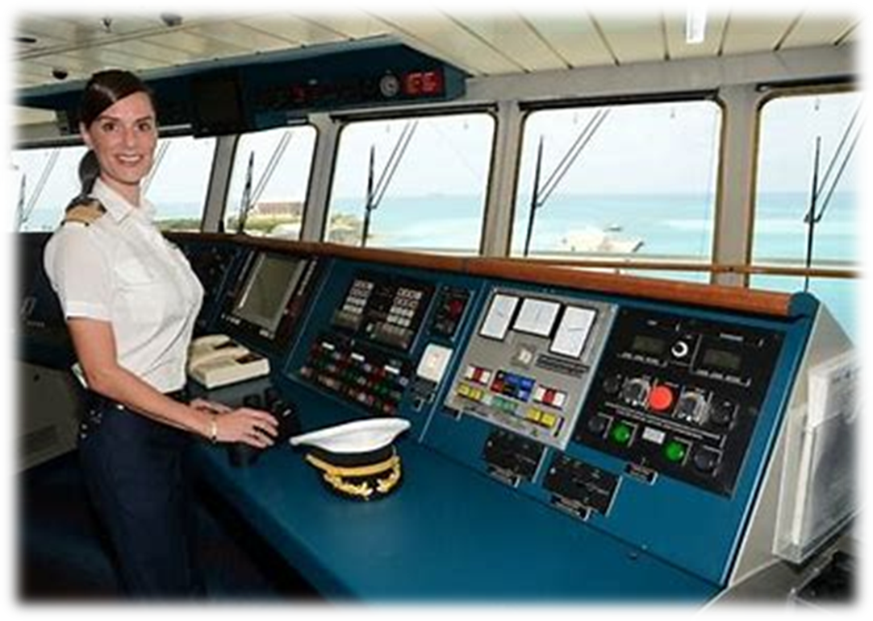
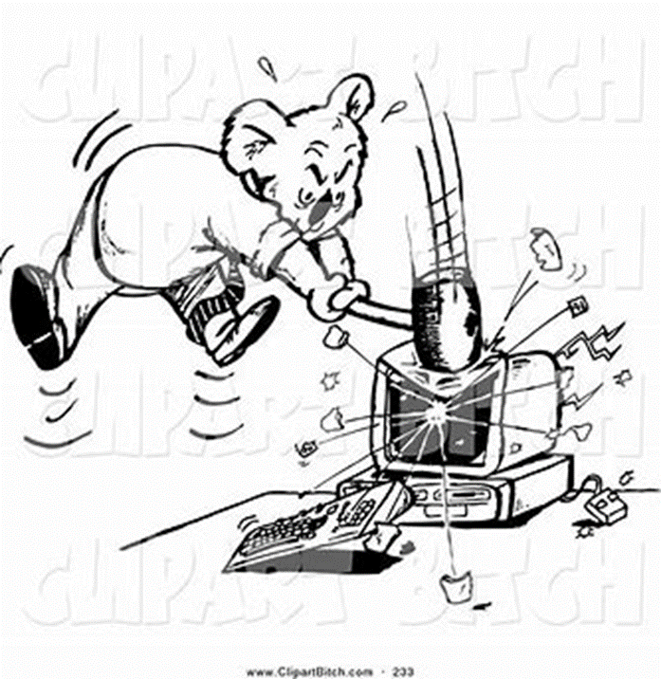
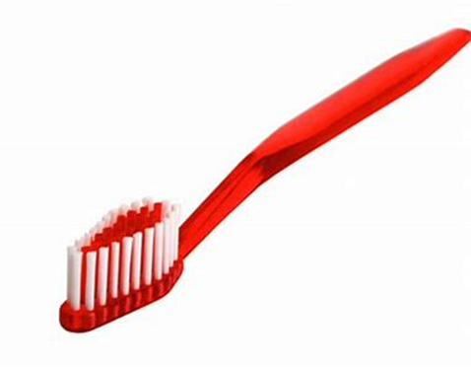
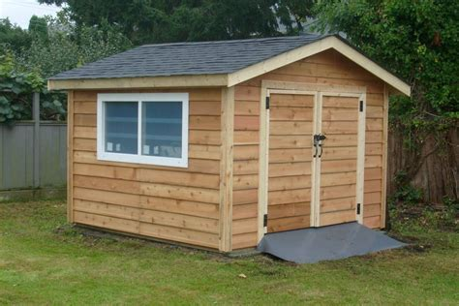
fish
shampoo
shelf
shop
am
get
clap
shop
fish
shut
wish
I
the
shampoo
shut
ship
brush
smash
wish
shed
rush
toothbrush

Slide 8
Activity page

Slide 9
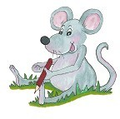
Dictation

Slide 10
ship

Slide 11
ship 2. shed

Slide 12
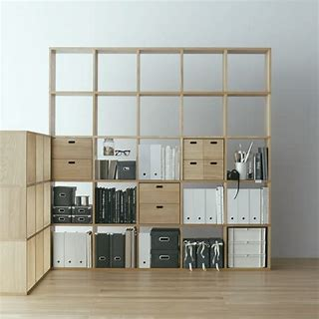
ship 2. shed 3. shelf

Slide 13
ship 2. shed 3. shelf
4. brush

Slide 14
ship 2. shed 3. shelf
4. brush 5. rush

Slide 15
ship 2. shed 3. shelf
4. brush 5. rush 6. smash

Slide 16
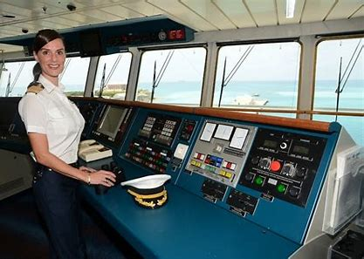
ship 2. shed 3. shelf
4. brush 5. rush 6. smash
7. I am on a ship.

Slide 17
ship 2. shed 3. shelf
4. brush 5. rush 6. smash
7. I am on a ship.
8. She shops for food.

Slide 18
ship 2. shed 3. shelf
4. brush 5. rush 6. smash
7. I am on a ship.
8. She shops for food.
9. His toothbrush is red.

Slide 19
Thank you! See you next time.

