Slide 1
Jolly Grammar 3-36

Slide 2
Spelling Test 35

Slide 3
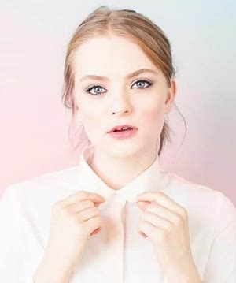
fair

Slide 4
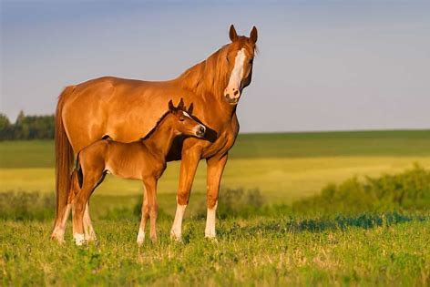
fair
mare

Slide 5
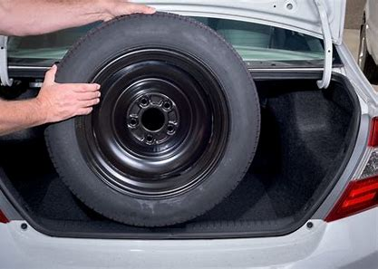
fair
mare
spare

Slide 6
fair
mare
spare
fairy

Slide 7
fair
mare
spare
fairy
bare

Slide 8
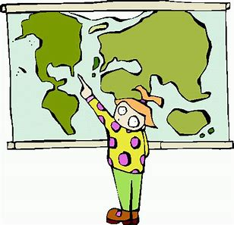
fair
mare
spare
fairy
bare
there

Slide 9
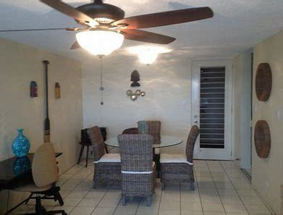
fair
mare
spare
fairy
bare
there
7. airless

Slide 10
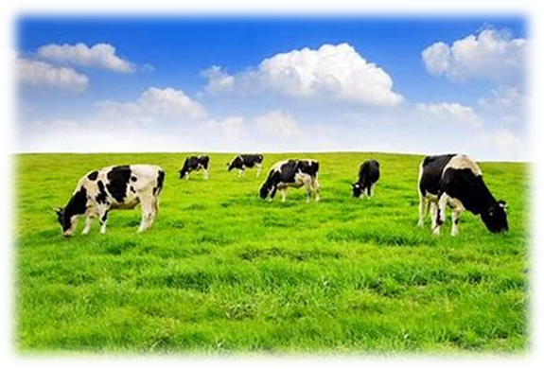
fair
mare
spare
fairy
bare
there
7. airless
8. dairy

Slide 11
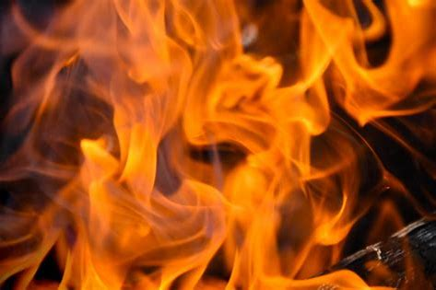
fair
mare
spare
fairy
bare
there
7. airless
8. dairy
9. flare

Slide 12
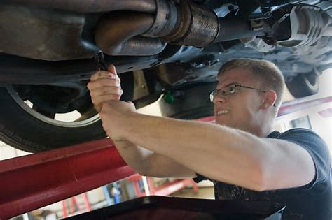
fair
mare
spare
fairy
bare
there
7. airless
8. dairy
9. flare
10. repair

Slide 13
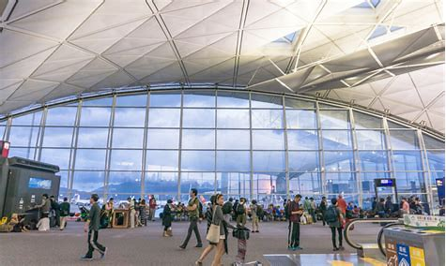
fair
mare
spare
fairy
bare
there
7. airless
8. dairy
9. flare
10. repair
11. airport

Slide 14
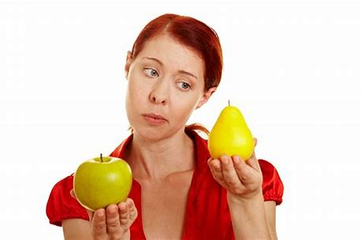
fair
mare
spare
fairy
bare
there
7. airless
8. dairy
9. flare
10. repair
11. airport
12. compare

Slide 15
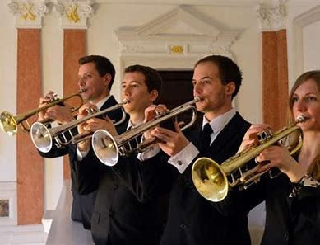
fair
mare
spare
fairy
bare
there
7. airless
8. dairy
9. flare
10. repair
11. airport
12. compare
13. fanfare

Slide 16
fair
mare
spare
fairy
bare
there
7. airless
8. dairy
9. flare
10. repair
11. airport
12. compare
13. fanfare
14. prepare

Slide 17
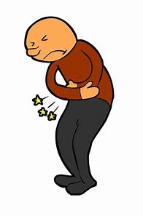
fair
mare
spare
fairy
bare
there
7. airless
8. dairy
9. flare
10. repair
11. airport
12. compare
13. fanfare
14. prepare
15. bearable

Slide 18
fair
mare
spare
fairy
bare
there
7. airless
8. dairy
9. flare
10. repair
11. airport
12. compare
13. fanfare
14. prepare
15. bearable
16. hairdresser

Slide 19
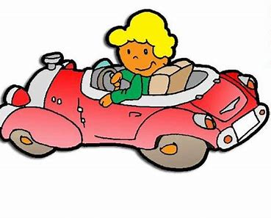
fair
mare
spare
fairy
bare
there
7. airless
8. dairy
9. flare
10. repair
11. airport
12. compare
13. fanfare
14. prepare
15. bearable
16. hairdresser
17. somewhere

Slide 20
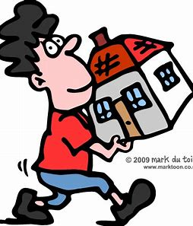
fair
mare
spare
fairy
bare
there
7. airless
8. dairy
9. flare
10. repair
11. airport
12. compare
13. fanfare
14. prepare
15. bearable
16. hairdresser
17. somewhere
18. wherewithal

Slide 21
Let’s review
tenses.

Slide 22
I cook.

Slide 23
I cook.
simple present

Slide 24
I cook.
simple past
simple present
simple future
past continuous
present continuous
future continuous

Slide 25
I cooked.
I cook.
simple past
simple present
simple future
past continuous
present continuous
future continuous

Slide 26
I cooked.
I cook.
I will cook.
simple past
simple present
simple future
past continuous
present continuous
future continuous

Slide 27
I cooked.
I cook.
I will cook.
I am cooking.
simple past
simple present
simple future
past continuous
present continuous
future continuous

Slide 28
I cooked.
I cook.
I will cook.
I was cooking.
I am cooking.
simple past
simple present
simple future
past continuous
present continuous
future continuous

Slide 29
I cooked.
I cook.
I will cook.
I was cooking.
I am cooking.
I will be cooking.
simple past
simple present
simple future
past continuous
present continuous
future continuous

Slide 30
Activity page
page.73

Slide 31
Revision

Slide 32
off
phone
cough
dreary
beer
sincere
fairy
bare
bear
there
feature

Slide 33
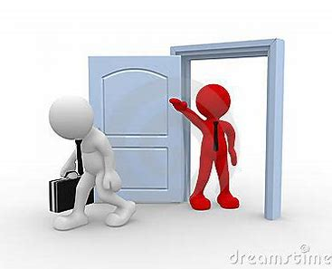
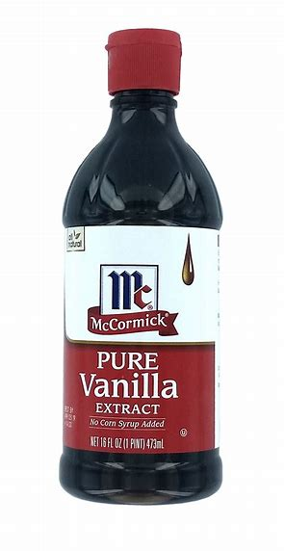
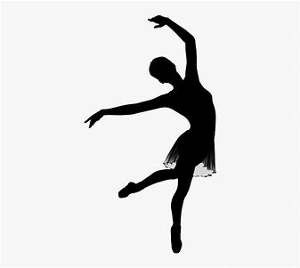
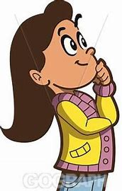
exit
expel
extract
ex-dancer
ex-boyfriend

Slide 34
Spelling List

Slide 35
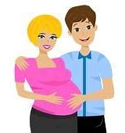
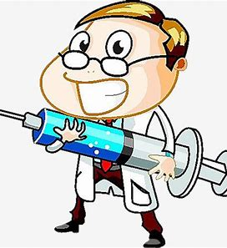
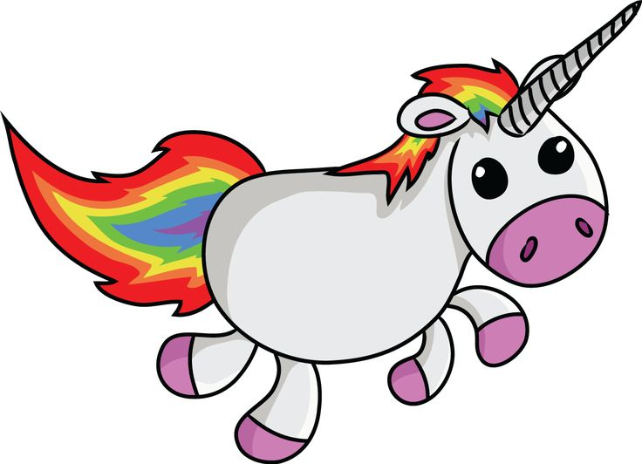
exit expect expel
expert extra exist

Slide 36
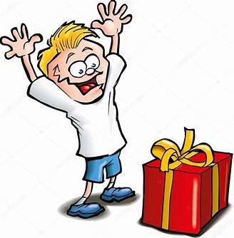
excuse except explain
explore extract excite

Slide 37
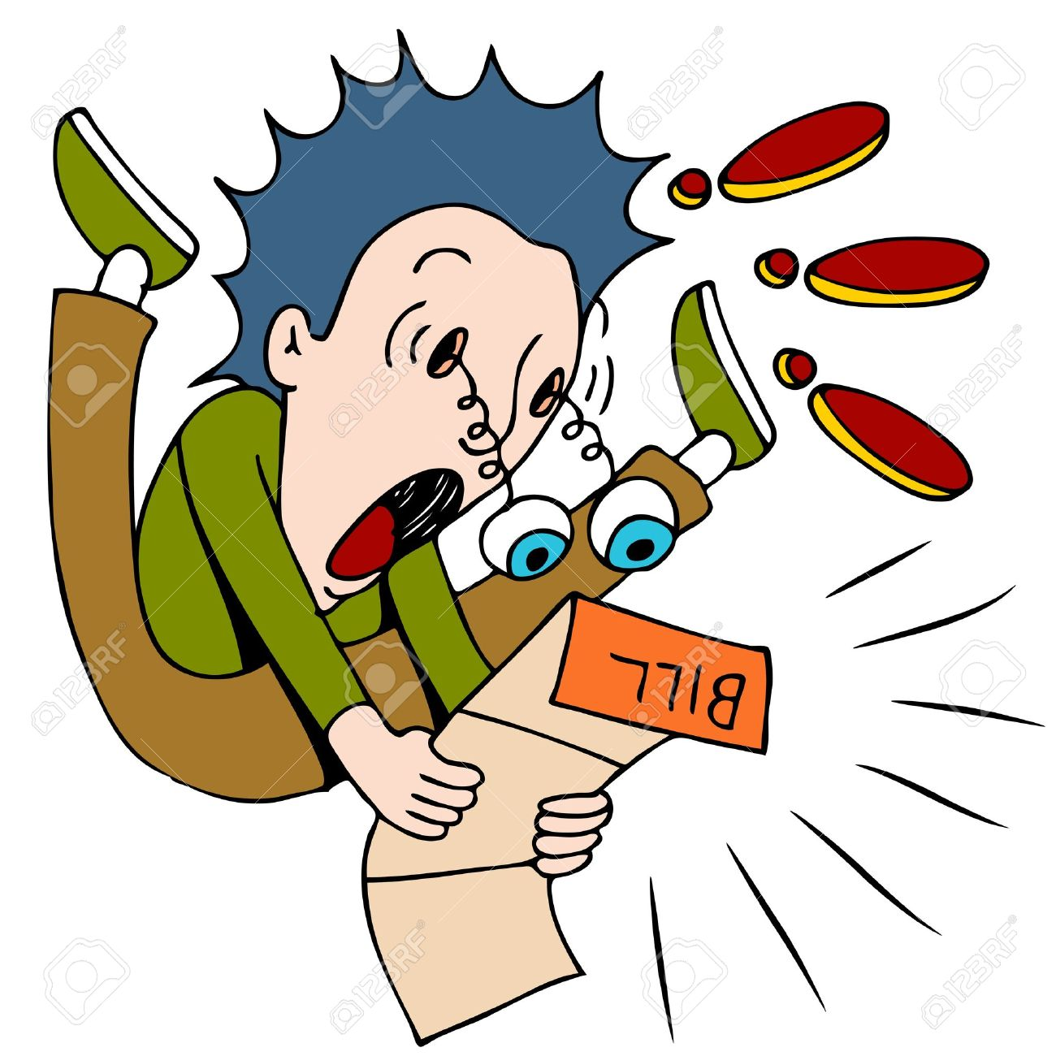
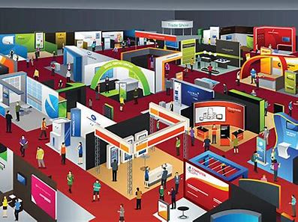
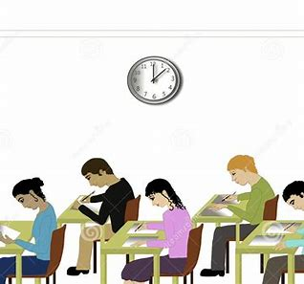
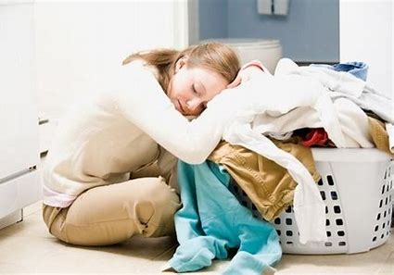
excellent expensive example
exhibition exhausted examination

Slide 39
Activity page
page.70

Slide 40
Let’s review
syllables.

Slide 41
expect
expensive
exit
except
excellent

Slide 42
Let’s parse
sentences.

Slide 43
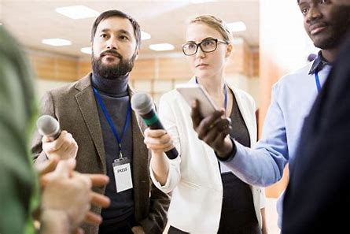
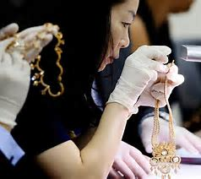
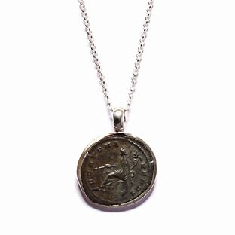
Parse these sentences.
They looked expectantly at the excellent explorer.
The excited expert is examining the expensive Roman necklace.

Slide 44
Parse these sentences.
They looked expectantly at the excellent explorer.
The excited expert is examining the expensive Roman necklace.

Slide 45
Parse these sentences.
They looked expectantly at the excellent explorer.
The excited expert is examining the expensive Roman necklace.

Slide 46
Parse these sentences.
They looked expectantly at the excellent explorer.
The excited expert is examining the expensive Roman necklace.

Slide 47
Parse these sentences.
They looked expectantly at the excellent explorer.
The excited expert is examining the expensive Roman necklace.

Slide 48
Parse these sentences.
They looked expectantly at the excellent explorer.
The excited expert is examining the expensive Roman necklace.

Slide 49
Parse these sentences.
They looked expectantly at the excellent explorer.
The excited expert is examining the expensive Roman necklace.

Slide 50
Parse these sentences.
They looked expectantly at the excellent explorer.
The excited expert is examining the expensive Roman necklace.

Slide 51
Parse these sentences.
They looked expectantly at the excellent explorer.
The excited expert is examining the expensive Roman necklace.

Slide 52
Parse these sentences.
They looked expectantly at the excellent explorer.
The excited expert is examining the expensive Roman necklace.

Slide 53
Parse these sentences.
They looked expectantly at the excellent explorer.
The excited expert is examining the expensive Roman necklace.

Slide 54
Parse these sentences.
They looked expectantly at the excellent explorer.
The excited expert is examining the expensive Roman necklace.

Slide 55
Parse these sentences.
They looked expectantly at the excellent explorer.
The excited expert is examining the expensive Roman necklace.

Slide 56
Dictation

Slide 57
Dictation
1.
2.
3.

Slide 58
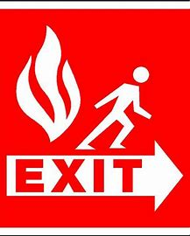
.

Slide 59
“Where is the exit?” she asked.

Slide 61
There was an extra seat on the bus.

Slide 62
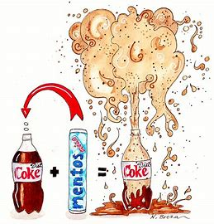

Slide 63
“The experiment has exploded!” exclaimed the reporter.

Slide 64
Homework

