Slide 1
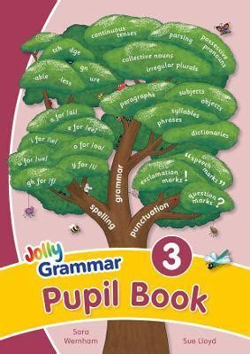
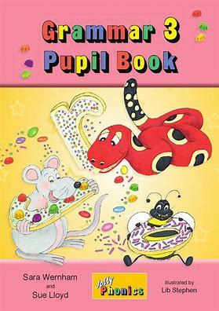
Jolly Grammar 3-35

Slide 2
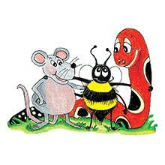
Spelling Test 34

Slide 3
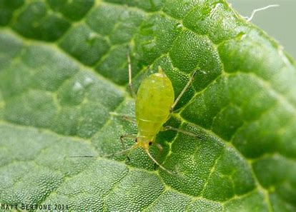
aphid

Slide 4
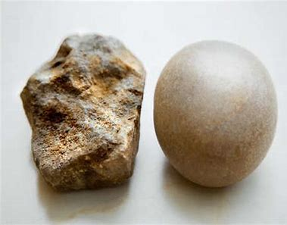
aphid
rough

Slide 5
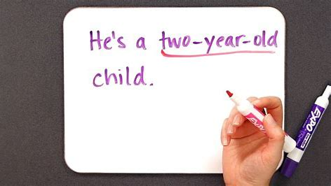
aphid
rough
hyphen

Slide 6
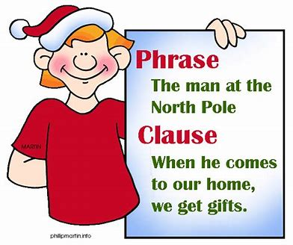
aphid
rough
hyphen
phrase

Slide 7
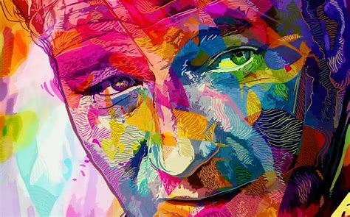
aphid
rough
hyphen
phrase
graphic

Slide 8
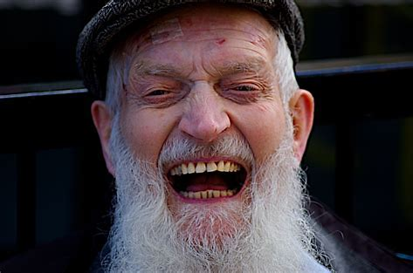
aphid
rough
hyphen
phrase
graphic
laugh

Slide 9
aphid
rough
hyphen
phrase
graphic
laugh
7. toughest

Slide 10
aphid
rough
hyphen
phrase
graphic
laugh
7. toughest
8. decipher

Slide 11
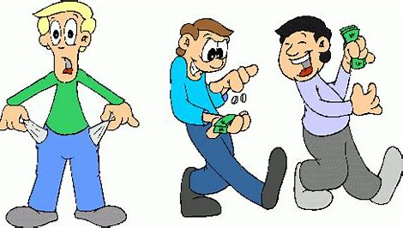
aphid
rough
hyphen
phrase
graphic
laugh
7. toughest
8. decipher
9. enough

Slide 12
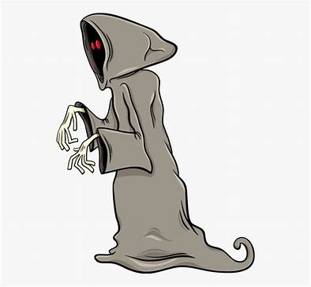
aphid
rough
hyphen
phrase
graphic
laugh
7. toughest
8. decipher
9. enough
10. phantom

Slide 13
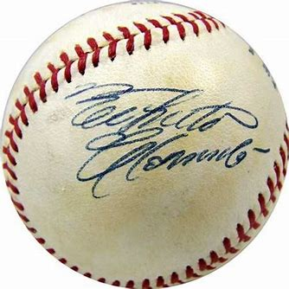
aphid
rough
hyphen
phrase
graphic
laugh
7. toughest
8. decipher
9. enough
10. phantom
11. autograph

Slide 14
aphid
rough
hyphen
phrase
graphic
laugh
7. toughest
8. decipher
9. enough
10. phantom
11. autograph
12. apostrophe

Slide 15
aphid
rough
hyphen
phrase
graphic
laugh
7. toughest
8. decipher
9. enough
10. phantom
11. autograph
12. apostrophe
13. triumph

Slide 16
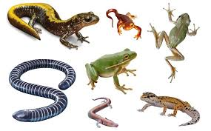
aphid
rough
hyphen
phrase
graphic
laugh
7. toughest
8. decipher
9. enough
10. phantom
11. autograph
12. apostrophe
13. triumph
14. amphibian

Slide 17
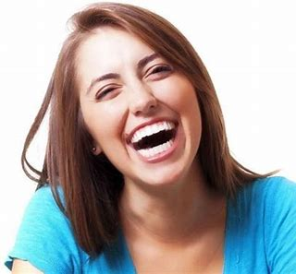
aphid
rough
hyphen
phrase
graphic
laugh
7. toughest
8. decipher
9. enough
10. phantom
11. autograph
12. apostrophe
13. triumph
14. amphibian
15. laughter

Slide 18
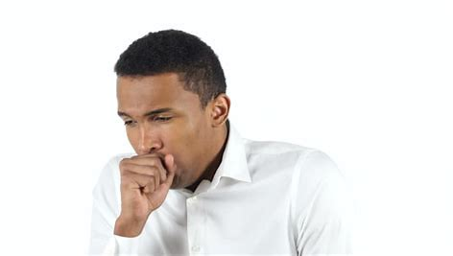
aphid
rough
hyphen
phrase
graphic
laugh
7. toughest
8. decipher
9. enough
10. phantom
11. autograph
12. apostrophe
13. triumph
14. amphibian
15. laughter
16. coughing

Slide 19
aphid
rough
hyphen
phrase
graphic
laugh
7. toughest
8. decipher
9. enough
10. phantom
11. autograph
12. apostrophe
13. triumph
14. amphibian
15. laughter
16. coughing
17. pharmacy

Slide 20
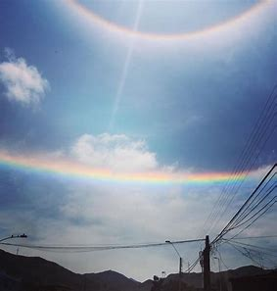
aphid
rough
hyphen
phrase
graphic
laugh
7. toughest
8. decipher
9. enough
10. phantom
11. autograph
12. apostrophe
13. triumph
14. amphibian
15. laughter
16. coughing
17. pharmacy
18. phenomenon

Slide 22
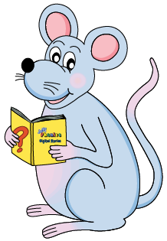
Let’s review
sentences
and phrases.

Slide 23
Phrases
knives and forks
in the shed
today at school
at the local museum
the house next door
on the phone
out and about
a box of chocolate

Slide 24
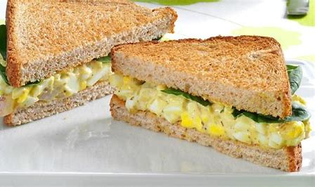
tasty egg sandwiches

Slide 25
tasty egg sandwiches
A phrase? A sentence?

Slide 26
tasty egg sandwiches
A phrase? A sentence?

Slide 27
tasty egg sandwiches
A sentence?

Slide 28
tasty egg sandwiches
A sentence?
Snake likes tasty egg sandwiches.

Slide 29
tasty egg sandwiches
A sentence?
Snake likes tasty egg sandwiches.

Slide 30
tasty egg sandwiches
A sentence?
Snake likes tasty egg sandwiches.

Slide 31
tasty egg sandwiches
A sentence?
Snake likes tasty egg sandwiches.

Slide 32
tasty egg sandwiches
A sentence?
Snake likes tasty egg sandwiches.

Slide 33
tasty egg sandwiches
A sentence?
Snake likes tasty egg sandwiches.

Slide 34
tasty egg sandwiches
A sentence?
Snake likes tasty egg sandwiches.
s

Slide 35
tasty egg sandwiches
A sentence?
Snake likes tasty egg sandwiches.
s
o

Slide 36
Snake likes tasty egg sandwiches.
The dog growls loudly.
s
o

Slide 37
Snake likes tasty egg sandwiches.
The dog growls loudly.
s
o

Slide 38
Snake likes tasty egg sandwiches.
The dog growls loudly.
s
o

Slide 39
Snake likes tasty egg sandwiches.
The dog growls loudly.
s
o

Slide 40
Snake likes tasty egg sandwiches.
The dog growls loudly.
s
o
s

Slide 41
Snake likes tasty egg sandwiches.
The dog growls loudly.
s
o
s

Slide 42
Activity page
page.71

Slide 43
Revision

Slide 44
drawn
auburn
chalk
sniff
graph
enough
figure
gnu
dessert
desert

Slide 45
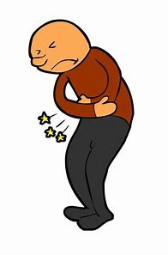
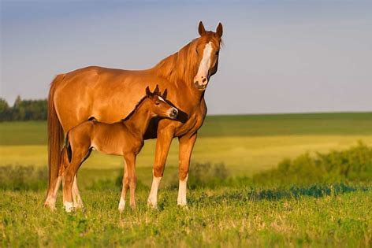
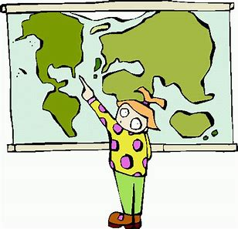
hairdresser
/air/
mare
/air/
there
/air/
bearable
/air/

Slide 46
Spelling List

Slide 47
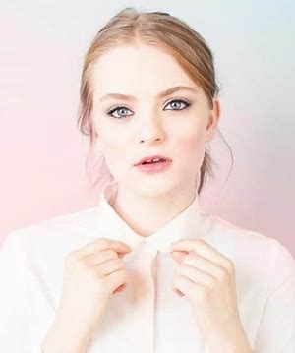
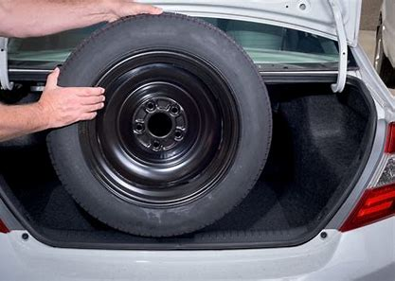
fair mare spare
fairy bare there

Slide 48
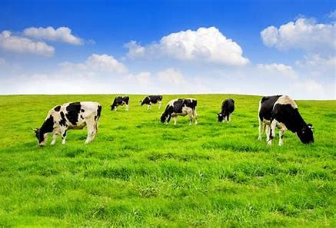
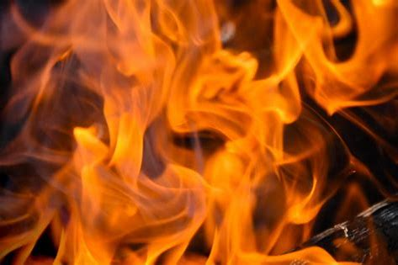
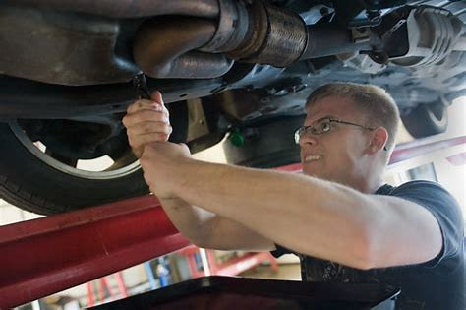
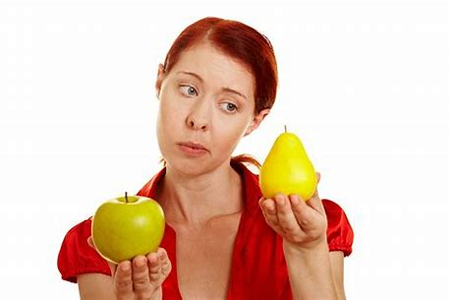
airless dairy flare
repair airport compare

Slide 49
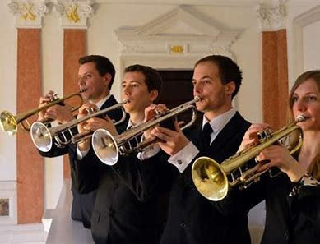
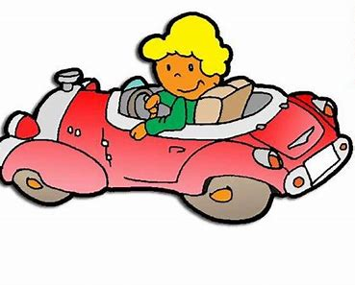
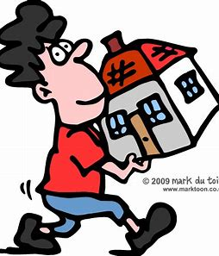
fanfare prepare bearable
hairdresser somewhere wherewithal

Slide 50
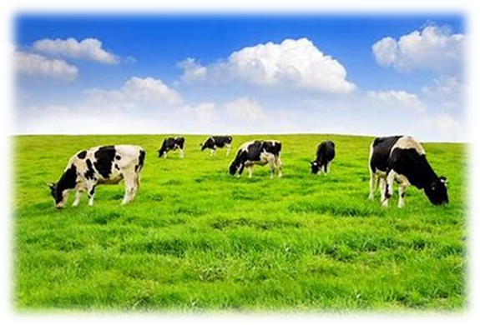

Slide 51
Activity page
page.70

Slide 52
Let’s review
syllables.

Slide 53
bearable
hairdresser
repair
fanfare
somewhere

Slide 54
Let’s parse
sentences.

Slide 55
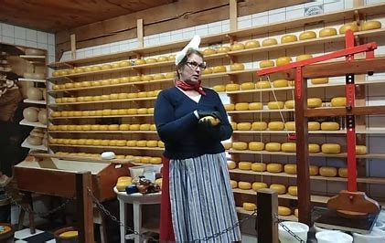
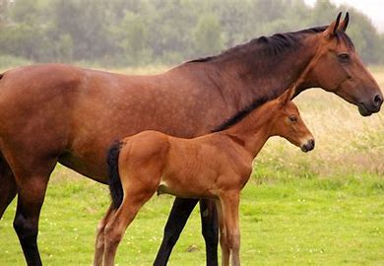
Parse these sentences.
She is making cheese in the farm dairy.
The brown mare had her young foal with her.

Slide 56
Parse these sentences.
She is making cheese in the farm dairy.
The brown mare had her young foal with her.

Slide 57
Parse these sentences.
She is making cheese in the farm dairy.
The brown mare had her young foal with her.

Slide 58
Parse these sentences.
She is making cheese in the farm dairy.
The brown mare had her young foal with her.

Slide 59
Parse these sentences.
She is making cheese in the farm dairy.
The brown mare had her young foal with her.

Slide 60
Parse these sentences.
She is making cheese in the farm dairy.
The brown mare had her young foal with her.

Slide 61
Parse these sentences.
She is making cheese in the farm dairy.
The brown mare had her young foal with her.

Slide 62
Parse these sentences.
She is making cheese in the farm dairy.
The brown mare had her young foal with her.

Slide 63
Parse these sentences.
She is making cheese in the farm dairy.
The brown mare had her young foal with her.

Slide 64
Parse these sentences.
She is making cheese in the farm dairy.
The brown mare had her young foal with her.

Slide 65
Parse these sentences.
She is making cheese in the farm dairy.
The brown mare had her young foal with her.

Slide 66
Parse these sentences.
She is making cheese in the farm dairy.
The brown mare had her young foal with her.

Slide 67
Parse these sentences.
She is making cheese in the farm dairy.
The brown mare had her young foal with her.

Slide 68
Parse these sentences.
She is making cheese in the farm dairy.
The brown mare had her young foal with her.

Slide 69
Parse these sentences.
She is making cheese in the farm dairy.
The brown mare had her young foal with her.

Slide 70
Word Descriptions

Slide 71
mare
2. dairy
bare
repair
airport
fanfare
prepare
fair
fairy
flare

Slide 72
Dictation

Slide 73
Dictation
1.
2.
3.

Slide 74
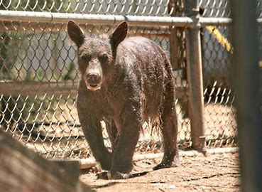

Slide 75
The bare bear had lost his hair.

Slide 76
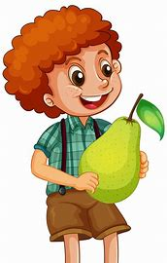

Slide 77
“Can I share your pear?” asked Seth.

Slide 78
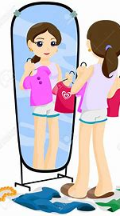
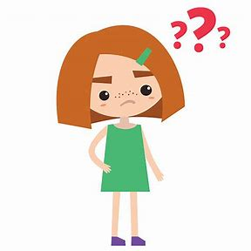

Slide 79
“What are you going to wear?” asked Meg.

Slide 80
Homework

