Slide 1
Jolly Grammar 2-36

Slide 2
Mini Test 35

Slide 3
1. swung

Slide 4
1. swung
2. spring

Slide 5
1. swung
2. spring
3. more

Slide 6
1. swung
2. spring
3. more
4. sore

Slide 7
1. swung
2. spring
3. more
4. sore
5. store

Slide 8
1. swung
2. spring
3. more
4. sore
5. store
6. snore

Slide 9
1. swung
2. spring
3. more
4. sore
5. store
6. snore
7. before

Slide 10
1. swung
2. spring
3. more
4. sore
5. store
6. snore
7. before
8. seashore

Slide 11
1. swung
2. spring
3. more
4. sore
5. store
6. snore
7. before
8. seashore
9. English

Slide 12
1. swung
2. spring
3. more
4. sore
5. store
6. snore
7. before
8. seashore
9. English
10. language

Slide 13
Let’s review
Punctuation marks

Slide 14
Fill in the missing punctuation marks.
Do you want to come and play with us asked Josh
Tommy replied I ll have to ask my dad first
Look exclaimed Josh There is your dad now Why
don’t you ask him
I will Tammy agreed

Slide 15
Fill in the missing punctuation marks.
“Do you want to come and play with us?” asked Josh.
Tommy replied I ll have to ask my dad first
Look exclaimed Josh There is your dad now Why
don’t you ask him
I will Tammy agreed

Slide 16
Fill in the missing punctuation marks.
“Do you want to come and play with us?” asked Josh.
Tommy replied, “I’ll have to ask my dad first.”
Look exclaimed Josh There is your dad now Why
don’t you ask him
I will Tammy agreed

Slide 17
Fill in the missing punctuation marks.
“Do you want to come and play with us?” asked Josh.
Tommy replied, “I’ll have to ask my dad first.”
“Look,” exclaimed Josh. “There is your dad now. Why
don’t you ask him?”
I will Tammy agreed

Slide 18
Fill in the missing punctuation marks.
“Do you want to come and play with us?” asked Josh.
Tommy replied, “I’ll have to ask my dad first.”
“Look,” exclaimed Josh. “There is your dad now. Why
don’t you ask him?”
“I will,“ Tammy agreed.

Slide 19
Parsing
With Big Book

Slide 20
Nouns Verbs Pronouns Adjectives
Adverbs Prepositions Conjunctions

Slide 21
Activity page
parsing

Slide 22
Nouns Verbs Pronouns Adjectives
Adverbs Prepositions Conjunctions
It is a sunny morning. Inky and Bee
are in the garden. Inky proudly shows
Bee her birthday present, a silver chain.
It glitters in the sunlight. Suddenly, a
magpie swoops to the ground and grabs
the chain.

Slide 23
Nouns Verbs Pronouns Adjectives
Adverbs Prepositions Conjunctions
It is a sunny morning. Inky and Bee
are in the garden. Inky proudly shows
Bee her birthday present, a silver chain.
It glitters in the sunlight. Suddenly, a
magpie swoops to the ground and grabs
the chain.

Slide 24
Nouns Verbs Pronouns Adjectives
Adverbs Prepositions Conjunctions
It is a sunny morning. Inky and Bee
are in the garden. Inky proudly shows
Bee her birthday present, a silver chain.
It glitters in the sunlight. Suddenly, a
magpie swoops to the ground and grabs
the chain.

Slide 25
Nouns Verbs Pronouns Adjectives
Adverbs Prepositions Conjunctions
It is a sunny morning. Inky and Bee
are in the garden. Inky proudly shows
Bee her birthday present, a silver chain.
It glitters in the sunlight. Suddenly, a
magpie swoops to the ground and grabs
the chain.

Slide 26
Nouns Verbs Pronouns Adjectives
Adverbs Prepositions Conjunctions
It is a sunny morning. Inky and Bee
are in the garden. Inky proudly shows
Bee her birthday present, a silver chain.
It glitters in the sunlight. Suddenly, a
magpie swoops to the ground and grabs
the chain.

Slide 27
Nouns Verbs Pronouns Adjectives
Adverbs Prepositions Conjunctions
It is a sunny morning. Inky and Bee
are in the garden. Inky proudly shows
Bee her birthday present, a silver chain.
It glitters in the sunlight. Suddenly, a
magpie swoops to the ground and grabs
the chain.

Slide 28
Nouns Verbs Pronouns Adjectives
Adverbs Prepositions Conjunctions
It is a sunny morning. Inky and Bee
are in the garden. Inky proudly shows
Bee her birthday present, a silver chain.
It glitters in the sunlight. Suddenly, a
magpie swoops to the ground and grabs
the chain.

Slide 29
Nouns Verbs Pronouns Adjectives
Adverbs Prepositions Conjunctions
It is a sunny morning. Inky and Bee
are in the garden. Inky proudly shows
Bee her birthday present, a silver chain.
It glitters in the sunlight. Suddenly, a
magpie swoops to the ground and grabs
the chain.

Slide 30
Nouns Verbs Pronouns Adjectives
Adverbs Prepositions Conjunctions
It is a sunny morning. Inky and Bee
are in the garden. Inky proudly shows
Bee her birthday present, a silver chain.
It glitters in the sunlight. Suddenly, a
magpie swoops to the ground and grabs
the chain.

Slide 31
Nouns Verbs Pronouns Adjectives
Adverbs Prepositions Conjunctions
It is a sunny morning. Inky and Bee
are in the garden. Inky proudly shows
Bee her birthday present, a silver chain.
It glitters in the sunlight. Suddenly, a
magpie swoops to the ground and grabs
the chain.

Slide 32
Nouns Verbs Pronouns Adjectives
Adverbs Prepositions Conjunctions
It is a sunny morning. Inky and Bee
are in the garden. Inky proudly shows
Bee her birthday present, a silver chain.
It glitters in the sunlight. Suddenly, a
magpie swoops to the ground and grabs
the chain.

Slide 33
Nouns Verbs Pronouns Adjectives
Adverbs Prepositions Conjunctions
It is a sunny morning. Inky and Bee
are in the garden. Inky proudly shows
Bee her birthday present, a silver chain.
It glitters in the sunlight. Suddenly, a
magpie swoops to the ground and grabs
the chain.

Slide 34
Nouns Verbs Pronouns Adjectives
Adverbs Prepositions Conjunctions
It is a sunny morning. Inky and Bee
are in the garden. Inky proudly shows
Bee her birthday present, a silver chain.
It glitters in the sunlight. Suddenly, a
magpie swoops to the ground and grabs
the chain.

Slide 35
Nouns Verbs Pronouns Adjectives
Adverbs Prepositions Conjunctions
It is a sunny morning. Inky and Bee
are in the garden. Inky proudly shows
Bee her birthday present, a silver chain.
It glitters in the sunlight. Suddenly, a
magpie swoops to the ground and grabs
the chain.

Slide 36
Nouns Verbs Pronouns Adjectives
Adverbs Prepositions Conjunctions
It is a sunny morning. Inky and Bee
are in the garden. Inky proudly shows
Bee her birthday present, a silver chain.
It glitters in the sunlight. Suddenly, a
magpie swoops to the ground and grabs
the chain.

Slide 37
Nouns Verbs Pronouns Adjectives
Adverbs Prepositions Conjunctions
It is a sunny morning. Inky and Bee
are in the garden. Inky proudly shows
Bee her birthday present, a silver chain.
It glitters in the sunlight. Suddenly, a
magpie swoops to the ground and grabs
the chain.

Slide 38
Nouns Verbs Pronouns Adjectives
Adverbs Prepositions Conjunctions
It is a sunny morning. Inky and Bee
are in the garden. Inky proudly shows
Bee her birthday present, a silver chain.
It glitters in the sunlight. Suddenly, a
magpie swoops to the ground and grabs
the chain.

Slide 39
Nouns Verbs Pronouns Adjectives
Adverbs Prepositions Conjunctions
It is a sunny morning. Inky and Bee
are in the garden. Inky proudly shows
Bee her birthday present, a silver chain.
It glitters in the sunlight. Suddenly, a
magpie swoops to the ground and grabs
the chain.

Slide 40
Nouns Verbs Pronouns Adjectives
Adverbs Prepositions Conjunctions
It is a sunny morning. Inky and Bee
are in the garden. Inky proudly shows
Bee her birthday present, a silver chain.
It glitters in the sunlight. Suddenly, a
magpie swoops to the ground and grabs
the chain.

Slide 41
Nouns Verbs Pronouns Adjectives
Adverbs Prepositions Conjunctions
It is a sunny morning. Inky and Bee
are in the garden. Inky proudly shows
Bee her birthday present, a silver chain.
It glitters in the sunlight. Suddenly, a
magpie swoops to the ground and grabs
the chain.

Slide 42
Nouns Verbs Pronouns Adjectives
Adverbs Prepositions Conjunctions
It is a sunny morning. Inky and Bee
are in the garden. Inky proudly shows
Bee her birthday present, a silver chain.
It glitters in the sunlight. Suddenly, a
magpie swoops to the ground and grabs
the chain.

Slide 43
Nouns Verbs Pronouns Adjectives
Adverbs Prepositions Conjunctions
It is a sunny morning. Inky and Bee
are in the garden. Inky proudly shows
Bee her birthday present, a silver chain.
It glitters in the sunlight. Suddenly, a
magpie swoops to the ground and grabs
the chain.

Slide 44
Nouns Verbs Pronouns Adjectives
Adverbs Prepositions Conjunctions
It is a sunny morning. Inky and Bee
are in the garden. Inky proudly shows
Bee her birthday present, a silver chain.
It glitters in the sunlight. Suddenly, a
magpie swoops to the ground and grabs
the chain.

Slide 45
Nouns Verbs Pronouns Adjectives
Adverbs Prepositions Conjunctions
It is a sunny morning. Inky and Bee
are in the garden. Inky proudly shows
Bee her birthday present, a silver chain.
It glitters in the sunlight. Suddenly, a
magpie swoops to the ground and grabs
the chain.

Slide 46
Nouns Verbs Pronouns Adjectives
Adverbs Prepositions Conjunctions
It is a sunny morning. Inky and Bee
are in the garden. Inky proudly shows
Bee her birthday present, a silver chain.
It glitters in the sunlight. Suddenly, a
magpie swoops to the ground and grabs
the chain.

Slide 47
Nouns Verbs Pronouns Adjectives
Adverbs Prepositions Conjunctions
It is a sunny morning. Inky and Bee
are in the garden. Inky proudly shows
Bee her birthday present, a silver chain.
It glitters in the sunlight. Suddenly, a
magpie swoops to the ground and grabs
the chain.

Slide 48
Nouns Verbs Pronouns Adjectives
Adverbs Prepositions Conjunctions
It is a sunny morning. Inky and Bee
are in the garden. Inky proudly shows
Bee her birthday present, a silver chain.
It glitters in the sunlight. Suddenly, a
magpie swoops to the ground and grabs
the chain.

Slide 49
Nouns Verbs Pronouns Adjectives
Adverbs Prepositions Conjunctions
It is a sunny morning. Inky and Bee
are in the garden. Inky proudly shows
Bee her birthday present, a silver chain.
It glitters in the sunlight. Suddenly, a
magpie swoops to the ground and grabs
the chain.

Slide 50
Nouns Verbs Pronouns Adjectives
Adverbs Prepositions Conjunctions
It is a sunny morning. Inky and Bee
are in the garden. Inky proudly shows
Bee her birthday present, a silver chain.
It glitters in the sunlight. Suddenly, a
magpie swoops to the ground and grabs
the chain.

Slide 51
Nouns Verbs Pronouns Adjectives
Adverbs Prepositions Conjunctions
It is a sunny morning. Inky and Bee
are in the garden. Inky proudly shows
Bee her birthday present, a silver chain.
It glitters in the sunlight. Suddenly, a
magpie swoops to the ground and grabs
the chain.

Slide 52
Nouns Verbs Pronouns Adjectives
Adverbs Prepositions Conjunctions
It is a sunny morning. Inky and Bee
are in the garden. Inky proudly shows
Bee her birthday present, a silver chain.
It glitters in the sunlight. Suddenly, a
magpie swoops to the ground and grabs
the chain.

Slide 53
Nouns Verbs Pronouns Adjectives
Adverbs Prepositions Conjunctions
It is a sunny morning. Inky and Bee
are in the garden. Inky proudly shows
Bee her birthday present, a silver chain.
It glitters in the sunlight. Suddenly, a
magpie swoops to the ground and grabs
the chain.

Slide 54
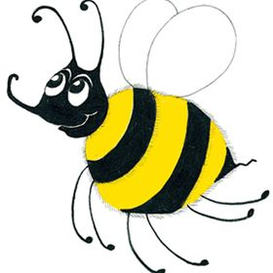
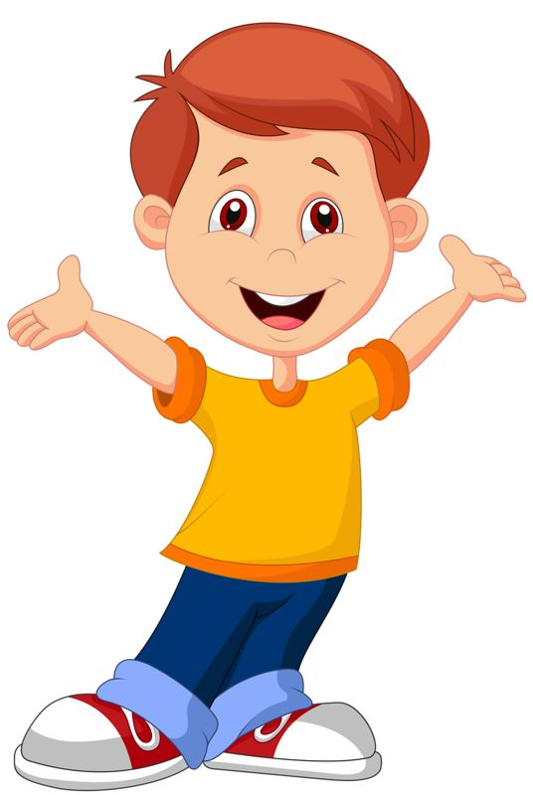
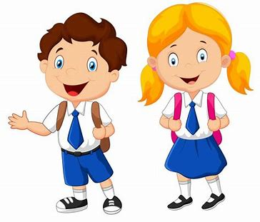
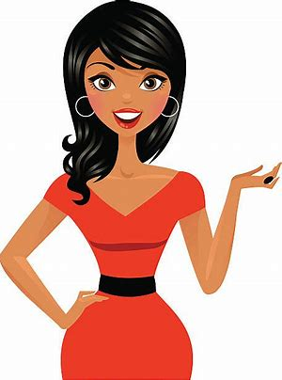
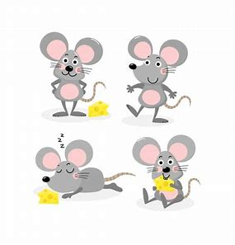
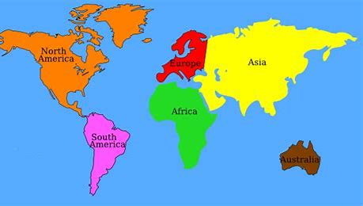
Tricky Plurals (and more)
child
children
woman
women
mouse
mice
library
computer
English
language
continent
world

Slide 55
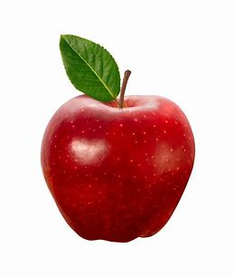
apple
/ool/

Slide 56
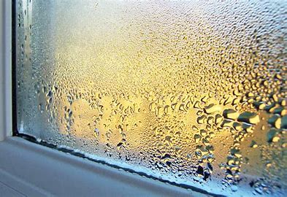
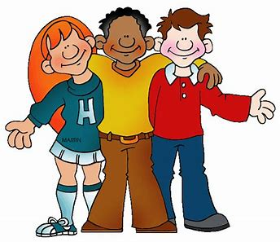
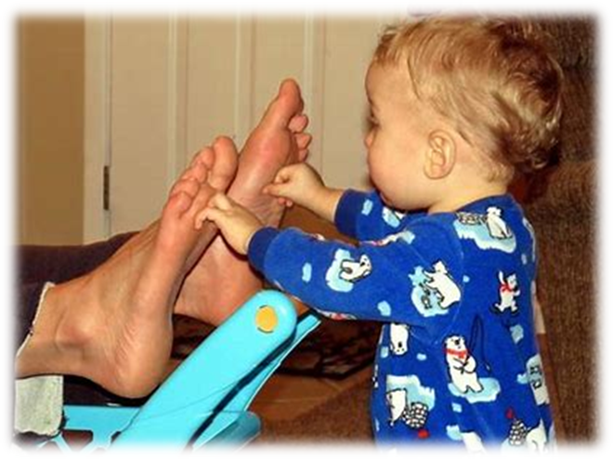
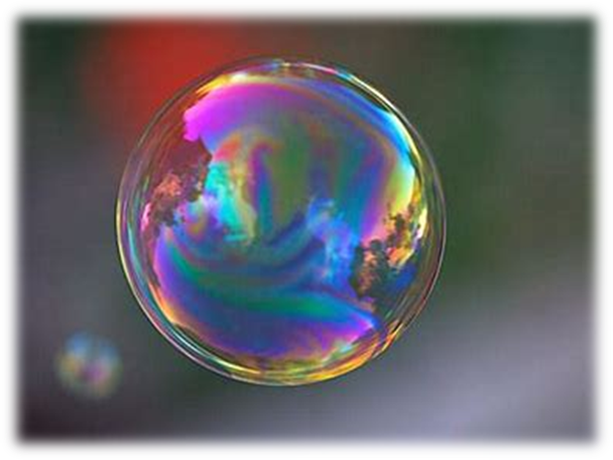
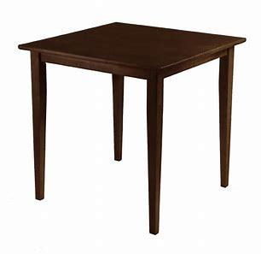
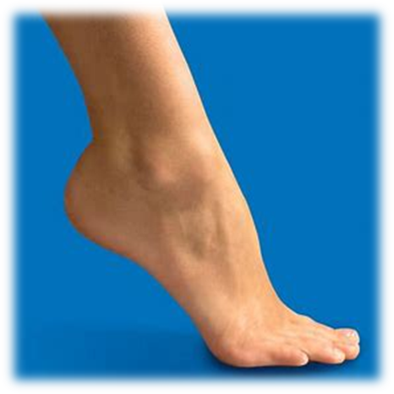
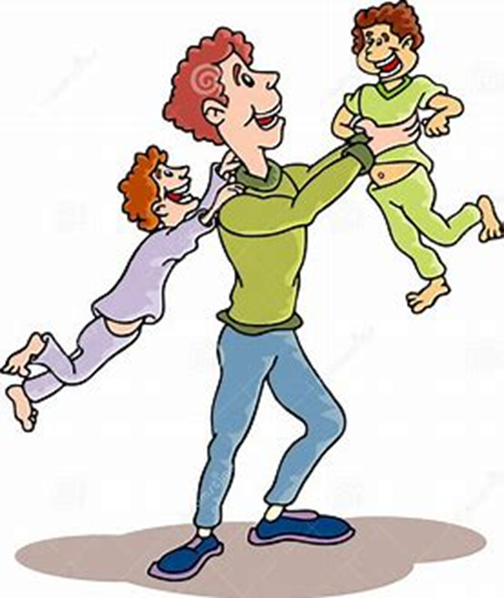
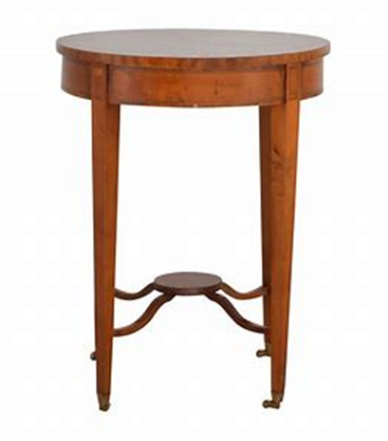
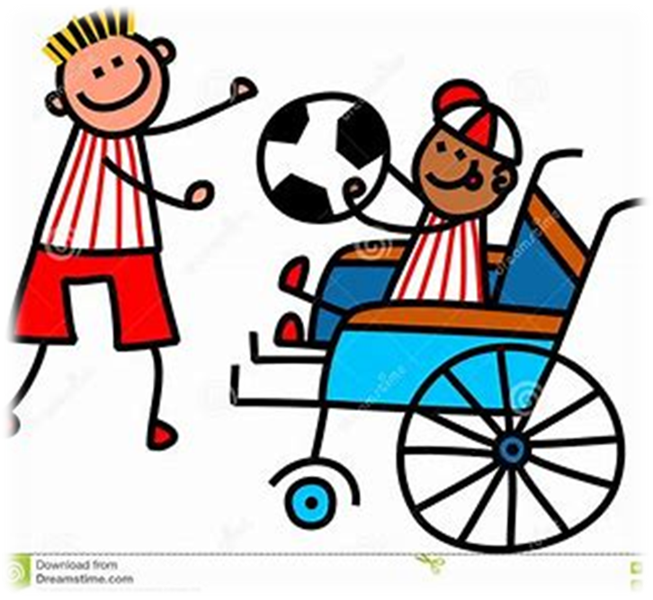
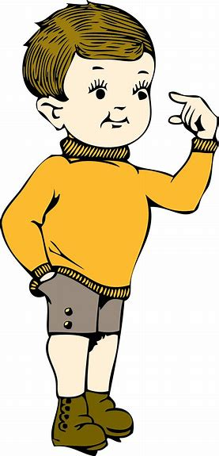
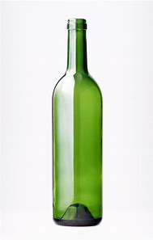
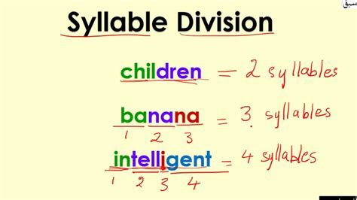
apple
middle
tickle
bubble
damp
stand
apple
table
little
middle
bottle
syllable
continent
world
table
ankle
uncle
able
wobble
little
syllable
bottle
simple

Slide 57
Activity page2

Slide 58
Dictation

Slide 59
Name:
1. 2. 3.
4. 5. 6.
7.
8.
9.

Slide 60
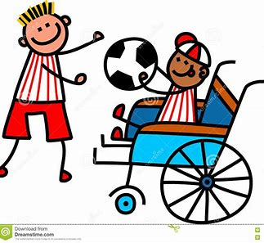
able

Slide 61
able 2. uncle

Slide 62
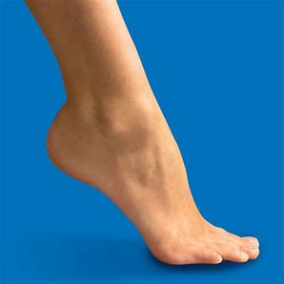
able 2. uncle 3. ankle

Slide 63
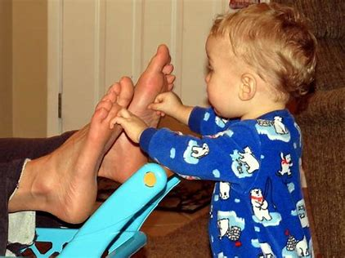
able 2. uncle 3. ankle
4. tickle

Slide 64
able 2. uncle 3. ankle
4. tickle 5. simple

Slide 65
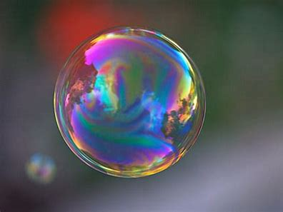
able 2. uncle 3. ankle
4. tickle 5. simple 6. bubble

Slide 66
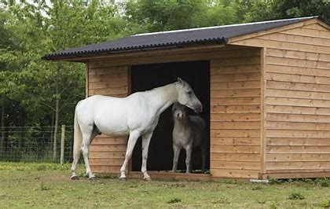
able 2. uncle 3. ankle
4. tickle 5. simple 6. bubble
7. The stable is in front of the field.

Slide 67
able 2. uncle 3. ankle
4. tickle 5. simple 6. bubble
7. The stable is in front of the field.
8. Somebody made the
furniture wobble.

Slide 68
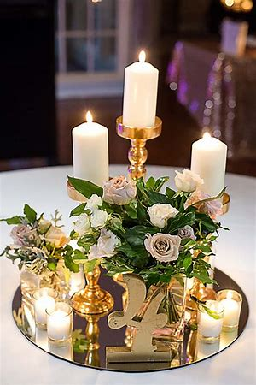
able 2. uncle 3. ankle
4. tickle 5. simple 6. bubble
7. The stable is in front of the field.
8. Somebody made the
furniture wobble.
9. I put candles in the
middle of the table.

Slide 69
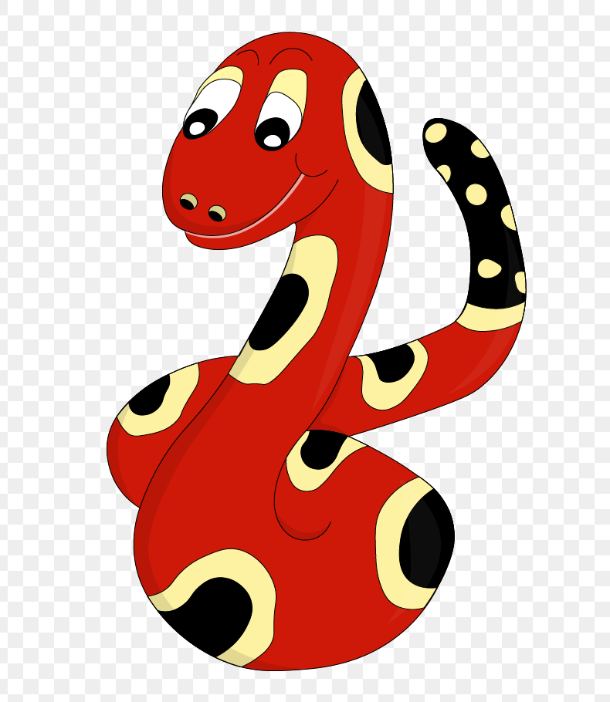
Thank you & Congratulations!

