Slide 1
Jolly Grammar 1-36

Slide 2
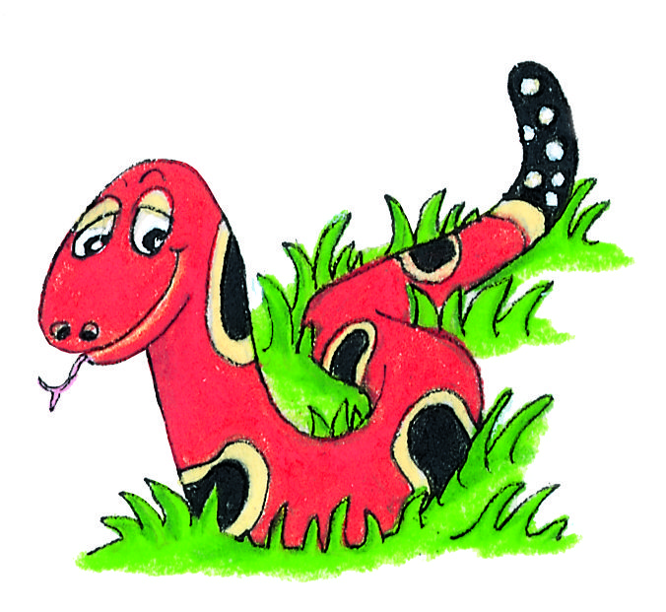
Spelling Test 35

Slide 3
map

Slide 4
map
fix

Slide 5
map
fix
jump

Slide 6
map
fix
jump
fault

Slide 7
map
fix
jump
fault
pause

Slide 8
map
fix
jump
fault
pause
6. haunt

Slide 9
map
fix
jump
fault
pause
6. haunt
7. August

Slide 10
map
fix
jump
fault
pause
6. haunt
7. August
8. after

Slide 11
map
fix
jump
fault
pause
6. haunt
7. August
8. after
9. every

Slide 12
map
fix
jump
fault
pause
6. haunt
7. August
8. after
9. every
10. astronaut

Slide 13
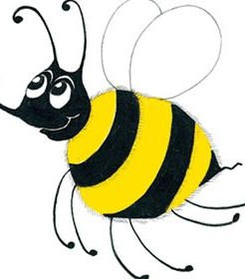
Let’s Revise
Parts of Speech
with Big Book

Slide 14
Nouns Verbs
Pronouns Adjectives Adverbs

Slide 15
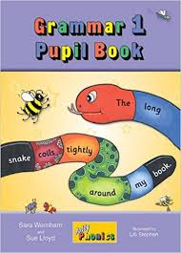
Activity Page:

Slide 16
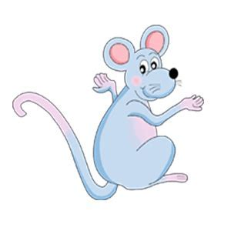
Nouns Verbs
Inky toils long and hard in the
garden. She digs the brown earth.
The birds watch her interestedly.
They wait eagerly for the grubs.
Pronouns Adjectives Adverbs

Slide 17
Nouns Verbs
Inky toils long and hard in the
garden. She digs the brown earth.
The birds watch her interestedly.
They wait eagerly for the grubs.
Pronouns Adjectives Adverbs

Slide 18
Nouns Verbs
Inky toils long and hard in the
garden. She digs the brown earth.
The birds watch her interestedly.
They wait eagerly for the grubs.
Pronouns Adjectives Adverbs

Slide 19
Nouns Verbs
Inky toils long and hard in the
garden. She digs the brown earth.
The birds watch her interestedly.
They wait eagerly for the grubs.
Pronouns Adjectives Adverbs

Slide 20
Nouns Verbs
Inky toils long and hard in the
garden. She digs the brown earth.
The birds watch her interestedly.
They wait eagerly for the grubs.
Pronouns Adjectives Adverbs

Slide 21
Nouns Verbs
Inky toils long and hard in the
garden. She digs the brown earth.
The birds watch her interestedly.
They wait eagerly for the grubs.
Pronouns Adjectives Adverbs

Slide 22
Nouns Verbs
Inky toils long and hard in the
garden. She digs the brown earth.
The birds watch her interestedly.
They wait eagerly for the grubs.
Pronouns Adjectives Adverbs

Slide 23
Nouns Verbs
Inky toils long and hard in the
garden. She digs the brown earth.
The birds watch her interestedly.
They wait eagerly for the grubs.
Pronouns Adjectives Adverbs

Slide 24
Nouns Verbs
Inky toils long and hard in the
garden. She digs the brown earth.
The birds watch her interestedly.
They wait eagerly for the grubs.
Pronouns Adjectives Adverbs

Slide 25
Nouns Verbs
Inky toils long and hard in the
garden. She digs the brown earth.
The birds watch her interestedly.
They wait eagerly for the grubs.
Pronouns Adjectives Adverbs

Slide 26
Nouns Verbs
Inky toils long and hard in the
garden. She digs the brown earth.
The birds watch her interestedly.
They wait eagerly for the grubs.
Pronouns Adjectives Adverbs

Slide 27
Nouns Verbs
Inky toils long and hard in the
garden. She digs the brown earth.
The birds watch her interestedly.
They wait eagerly for the grubs.
Pronouns Adjectives Adverbs

Slide 28
Nouns Verbs
Inky toils long and hard in the
garden. She digs the brown earth.
The birds watch her interestedly.
They wait eagerly for the grubs.
Pronouns Adjectives Adverbs

Slide 29
Nouns Verbs
Inky toils long and hard in the
garden. She digs the brown earth.
The birds watch her interestedly.
They wait eagerly for the grubs.
Pronouns Adjectives Adverbs

Slide 30
Nouns Verbs
Inky toils long and hard in the
garden. She digs the brown earth.
The birds watch her interestedly.
They wait eagerly for the grubs.
Pronouns Adjectives Adverbs

Slide 31
Nouns Verbs
Inky toils long and hard in the
garden. She digs the brown earth.
The birds watch her interestedly.
They wait eagerly for the grubs.
Pronouns Adjectives Adverbs

Slide 32
Nouns Verbs
Inky toils long and hard in the
garden. She digs the brown earth.
The birds watch her interestedly.
They wait eagerly for the grubs.
Pronouns Adjectives Adverbs

Slide 33
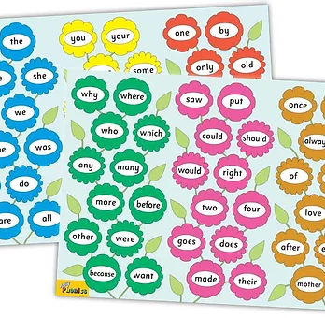
Tricky Words
^{6th} set

Slide 34
once

Slide 35
upon

Slide 36
always

Slide 37
also

Slide 38
of

Slide 39
eight

Slide 40
love

Slide 41
cover

Slide 42
after

Slide 43
every

Slide 44
mother

Slide 45
father

Slide 46
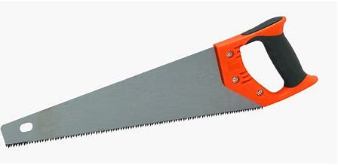

Slide 47
saw

Slide 48
saw
/or/

Slide 49
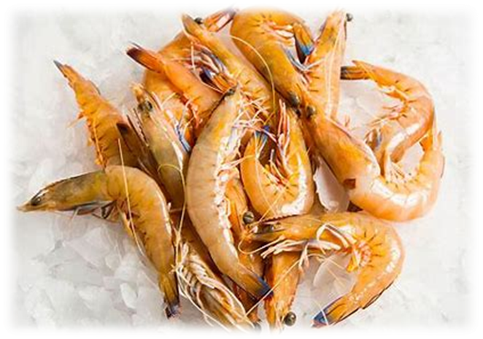
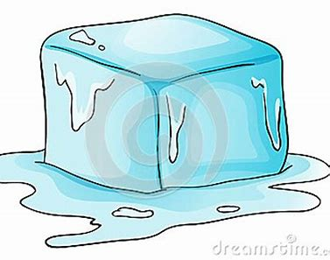
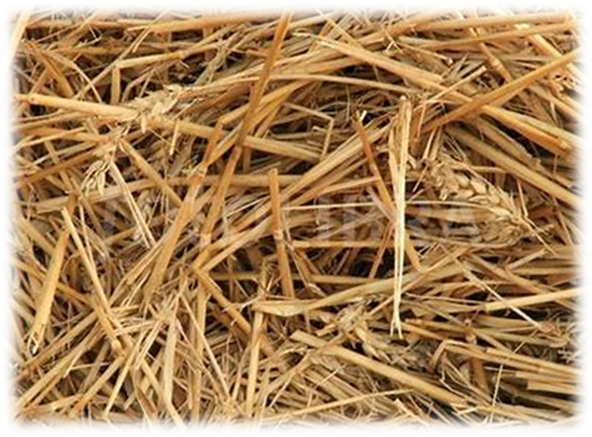
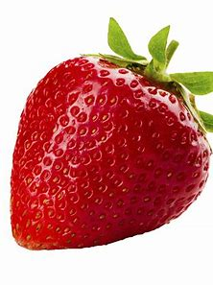
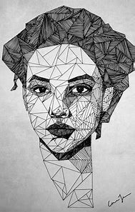
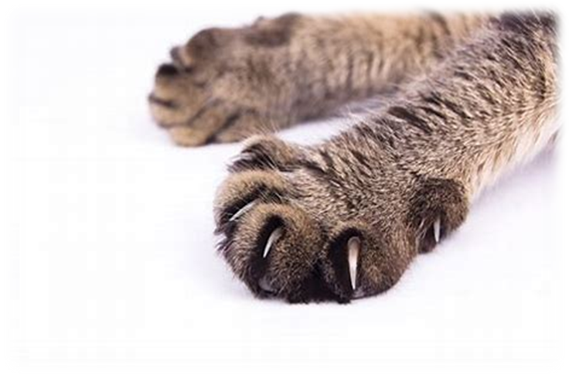
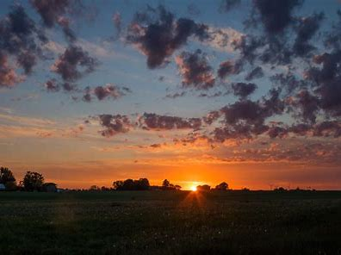
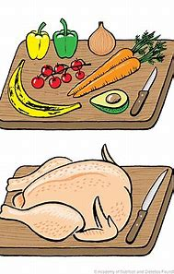
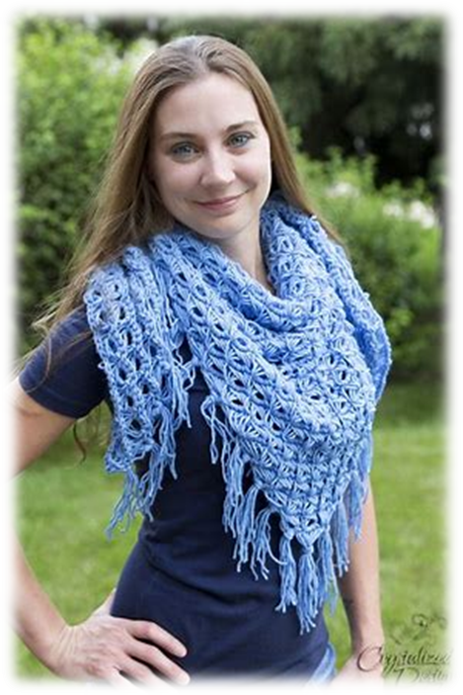
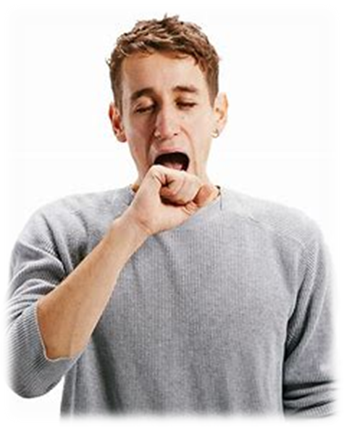
saw
prawn
thaw
straw
zip
men
pond
saw
claw
dawn
prawn
mother
father
strawberry
claw
strawberry
drawn
dawn
raw
shawl
yawn

Slide 50
Activity page

Slide 51
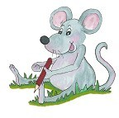
Dictation

Slide 52
raw

Slide 53
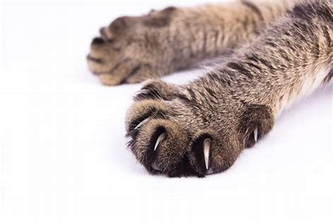
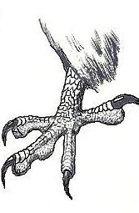
raw 2. claw

Slide 54
raw 2. claw 3. thaw

Slide 55
raw 2. claw 3. thaw
4. drawn

Slide 56
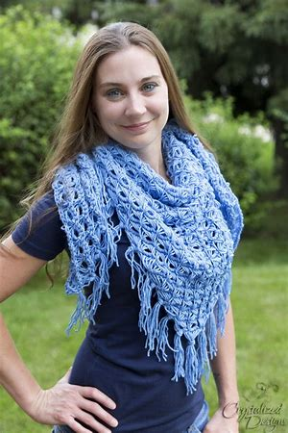
raw 2. claw 3. thaw
4. drawn 5. shawl

Slide 57
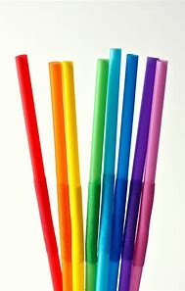
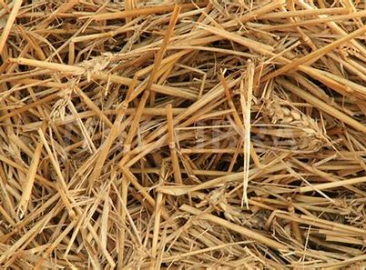
raw 2. claw 3. thaw
4. drawn 5. shawl 6. straw

Slide 58
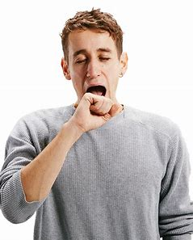
raw 2. claw 3. thaw
4. drawn 5. shawl 6. straw
7. Try not to yawn.

Slide 59
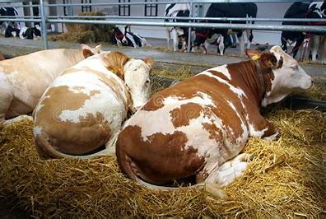
raw 2. claw 3. thaw
4. drawn 5. shawl 6. straw
7. Try not to yawn.
8. The cows lie down
on some straw.

Slide 60
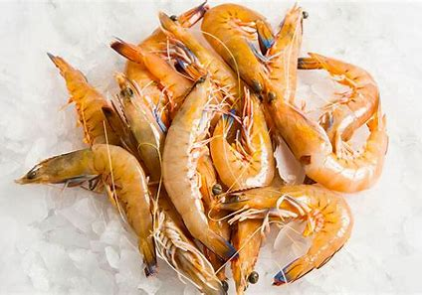
raw 2. claw 3. thaw
4. drawn 5. shawl 6. straw
7. Try not to yawn.
8. The cows lie down
on some straw.
9. Would you like some prawns?

Slide 61
Thank you! See you next time.

