Slide 1
Jolly Grammar
5a-36

Slide 2
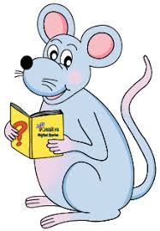
Spelling Test 18

Slide 3
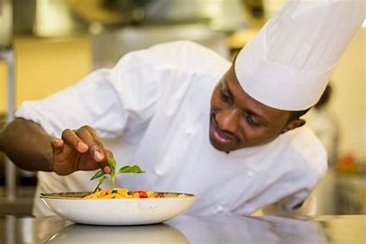
chef

Slide 4
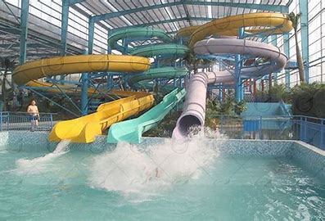
chef
chute

Slide 5
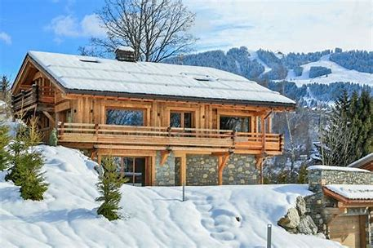
chef
chute
chalet

Slide 6
chef
chute
chalet
chevron

Slide 7
chef
chute
chalet
chevron
chiffon

Slide 8
chef
chute
chalet
chevron
chiffon
machine

Slide 9
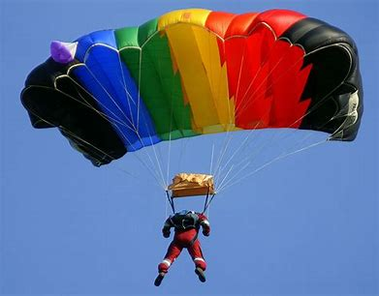
chef
chute
chalet
chevron
chiffon
machine
parachute

Slide 10
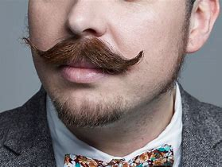
chef
chute
chalet
chevron
chiffon
machine
parachute
moustache

Slide 11
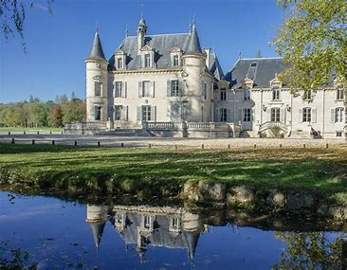
chef
chute
chalet
chevron
chiffon
machine
parachute
moustache
chateau

Slide 12
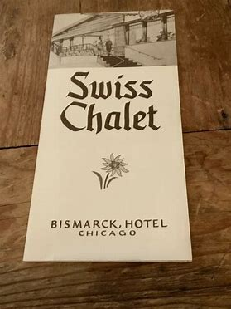
chef
chute
chalet
chevron
chiffon
machine
parachute
moustache
chateau
10. brochure

Slide 13
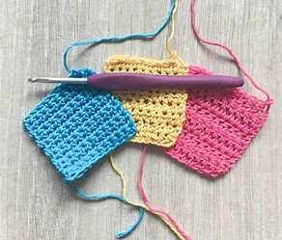
chef
chute
chalet
chevron
chiffon
machine
parachute
moustache
chateau
10. brochure
11. crochet

Slide 14
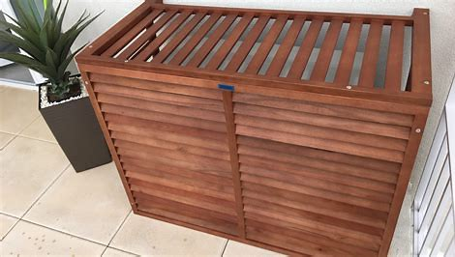
chef
chute
chalet
chevron
chiffon
machine
parachute
moustache
chateau
10. brochure
11. crochet
12. cache

Slide 15
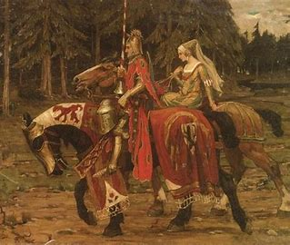
chef
chute
chalet
chevron
chiffon
machine
parachute
moustache
chateau
10. brochure
11. crochet
12. cache
13. chivalry

Slide 16
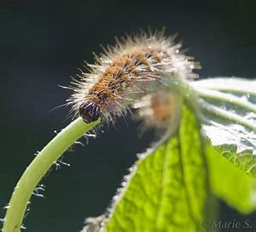
chef
chute
chalet
chevron
chiffon
machine
parachute
moustache
chateau
10. brochure
11. crochet
12. cache
13. chivalry
14. chenille

Slide 17
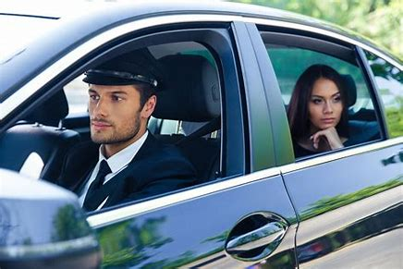
chef
chute
chalet
chevron
chiffon
machine
parachute
moustache
chateau
10. brochure
11. crochet
12. cache
13. chivalry
14. chenille
15. chauffeur

Slide 18
chef
chute
chalet
chevron
chiffon
machine
parachute
moustache
chateau
10. brochure
11. crochet
12. cache
13. chivalry
14. chenille
15. chauffeur
16. cliche

Slide 19
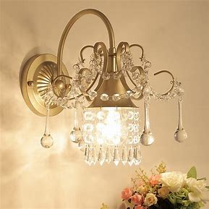
chef
chute
chalet
chevron
chiffon
machine
parachute
moustache
chateau
10. brochure
11. crochet
12. cache
13. chivalry
14. chenille
15. chauffeur
16. cliche
17. chandelier

Slide 20
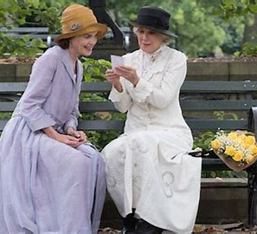
chef
chute
chalet
chevron
chiffon
machine
parachute
moustache
chateau
10. brochure
11. crochet
12. cache
13. chivalry
14. chenille
15. chauffeur
16. cliche
17. chandelier
18. chaperone

Slide 21
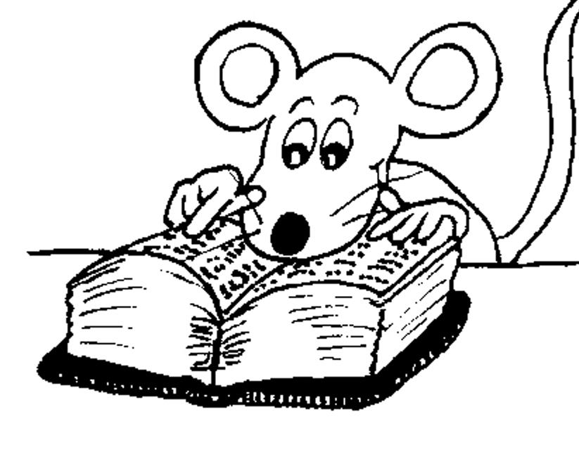
Let’s Review

Slide 22
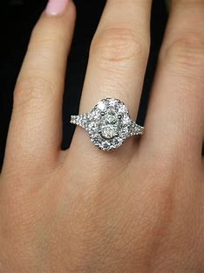
She wore a sparkling diamond ring.

Slide 23
She wore a sparkling diamond ring.

Slide 24
She wore a sparkling diamond ring.

Slide 25
She wore a sparkling diamond ring.
spark ＋ ing

Slide 26
She wore a sparkling diamond ring.
spark ＋ ing
noun?

Slide 27
She wore a sparkling diamond ring.
spark ＋ ing
noun?

Slide 28
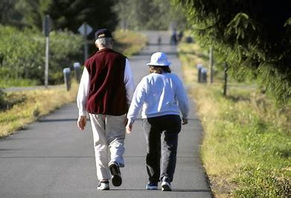
Zack and Jess had recently walked up the road.

Slide 29
Zack and Jess had recently walked up the road.

Slide 30
S
Zack and Jess had recently walked up the road.

Slide 31
S
Zack and Jess had recently walked up the road.
(intransitive)

Slide 32
S
Zack and Jess had recently walked up the road.
(intransitive)

Slide 33
Zack and Jess had recently walked up the road.
Subject
Verb
Object

Slide 34
Zack and Jess had recently walked up the road.
Subject
Verb
had walked
Object

Slide 35
Zack and Jess had recently walked up the road.
Subject
Verb
had walked
(intransitive)
Object

Slide 36
Zack and Jess had recently walked up the road.
Subject
Zack
and
Jess
Verb
had walked
(intransitive)
Object

Slide 37
Zack and Jess had recently walked up the road.
Subject
Zack
and
Jess
Verb
had walked
(intransitive)
recently
Object

Slide 38
Zack and Jess had recently walked (up the road).
Subject
Zack
and
Jess
Verb
had walked
(intransitive)
recently
up the road
Object

Slide 39
Zack and Jess had recently walked (up the road).
Subject
Zack
and
Jess
Verb
had walked
(intransitive)
recently
up the road
Object
Prepositional phrase as an adverb

Slide 40
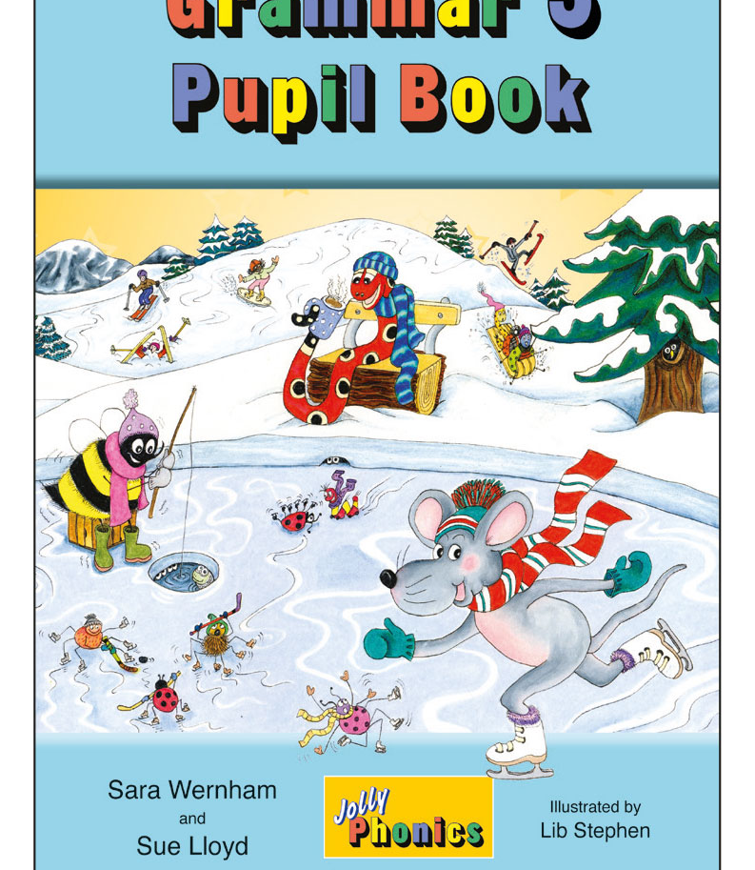
Activity Page
Prepositional Phrases as Adverbs

Slide 41
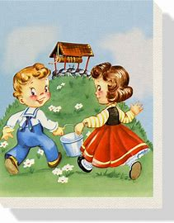
Jack and Jill went up the hill.

Slide 42
Jack and Jill went (up the hill).
Where?

Slide 43
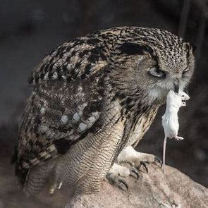
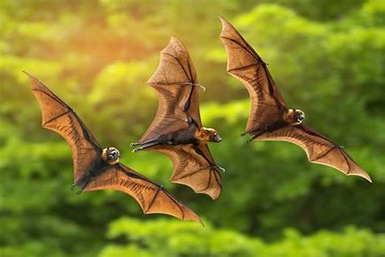
Bats and owls hunt during the night.

Slide 44
Bats and owls hunt (during the night).
When?

Slide 45
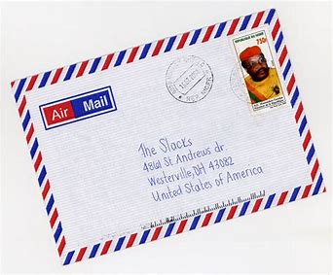
I have sent the letter by airmail.

Slide 46
I have sent the letter (by airmail).
How?

Slide 47
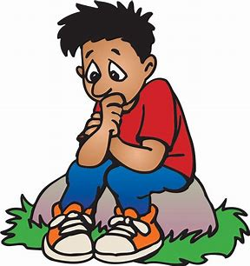
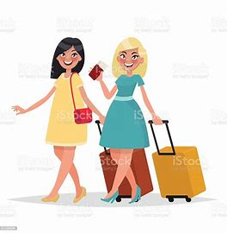
My friends have gone without me.

Slide 48
My friends have gone (without me).
How?

Slide 49
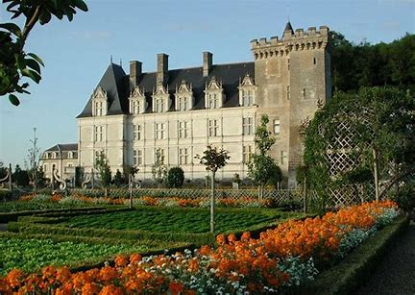
We visited the French chateau until 3pm.

Slide 50
We visited the French chateau (until 3pm).
When?

Slide 51
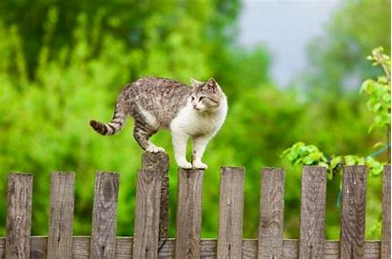
A cat was creeping along the fence.

Slide 52
A cat was creeping (along the fence).
Where?

Slide 53
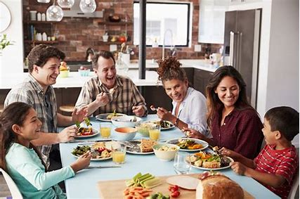
The family were eating at the table.

Slide 54
The family were eating (at the table).
Where?

Slide 55
They finished their homework in silence.

Slide 56
They finished their homework (in silence).
How?

Slide 57
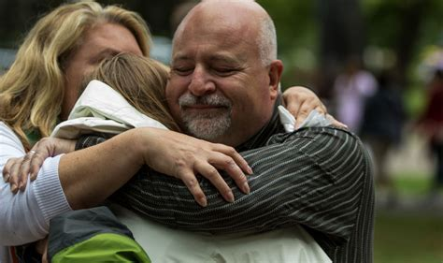
She greeted her relations with a big hug.

Slide 58
She greeted her relations (with a big hug).
How?

Slide 59
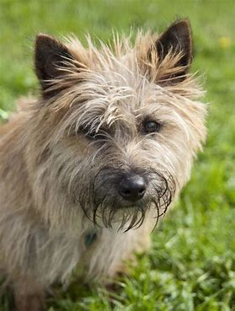
The scruffy brown dog barked for a long time.

Slide 60
The scruffy brown dog barked (for a long time).
When?

Slide 61
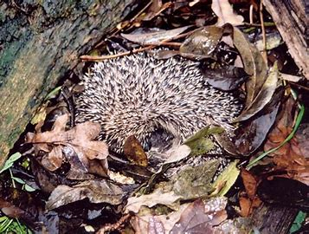
The hedgehog built its nest among the leaves.

Slide 62
The hedgehog built its nest (among the leaves).
Where?

Slide 63
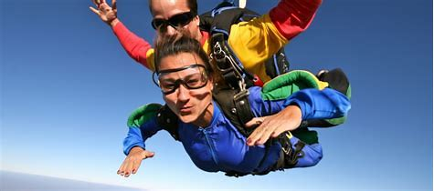
We will do the parachute jump after breakfast.

Slide 64
We will do the parachute jump (after breakfast).
When?

Slide 65
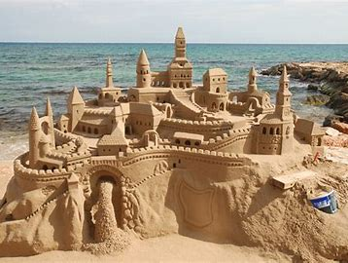
Milly and Zeena built a sandcastle
on the beach.

Slide 66
Milly and Zeena built a sandcastle
(on the beach).
Where?

Slide 67
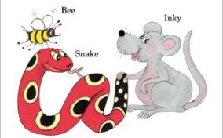
See you
next time!

