Slide 1
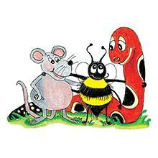
Jolly Grammar 2-35

Slide 2
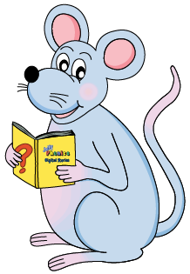
Mini Test 34

Slide 3
1. quilt

Slide 4
1. quilt
2. sweet

Slide 5
1. quilt
2. sweet
3. field

Slide 6
1. quilt
2. sweet
3. field
4. piece

Slide 7
1. quilt
2. sweet
3. field
4. piece
5. chief

Slide 8
1. quilt
2. sweet
3. field
4. piece
5. chief
6. thief

Slide 9
1. quilt
2. sweet
3. field
4. piece
5. chief
6. thief
7. shield

Slide 10
1. quilt
2. sweet
3. field
4. piece
5. chief
6. thief
7. shield
8. belief

Slide 11
1. quilt
2. sweet
3. field
4. piece
5. chief
6. thief
7. shield
8. belief
9. library

Slide 12
1. quilt
2. sweet
3. field
4. piece
5. chief
6. thief
7. shield
8. belief
9. library
10. computer

Slide 13
Let’s review
Comparatives &
Superlative

Slide 14
Think of a more interesting word to replace each of the underlined words, and write it on the line.
She wore a red dress.
The dinosaur gave a loud roar.
It was a cold morning.
He caught a small fish.

Slide 15
Think of a more interesting word to replace each of the underlined words, and write it on the line.
She wore a red dress. rosy, scarlet
The dinosaur gave a loud roar.
It was a cold morning.
He caught a small fish.

Slide 16
Think of a more interesting word to replace each of the underlined words, and write it on the line.
She wore a red dress. rosy, scarlet
The dinosaur gave a loud roar. big, noisy
It was a cold morning.
He caught a small fish.

Slide 17
Think of a more interesting word to replace each of the underlined words, and write it on the line.
She wore a red dress. rosy, scarlet
The dinosaur gave a loud roar. big, noisy
It was a cold morning. chilly, freezing
He caught a small fish.

Slide 18
Think of a more interesting word to replace each of the underlined words, and write it on the line.
She wore a red dress. rosy, scarlet
The dinosaur gave a loud roar. big, noisy
It was a cold morning. chilly, freezing
He caught a small fish. tiny, little

Slide 19
Commas in Speech

Slide 20
when shall we bring the sandwiches cakes milk and lemonade for the party asked jenny

Slide 21
when shall we bring the sandwiches cakes milk and lemonade for the party asked jenny
・Two capital letters
・a pair of speech marks
・two commas
・a question mark
・a full stop

Slide 22
When shall we bring the sandwiches cakes milk and lemonade for the party asked Jenny
・Two capital letters
・a pair of speech marks
・two commas
・a question mark
・a full stop

Slide 23
“When shall we bring the sandwiches cakes milk and lemonade for the party” asked Jenny
・Two capital letters
・a pair of speech marks
・two commas
・a question mark
・a full stop

Slide 24
“When shall we bring the sandwiches, cakes, milk and lemonade for the party” asked Jenny
・Two capital letters
・a pair of speech marks
・two commas
・a question mark
・a full stop

Slide 25
“When shall we bring the sandwiches, cakes, milk and lemonade for the party?” asked Jenny
・Two capital letters
・a pair of speech marks
・two commas
・a question mark
・a full stop

Slide 26
“When shall we bring the sandwiches, cakes, milk and lemonade for the party?” asked Jenny.
・Two capital letters
・a pair of speech marks
・two commas
・a question mark
・a full stop

Slide 27
“We would love to go on holiday,” replied Mr. Green.

Slide 28
“We would love to go on holiday,” replied Mr. Green.

Slide 29
Activity page1
Commas in Speech

Slide 30
Add the missing commas and speech marks to these sentences.
My favourite colour is blue said the little girl.
2. The policewoman put her hand up and said Stop!
3. Hello said Uncle John. How are you today?
4. I know the names of all the dinosaurs said Toby and I’ve
got a book about them at home.

Slide 31
Add the missing commas and speech marks to these sentences.
“My favourite colour is blue,” said the little girl.
2. The policewoman put her hand up and said Stop!
3. Hello said Uncle John. How are you today?
4. I know the names of all the dinosaurs said Toby and I’ve
got a book about them at home.

Slide 32
Add the missing commas and speech marks to these sentences.
“My favourite colour is blue,” said the little girl.
2. The policewoman put her hand up and said, “Stop!”
3. Hello said Uncle John. How are you today?
4. I know the names of all the dinosaurs said Toby and I’ve
got a book about them at home.

Slide 33
Add the missing commas and speech marks to these sentences.
“My favourite colour is blue,” said the little girl.
2. The policewoman put her hand up and said, “Stop!”
3. “Hello,” said Uncle John. “How are you today?”
4. I know the names of all the dinosaurs said Toby and I’ve
got a book about them at home.

Slide 34
Add the missing commas and speech marks to these sentences.
“My favourite colour is blue,” said the little girl.
2. The policewoman put her hand up and said, “Stop!”
3. “Hello,” said Uncle John. “How are you today?”
4. “I know the names of all the dinosaurs,” said Toby, “and I’ve
got a book about them at home.”

Slide 35
“Hello Bee!” called Inky.
“Hello Inky,” replied Bee, waving her antenna and flying over to her friend.
“Did you have a good time at the amusement part yesterday?” asked Inky.
“Oh yes,” sighed Bee, “It was brilliant. I went on all the rides and we stayed all day.”
“Did everyone from the hive go?” wondered Inky.
“Yes,” said Bee and then she paused.
“Everyone who wanted to,” she corrected herself.

Slide 36
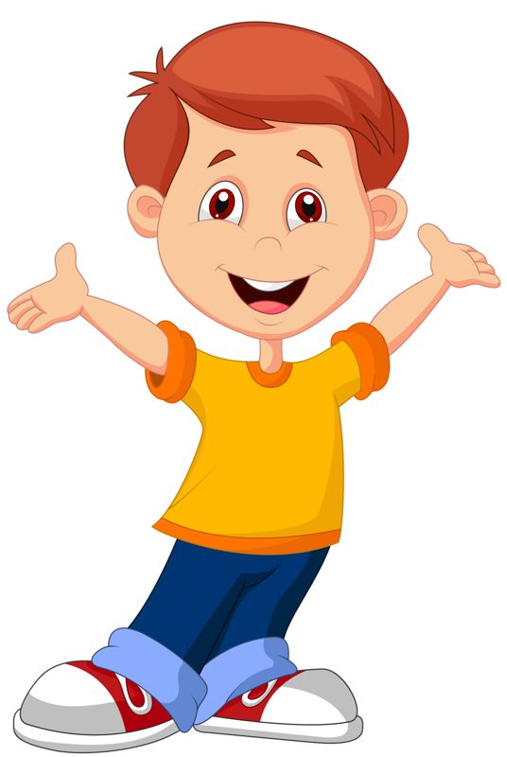
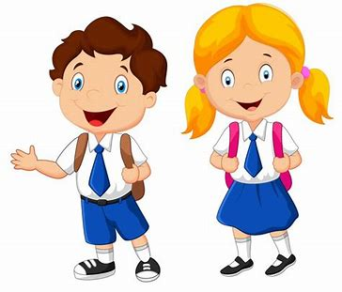
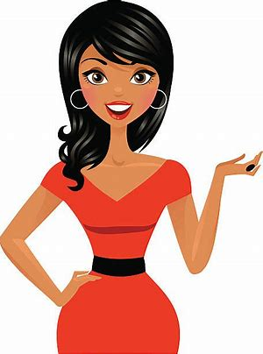
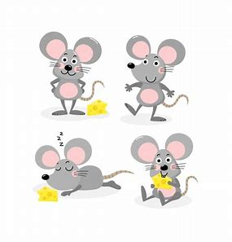
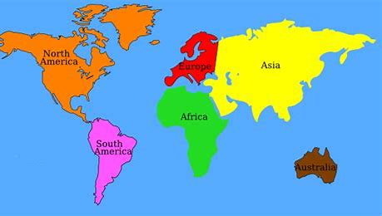
Tricky Plurals (and more)
child
children
woman
women
mouse
mice
library
computer
English
language
continent
world

Slide 37
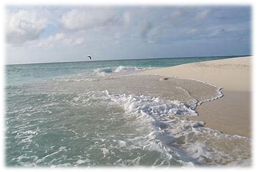

Slide 38
seashore

Slide 39
seashore
/or/

Slide 40
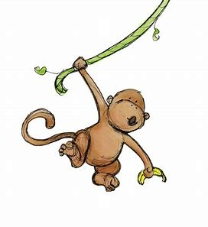
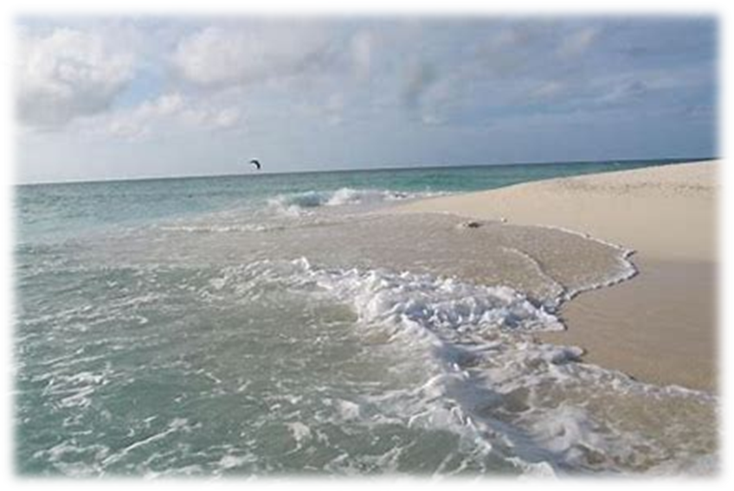
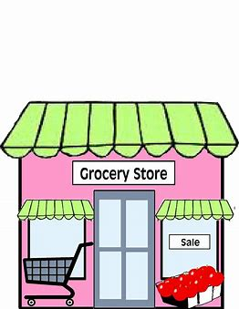
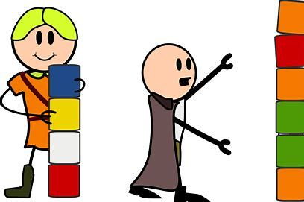
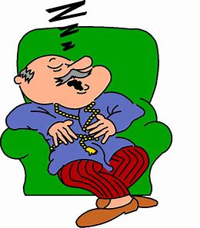
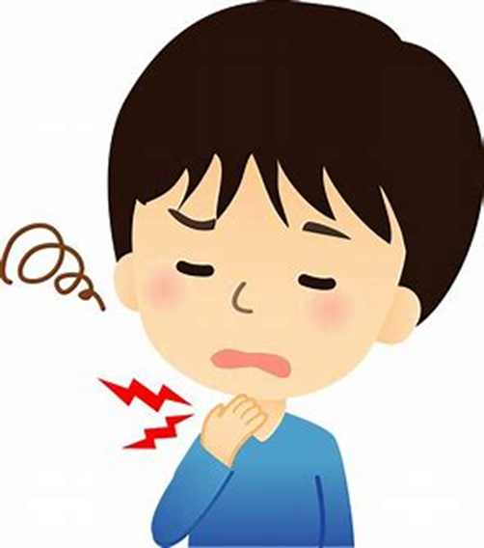
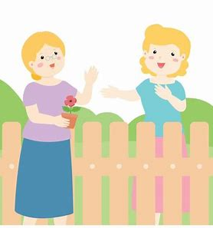
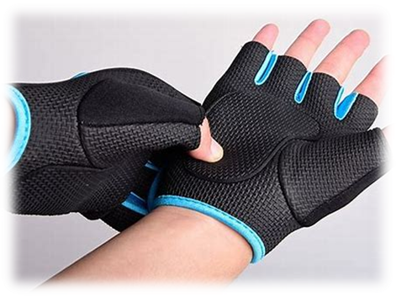
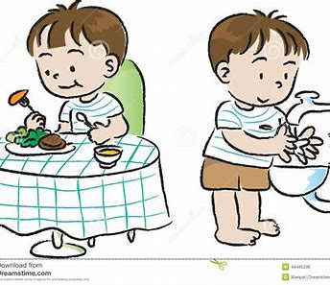
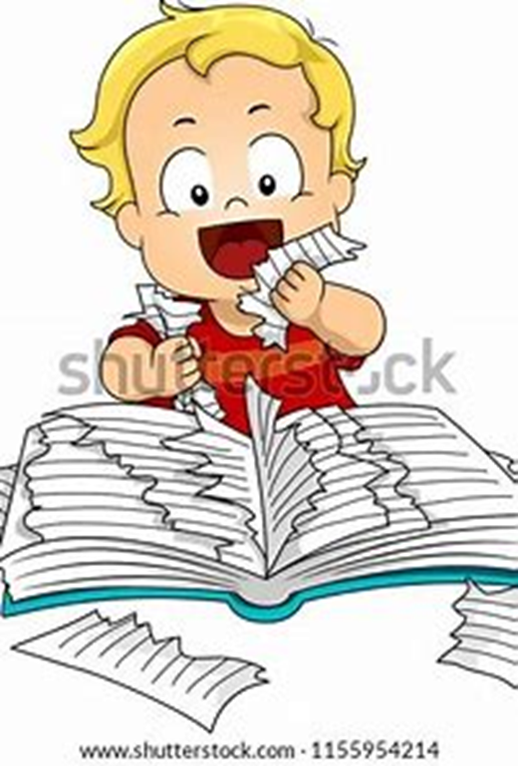
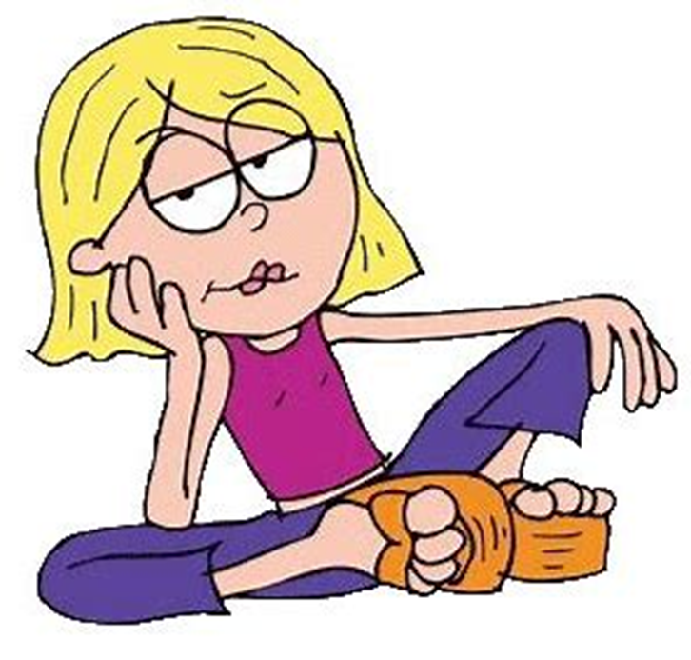
seashore
store
core
score
swung
spring
more
wore
store
snore
before
seashore
English
language
more
snore
sore
neighbour
wore
before
tore
bore

Slide 41
Activity page2

Slide 42
Dictation

Slide 43
Name:
1. 2. 3.
4. 5. 6.
7.
8.
9.

Slide 44
core

Slide 45
core 2. sore

Slide 46
core 2. sore 3. tore

Slide 47
core 2. sore 3. tore
4. score

Slide 48
core 2. sore 3. tore
4. score 5. bore

Slide 49
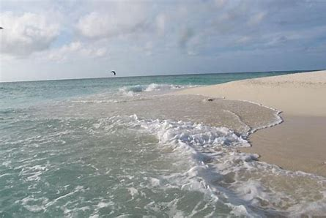
core 2. sore 3. tore
4. score 5. bore 6. ashore

Slide 50
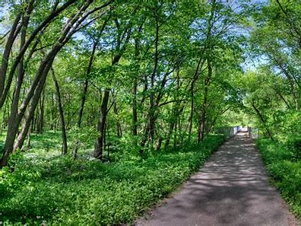
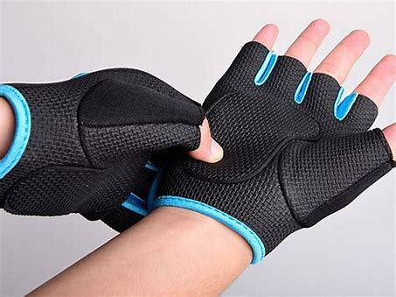
core 2. sore 3. tore
4. score 5. bore 6. ashore
7. I wore gloves for the nature trail.

Slide 51
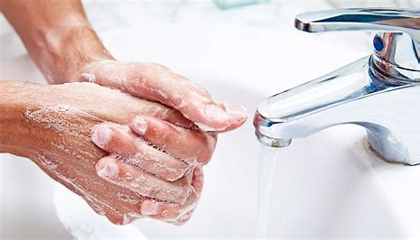
core 2. sore 3. tore
4. score 5. bore 6. ashore
7. I wore gloves for the nature trail.
8. He washed his hands
before supper.

Slide 52
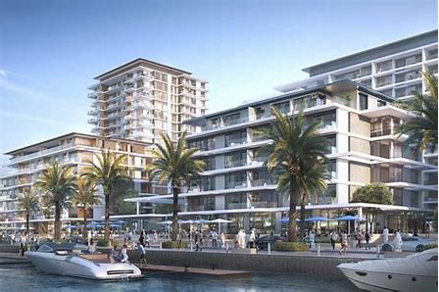
core 2. sore 3. tore
4. score 5. bore 6. ashore
7. I wore gloves for the nature trail.
8. He washed his hands
before supper.
9. Our neighbour
used to live by the seashore.

Slide 53
Homework

Slide 54
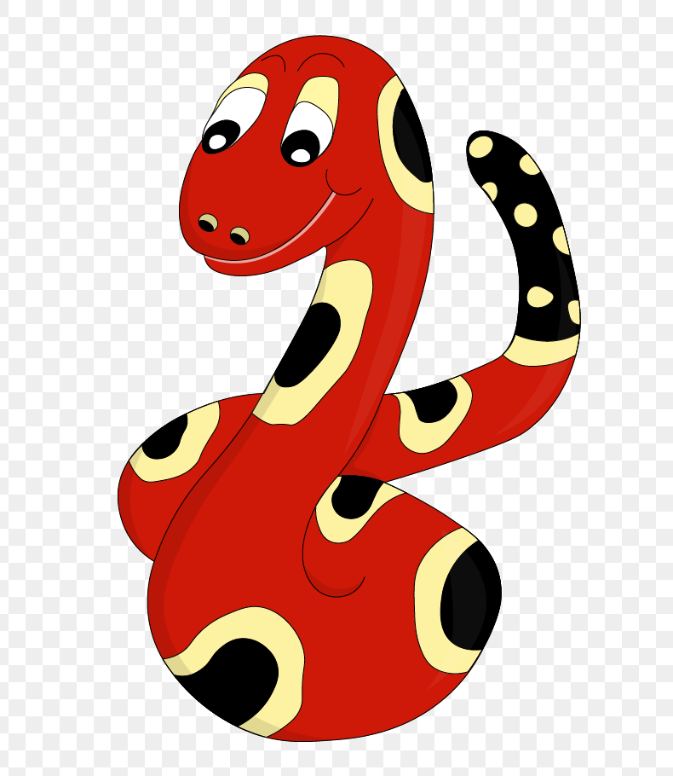
Thank you!
See you
next lesson.

