Slide 1
Jolly Grammar 1-35

Slide 2
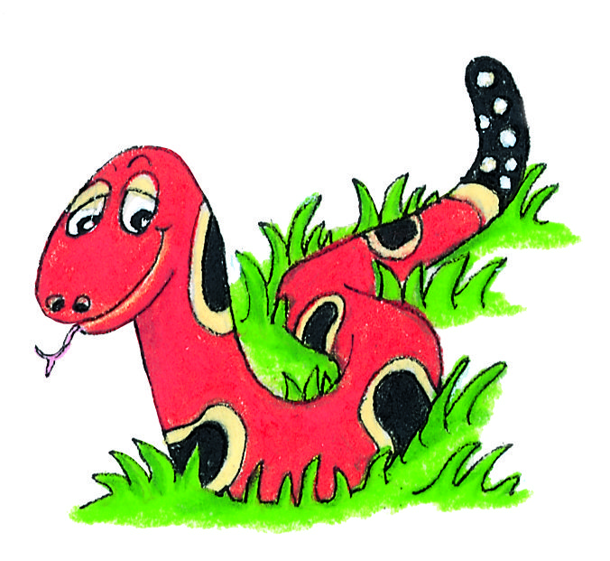
Spelling Test 34

Slide 3
not

Slide 4
not
sum

Slide 5
not
sum
next

Slide 6
not
sum
next
turn

Slide 7
not
sum
next
turn
nurse

Slide 8
not
sum
next
turn
nurse
6. turkey

Slide 9
not
sum
next
turn
nurse
6. turkey
7. purple

Slide 10
not
sum
next
turn
nurse
6. turkey
7. purple
8. love

Slide 11
not
sum
next
turn
nurse
6. turkey
7. purple
8. love
9. cover

Slide 12
not
sum
next
turn
nurse
6. turkey
7. purple
8. love
9. cover
10. hamburger

Slide 13
Questions

Slide 14
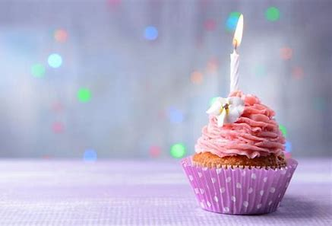
When is your birthday?

Slide 15
When is your birthday?

Slide 16
what

Slide 17
what where

Slide 18
what where when

Slide 19
what where when why

Slide 20
what where when why who

Slide 21
what where when why who which

Slide 22
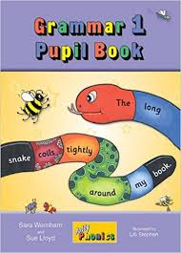
Activity Page:

Slide 23
what where when why who which
won the quiz?
time is it?
book do you like best?
are you going on holiday?
did you do that?
6. can we play tennis?

Slide 24
what where when why who which
Who won the quiz?
time is it?
book do you like best?
are you going on holiday?
did you do that?
6. can we play tennis?

Slide 25
what where when why who which
Who won the quiz?
What time is it?
book do you like best?
are you going on holiday?
did you do that?
6. can we play tennis?

Slide 26
what where when why who which
Who won the quiz?
What time is it?
Which book do you like best?
are you going on holiday?
did you do that?
6. can we play tennis?

Slide 27
what where when why who which
Who won the quiz?
What time is it?
Which book do you like best?
Where are you going on holiday?
did you do that?
6. can we play tennis?

Slide 28
what where when why who which
Who won the quiz?
What time is it?
Which book do you like best?
Where are you going on holiday?
Why did you do that?
6. can we play tennis?

Slide 29
what where when why who which
Who won the quiz?
What time is it?
Which book do you like best?
Where are you going on holiday?
Why did you do that?
6. When can we play tennis?

Slide 30
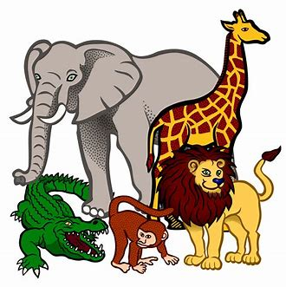
What is your favorite animal?

Slide 31
What is your favorite animal?

Slide 32
Do you have fur?

Slide 33
Do you have fur?
How many legs do you have?

Slide 34
Do you have fur?
How many legs do you have?
Do you have long ears?

Slide 35
Do you have fur?
How many legs do you have?
Do you have long ears?
What do you eat?

Slide 36
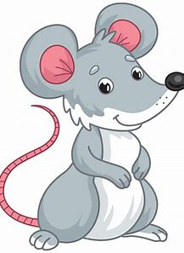
Do you have fur?
How many legs do you have?
Do you have long ears?
What do you eat?

Slide 37
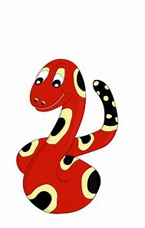
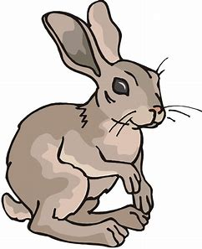
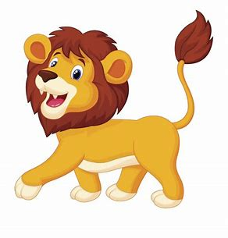
Do you have fur?
How many legs do you have?
Do you have long ears?
What do you eat?

Slide 38
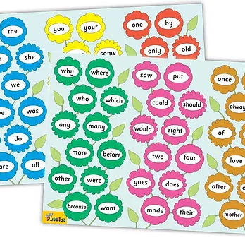
Tricky Words
^{6th} set

Slide 39
once

Slide 40
upon

Slide 41
always

Slide 42
also

Slide 43
of

Slide 44
eight

Slide 45
love

Slide 46
cover

Slide 47
after

Slide 48
every

Slide 49
mother

Slide 50
father

Slide 51
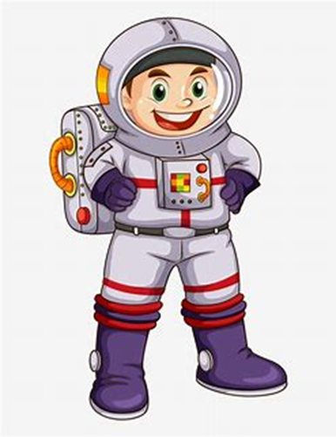

Slide 52
astronaut

Slide 53
astronaut
/or/

Slide 54
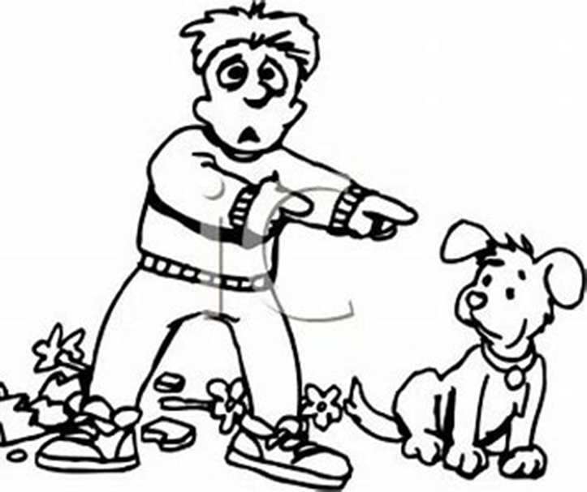
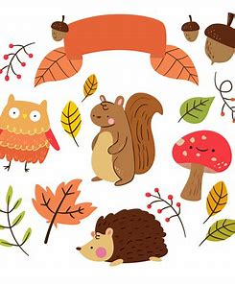
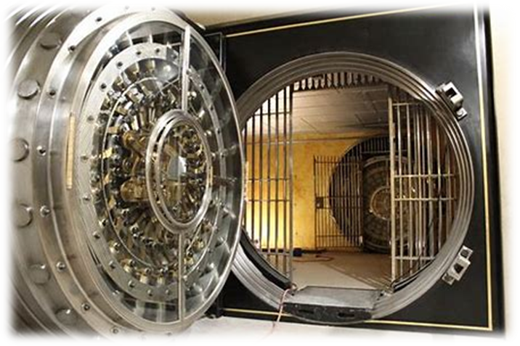
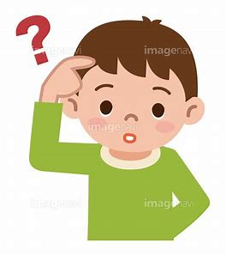
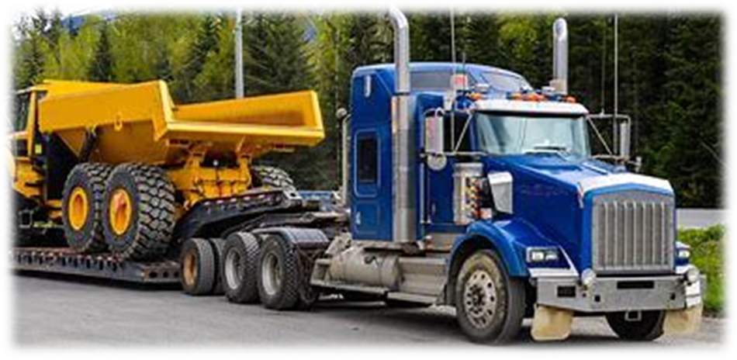
astronaut
haunt
fault
map
fix
jump
fault
pause
haunt
August
after
every
astronaut
August
autumn
vault
pause
haul
launch

Slide 55
Activity page

Slide 56
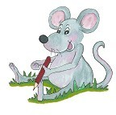
Dictation

Slide 57
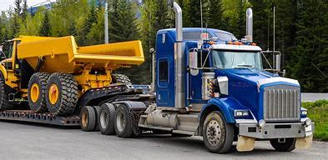
haul

Slide 58
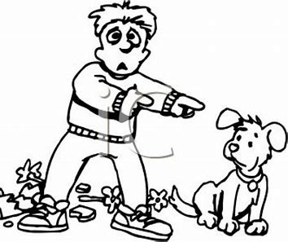
haul 2. fault

Slide 59
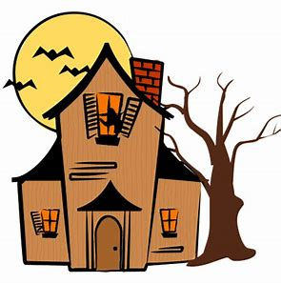
haul 2. fault 3. haunt

Slide 60
haul 2. fault 3. haunt
4. August

Slide 61
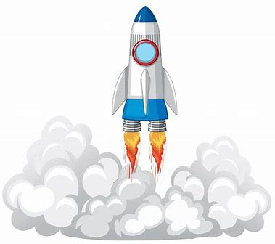
haul 2. fault 3. haunt
4. August 5. launch

Slide 62
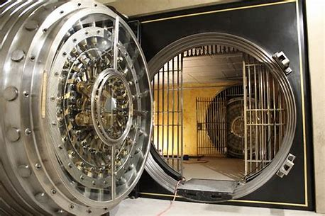
haul 2. fault 3. haunt
4. August 5. launch 6. vault

Slide 63
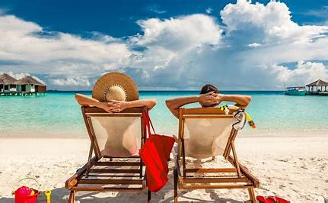
haul 2. fault 3. haunt
4. August 5. launch 6. vault
7. They always go there in August.

Slide 64
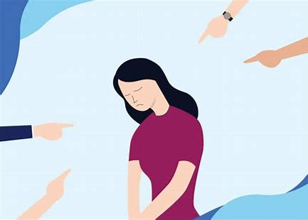
haul 2. fault 3. haunt
4. August 5. launch 6. vault
7. They always go there in August.
8. It was her fault.

Slide 65
haul 2. fault 3. haunt
4. August 5. launch 6. vault
7. They always go there in August.
8. It was her fault.
9. Once I saw an astronaut.

Slide 66
Thank you! See you next time.

