Slide 1
Jolly Grammar
5a-35

Slide 2
Let’s review
Transitive & Intransitive Verbs.

Slide 3
In each sentence, underline the verb in red and identify the subject and also the object, if there is one. Then decide the verb is transitive or intransitive.

Slide 4
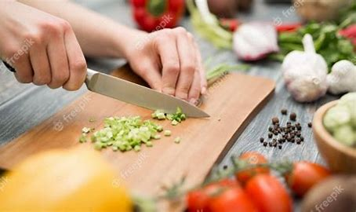
The chef has chopped the vegetables
finely.
→

Slide 5
S
The chef has chopped the vegetables
finely.
O
→ transitive

Slide 6
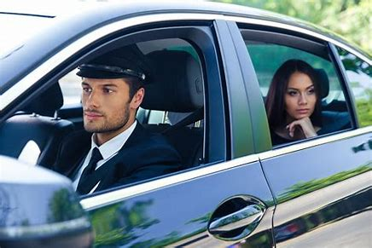
The chauffeur was driving very carefully.
→

Slide 7
S
The chauffeur was driving very carefully.
→ intransitive

Slide 8
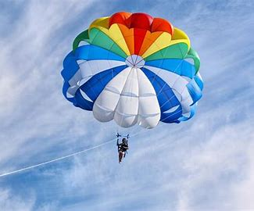
His parachute had opened just in time.
→

Slide 9
S
His parachute had opened just in time.
→ intransitive

Slide 10
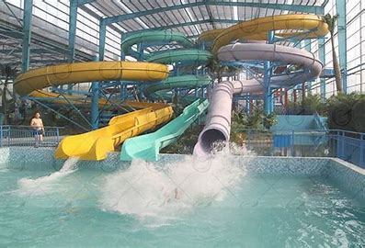
The new pool will have several water
chutes.
→

Slide 11
S
The new pool will have several water
chutes.
O
→ transitive

Slide 12
The machine is working properly now.
→

Slide 13
S
The machine is working properly now.
→ intransitive

Slide 14
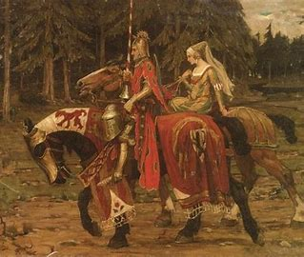
The knight’s chivalry impressed the queen.
→

Slide 15
S
The knight’s chivalry impressed the queen.
O
→ transitive

Slide 16
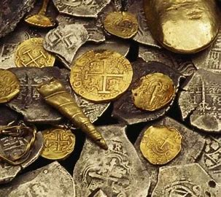
The pirates found the secret cache of gold.
→ transitive

Slide 17
S
The pirates found the secret cache of gold.
O
→ transitive

Slide 18
The crystal chandelier hung in the great wall.
→ intransitive

Slide 19
S
The crystal chandelier hung in the great wall.
→ intransitive

Slide 20
Let’s review
spellings.

Slide 21
information
version
expression
magician
identification
comprehension
submission
physician

Slide 22
Spelling Point
<ch><che>

Slide 23
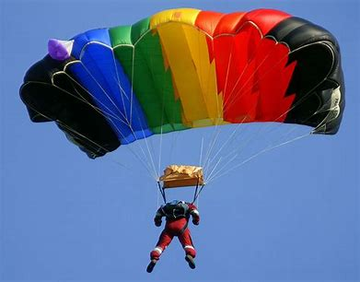
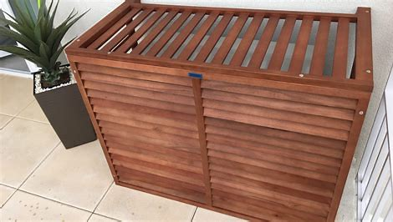
parachute cache

Slide 24
parachute cache
/sh/

Slide 25
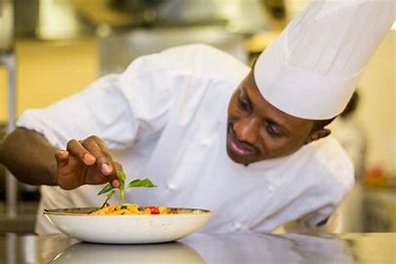
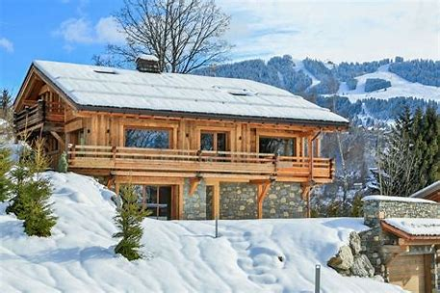
chef chute chalet
chevron chiffon machine

Slide 26
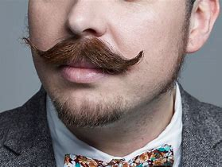
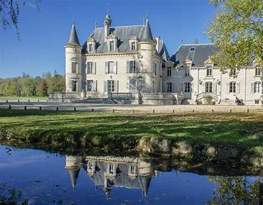
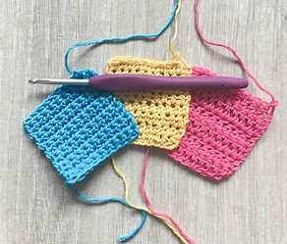
parachute moustache chateau
brochure crochet cache

Slide 27
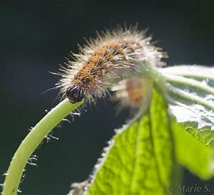
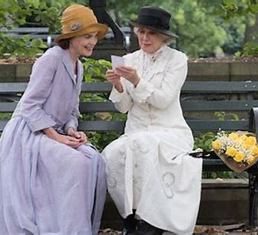
chivalry chenille chauffeur
cliche chandelier chaperone

Slide 29
Activity Page:
Spelling
<ch><che>

Slide 30
Match the words

Slide 31
Parsing & Sentence Walls

Slide 32
The French chateau will not be hiring a new chauffeur and chef.
Subject
chateau
The French
Verb
will be hiring
(transitive)
not
Object
chauffeur/
chef
a new

Slide 33
Dictation

Slide 35
“Do you know how to crochet?” asked the chaperone.

Slide 36
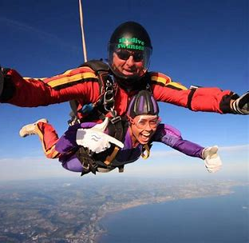

Slide 37
My cousin is doing a parachute jump for charity.

Slide 39
The brochure had lots of information on the chalets.

Slide 40
Thank you.
See you
next time!

