Slide 1
Jolly Grammar 3-33

Slide 2
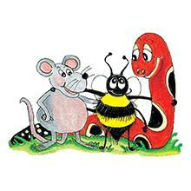
Spelling Test 32

Slide 3
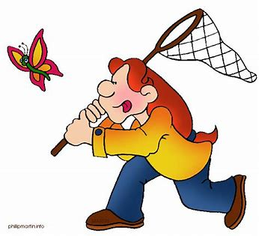
capture

Slide 4
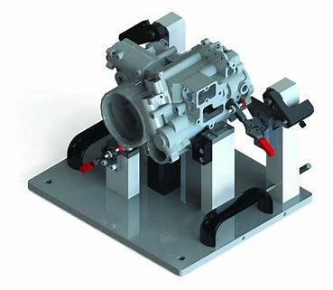
capture
fixture

Slide 5
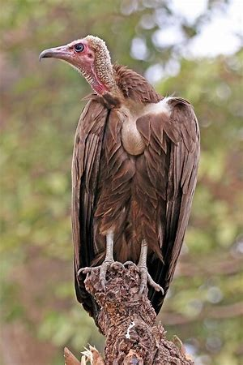
capture
fixture
vulture

Slide 6
capture
fixture
vulture
feature

Slide 7
capture
fixture
vulture
feature
puncture

Slide 8
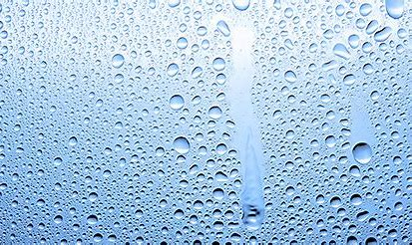
capture
fixture
vulture
feature
puncture
moisture

Slide 9
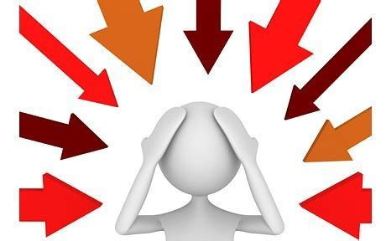
capture
fixture
vulture
feature
puncture
moisture
7. pressure

Slide 10
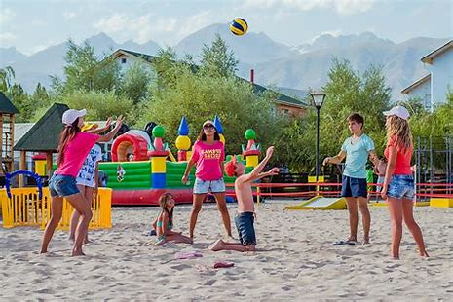
capture
fixture
vulture
feature
puncture
moisture
7. pressure
8. leisure

Slide 11
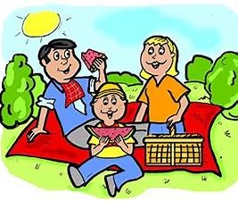
capture
fixture
vulture
feature
puncture
moisture
7. pressure
8. leisure
9. pleasure

Slide 12
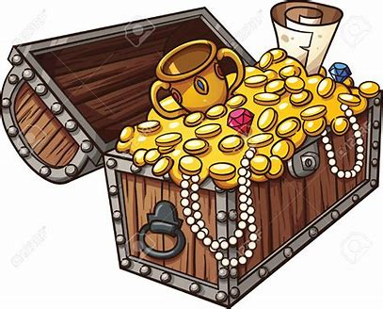
capture
fixture
vulture
feature
puncture
moisture
7. pressure
8. leisure
9. pleasure
10. treasure

Slide 13
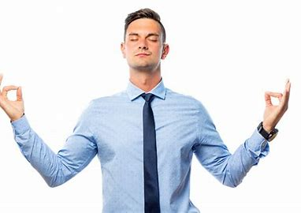
capture
fixture
vulture
feature
puncture
moisture
7. pressure
8. leisure
9. pleasure
10. treasure
11. composure

Slide 14
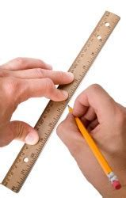
capture
fixture
vulture
feature
puncture
moisture
7. pressure
8. leisure
9. pleasure
10. treasure
11. composure
12. measurement

Slide 15
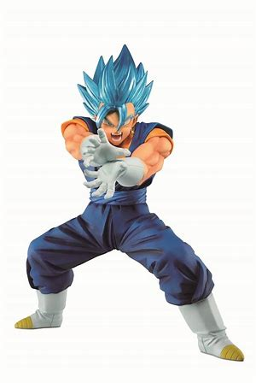
capture
fixture
vulture
feature
puncture
moisture
7. pressure
8. leisure
9. pleasure
10. treasure
11. composure
12. measurement
13. figure

Slide 16
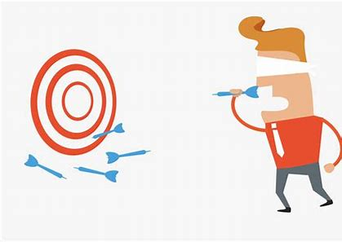
capture
fixture
vulture
feature
puncture
moisture
7. pressure
8. leisure
9. pleasure
10. treasure
11. composure
12. measurement
13. figure
14. failure

Slide 17
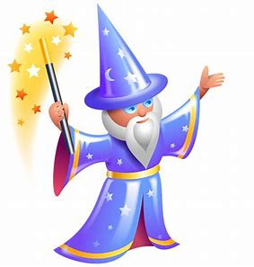
capture
fixture
vulture
feature
puncture
moisture
7. pressure
8. leisure
9. pleasure
10. treasure
11. composure
12. measurement
13. figure
14. failure
15. conjure

Slide 18
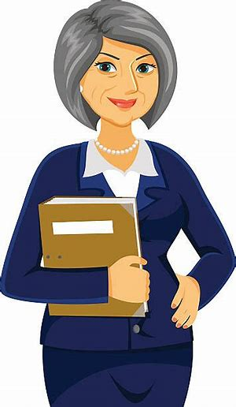
capture
fixture
vulture
feature
puncture
moisture
7. pressure
8. leisure
9. pleasure
10. treasure
11. composure
12. measurement
13. figure
14. failure
15. conjure
16. mature

Slide 19
capture
fixture
vulture
feature
puncture
moisture
7. pressure
8. leisure
9. pleasure
10. treasure
11. composure
12. measurement
13. figure
14. failure
15. conjure
16. mature
17. secure

Slide 20
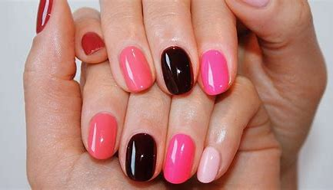
capture
fixture
vulture
feature
puncture
moisture
7. pressure
8. leisure
9. pleasure
10. treasure
11. composure
12. measurement
13. figure
14. failure
15. conjure
16. mature
17. secure
18. manicure

Slide 21
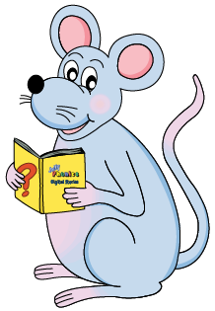
Let’s review
Proper nouns &
Common nouns.

Slide 22
Anna and Tom went to Spain in August.

Slide 23
Anna and Tom went to Spain in August.

Slide 24
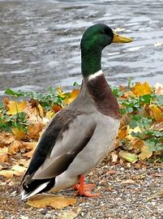
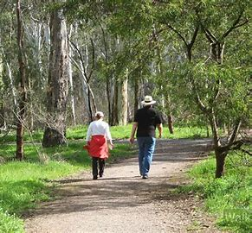
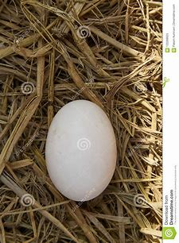
We went for a walk in the park and saw the ducks.
There was an egg in the nest.

Slide 25
We went for a walk in the park and saw the ducks.
There was an egg in the nest.

Slide 26
Common Nouns

Slide 27
Common Nouns
Concrete nouns

Slide 28
Common Nouns
Concrete nouns
Collective nouns

Slide 29
Common Nouns
Concrete nouns
Collective nouns
→ group of objects

Slide 30
Common Nouns
Concrete nouns
Collective nouns
→ group of objects
a class of children, a herd of cows,
a pack of cards

Slide 31
Common Nouns
Concrete nouns
Collective nouns
→ group of objects
a class of children, a herd of cows,
a pack of cards
3. Abstract nouns

Slide 32
Activity page
page.67

Slide 33
Find the collective nouns in each sentence.

Slide 34
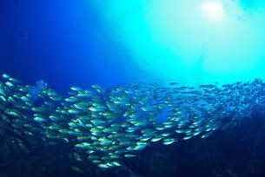
A shoal of fish swam into the bay.

Slide 35
A shoal of fish swam into the bay.

Slide 36
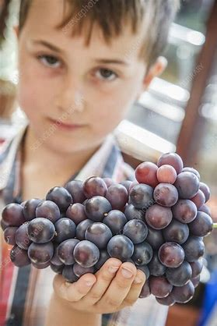
The boy picked up a bunch of grapes.

Slide 37
The boy picked up a bunch of grapes.

Slide 38
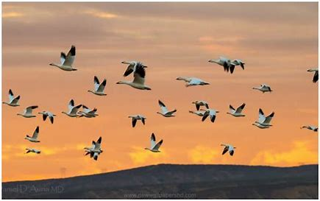
We saw a huge flock of birds in the sky.

Slide 39
We saw a huge flock of birds in the sky.

Slide 40
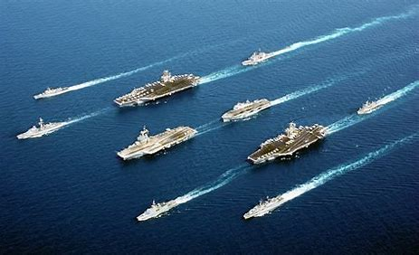
There was a huge fleet of ships out at sea.

Slide 41
There was a huge fleet of ships out at sea.

Slide 42
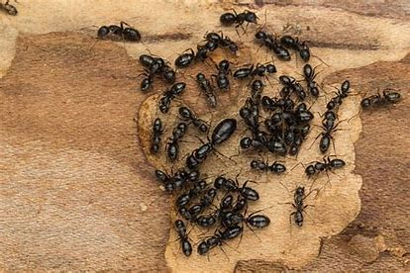
There is a colony of ants in the garden.

Slide 43
There is a colony of ants in the garden.

Slide 44
The audience of listeners
enjoyed the radio show.

Slide 45
The audience of listeners
enjoyed the radio show.

Slide 46
Complete each phrase with a suitable noun.

Slide 47
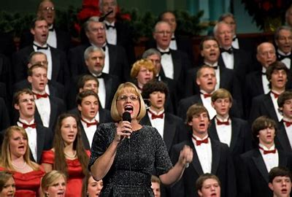
a choir of singers

Slide 48
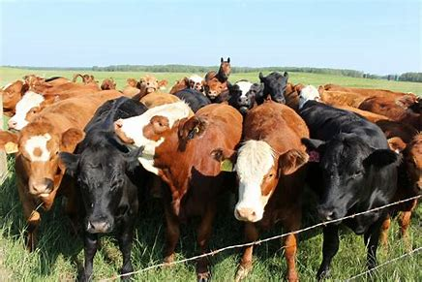
a choir of singers
a heard of cows

Slide 49
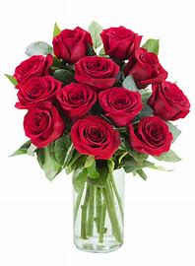
a choir of singers
a heard of cows
a bouquet of roses

Slide 50
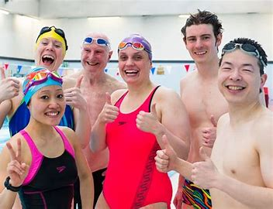
a choir of singers
a heard of cows
a bouquet of roses
a team of swimmers

Slide 51
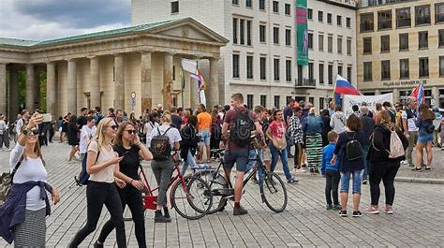
a choir of singers
a heard of cows
a bouquet of roses
a team of swimmers
a crowd of sightseers

Slide 52
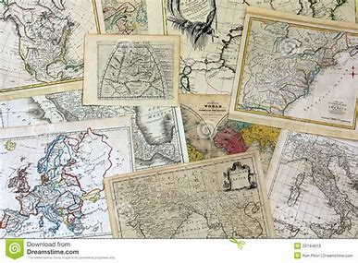
a choir of singers
a heard of cows
a bouquet of roses
a team of swimmers
a crowd of sightseers
a library of maps

Slide 53
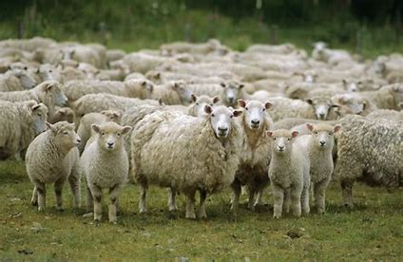
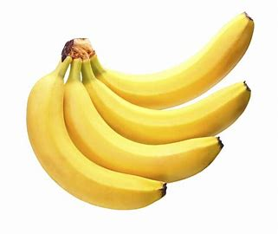
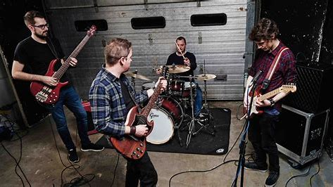
Write a collective noun to describe each of these groups.

Slide 54
Write a collective noun to describe each of these groups.
a flock of sheep

Slide 55
Write a collective noun to describe each of these groups.
a flock of sheep
a bunch of bananas

Slide 56
Write a collective noun to describe each of these groups.
a flock of sheep
a bunch of bananas
a band of musicians

Slide 57
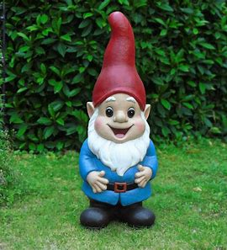
gnome
/n/

Slide 58
Spelling List

Slide 59
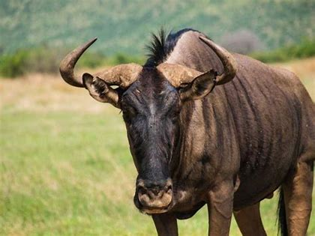
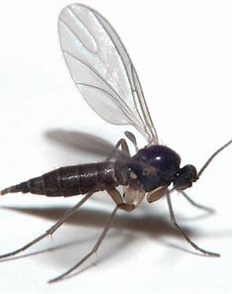
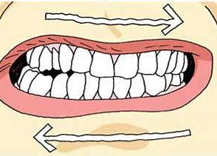
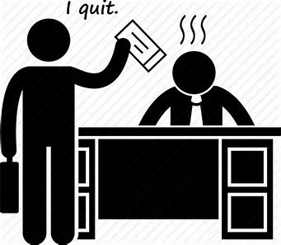
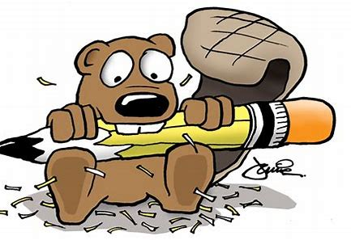
gnu gnat gnash
resign gnaw gnome

Slide 60
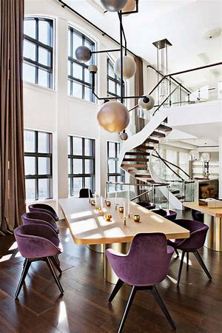
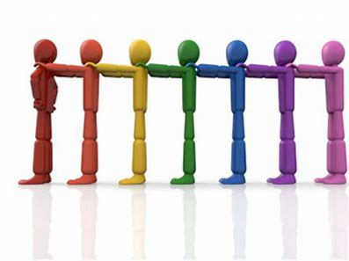
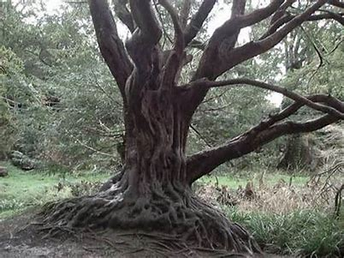
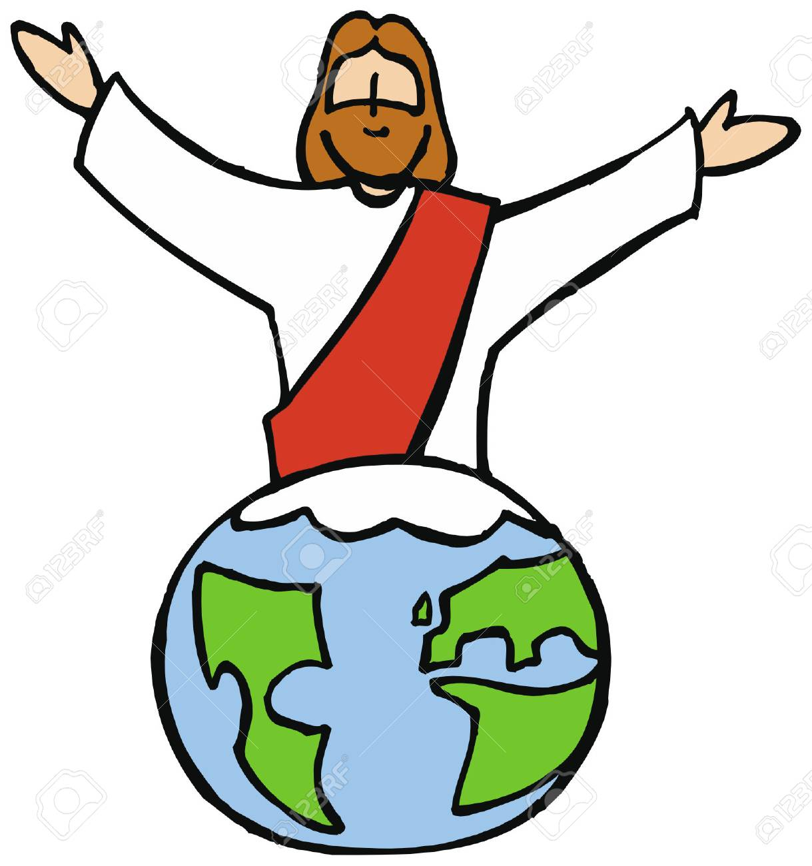
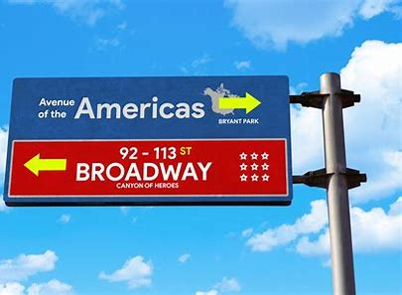
design align assign
gnarled signpost reign

Slide 61
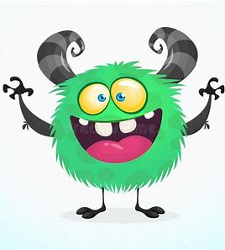
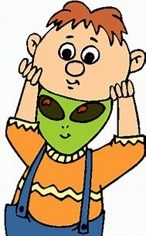
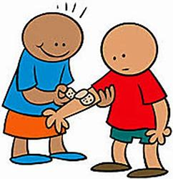
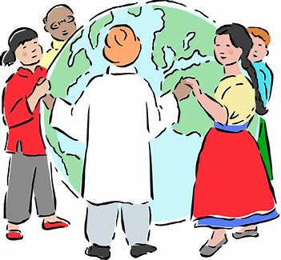
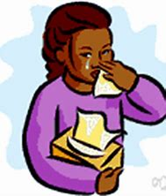
feign malign designer
benign foreigner poignant

Slide 63
Activity page
page.66

Slide 64
Let’s review
syllables.

Slide 65
signpost
gnat
assign
gnome
design

Slide 66
Let’s parse
sentences.

Slide 67
Parse these sentences.
The foreigner saw the broken signpost.
The fierce lion gnashed his teeth and gnaws at the bone.

Slide 68
Parse these sentences.
The foreigner saw the broken signpost.
The fierce lion gnashed his teeth and gnaws at the bone.

Slide 69
Parse these sentences.
The foreigner saw the broken signpost.
The fierce lion gnashed his teeth and gnaws at the bone.

Slide 70
Parse these sentences.
The foreigner saw the broken signpost.
The fierce lion gnashed his teeth and gnaws at the bone.

Slide 71
Parse these sentences.
The foreigner saw the broken signpost.
The fierce lion gnashed his teeth and gnaws at the bone.

Slide 72
Parse these sentences.
The foreigner saw the broken signpost.
The fierce lion gnashed his teeth and gnaws at the bone.

Slide 73
Parse these sentences.
The foreigner saw the broken signpost.
The fierce lion gnashed his teeth and gnaws at the bone.

Slide 74
Parse these sentences.
The foreigner saw the broken signpost.
The fierce lion gnashed his teeth and gnaws at the bone.

Slide 75
Parse these sentences.
The foreigner saw the broken signpost.
The fierce lion gnashed his teeth and gnaws at the bone.

Slide 76
Parse these sentences.
The foreigner saw the broken signpost.
The fierce lion gnashed his teeth and gnaws at the bone.

Slide 77
Parse these sentences.
The foreigner saw the broken signpost.
The fierce lion gnashed his teeth and gnaws at the bone.

Slide 78
Parse these sentences.
The foreigner saw the broken signpost.
The fierce lion gnashed his teeth and gnaws at the bone.

Slide 79
Parse these sentences.
The foreigner saw the broken signpost.
The fierce lion gnashed his teeth and gnaws at the bone.

Slide 80
Parse these sentences.
The foreigner saw the broken signpost.
The fierce lion gnashed his teeth and gnaws at the bone.

Slide 81
Parse these sentences.
The foreigner saw the broken signpost.
The fierce lion gnashed his teeth and gnaws at the bone.

Slide 82
Put the words in the spelling list into the crossword.

Slide 83
Dictation

Slide 84
Dictation
1.
2.
3.

Slide 86
“Is that a designer dress?” enquired Ann.

Slide 88
The gnu flicked his tail at the gnats.

Slide 90
Old oak tree had a gnarled and twisted trunk.

Slide 91
Homework

