Slide 1
Jolly Grammar
5a-34

Slide 2
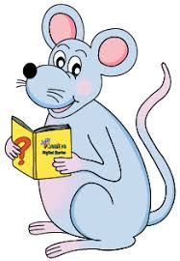
Spelling Test 17

Slide 3
nation

Slide 4
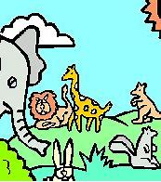
nation
creation

Slide 5
nation
creation
operation

Slide 6
nation
creation
operation
education

Slide 7
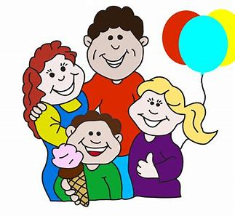
nation
creation
operation
education
relation

Slide 8
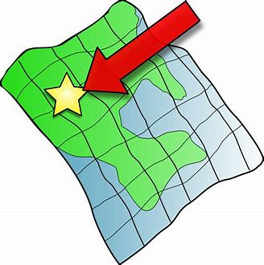
nation
creation
operation
education
relation
location

Slide 9
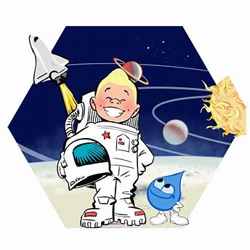
nation
creation
operation
education
relation
location
exploration

Slide 10
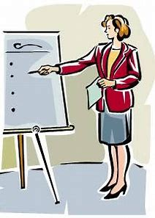
nation
creation
operation
education
relation
location
exploration
explanation

Slide 11
nation
creation
operation
education
relation
location
exploration
explanation
conversation

Slide 12
nation
creation
operation
education
relation
location
exploration
explanation
conversation
10. information

Slide 13
nation
creation
operation
education
relation
location
exploration
explanation
conversation
10. information
11. quotation

Slide 14
nation
creation
operation
education
relation
location
exploration
explanation
conversation
10. information
11. quotation
12. association

Slide 15
nation
creation
operation
education
relation
location
exploration
explanation
conversation
10. information
11. quotation
12. association
13. celebration

Slide 16
nation
creation
operation
education
relation
location
exploration
explanation
conversation
10. information
11. quotation
12. association
13. celebration
14. investigation

Slide 17
nation
creation
operation
education
relation
location
exploration
explanation
conversation
10. information
11. quotation
12. association
13. celebration
14. investigation
15. cancellation

Slide 18
nation
creation
operation
education
relation
location
exploration
explanation
conversation
10. information
11. quotation
12. association
13. celebration
14. investigation
15. cancellation
16. identification

Slide 19
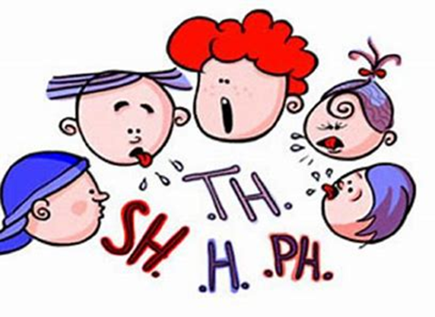
nation
creation
operation
education
relation
location
exploration
explanation
conversation
10. information
11. quotation
12. association
13. celebration
14. investigation
15. cancellation
16. identification
17. pronunciation

Slide 20
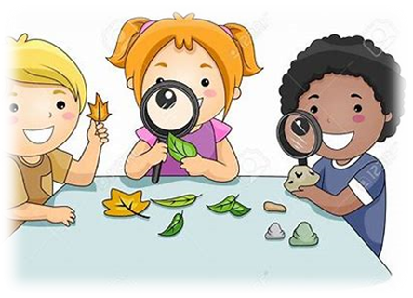
nation
creation
operation
education
relation
location
exploration
explanation
conversation
10. information
11. quotation
12. association
13. celebration
14. investigation
15. cancellation
16. identification
17. pronunciation
18. observation

Slide 21
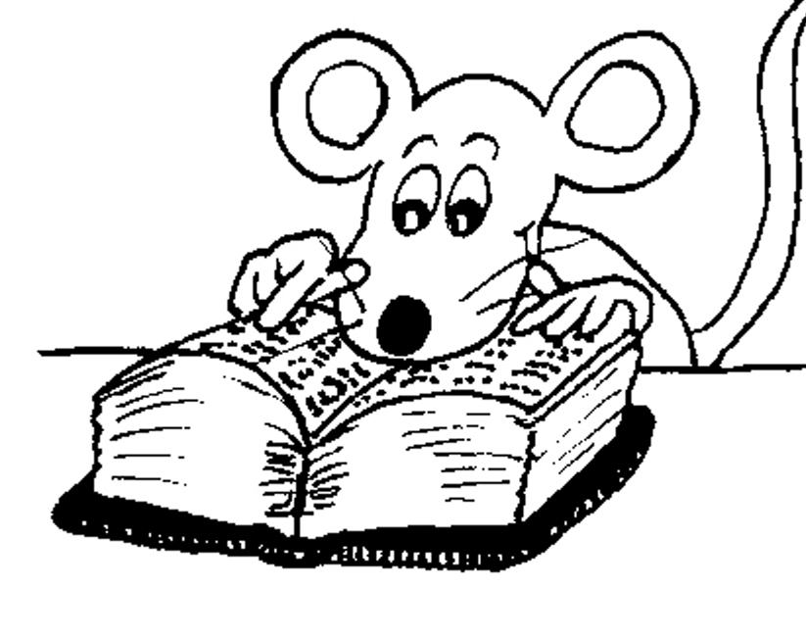
Let’s Review
Subjects and Objects.

Slide 22
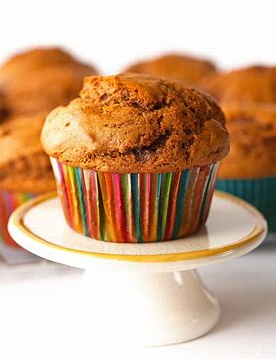
The brother and sister made
ginger and muffins.

Slide 23
The brother and sister made
ginger and muffins.
Identify the simple subject and object of the sentence.

Slide 24
S
S
The brother and sister made
ginger and muffins.
Identify the simple subject and object of the sentence.

Slide 25
S
S
The brother and sister made
ginger and muffins.
Identify the simple subject and object of the sentence.

Slide 26
S
S
The brother and sister made
ginger and muffins.
O
O
Identify the simple subject and object of the sentence.

Slide 27
Let’s Review
Compound words &
Compound sentences.

Slide 28
◍ Compound words
blackbird
◍ Compound sentences
It is raining so we canceled the picnic.
◍ Compound subjects and objects
The brother and sister made
ginger and muffins.

Slide 29
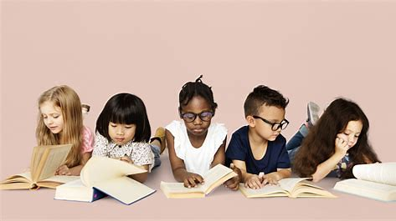
The children are reading quietly.
Identify the simple subject and object of the sentence.

Slide 30
S
The children are reading quietly.
Identify the simple subject and object of the sentence.

Slide 31
S
The children are reading quietly.
Identify the simple subject and object of the sentence.

Slide 32
S
The children are reading quietly.
A sentence always has a verb and subject, but it does not necessarily have an object.

Slide 33
The children are reading quietly.

Slide 34
The children are reading quietly.
The children are reading their books.
O

Slide 35
The children are reading quietly.
The children are reading their books.
→ transitive

Slide 36
The children are reading quietly.
→ intransitive
The children are reading their books.
→ transitive

Slide 37
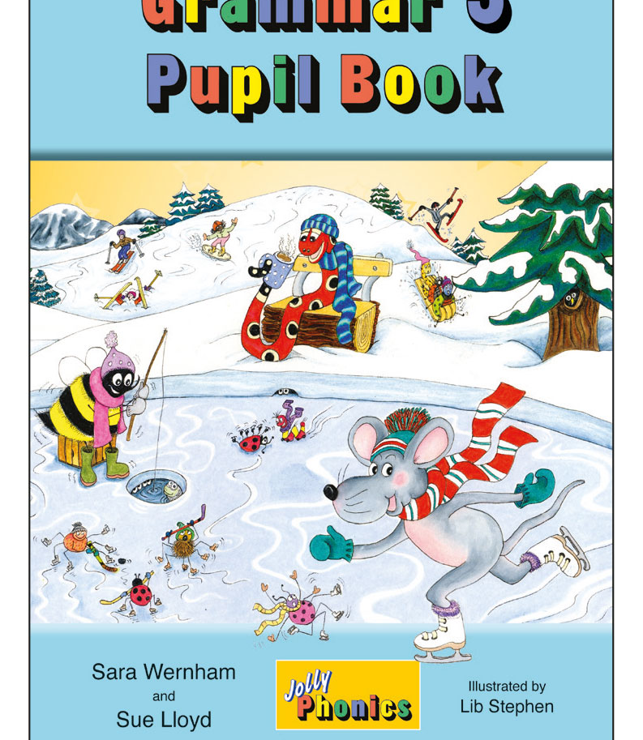
Activity Page
Transitive and Intransitive Verbs

Slide 38
S
I have arranged the flowers carefully.
O

Slide 39
S
I have arranged the flowers carefully.
→ transitive
O

Slide 40
Suddenly, the magician vanished.

Slide 41
S
Suddenly, the magician vanished.
→ intransitive

Slide 42
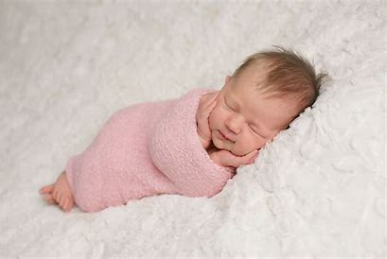
The tiny baby is sleeping.

Slide 43
S
The tiny baby is sleeping.
→ intransitive

Slide 44
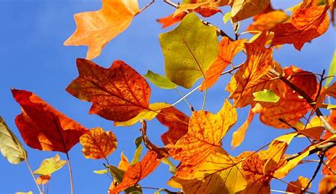
Soon the autumn leaves will fall.

Slide 45
S
Soon the autumn leaves will fall.
→ intransitive

Slide 46
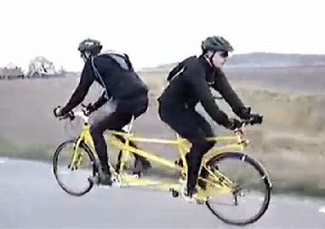
He rode his bike in the opposite direction.

Slide 47
S
He rode his bike in the opposite direction.
→ transitive
O

Slide 48
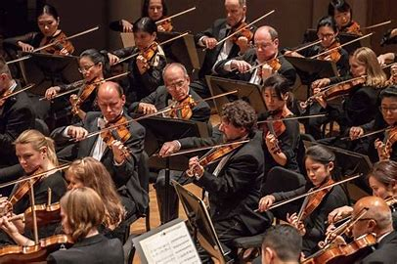
This orchestra has some superb musicians.

Slide 49
S
This orchestra has some superb musicians.
→ transitive
O

Slide 50
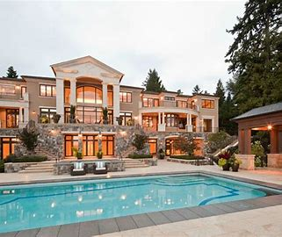
A multimillionaire bought the big mansion.

Slide 51
S
A multimillionaire bought the big mansion.
→ transitive
O

Slide 52
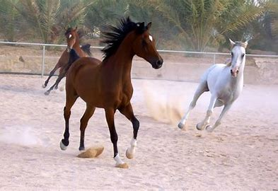
Some horses in the field were galloping.

Slide 53
S
Some horses in the field were galloping.
→ intransitive

Slide 54
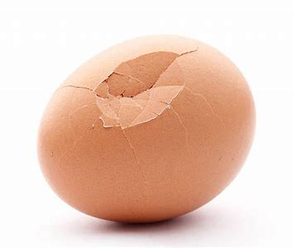
The little brown egg had cracked.

Slide 55
S
The little brown egg had cracked.
→ intransitive

Slide 56
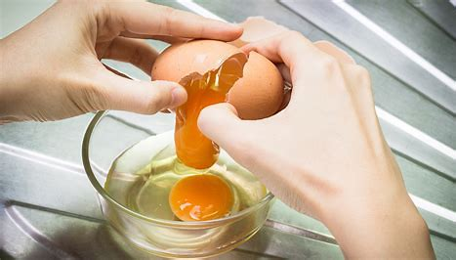
She cracked the eggs into a bowl.

Slide 57
S
She cracked the eggs into a bowl.
→ transitive
O

Slide 58
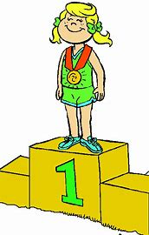
Jennifer won the poetry competition.

Slide 59
S
Jennifer won the poetry competition.
→ transitive
O

Slide 60
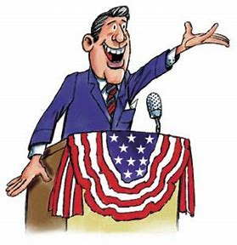
The politician answered the questions fully.

Slide 61
S
The politician answered the questions fully.
→ transitive
O

Slide 62
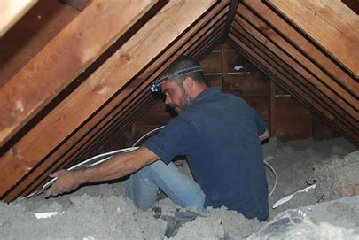
An electrician sneezed loudly in the dusty attic.

Slide 63
S
An electrician sneezed loudly in the dusty attic.
→ intransitive

Slide 64
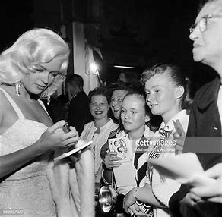
The superstar signed her autograph for her fans.

Slide 65
S
The superstar signed her autograph for her fans.
→ transitive
O

Slide 66
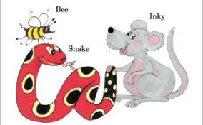
See you
next time!

