Slide 1
Jolly Grammar 3-32

Slide 2
Spelling Test 31

Slide 3
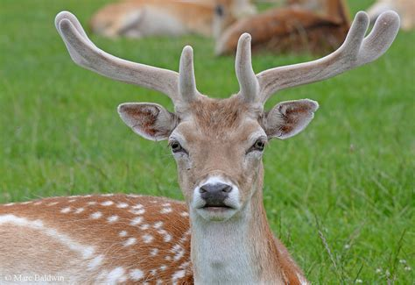
deer

Slide 4
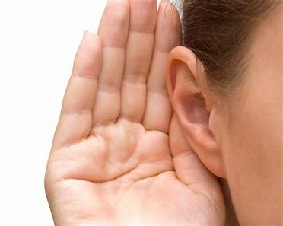
deer
hear

Slide 5
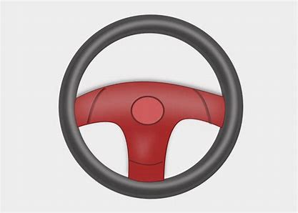
deer
hear
steer

Slide 6
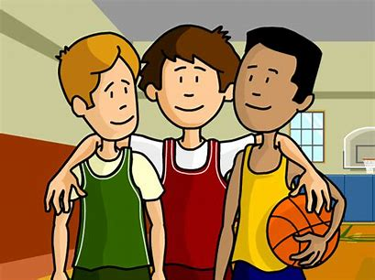
deer
hear
steer
peer

Slide 7
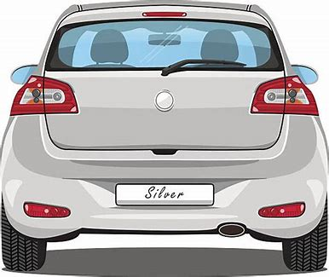
deer
hear
steer
peer
rear

Slide 8
deer
hear
steer
peer
rear
cheer

Slide 9
deer
hear
steer
peer
rear
cheer
7. here

Slide 10
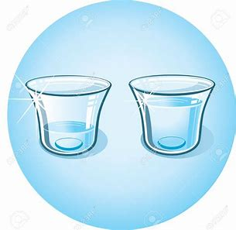
deer
hear
steer
peer
rear
cheer
7. here
8. clear

Slide 11
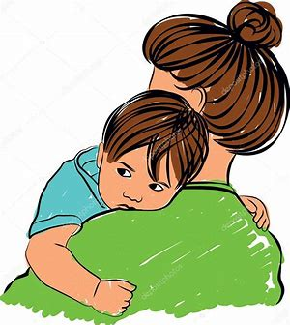
deer
hear
steer
peer
rear
cheer
7. here
8. clear
9. mere

Slide 12
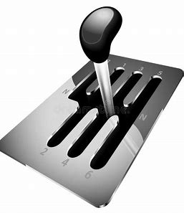
deer
hear
steer
peer
rear
cheer
7. here
8. clear
9. mere
10. gearbox

Slide 13
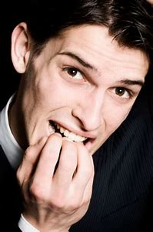
deer
hear
steer
peer
rear
cheer
7. here
8. clear
9. mere
10. gearbox
11. fearful

Slide 14
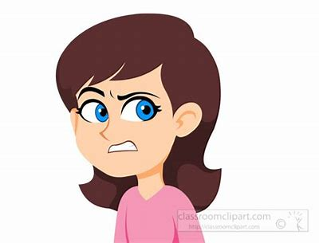
deer
hear
steer
peer
rear
cheer
7. here
8. clear
9. mere
10. gearbox
11. fearful
12. sneering

Slide 15
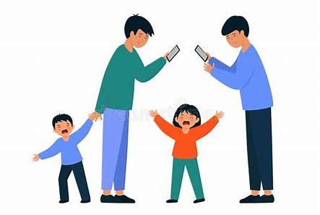
deer
hear
steer
peer
rear
cheer
7. here
8. clear
9. mere
10. gearbox
11. fearful
12. sneering
13. interfere

Slide 16
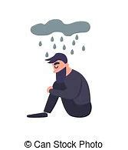
deer
hear
steer
peer
rear
cheer
7. here
8. clear
9. mere
10. gearbox
11. fearful
12. sneering
13. interfere
14. dreary

Slide 17
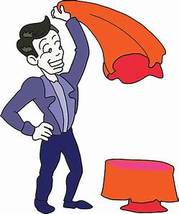
deer
hear
steer
peer
rear
cheer
7. here
8. clear
9. mere
10. gearbox
11. fearful
12. sneering
13. interfere
14. dreary
15. disappear

Slide 18
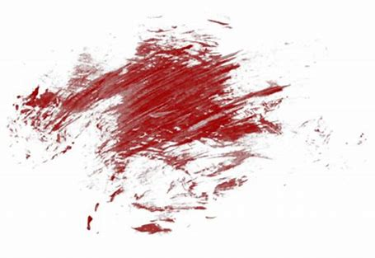
deer
hear
steer
peer
rear
cheer
7. here
8. clear
9. mere
10. gearbox
11. fearful
12. sneering
13. interfere
14. dreary
15. disappear
16. smeary

Slide 19
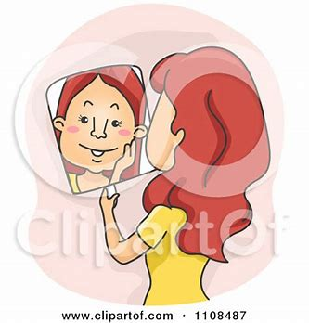
deer
hear
steer
peer
rear
cheer
7. here
8. clear
9. mere
10. gearbox
11. fearful
12. sneering
13. interfere
14. dreary
15. disappear
16. smeary
17. appearance

Slide 20
deer
hear
steer
peer
rear
cheer
7. here
8. clear
9. mere
10. gearbox
11. fearful
12. sneering
13. interfere
14. dreary
15. disappear
16. smeary
17. appearance
18. atmosphere

Slide 21
Let’s review
Suffixes.

Slide 22
Suffixes
changed

Slide 23
Suffixes
changed
colorless

Slide 24
Suffixes
changed
colorless
countable

Slide 25
Suffixes
changed
colorless
countable
joyful

Slide 26
Prefixes
im
non
re
mid
semi
pre
un
dis
mis
impossible, impatient
nonstop, nonsense
recycle, replace
midsummer, midnight
semicircle, semifinal
prepare, prevent
unwell, unhappy
disappear, disagree
misplace, misuse

Slide 27
Prefixes
im
non
re
mid
semi
pre
un
dis
mis
impossible, impatient
nonstop, nonsense
recycle, replace
midsummer, midnight
semicircle, semifinal
prepare, prevent
unwell, unhappy
disappear, disagree
misplace, misuse

Slide 28
Prefixes
im
non
re
mid
semi
pre
un
dis
mis
not
impossible, impatient
nonstop, nonsense
recycle, replace
midsummer, midnight
semicircle, semifinal
prepare, prevent
unwell, unhappy
disappear, disagree
misplace, misuse

Slide 29
Prefixes
im
non
re
mid
semi
pre
un
dis
mis
not
not
impossible, impatient
nonstop, nonsense
recycle, replace
midsummer, midnight
semicircle, semifinal
prepare, prevent
unwell, unhappy
disappear, disagree
misplace, misuse

Slide 30
Prefixes
im
non
re
mid
semi
pre
un
dis
mis
not
not
again
impossible, impatient
nonstop, nonsense
recycle, replace
midsummer, midnight
semicircle, semifinal
prepare, prevent
unwell, unhappy
disappear, disagree
misplace, misuse

Slide 31
Prefixes
im
non
re
mid
semi
pre
un
dis
mis
not
not
again
middle
impossible, impatient
nonstop, nonsense
recycle, replace
midsummer, midnight
semicircle, semifinal
prepare, prevent
unwell, unhappy
disappear, disagree
misplace, misuse

Slide 32
Prefixes
im
non
re
mid
semi
pre
un
dis
mis
not
not
again
middle
half
impossible, impatient
nonstop, nonsense
recycle, replace
midsummer, midnight
semicircle, semifinal
prepare, prevent
unwell, unhappy
disappear, disagree
misplace, misuse

Slide 33
Prefixes
im
non
re
mid
semi
pre
un
dis
mis
not
not
again
middle
half
before
impossible, impatient
nonstop, nonsense
recycle, replace
midsummer, midnight
semicircle, semifinal
prepare, prevent
unwell, unhappy
disappear, disagree
misplace, misuse

Slide 34
Prefixes
im
non
re
mid
semi
pre
un
dis
mis
not
not
again
middle
half
before
not
impossible, impatient
nonstop, nonsense
recycle, replace
midsummer, midnight
semicircle, semifinal
prepare, prevent
unwell, unhappy
disappear, disagree
misplace, misuse

Slide 35
Prefixes
im
non
re
mid
semi
pre
un
dis
mis
not
not
again
middle
half
before
not
undo
impossible, impatient
nonstop, nonsense
recycle, replace
midsummer, midnight
semicircle, semifinal
prepare, prevent
unwell, unhappy
disappear, disagree
misplace, misuse

Slide 36
Prefixes
im
non
re
mid
semi
pre
un
dis
mis
not
not
again
middle
half
before
not
undo
wrongly
not
impossible, impatient
nonstop, nonsense
recycle, replace
midsummer, midnight
semicircle, semifinal
prepare, prevent
unwell, unhappy
disappear, disagree
misplace, misuse

Slide 37
Activity page
page.63

Slide 38
treasure
/ure/

Slide 39
Spelling List

Slide 40
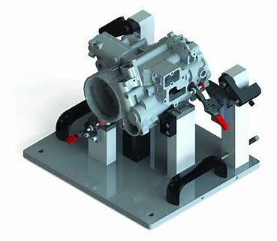
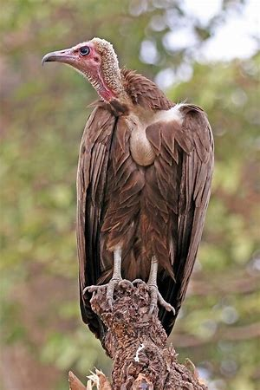
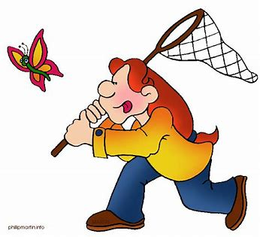
capture fixture vulture
feature puncture moisture

Slide 41
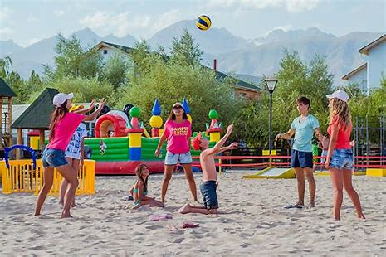
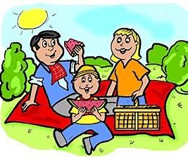
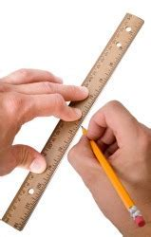
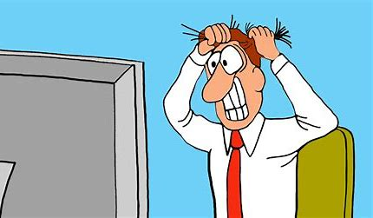
pressure leisure pleasure
treasure composure measurement

Slide 42
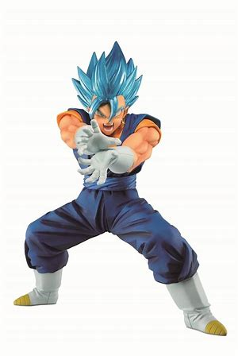
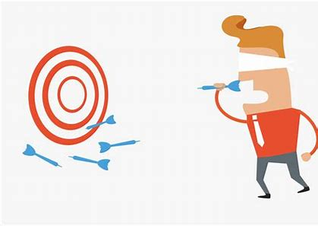
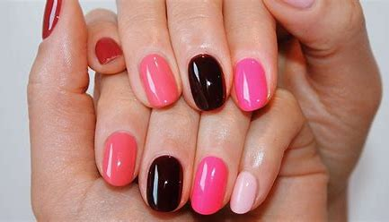
figure failure conjure
mature secure manicure

Slide 44
Activity page
page.64

Slide 45
Let’s review
syllables.

Slide 46
pressure
vulture
composure
moisture
fixture

Slide 47
Let’s parse
sentences.

Slide 48
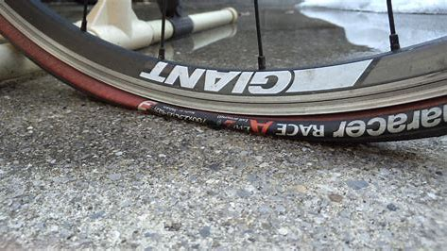
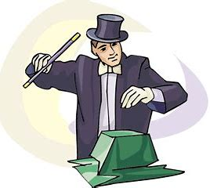
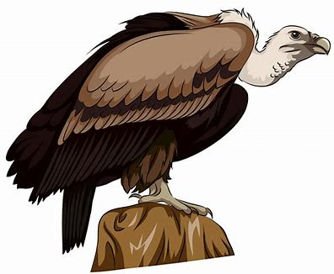
Parse these sentences.
His new bike has a slow puncture.
The mature conjurer produced a huge vulture from the box.

Slide 49
Parse these sentences.
His new bike has a slow puncture.
The mature conjurer produced a huge vulture from the box.

Slide 50
Parse these sentences.
His new bike has a slow puncture.
The mature conjurer produced a huge vulture from the box.

Slide 51
Parse these sentences.
His new bike has a slow puncture.
The mature conjurer produced a huge vulture from the box.

Slide 52
Parse these sentences.
His new bike has a slow puncture.
The mature conjurer produced a huge vulture from the box.

Slide 53
Parse these sentences.
His new bike has a slow puncture.
The mature conjurer produced a huge vulture from the box.

Slide 54
Parse these sentences.
His new bike has a slow puncture.
The mature conjurer produced a huge vulture from the box.

Slide 55
Parse these sentences.
His new bike has a slow puncture.
The mature conjurer produced a huge vulture from the box.

Slide 56
Parse these sentences.
His new bike has a slow puncture.
The mature conjurer produced a huge vulture from the box.

Slide 57
Parse these sentences.
His new bike has a slow puncture.
The mature conjurer produced a huge vulture from the box.

Slide 58
Parse these sentences.
His new bike has a slow puncture.
The mature conjurer produced a huge vulture from the box.

Slide 59
Parse these sentences.
His new bike has a slow puncture.
The mature conjurer produced a huge vulture from the box.

Slide 60
Parse these sentences.
His new bike has a slow puncture.
The mature conjurer produced a huge vulture from the box.

Slide 61
Parse these sentences.
His new bike has a slow puncture.
The mature conjurer produced a huge vulture from the box.

Slide 62
Find the words from the spelling list.

Slide 63
Dictation

Slide 64
Dictation
1.
2.
3.

Slide 66
1.
I fractured my arm while having an adventure.

Slide 67
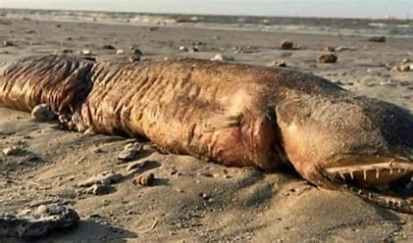

Slide 68
2.
“I took a picture of the creature!” exclaimed Trevor.

Slide 69
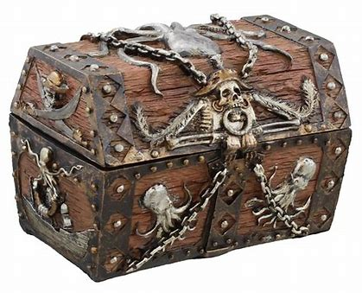
3. The pirates measured their treasure.

Slide 71
Homework

