Slide 1
Jolly Grammar 1-33

Slide 2
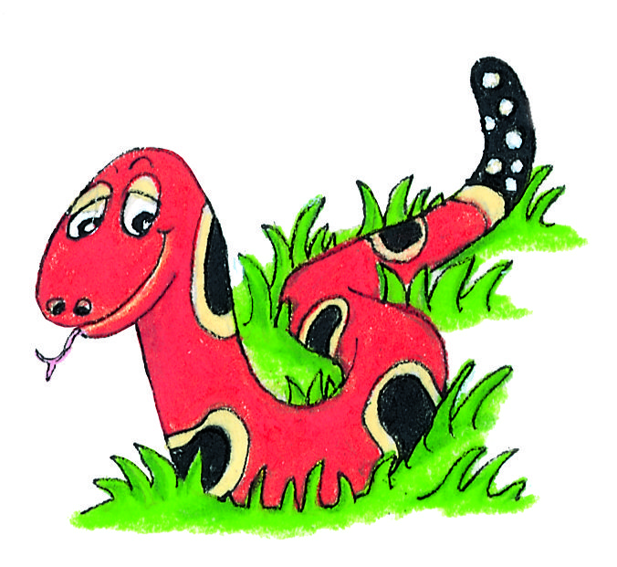
Spelling Test 32

Slide 3
mud

Slide 4
mud
jam

Slide 5
mud
jam
sent

Slide 6
mud
jam
sent
term

Slide 7
mud
jam
sent
term
summer

Slide 8
mud
jam
sent
term
summer
6. river

Slide 9
mud
jam
sent
term
summer
6. river
7. number

Slide 10
mud
jam
sent
term
summer
6. river
7. number
8. always

Slide 11
mud
jam
sent
term
summer
6. river
7. number
8. always
9. also

Slide 12
mud
jam
sent
term
summer
6. river
7. number
8. always
9. also
10.woodpecker

Slide 13
Word Web

Slide 14
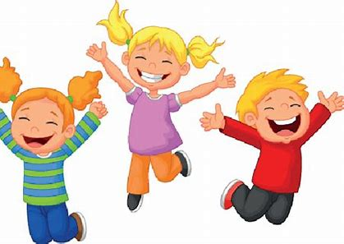

Slide 15
happy

Slide 16
happy
jolly

Slide 17
happy
jolly
cheerful

Slide 18
happy
jolly
cheerful
merry

Slide 19
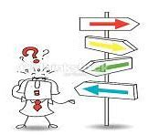
“Where are you going?” said Jim.

Slide 20
“Where are you going?” said Jim.

Slide 21
“Where are you going?” said Jim.
asked

Slide 22
“Where are you going?” said Jim.
asked
shouted

Slide 23
“Where are you going?” said Jim.
asked
shouted
whispered

Slide 24
“Where are you going?” said Jim.
asked
shouted
whispered
screamed

Slide 25
Activity Page:

Slide 26
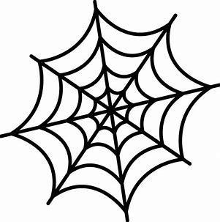
sad

Slide 27
sad
unhappy depressed heartbroken
melancholy dismal mournful
sorry pessimistic

Slide 28
sad
unhappy depressed heartbroken
melancholy dismal mournful
sorry pessimistic
cold

Slide 29
sad
unhappy depressed heartbroken
melancholy dismal mournful
sorry pessimistic
cold
chilly freezing icy
frosty chilled brisk
wintry

Slide 30
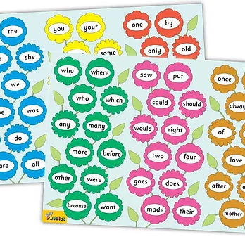
Tricky Words
^{6th} set

Slide 31
once

Slide 32
upon

Slide 33
always

Slide 34
of

Slide 35
also

Slide 36
eight

Slide 37
love

Slide 38
cover

Slide 39
after

Slide 40
every

Slide 41
mother

Slide 42
father

Slide 43
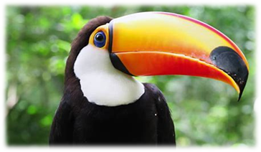
bird
/er/

Slide 44
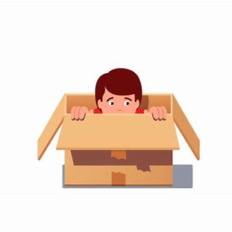
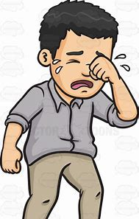
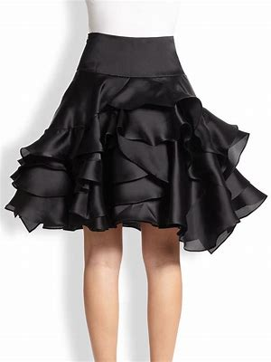
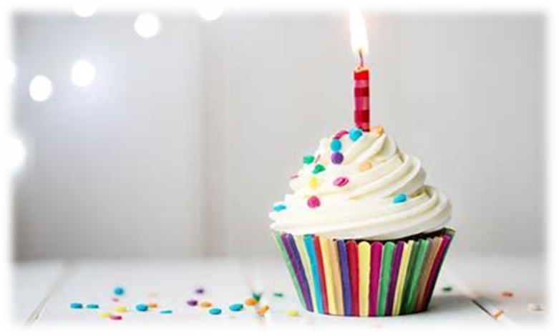
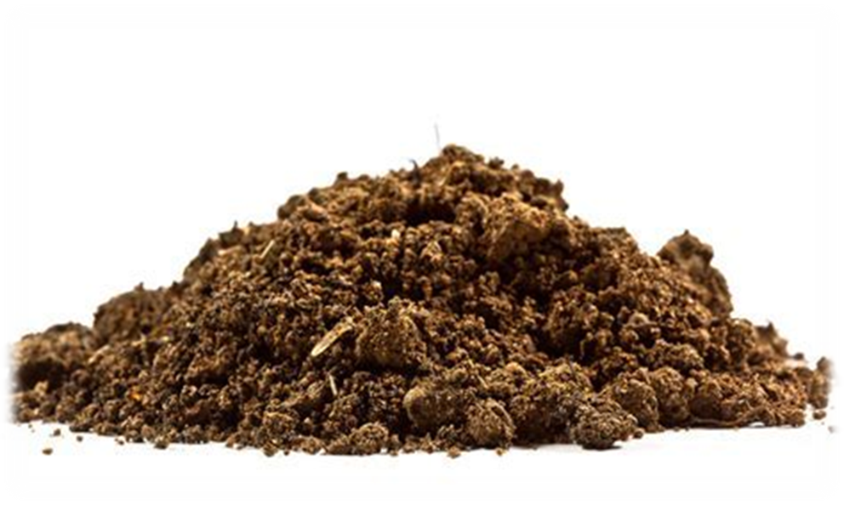
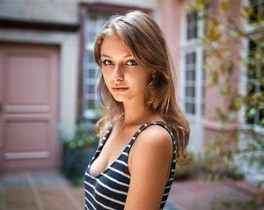
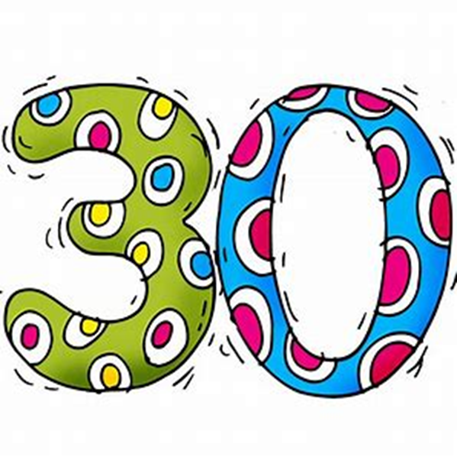
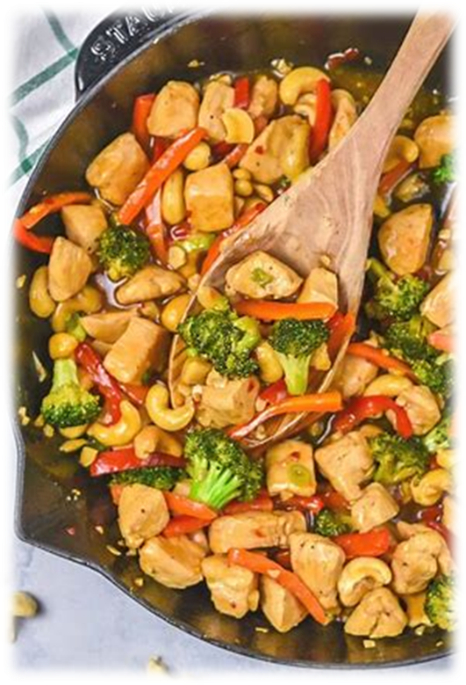
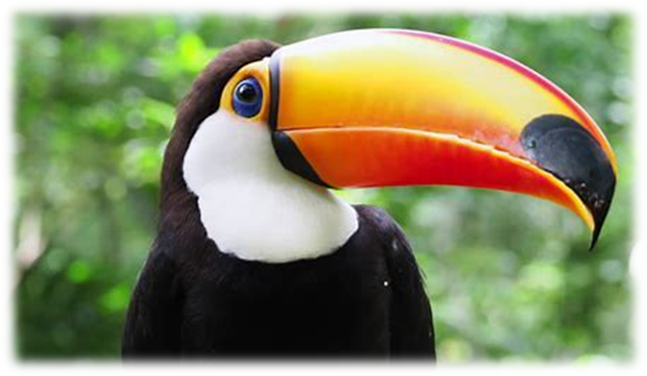
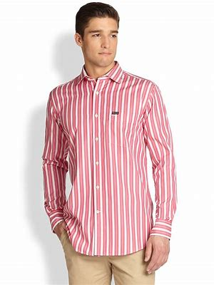
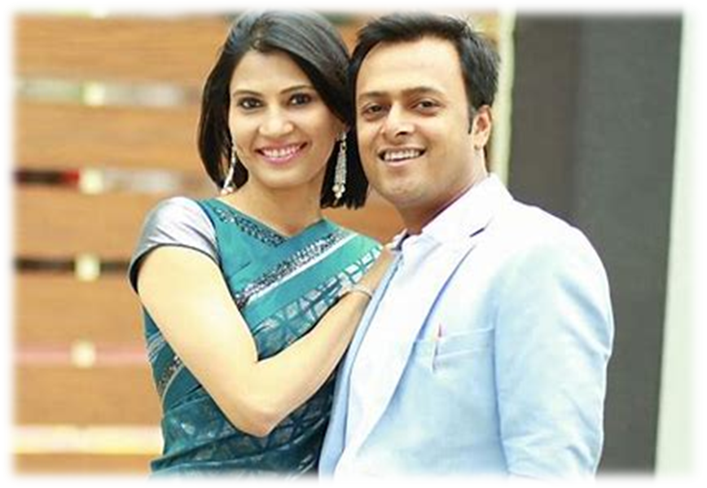
skirt
birthday
dirt
yet
hid
wept
skirt
girl
shirt
first
of
eight
birthday
girl
thirty
bird
stir
shirt
first
sir
third

Slide 45
Activity page

Slide 46
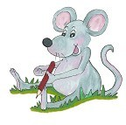
Dictation

Slide 47
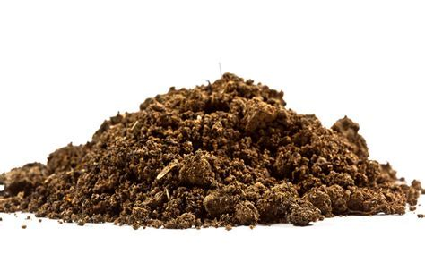
dirt

Slide 48
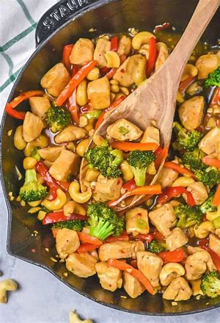
dirt 2. stir

Slide 49
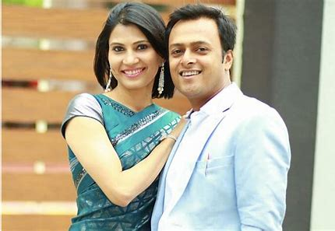
dirt 2. stir 3. sir

Slide 50
dirt 2. stir 3. sir
4. third

Slide 51
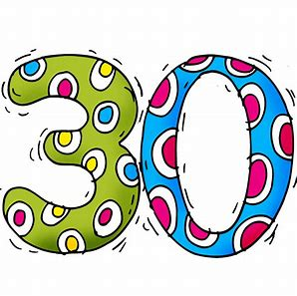
dirt 2. stir 3. sir
4. third 5. thirty

Slide 52
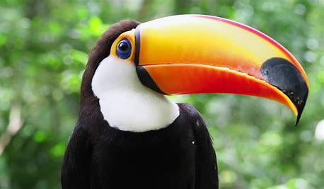
dirt 2. stir 3. sir
4. third 5. thirty 6. bird

Slide 53
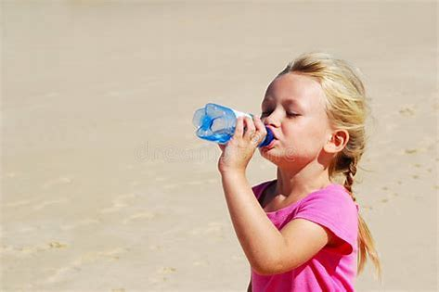
dirt 2. stir 3. sir
4. third 5. thirty 6. bird
7. The girl is thirsty.

Slide 54
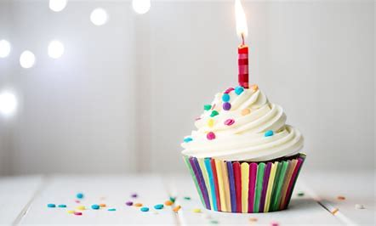
dirt 2. stir 3. sir
4. third 5. thirty 6. bird
7. The girl is thirsty.
8. When is your
birthday?

Slide 55
dirt 2. stir 3. sir
4. third 5. thirty 6. bird
7. The girl is thirsty.
8. When is your
birthday?
9. I have a green skirt and red shirt.

Slide 56
Thank you! See you next time.

