Slide 1
Jolly Grammar
5a-33

Slide 2
Let’s review
Noun phrases and simple subject/object.

Slide 3
In each sentence, underline the nouns in black and a put a black box around the noun phrase acting as the subject and object. Then write the noun phrase and simple subject/object.

Slide 4
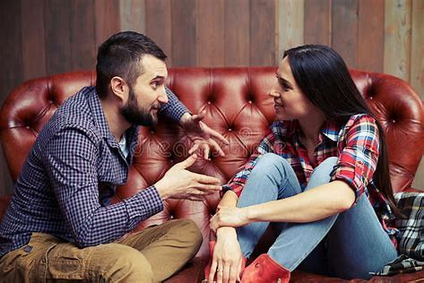
They always had
the most interesting conversations.

Slide 5
They always had
the most interesting conversations.

Slide 6
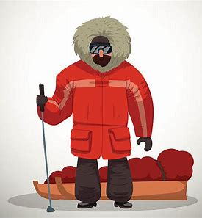
The lost Arctic explorer eventually returned safely.

Slide 7
The lost Arctic explorer eventually returned safely.

Slide 8
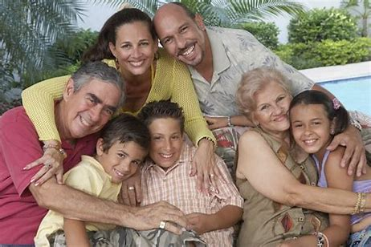
Her husband’s closest relations
will be arriving soon.

Slide 9
Her husband’s closest relations
will be arriving soon.

Slide 10
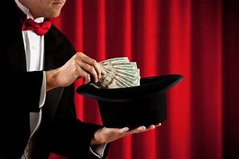
The magical, mysterious magician totally amazed us .

Slide 11
The magical, mysterious magician totally amazed us .

Slide 12
I did not understand
his long, complicated explanation.

Slide 13
I did not understand
his long, complicated explanation.

Slide 14
Let’s review
suffixes.

Slide 15
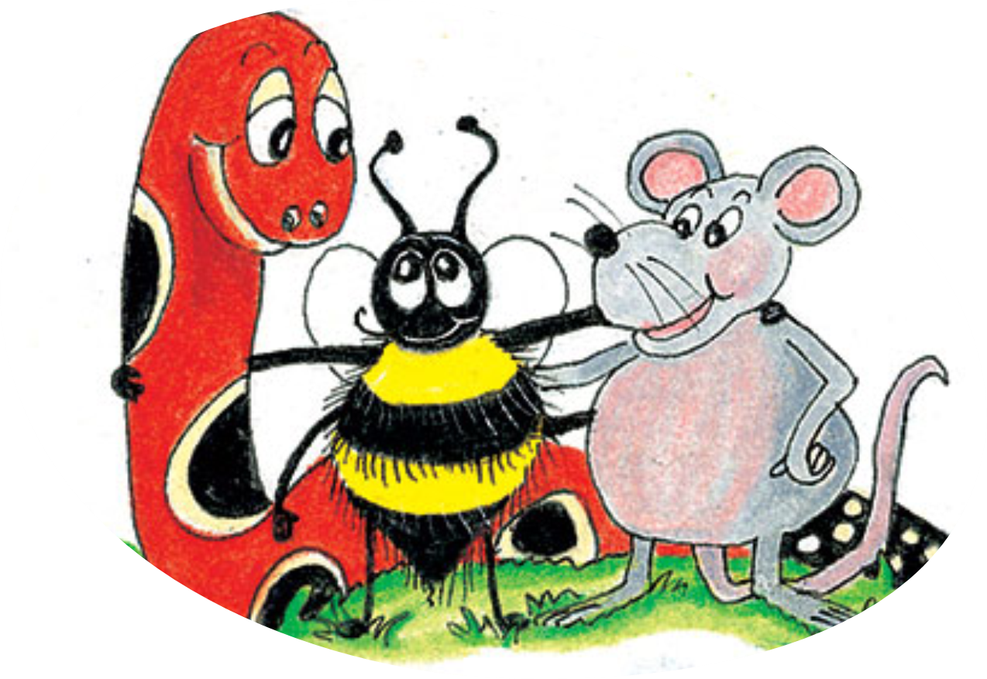
option
aversion
permission
beautician
introduction
extension
depression
musician

Slide 16
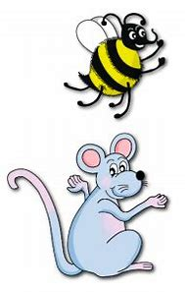
Spelling Point
<-ation>

Slide 17
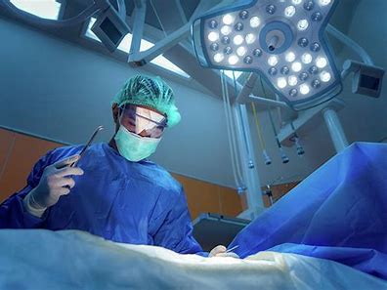
A surgeon operates on a patient.
She performs an operation.

Slide 18
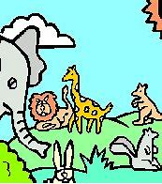
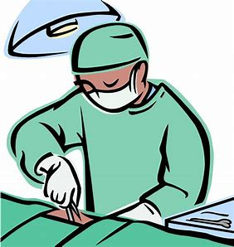
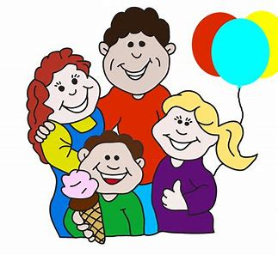
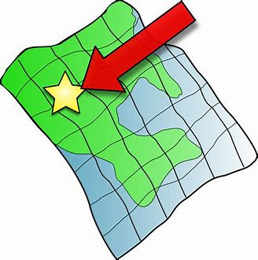
nation creation operation
education relation location

Slide 19
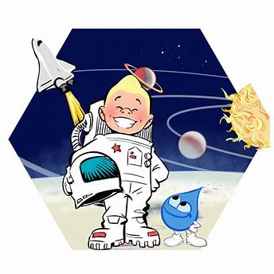
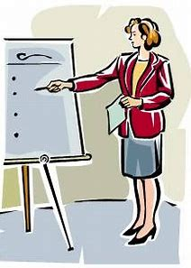
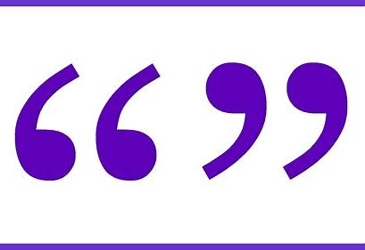
exploration explanation conversation
information quotation association

Slide 20
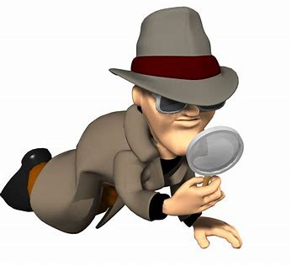
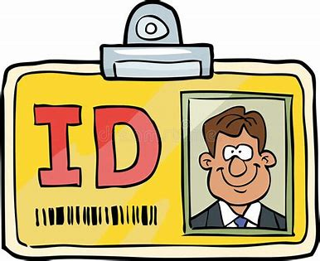
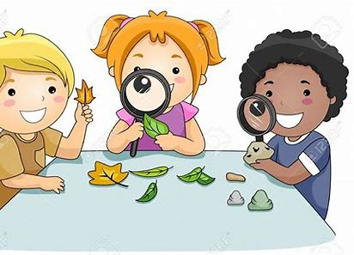
celebration investigation cancellation
identification pronunciation observation

Slide 22
Activity Page:
Spelling
<-ation>

Slide 23
What is the root verb?

Slide 24
to create
to operate
to educate
to locate
to relate
to converse
to associate
to explore
to quote
to explain
to inform
to identify
to investigate
to cancel
to observe
to celebrate
to pronounce

Slide 25
Parsing & Sentence Walls

Slide 26
Emma and Sally make
some interesting observations.
Subject
Emma/Sally
Verb
make
Object
observations
some
interesting

Slide 27
Dictation

Slide 28
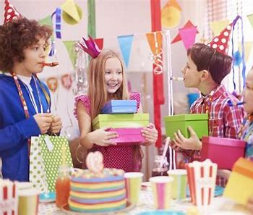

Slide 29
I invited my relations to my birthday celebrations.

Slide 30
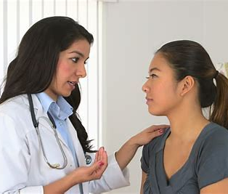

Slide 31
“Your operation has been postponed,” confirmed the doctor.

Slide 32
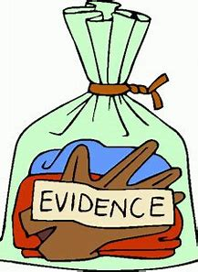

Slide 33
They discovered important evidence during the investigation.

Slide 34
Thank you.
See you
next time!

