Slide 1
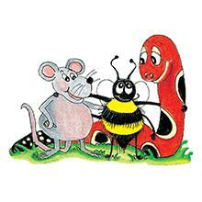
Jolly Grammar 2-32

Slide 2
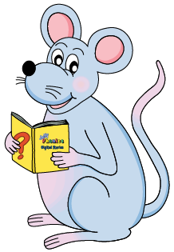
Mini Test 31

Slide 3
grub

Slide 4
grub
slug

Slide 5
grub
slug
eight

Slide 6
grub
slug
eight
eighteen

Slide 7
grub
slug
eight
eighteen
eighty

Slide 8
6. weigh
grub
slug
eight
eighteen
eighty

Slide 9
6. weigh
7. reindeer
grub
slug
eight
eighteen
eighty

Slide 10
6. weigh
7. reindeer
8. neighbour
grub
slug
eight
eighteen
eighty

Slide 11
6. weigh
7. reindeer
8. neighbour
9. child
grub
slug
eight
eighteen
eighty

Slide 12
6. weigh
7. reindeer
8. neighbour
9. child
10. children
grub
slug
eight
eighteen
eighty

Slide 13
Let’s review
Homophone

Slide 14
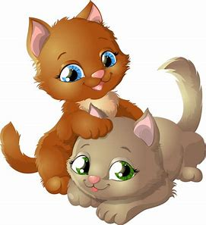
to, too or two?
I have cats called Micky and Minnie.
We went the mountains last summer.
There were many of us squeeze in the car.
I must go at o’clock. Do you want to come ?

Slide 15
to, too or two?
I have two cats called Micky and Minnie.
We went the mountains last summer.
There were many of us squeeze in the car.
I must go at o’clock. Do you want to come ?

Slide 16
to, too or two?
I have two cats called Micky and Minnie.
We went to the mountains last summer.
There were many of us squeeze in the car.
I must go at o’clock. Do you want to come ?

Slide 17
to, too or two?
I have two cats called Micky and Minnie.
We went to the mountains last summer.
There were too many of us squeeze in the car.
I must go at o’clock. Do you want to come ?

Slide 18
to, too or two?
I have two cats called Micky and Minnie.
We went to the mountains last summer.
There were too many of us to squeeze in the car.
I must go at o’clock. Do you want to come ?

Slide 19
to, too or two?
I have two cats called Micky and Minnie.
We went to the mountains last summer.
There were too many of us to squeeze in the car.
I must go at two o’clock. Do you want to come ?

Slide 20
to, too or two?
I have two cats called Micky and Minnie.
We went to the mountains last summer.
There were too many of us to squeeze in the car.
I must go at two o’clock. Do you want to come too?

Slide 21
Let’s review
Prefixes.

Slide 22
happy
unhappy

Slide 23
un- dis- mis- im-
It was impossible to walk along the path.
I really dislike writing stories in school.
Dad unpacked the large suitcases.
Jason misunderstood what he had to do.

Slide 24
Let’s learn
Suffixes.

Slide 25
Activity page1
Suffixes <-ing>

Slide 26
A
B
C
knock
wish
try
look

Slide 27
A
B
C
knock
knocking
wish
try
look

Slide 28
A
B
C
knock
knocking
wish
wishing
try
look

Slide 29
A
B
C
knock
knocking
wish
wishing
try
trying
look

Slide 30
A
B
C
knock
knocking
wish
wishing
try
trying
look
looking

Slide 31
A
B
C
knock
knocking
wish
wishing
try
trying
look
looking
save
complete
hide
joke

Slide 32
A
B
C
knock
knocking
wish
wishing
try
trying
look
looking
save
saving
complete
hide
joke

Slide 33
A
B
C
knock
knocking
wish
wishing
try
trying
look
looking
save
saving
complete
completing
hide
joke

Slide 34
A
B
C
knock
knocking
wish
wishing
try
trying
look
looking
save
saving
complete
completing
hide
hiding
joke

Slide 35
A
B
C
knock
knocking
wish
wishing
try
trying
look
looking
save
saving
complete
completing
hide
hiding
joke
joking

Slide 36
A
B
C
knock
knocking
wish
wishing
try
trying
look
looking
save
saving
complete
completing
hide
hiding
joke
joking
wag
get
spin
drop

Slide 37
A
B
C
knock
knocking
wish
wishing
try
trying
look
looking
save
saving
complete
completing
hide
hiding
joke
joking
wag
wagging
get
spin
drop

Slide 38
A
B
C
knock
knocking
wish
wishing
try
trying
look
looking
save
saving
complete
completing
hide
hiding
joke
joking
wag
wagging
get
getting
spin
drop

Slide 39
A
B
C
knock
knocking
wish
wishing
try
trying
look
looking
save
saving
complete
completing
hide
hiding
joke
joking
wag
wagging
get
getting
spin
spinning
drop

Slide 40
A
B
C
knock
knocking
wish
wishing
try
trying
look
looking
save
saving
complete
completing
hide
hiding
joke
joking
wag
wagging
get
getting
spin
spinning
drop
dropping

Slide 41
A
B
C
knock
wish
try
look
save
complete
hide
joke
wag
get
spin
drop

Slide 42
talk
run
hope
jog
ride
clap
swim
copy
look
fly
sneeze
arrive

Slide 43
talk
talking
run
running
hope
hoping
jog
jogging
ride
riding
clap
clapping
swim
swimming
copy
copying
look
looking
fly
flying
sneeze
sneezing
arrive
arriving

Slide 44
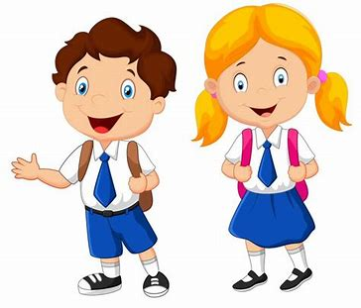
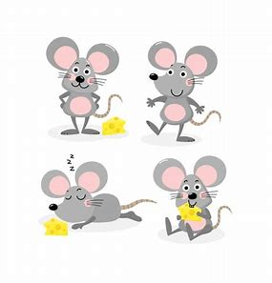
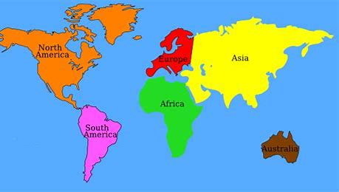
Tricky Plurals (and more)
child
children
woman
women
mouse
mice
library
computer
English
language
continent
world

Slide 45
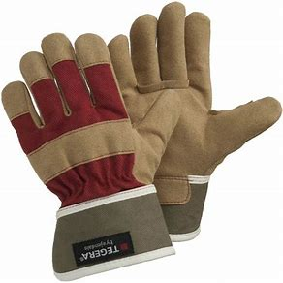
gloves
/u/

Slide 46
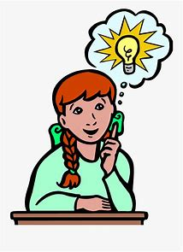
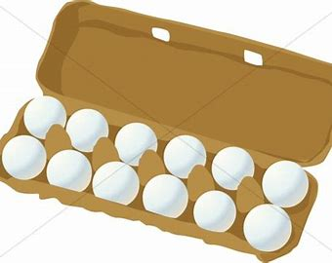
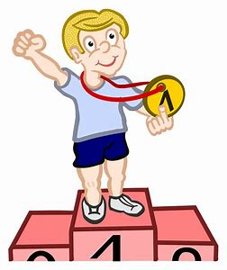
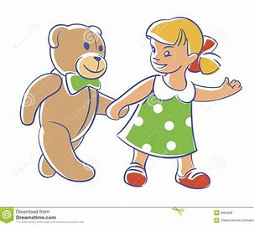
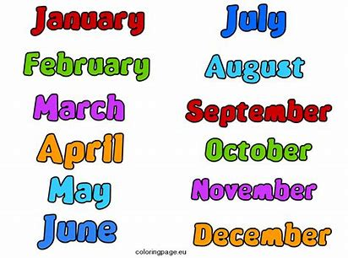
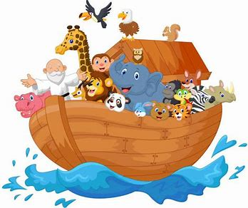
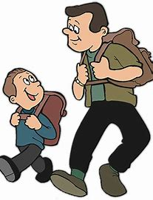
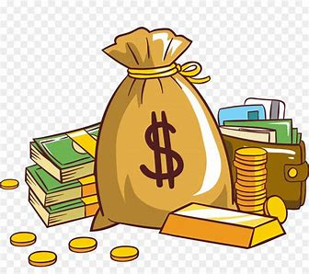
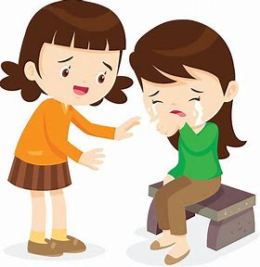
gloves
dozen
won
come
month
ark
clever
gloves
son
front
dozen
monkey
somebody
woman
women
son
monkey
money
Monday
front
somebody
comforting

Slide 47
Activity page2

Slide 48
Dictation

Slide 49
Name:
1. 2. 3.
4. 5. 6.
7.
8.
9.

Slide 50
won

Slide 51
won 2. money

Slide 52
won 2. money 3. come

Slide 53
won 2. money 3. come
4. month

Slide 54
won 2. money 3. come
4. month 5. Monday

Slide 55
won 2. money 3. come
4. month 5. Monday 6. comforting

Slide 56
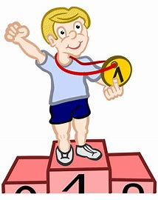
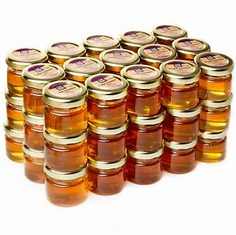
won 2. money 3. come
4. month 5. Monday 6. comforting
7. We won eight jars of honey.

Slide 57
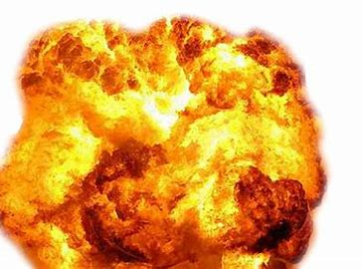
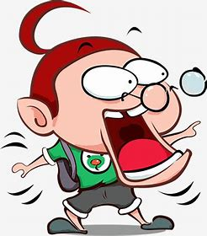
won 2. money 3. come
4. month 5. Monday 6. comforting
7. We won eight jars of honey.
8. My brother saw the explosion .

Slide 58
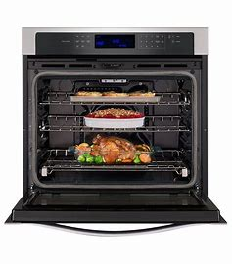
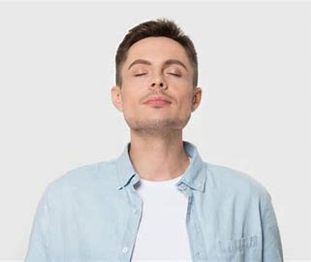
won 2. money 3. come
4. month 5. Monday 6. comforting
7. We won eight jars of honey.
8. My brother saw the explosion .
9. A wonderful smell was
coming from the oven?

Slide 59
Homework

Slide 60
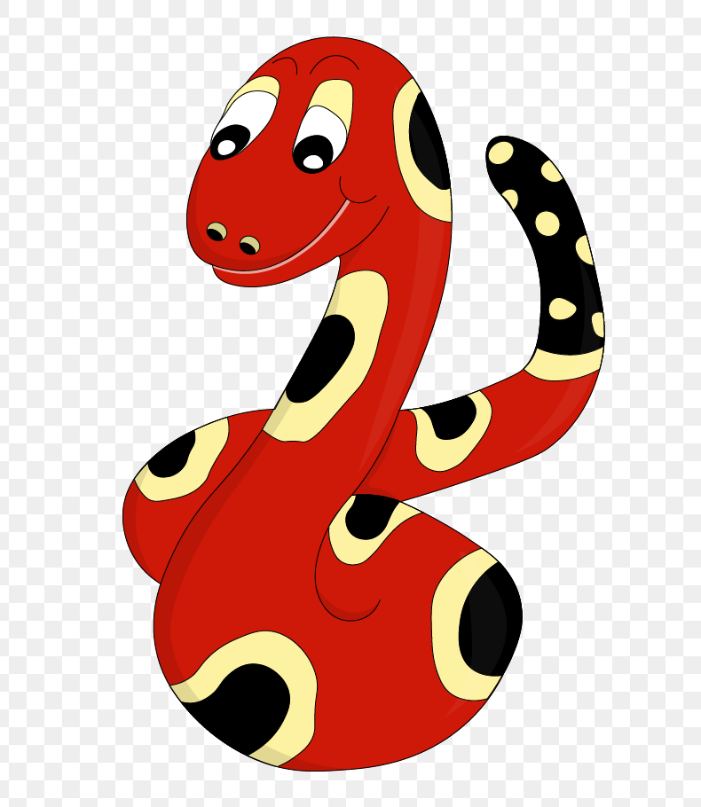
Thank you!
See you
next lesson.

