Slide 1
Jolly Grammar 3-31

Slide 2
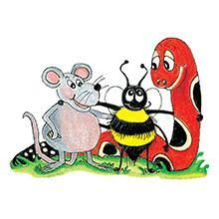
Spelling Test 30

Slide 3
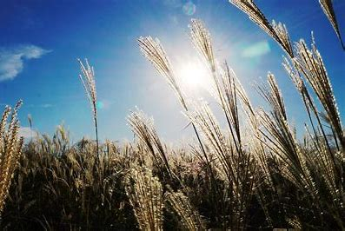
reed

Slide 4
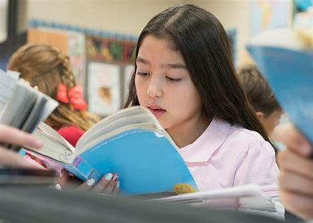
reed
read

Slide 5
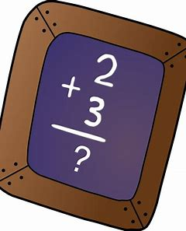
reed
read
sum

Slide 6
reed
read
sum
some

Slide 7
reed
read
sum
some
blue

Slide 8
reed
read
sum
some
blue
blew

Slide 9
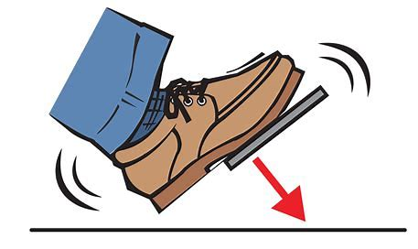
reed
read
sum
some
blue
blew
7. brake

Slide 10
reed
read
sum
some
blue
blue
7. brake
8. break

Slide 11
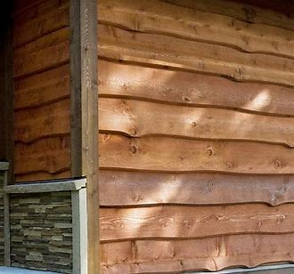
reed
read
sum
some
blue
blue
7. brake
8. break
9. wood

Slide 12
reed
read
sum
some
blue
blue
7. brake
8. break
9. wood
10. would

Slide 13
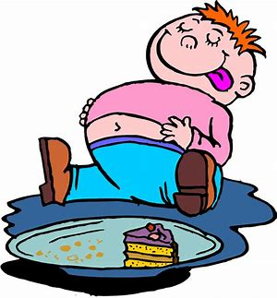
reed
read
sum
some
blue
blue
7. brake
8. break
9. wood
10. would
11. ate

Slide 14
reed
read
sum
some
blue
blue
7. brake
8. break
9. wood
10. would
11. ate
12. eight

Slide 15
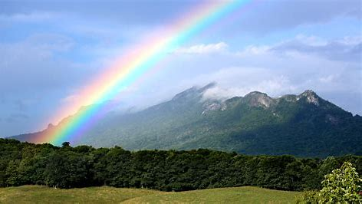
reed
read
sum
some
blue
blue
7. brake
8. break
9. wood
10. would
11. ate
12. eight
13. weather

Slide 16
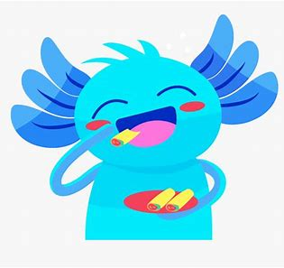
reed
read
sum
some
blue
blue
7. brake
8. break
9. wood
10. would
11. ate
12. eight
13. weather
14. whether

Slide 17
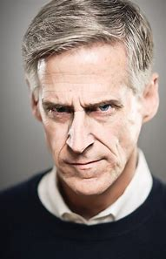
reed
read
sum
some
blue
blue
7. brake
8. break
9. wood
10. would
11. ate
12. eight
13. weather
14. whether
15. stare

Slide 18
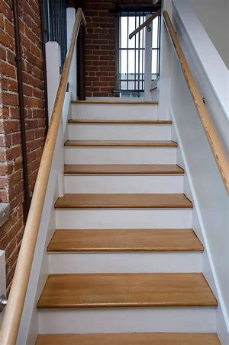
reed
read
sum
some
blue
blue
7. brake
8. break
9. wood
10. would
11. ate
12. eight
13. weather
14. whether
15. stare
16. stair

Slide 19
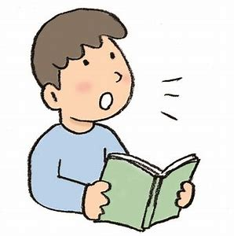
reed
read
sum
some
blue
blue
7. brake
8. break
9. wood
10. would
11. ate
12. eight
13. weather
14. whether
15. stare
16. stair
17. aloud

Slide 20
reed
read
sum
some
blue
blue
7. brake
8. break
9. wood
10. would
11. ate
12. eight
13. weather
14. whether
15. stare
16. stair
17. aloud
18. allowed

Slide 21
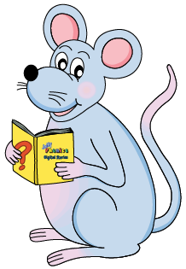
Let’s review
Speech marks.

Slide 22
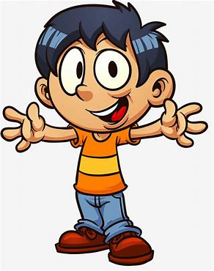
I saw you.

Slide 23
I saw you.
Bill said “I saw you.”

Slide 24
What is your name?

Slide 25
What is your name?
Bill said “What is your name?”

Slide 26
What is your name?
Bill said “What is your name?”
asked
questioned

Slide 27
Go away!

Slide 28
Go away!
Bill said “Go away!”
shouted
exclaimed

Slide 29
Activity page
page.63

Slide 30
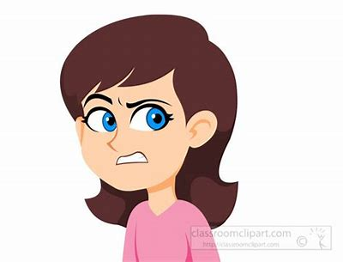
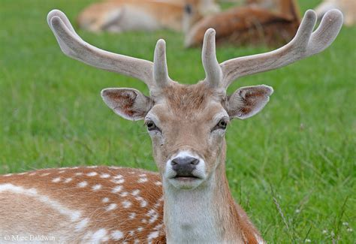
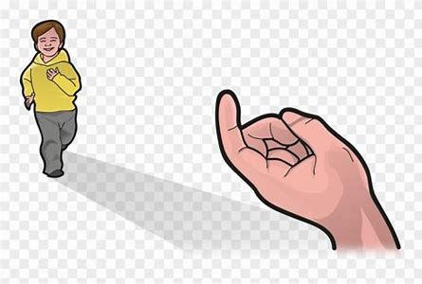
dear
/ear/
here
/ear/
sneering
/ear/

Slide 31
Spelling List

Slide 32
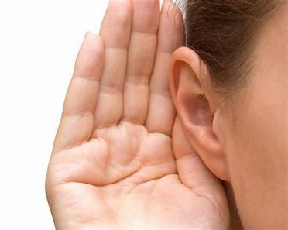
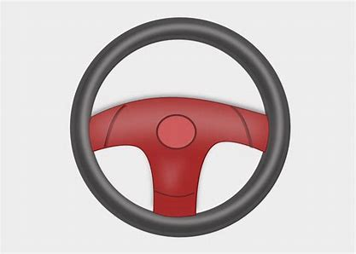
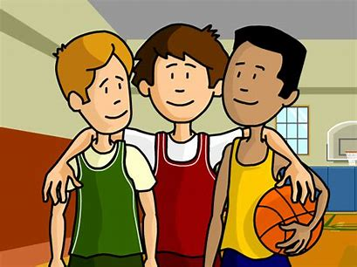
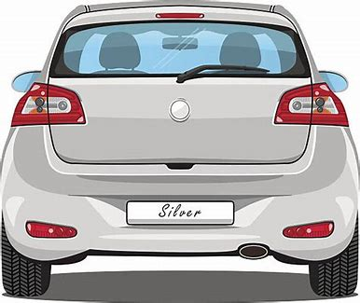
deer hear steer
peer rear cheer

Slide 33
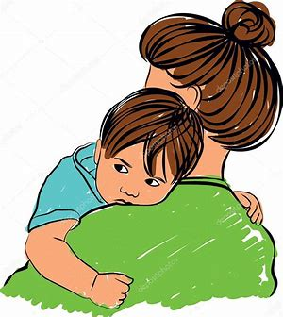
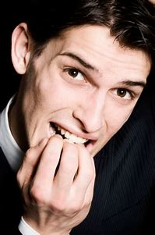
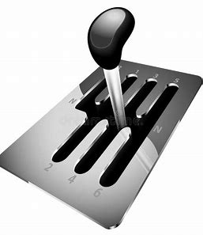
here clear mere
gearbox fearful sneering

Slide 34
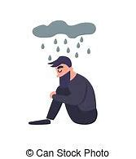
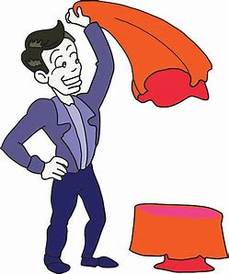
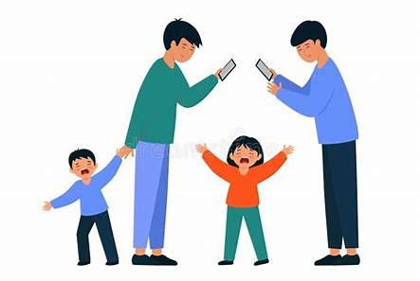
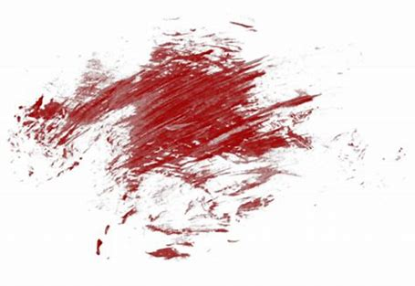
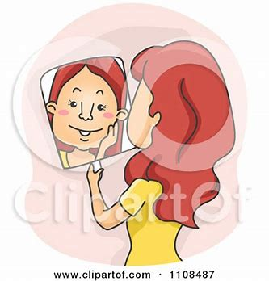
interfere dreary disappear
smeary appearance atmosphere

Slide 36
Activity page
page.60

Slide 37
Let’s review
syllables.

Slide 38
cheerful
atmosphere
fearless
nearly
interfere

Slide 39
Let’s parse
sentences.

Slide 40
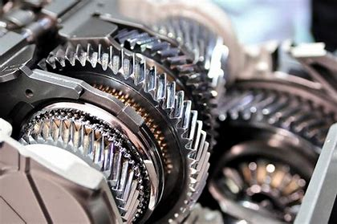
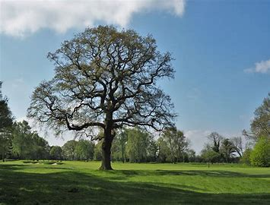
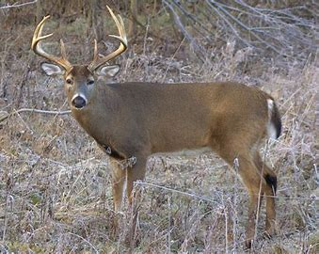
Parse these sentences.
The red car had a faulty gearbox.
The fearful deer stood hesitantly
by the big oak tree.

Slide 41
Parse these sentences.
The red car had a faulty gearbox.
The fearful deer stood hesitantly
by the big oak tree.

Slide 42
Parse these sentences.
The red car had a faulty gearbox.
The fearful deer stood hesitantly
by the big oak tree.

Slide 43
Parse these sentences.
The red car had a faulty gearbox.
The fearful deer stood hesitantly
by the big oak tree.

Slide 44
Parse these sentences.
The red car had a faulty gearbox.
The fearful deer stood hesitantly
by the big oak tree.

Slide 45
Parse these sentences.
The red car had a faulty gearbox.
The fearful deer stood hesitantly
by the big oak tree.

Slide 46
Parse these sentences.
The red car had a faulty gearbox.
The fearful deer stood hesitantly
by the big oak tree.

Slide 47
Parse these sentences.
The red car had a faulty gearbox.
The fearful deer stood hesitantly
by the big oak tree.

Slide 48
Parse these sentences.
The red car had a faulty gearbox.
The fearful deer stood hesitantly
by the big oak tree.

Slide 49
Parse these sentences.
The red car had a faulty gearbox.
The fearful deer stood hesitantly
by the big oak tree.

Slide 50
Parse these sentences.
The red car had a faulty gearbox.
The fearful deer stood hesitantly
by the big oak tree.

Slide 51
Parse these sentences.
The red car had a faulty gearbox.
The fearful deer stood hesitantly
by the big oak tree.

Slide 52
Parse these sentences.
The red car had a faulty gearbox.
The fearful deer stood hesitantly
by the big oak tree.

Slide 53
Draw the correct picture.

Slide 54
Dictation

Slide 55
Dictation
1.
2.
3.

Slide 56
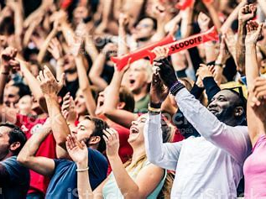

Slide 57
1.
The cheering crowd was waiting for the prince and princess’s appearance.

Slide 58
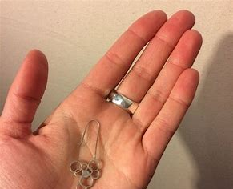

Slide 59
2.
“My best earrings have disappeared,” said Beth.

Slide 60
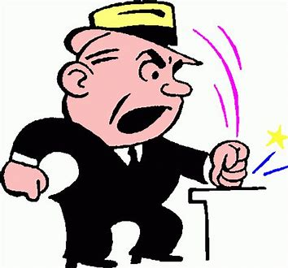

Slide 61
3. “Did you hear the dreary speech?” asked Bill.

Slide 62
Homework

