Slide 1
Jolly Grammar 1-32

Slide 2
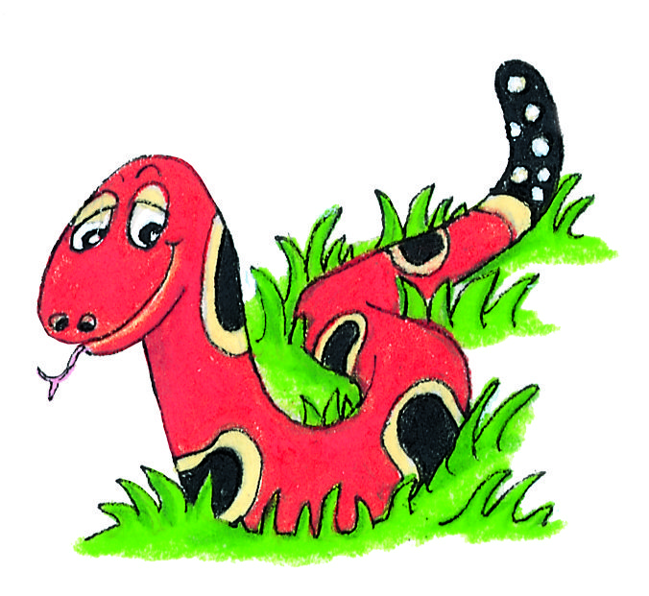
Spelling Test 31

Slide 3
fin

Slide 4
fin
sob

Slide 5
fin
sob
left

Slide 6
fin
sob
left
sink

Slide 7
fin
sob
left
sink
pink

Slide 8
fin
sob
left
sink
ping
6. drink

Slide 9
fin
sob
left
sink
ping
6. drink
7. thank

Slide 10
fin
sob
left
sink
ping
6. drink
7. thank
8. once

Slide 11
fin
sob
left
sink
ping
6. drink
7. thank
8. once
9. upon

Slide 12
fin
sob
left
sink
ping
6. drink
7. thank
8. once
9. upon
10.winking

Slide 13
Speech Marks

Slide 14
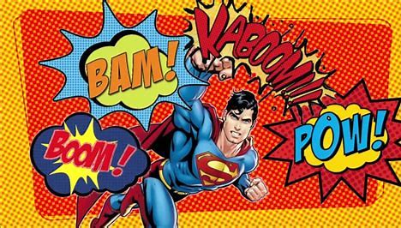

Slide 15
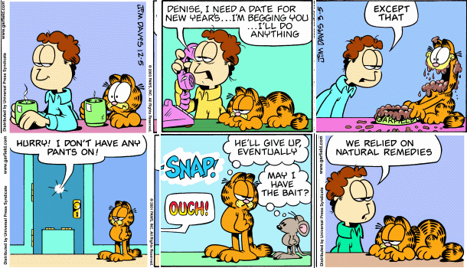

Slide 16
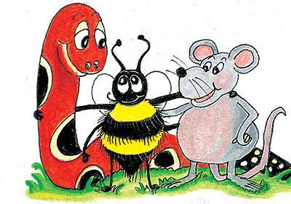
Hello.
Let’s play.

Slide 17
Hello.
Let’s play.
“Hello”
said Snake.

Slide 18
Hello.
Let’s play.
“Hello”
said Snake.
“Let’s play”
said Inky.

Slide 19
Hello.
Let’s play.
“Hello”
said Snake.
“Let’s play”
said Inky.
Speech marks

Slide 20
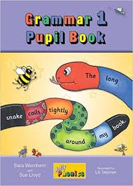
Activity Page:

Slide 21
Zzzz
“ ”
said the bee.

Slide 22
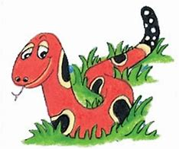
“ ”
said the snake.

Slide 23
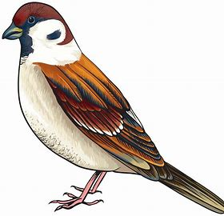
“ ”
said the bird.

Slide 24
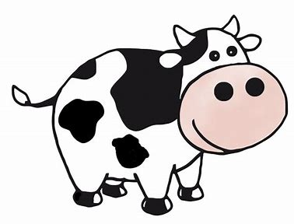
“ ”
said the cow.

Slide 25
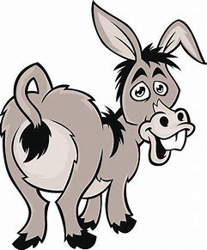
“ ”
said the donkey.

Slide 26
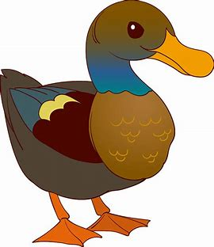
“ ”
said the duck.

Slide 27
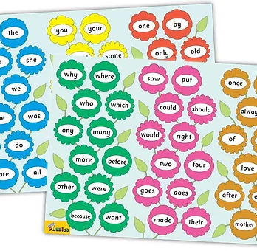
Tricky Words
^{6th} set

Slide 28
once

Slide 29
upon

Slide 30
always

Slide 31
also

Slide 32
also

Slide 33
eight

Slide 34
love

Slide 35
cover

Slide 36
after

Slide 37
every

Slide 38
mother

Slide 39
father

Slide 40
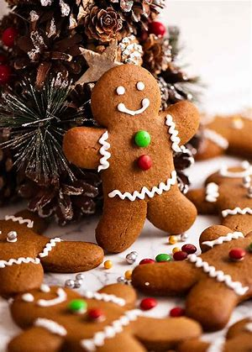
gingerbread
/er/

Slide 41
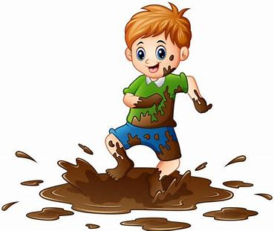
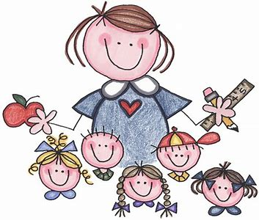
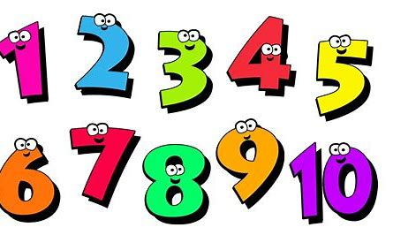
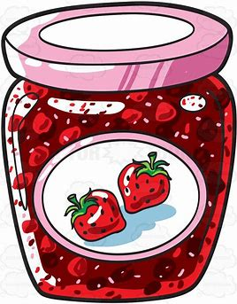
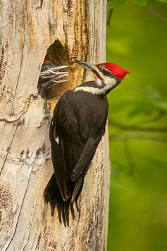
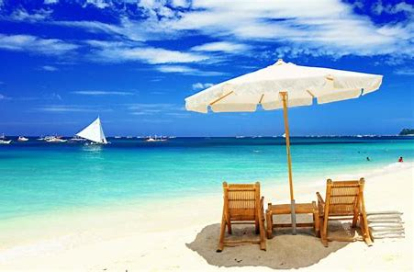
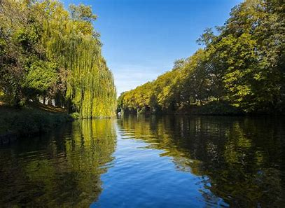
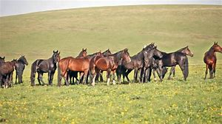
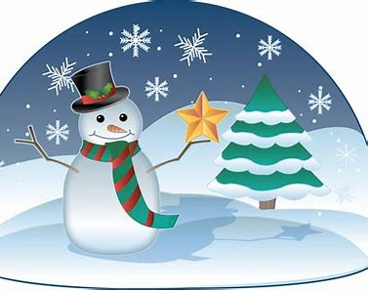
term
number
fern
silver
mud
jam
sent
term
summer
river
number
always
also
woodpecker
summer
woodpecker
river
herd
never
winter

Slide 42
Activity page

Slide 43
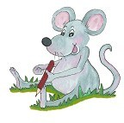
Dictation

Slide 44
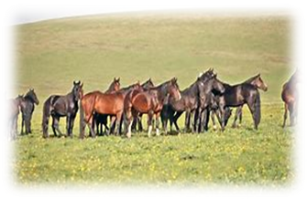
herd

Slide 45
herd 2. fern

Slide 46
herd 2. fern 3. term

Slide 47
herd 2. fern 3. term
4. never

Slide 48
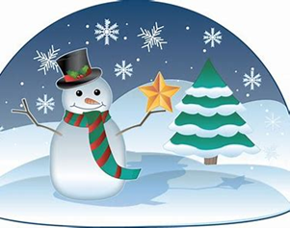
herd 2. fern 3. term
4. never 5. winter

Slide 49
herd 2. fern 3. term
4. never 5. winter 6. silver

Slide 50
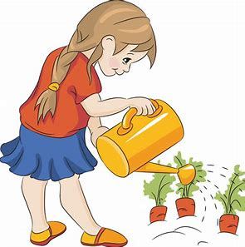
herd 2. fern 3. term
4. never 5. winter 6. silver
7. I grew some ferns.

Slide 51
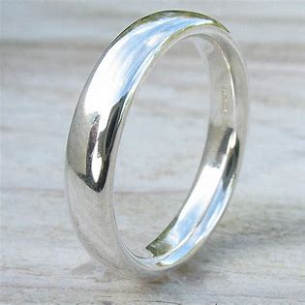
herd 2. fern 3. term
4. never 5. winter 6. silver
7. I grew some ferns.
8. Her ring is made
of silver.

Slide 52
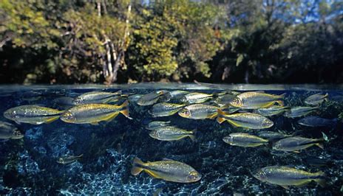
herd 2. fern 3. term
4. never 5. winter 6. silver
7. I grew some ferns.
8. Her ring is made
of silver.
9. There are fish in the river.

Slide 53
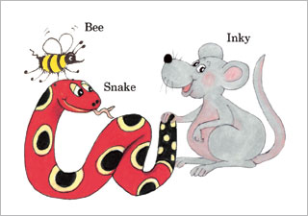
Homework

Slide 54
Thank you! See you next time.

