Slide 1
Jolly Grammar 1-31

Slide 2
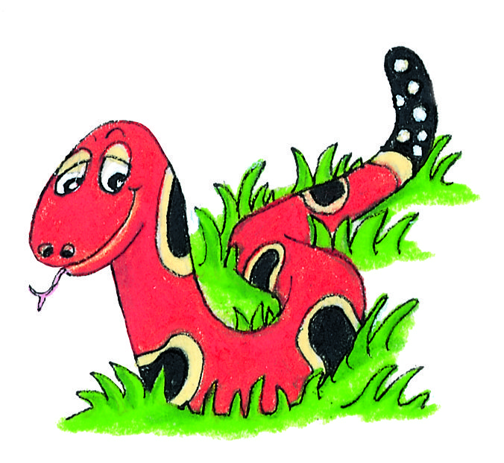
Spelling Test 30

Slide 3
bad

Slide 4
bad
vet

Slide 5
bad
vet
fact

Slide 6
bad
vet
fact
all

Slide 7
bad
vet
fact
all
talk

Slide 8
bad
vet
fact
all
talk
6. walk

Slide 9
bad
vet
fact
all
talk
6. walk
7. small

Slide 10
bad
vet
fact
all
talk
6. walk
7. small
8. made

Slide 11
bad
vet
fact
all
talk
6. walk
7. small
8. made
9. their

Slide 12
bad
vet
fact
all
talk
6. walk
7. small
8. made
9. their
10.beanstalk

Slide 13
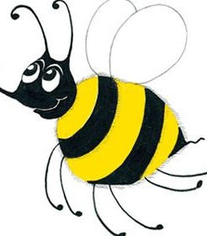
Dictionary

Slide 14
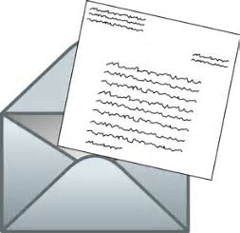
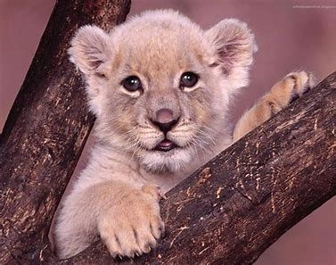
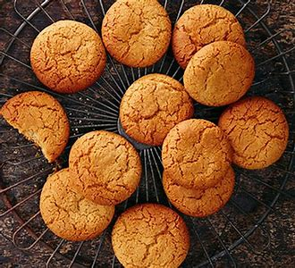
leter
animal
biskit

Slide 15
leter
animal
biskit
letter
biscuit

Slide 16
Activity Page:

Slide 17
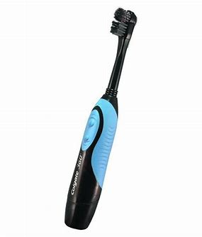
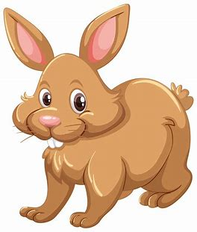
Using a Dictionary
toofbrush rabbit starr
toothbrush rabit star
octopus flouer buterfie
octapus flower butterfly

Slide 18
Using a Dictionary
toofbrush rabbit starr
toothbrush rabit star
octopus flouer buterfie
octapus flower butterfly

Slide 19
Using a Dictionary
toofbrush rabbit starr
toothbrush rabit star
octopus flouer buterfie
octapus flower butterfly

Slide 20
Using a Dictionary
toofbrush rabbit starr
toothbrush rabit star
octopus flouer buterfie
octapus flower butterfly

Slide 21
Using a Dictionary
toofbrush rabbit starr
toothbrush rabit star
octopus flouer buterfie
octapus flower butterfly

Slide 22
Using a Dictionary
toofbrush rabbit starr
toothbrush rabit star
octopus flouer buterfie
octapus flower butterfly

Slide 23
Using a Dictionary
toofbrush rabbit starr
toothbrush rabit star
octopus flouer buterfie
octapus flower butterfly

Slide 24
These words are spelt incorrectly. Look them up and copy out the correct spelling.
boock carpit triangel

Slide 25
These words are spelt incorrectly. Look them up and copy out the correct spelling.
boock carpit triangel
book carpet triangle

Slide 26
We can also use a dictionary to find out what a word means. Look up these words and write down their meanings.
atlas
yacht

Slide 27
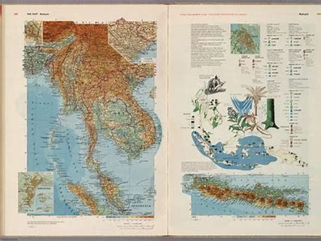
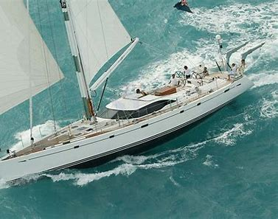
We can also use a dictionary to find out what a word means. Look up these words and write down their meanings.
atlas
yacht

Slide 28
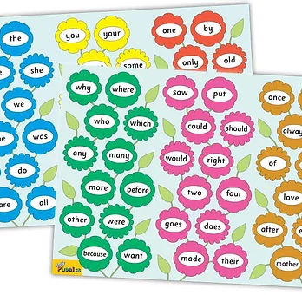
Tricky Words
^{6th} set

Slide 29
upon

Slide 30
once

Slide 31
always

Slide 32
also

Slide 33
of

Slide 34
eight

Slide 35
love

Slide 36
cover

Slide 37
after

Slide 38
every

Slide 39
mother

Slide 40
father

Slide 41
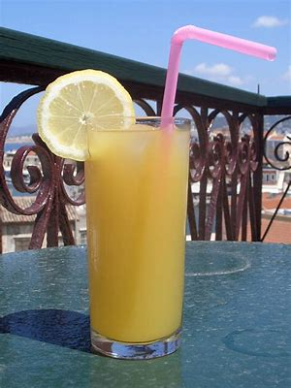
drink
/ng-k/

Slide 42
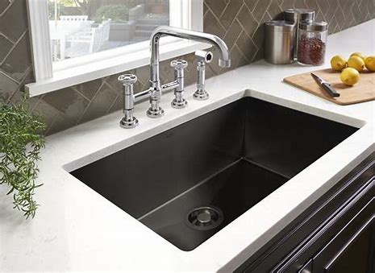
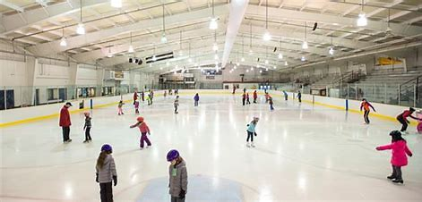
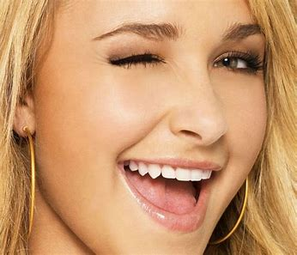
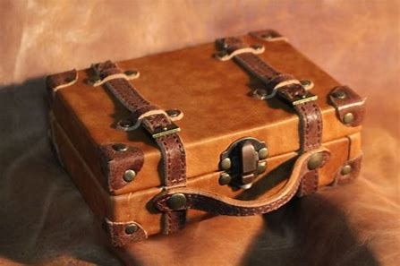
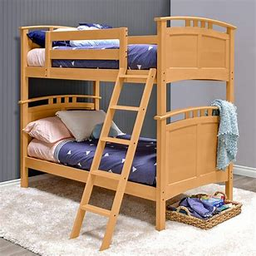
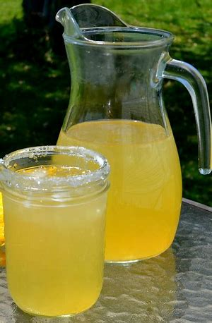
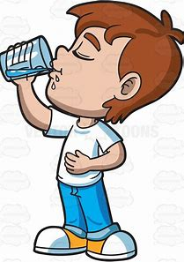
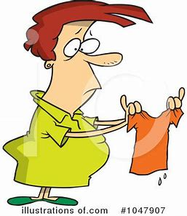
sink
thank
rink
blink
fin
sob
left
sink
pink
drink
thank
once
upon
winking
pink
winking
trunk
bunk
drink
ink
drank
shrink

Slide 43
Activity page

Slide 44
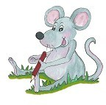
Dictation

Slide 45
ink

Slide 46
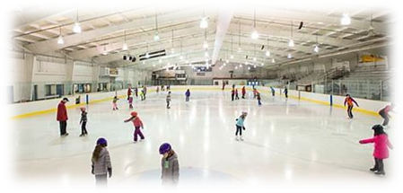
ink 2. rink

Slide 47
ink 2. rink 3. blink

Slide 48
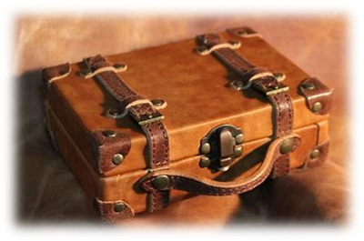
ink 2. rink 3. blink
4. trunk

Slide 49
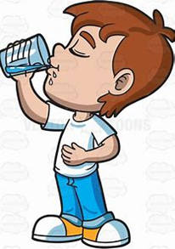
ink 2. rink 3. blink
4. trunk 5. drank

Slide 50
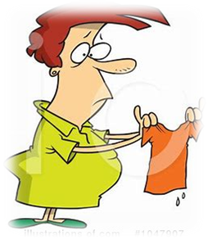
ink 2. rink 3. blink
4. trunk 5. drank 6. shrink

Slide 51
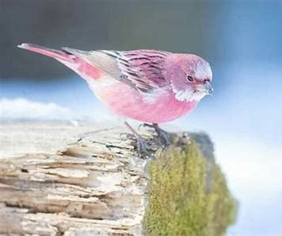
ink 2. rink 3. blink
4. trunk 5. drank 6. shrink
7. The pink bird blinks.

Slide 52
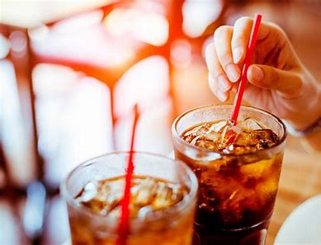
ink 2. rink 3. blink
4. trunk 5. drank 6. shrink
7. The pink bird blinks.
8. What would you like
to drink?

Slide 53
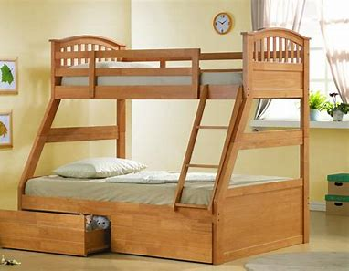
ink 2. rink 3. blink
4. trunk 5. drank 6. shrink
7. The pink bird blinks.
8. What would you like
to drink?
9. I sleep in the top bunk.

Slide 54
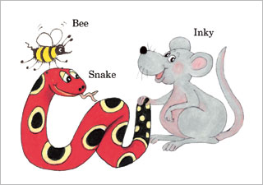
Homework

Slide 55
Thank you! See you next time.

