Slide 1
Jolly Grammar
5a-31

Slide 2
Let’s review
Antonyms and Synonyms.

Slide 3
antonym
synonym
change
silence
courage
damage
multiple
superior

Slide 4
antonym
synonym
change
silence
courage
damage
multiple
superior
replace

Slide 5
antonym
synonym
change
silence
courage
damage
multiple
superior
keep
replace

Slide 6
antonym
synonym
change
silence
courage
damage
multiple
superior
keep
replace
hush

Slide 7
antonym
synonym
change
silence
courage
damage
multiple
superior
keep
noise
replace
hush

Slide 8
antonym
synonym
change
silence
courage
damage
multiple
superior
keep
noise
replace
hush
bravery

Slide 9
antonym
synonym
change
silence
courage
damage
multiple
superior
keep
noise
cowardice
replace
hush
bravery

Slide 10
antonym
synonym
change
silence
courage
damage
multiple
superior
keep
noise
cowardice
replace
hush
bravery
ruin

Slide 11
antonym
synonym
change
silence
courage
damage
multiple
superior
keep
noise
cowardice
repair
replace
hush
bravery
ruin

Slide 12
antonym
synonym
change
silence
courage
damage
multiple
superior
keep
noise
cowardice
repair
replace
hush
bravery
ruin
many

Slide 13
antonym
synonym
change
silence
courage
damage
multiple
superior
keep
noise
cowardice
repair
few
replace
hush
bravery
ruin
many

Slide 14
antonym
synonym
change
silence
courage
damage
multiple
superior
keep
noise
cowardice
repair
few
replace
hush
bravery
ruin
many
better

Slide 15
antonym
synonym
change
silence
courage
damage
multiple
superior
keep
noise
cowardice
repair
few
worse
replace
hush
bravery
ruin
many
better

Slide 16
Let’s review
suffixes.

Slide 17
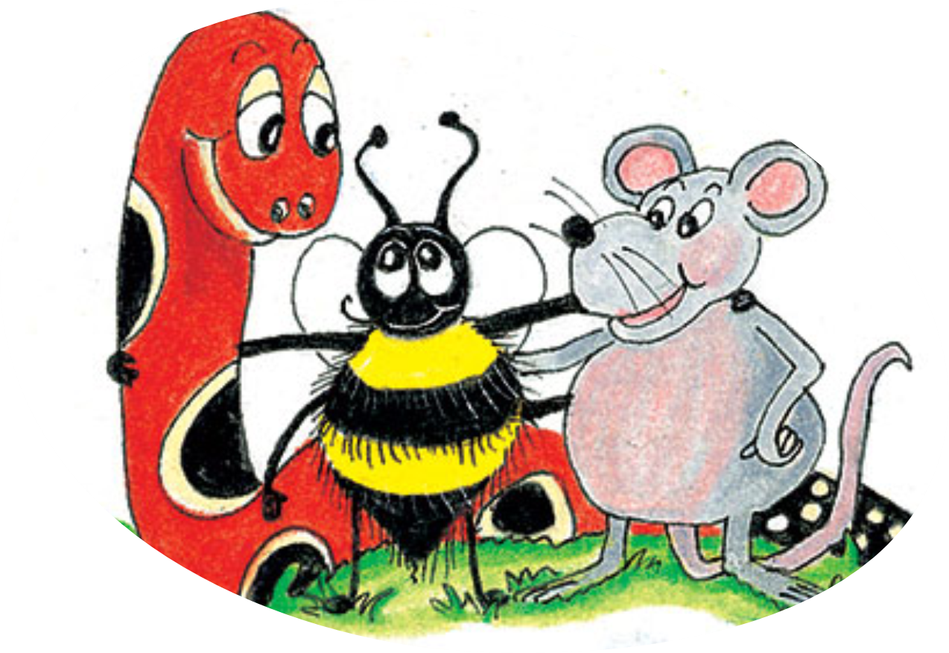
mention

Slide 18
mention
pension

Slide 19
mention
pension
mission

Slide 20
mention
pension
mission
direction

Slide 21
mention
pension
mission
direction
diversion

Slide 22
mention
pension
mission
direction
diversion
progression

Slide 23
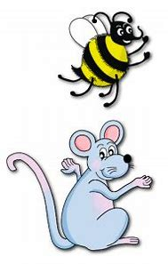
Spelling Point
<cian>

Slide 24
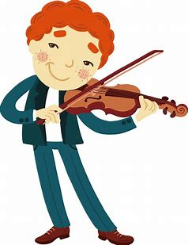
musician

Slide 25
musician
magician

Slide 26
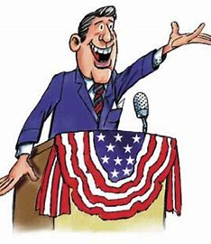
musician
magician
politician

Slide 27
musician
magician
politician
People with a particular skill
or occupation

Slide 28
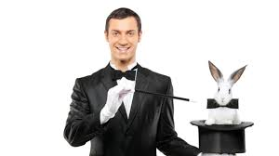
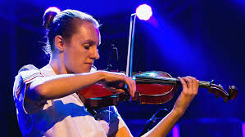
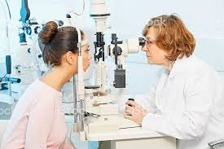
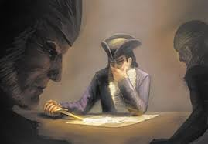
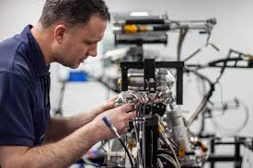
musician magician dietician
optician tactician technician

Slide 29
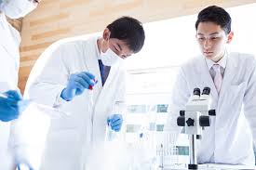
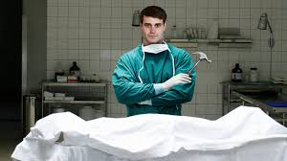
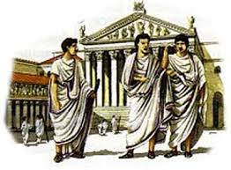
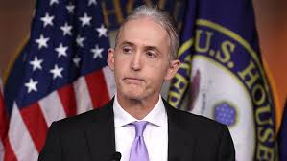
clinician mortician patrician
politician physician electrician

Slide 30
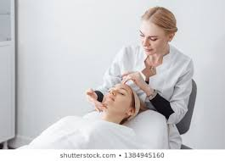
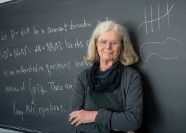
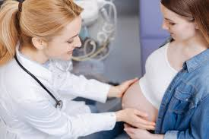
beautician statistician arithmetician
mathematician obstetrician paediatrician

Slide 32
Activity Page:
Spelling
<cian>

Slide 33
Write the meaning of each of the spelling word

Slide 34
Parsing & Sentence Walls

Slide 35
Tom has definitely made an excellent impression.
Subject
Tom
Verb
has made
definitely
Object
impression
an excellent

Slide 36
Dictation

Slide 37
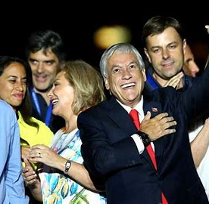

Slide 38
The politician exclaimed, “We won the election!”.

Slide 39
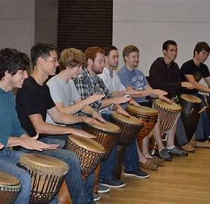

Slide 40
The musician had studied percussion at his old college.

Slide 42
The electrician is very proud of his profession.

Slide 43
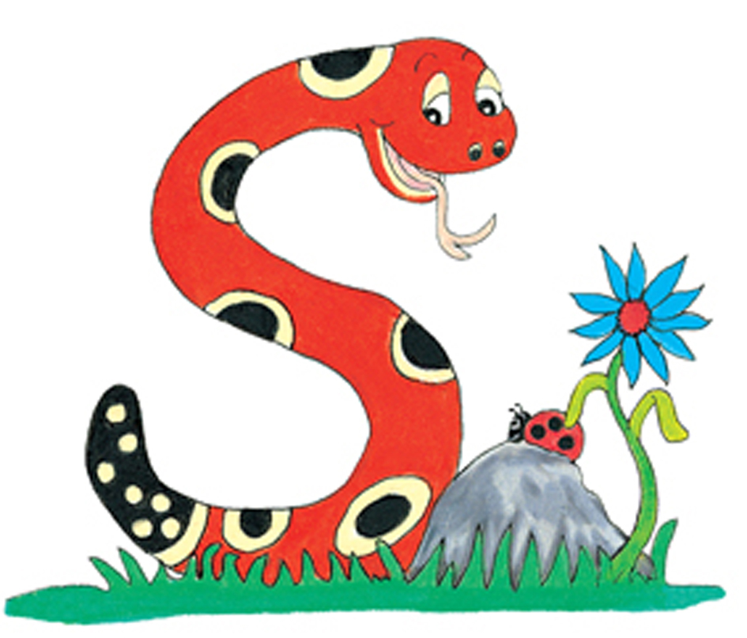
Thank you.
See you
next time!

