Slide 1
Jolly Grammar 1-30

Slide 2
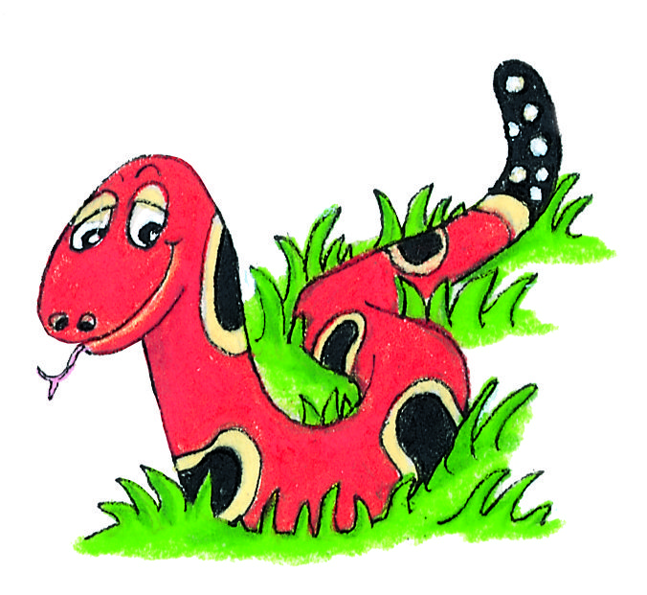
Spelling Test 29

Slide 3
got

Slide 4
got
bun

Slide 5
got
bun
belt

Slide 6
got
bun
belt
fork

Slide 7
got
bun
belt
fork
storm

Slide 8
got
bun
belt
fork
storm
6. horse

Slide 9
got
bun
belt
fork
storm
6. horse
7. forty

Slide 10
got
bun
belt
fork
storm
6. horse
7. forty
8. goes

Slide 11
got
bun
belt
fork
storm
6. horse
7. forty
8. goes
9. does

Slide 12
got
bun
belt
fork
storm
6. horse
7. forty
8. goes
9. does
10.morning

Slide 13
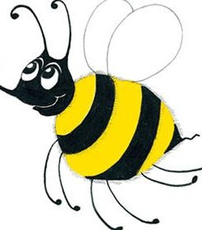
Antonym

Slide 14
Antonym
(opposites)

Slide 15
big
dark
up
night

Slide 16
antonyms
big
dark
up
night

Slide 17
antonyms
big
dark
up
night
small

Slide 18
antonyms
big
dark
up
night
small
light

Slide 19
antonyms
big
dark
up
night
small
light
down

Slide 20
antonyms
big
dark
up
night
small
light
down
day

Slide 21
Let’s read

Slide 22
A tall man drove backwards out of his garage and on to rough road. At the roundabout he turned right. It was a dark, wet night. He made a quick turn at a small bend in the road and hit a low wall. The car went over the wall and stopped.

Slide 23
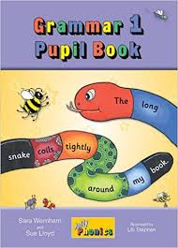
Activity Page:

Slide 24
antonyms
white
hot
up
asleep
day
quiet
hard
open

Slide 25
antonyms
white
hot
up
asleep
black
day
quiet
hard
open

Slide 26
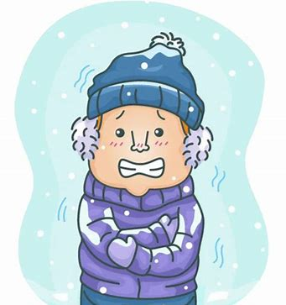
antonyms
white
hot
up
asleep
black
cold
day
quiet
hard
open

Slide 27
antonyms
white
hot
up
asleep
black
cold
down
day
quiet
hard
open

Slide 28
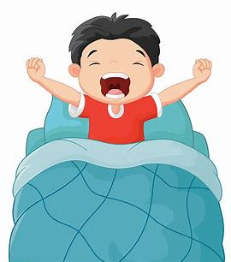
antonyms
white
hot
up
asleep
black
cold
down
awake
day
quiet
hard
open

Slide 29
antonyms
white
hot
up
asleep
black
cold
down
awake
day
quiet
hard
open
night

Slide 30
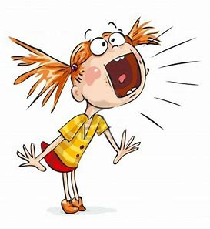
antonyms
white
hot
up
asleep
black
cold
down
awake
day
quiet
hard
open
night
loud

Slide 31
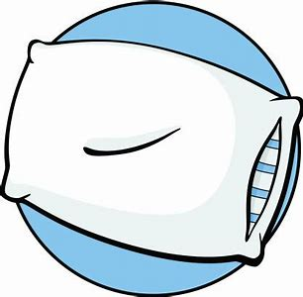
antonyms
white
hot
up
asleep
black
cold
down
awake
day
quiet
hard
open
night
loud
soft

Slide 32
antonyms
white
hot
up
asleep
black
cold
down
awake
day
quiet
hard
open
night
loud
soft
closed

Slide 33
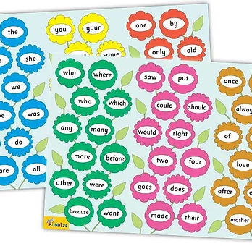
Tricky Words
^{5th} set

Slide 34
saw

Slide 35
put

Slide 36
could

Slide 37
should

Slide 38
would

Slide 39
right

Slide 40
two

Slide 41
four

Slide 42
goes

Slide 43
does

Slide 44
made

Slide 45
their

Slide 46
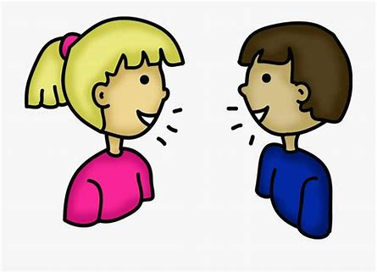
talk
/or/

Slide 47
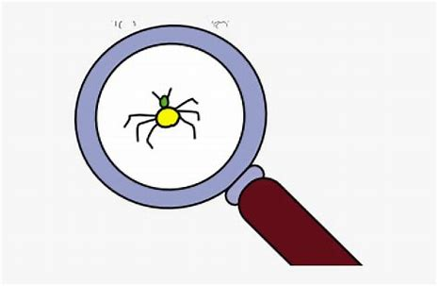
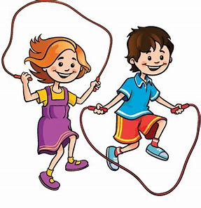
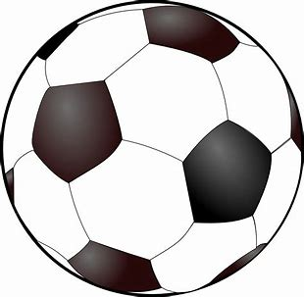
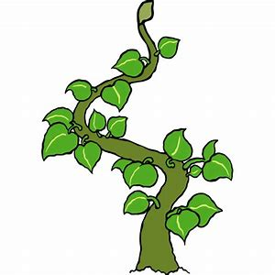
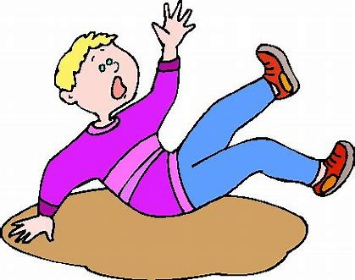
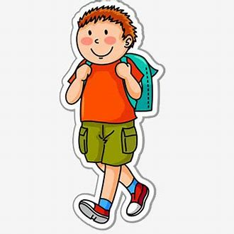
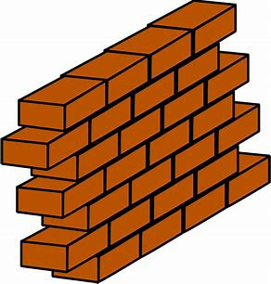
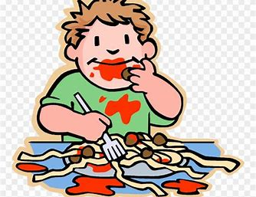
all
small
also
ball
bad
vet
fact
all
talk
walk
small
made
their
beanstalk
talk
beanstalk
falling
walk
always
wall

Slide 48
Activity page

Slide 49
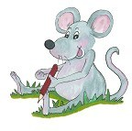
Dictation

Slide 50
also

Slide 51
also 2. talk

Slide 52
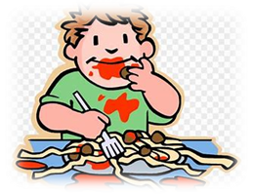
also 2. talk 3. always

Slide 53
also 2. talk 3. always
4. falling

Slide 54
also 2. talk 3. always
4. falling 5. ball

Slide 55
also 2. talk 3. always
4. falling 5. ball 6. wall

Slide 56
also 2. talk 3. always
4. falling 5. ball 6. wall
7. They took a short walk.

Slide 57
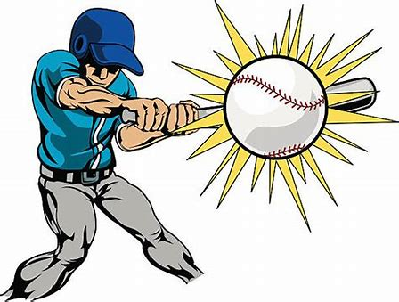
also 2. talk 3. always
4. falling 5. ball 6. wall
7. They took a short walk.
8. He always hits the ball.

Slide 58
also 2. talk 3. always
4. falling 5. ball 6. wall
7. They took a short walk.
8. He always hits the ball.
9. The beanstalk grew tall.

Slide 59
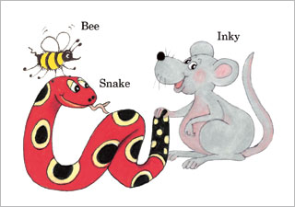
Homework

Slide 60
Thank you! See you next time.

