Slide 1
Jolly Grammar
5a-30

Slide 2
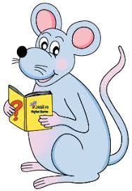
Spelling Test 15

Slide 3
session

Slide 4
session
passion

Slide 5
session
passion
mission

Slide 6
session
passion
mission
permission

Slide 7
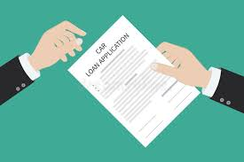
session
passion
mission
permission
submission

Slide 8
session
passion
mission
permission
submission
admission

Slide 9
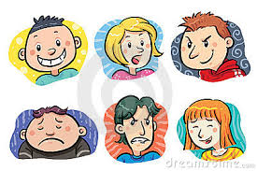
session
passion
mission
permission
submission
admission
expression

Slide 10
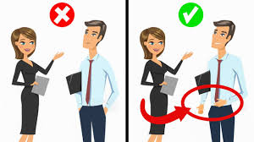
session
passion
mission
permission
submission
admission
expression
impression

Slide 11
session
passion
mission
permission
submission
admission
expression
impression
profession

Slide 12
session
passion
mission
permission
submission
admission
expression
impression
profession
10. aggression

Slide 13
session
passion
mission
permission
submission
admission
expression
impression
profession
10. aggression
11. progression

Slide 14
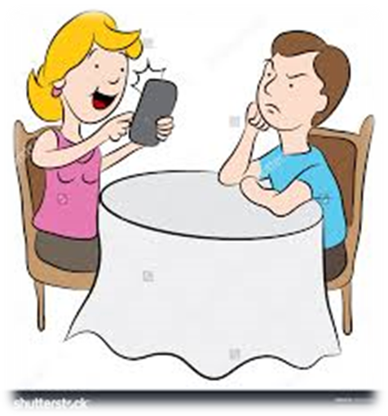
session
passion
mission
permission
submission
admission
expression
impression
profession
10. aggression
11. progression
12. obsession

Slide 15
session
passion
mission
permission
submission
admission
expression
impression
profession
10. aggression
11. progression
12. obsession
13. discussion

Slide 16
session
passion
mission
permission
submission
admission
expression
impression
profession
10. aggression
11. progression
12. obsession
13. discussion
14. depression

Slide 17
session
passion
mission
permission
submission
admission
expression
impression
profession
10. aggression
11. progression
12. obsession
13. discussion
14. depression
15. succession

Slide 18
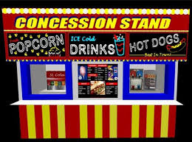
session
passion
mission
permission
submission
admission
expression
impression
profession
10. aggression
11. progression
12. obsession
13. discussion
14. depression
15. succession
16. concession

Slide 19
session
passion
mission
permission
submission
admission
expression
impression
profession
10. aggression
11. progression
12. obsession
13. discussion
14. depression
15. succession
16. concession
17. omission

Slide 20
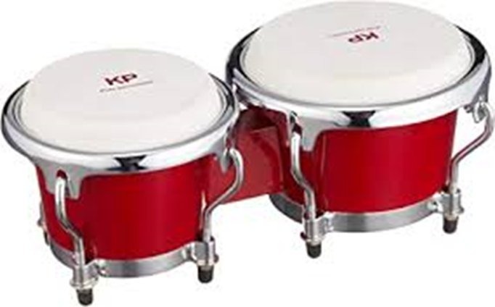
session
passion
mission
permission
submission
admission
expression
impression
profession
10. aggression
11. progression
12. obsession
13. discussion
14. depression
15. succession
16. concession
17. omission
18. percussion

Slide 21
Let’s Review
Subjects and
Objects.

Slide 22
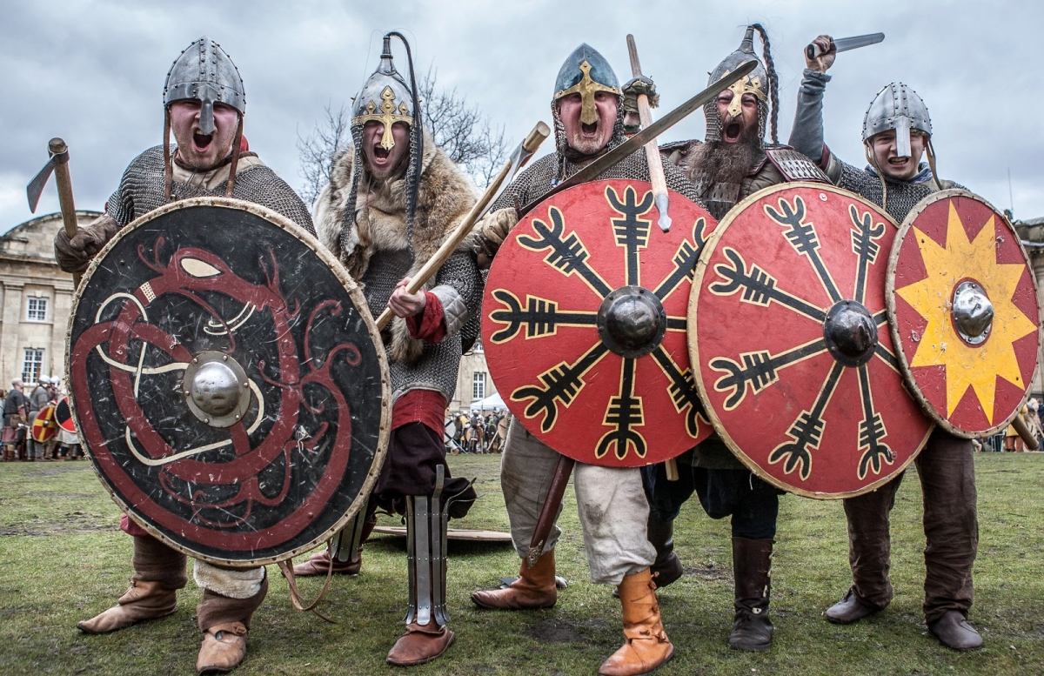
The fierce Viking warriors

Slide 23
The fierce Viking warriors
Sentence? Phrase?

Slide 24
The fierce Viking warriors
Noun Phrase? Prepositional Phrase?

Slide 25
The fierce Viking warriors

Slide 26
The fierce Viking warriors
had raided their village.

Slide 27
The fierce Viking warriors
had raided their village.

Slide 28
The fierce Viking warriors
had raided their village.

Slide 29
The fierce Viking warriors
had raided their village.

Slide 30
The fierce Viking warriors
had raided their village.

Slide 31
The fierce Viking warriors
had raided their village.

Slide 32
The fierce Viking warriors
had raided their village.
Subject
Verb
Object

Slide 33
Activity Page
Noun Phrases as Subjects and Objects

Slide 34
Two savage lions roared loudly.
Subject
Verb
Object

Slide 35
We recently visited a new French restaurant.
Subject
Verb
Object

Slide 36
The multitalented megastar
has mysteriously disappeared.
Subject
Verb
Object

Slide 37
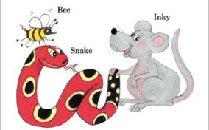
See you
next time!

