Slide 1
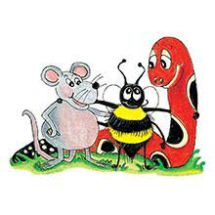
Jolly Grammar 2-29

Slide 2
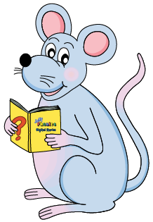
Mini Test 28

Slide 3
mend

Slide 4
mend
silk

Slide 5
mend
silk
bear

Slide 6
mend
silk
bear
tear

Slide 7
mend
silk
bear
tear
pear

Slide 8
6. wear
mend
silk
bear
tear
pear

Slide 9
6. wear
7. swear
mend
silk
bear
tear
pear

Slide 10
6. wear
7. swear
8. underwear
mend
silk
bear
tear
pear

Slide 11
6. wear
7. swear
8. underwear
9. weight
mend
silk
bear
tear
pear

Slide 12
6. wear
7. swear
8. underwear
9. weight
10. volume
mend
silk
bear
tear
pear

Slide 13
Let’s review
Apostrophe<s>

Slide 14
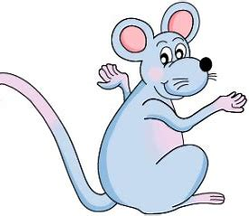
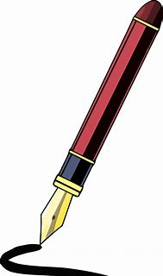
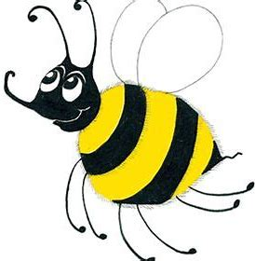
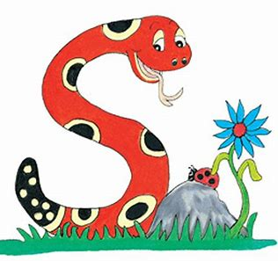
What are these things and whose are they?
There is an apostrophe <s> missing from each of these sentences. Write them in.
Bee went to Inky house on Saturday morning.
Inky liked Bee new red boots.

Slide 15
What are these things and whose are they?
Inky’s pen
There is an apostrophe <s> missing from each of these sentences. Write them in.
Bee went to Inky house on Saturday morning.
Inky liked Bee new red boots.

Slide 16
What are these things and whose are they?
Inky’s pen
Bee’s umbrella
There is an apostrophe <s> missing from each of these sentences. Write them in.
Bee went to Inky house on Saturday morning.
Inky liked Bee new red boots.

Slide 17
What are these things and whose are they?
Inky’s pen
Bee’s umbrella
Snake’s book
There is an apostrophe <s> missing from each of these sentences. Write them in.
Bee went to Inky house on Saturday morning.
Inky liked Bee new red boots.

Slide 18
What are these things and whose are they?
Inky’s pen
Bee’s umbrella
Snake’s book
There is an apostrophe <s> missing from each of these sentences. Write them in.
Bee went to Inky’s house on Saturday morning.
Inky liked Bee new red boots.

Slide 19
What are these things and whose are they?
Inky’s pen
Bee’s umbrella
Snake’s book
There is an apostrophe <s> missing from each of these sentences. Write them in.
Bee went to Inky’s house on Saturday morning.
Inky liked Bee’s new red boots.

Slide 20
Let’s learn
Contractions

Slide 21
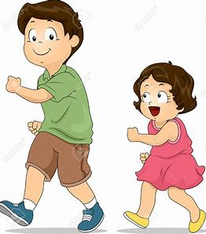
Kate’s bike
Luke’s sister?

Slide 22
Kate’s bike
Luke’s sister?
No, she isn’t.

Slide 23
isn’t

Slide 24
is not → isn’t

Slide 25
o
is n t → isn’t

Slide 26
o
isnt → isn’t

Slide 27
is not → isn’t
We sometimes shorten pairs of words by joining them together and leaving out some of the letters. We use an apostrophe to show where the missing letter, or letters, used to be. These shortened words are called contractions.

Slide 28
Activity page1
Apostrophe<s>

Slide 29
couldn’t
haven’t
don’t
didn’t
mustn’t
I’m
Write out each contraction in full, as to words and with no letters missing.

Slide 30
couldn’t
haven’t
don’t
could not
didn’t
mustn’t
I’m

Slide 31
couldn’t
haven’t
don’t
could not
have not
didn’t
mustn’t
I’m

Slide 32
couldn’t
haven’t
don’t
could not
have not
do not
didn’t
mustn’t
I’m

Slide 33
couldn’t
haven’t
don’t
could not
have not
do not
didn’t
mustn’t
I’m
did not

Slide 34
couldn’t
haven’t
don’t
could not
have not
do not
didn’t
mustn’t
I’m
did not
must not

Slide 35
couldn’t
haven’t
don’t
could not
have not
do not
didn’t
mustn’t
I’m
did not
must not
I am
Well done!

Slide 36
I shall
you will
he will
she will
it will
we shall
you will
they will
Write out each pair of words as a contraction by joining them together and replacing some of the letters with an apostrophe.

Slide 37
I shall
you will
he will
she will
it will
I’ll
we shall
you will
they will

Slide 38
I shall
you will
he will
she will
it will
I’ll
you’ll
we shall
you will
they will

Slide 39
I shall
you will
he will
she will
it will
I’ll
you’ll
he’ll
we shall
you will
they will

Slide 40
I shall
you will
he will
she will
it will
I’ll
you’ll
he’ll
she’ll
we shall
you will
they will

Slide 41
I shall
you will
he will
she will
it will
I’ll
you’ll
he’ll
she’ll
it’ll
we shall
you will
they will

Slide 42
I shall
you will
he will
she will
it will
I’ll
you’ll
he’ll
she’ll
it’ll
we shall
you will
they will
we’ll

Slide 43
I shall
you will
he will
she will
it will
I’ll
you’ll
he’ll
she’ll
it’ll
we shall
you will
they will
we’ll
you’ll

Slide 44
I shall
you will
he will
she will
it will
I’ll
you’ll
he’ll
she’ll
it’ll
we shall
you will
they will
we’ll
you’ll
they’ll

Slide 45
★IMPORTANT★
We use contractions when we speak. They should not be used in writing except when writing direct speech, or in a friendly note.

Slide 46
Measurement Words
centimetre 3cm
metre 3m
gram 30g
kilogram 3kg
millilitre 300ml
litre 2L
weight 28kg
volume
minute
second
fraction 1/3
estimate

Slide 47
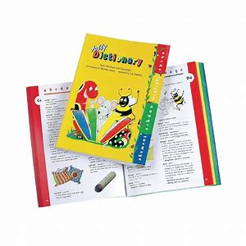
dictionary
/sh/

Slide 48
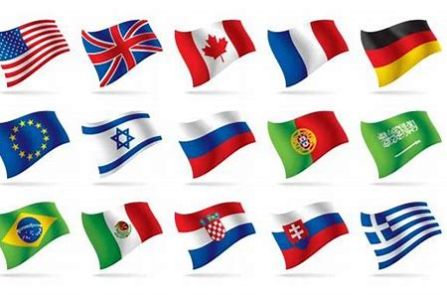
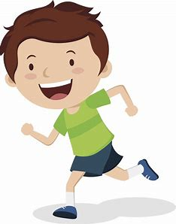
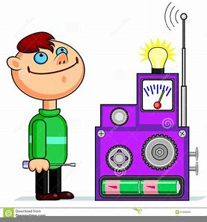
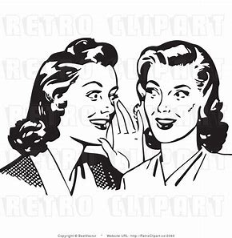
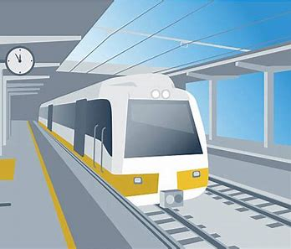
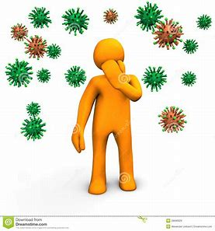
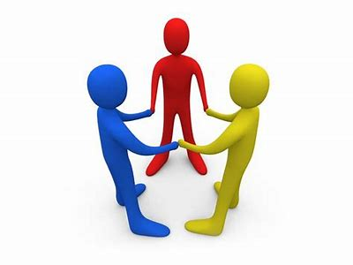
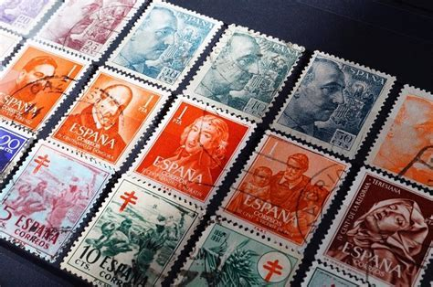
nation
action
lotion
invention
must
stuck
nation
station
relation
action
fiction
dictionary
minute
second
mention
station
fiction
direction
infection
relation
dictionary
collection

Slide 49
Activity page2

Slide 50
Dictation

Slide 51
Name:
1. 2. 3.
4. 5. 6.
7.
8.
9.

Slide 52
lotion

Slide 53
lotion 2. direction

Slide 54
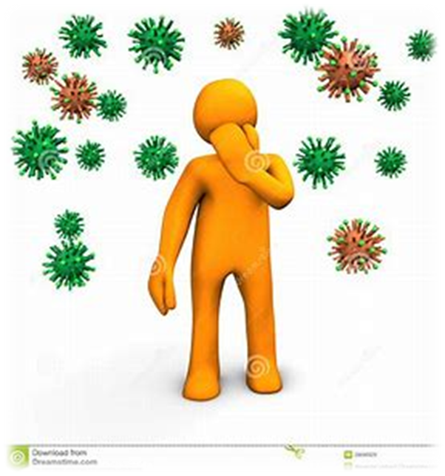
lotion 2. direction 3. infection

Slide 55
lotion 2. direction 3. infection
4. invention

Slide 56
lotion 2. direction 3. infection
4. invention 5. mention

Slide 57
lotion 2. direction 3. infection
4. invention 5. mention 6. collection

Slide 58
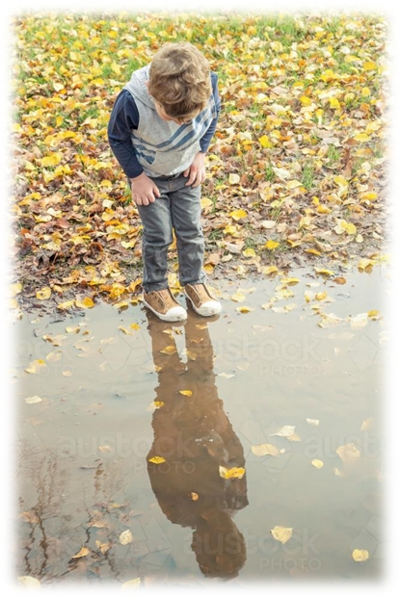
lotion 2. direction 3. infection
4. invention 5. mention 6. collection
7. He swears he can see his reflection.

Slide 59
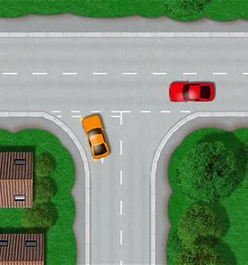
lotion 2. direction 3. infection
4. invention 5. mention 6. collection
7. He swears he can see his reflection.
8. There is a junction
near the station.

Slide 60
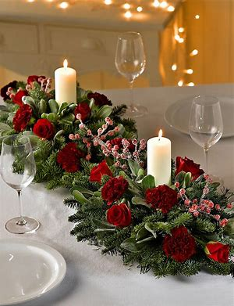
lotion 2. direction 3. infection
4. invention 5. mention 6. collection
7. He swears he can see his reflection.
8. There is a junction
near the station.
9. Shall I mention the
Christmas decorations?

Slide 61
Homework

Slide 62
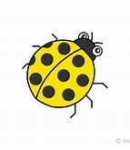
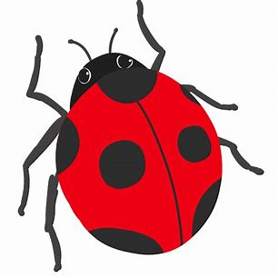
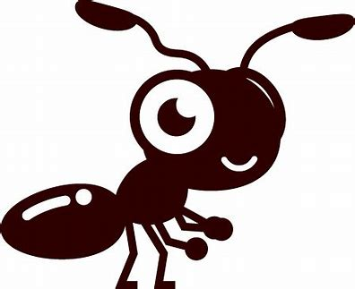
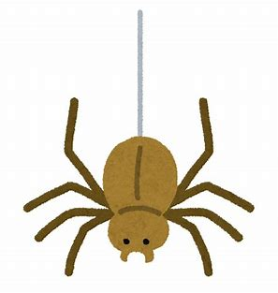
Write a contraction to complete the answer to each question.
“Is it raining?”
“Do you like mustard?”
“No, it .”
“No, I .”
“Did she telephone?”
“Could he swim?”
“No, she .”
“No, he .”

Slide 63
Write a contraction to complete the answer to each question.
“Is it raining?”
“Do you like mustard?”
“No, it .”
“No, I .”
“Did she telephone?”
“Could he swim?”
“No, she .”
“No, he .”

Slide 64
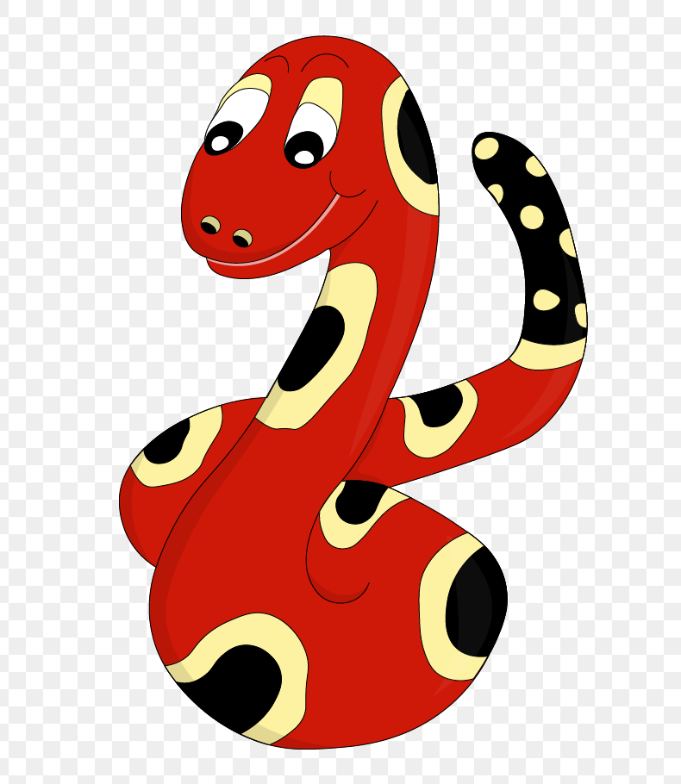
Thank you!
See you
next lesson.

