Slide 1
Jolly Grammar 1-29

Slide 2
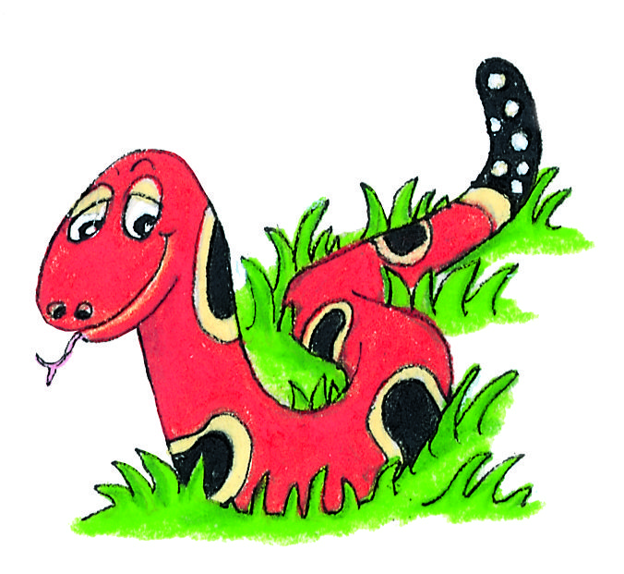
Spelling Test 28

Slide 3
jet

Slide 4
jet
dig

Slide 5
jet
dig
help

Slide 6
jet
dig
help
boy

Slide 7
jet
dig
help
boy
toy

Slide 8
jet
dig
help
boy
toy
6. enjoy

Slide 9
jet
dig
help
boy
toy
6. enjoy
7. annoy

Slide 10
jet
dig
help
boy
toy
6. enjoy
7. annoy
8. two

Slide 11
jet
dig
help
boy
toy
6. enjoy
7. annoy
8. two
9. four

Slide 12
jet
dig
help
boy
toy
6. enjoy
7. annoy
8. two
9. four
10.destroy

Slide 13
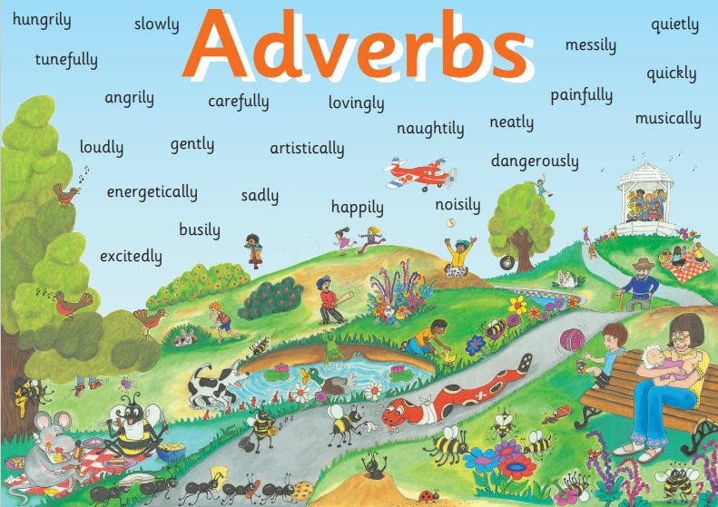

Slide 14
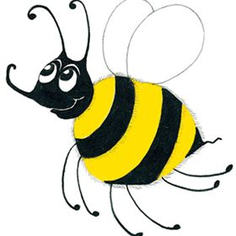
Bee’s Busy Day
Bee woke up suddenly ,
and traipsed slowly down
the hive to have breakfast.
She buzzed loudly as she
flew to the farm. She soon
collected as much pollen as she
could, and flew quickly back to
the hive. She smiled happily to
herself. Bee, and her friends Inky
and Snake, had planned a day out.
loudly
soon
suddenly
happily
quickly
slowly

Slide 15
Let’s review
Singular & Plural

Slide 16
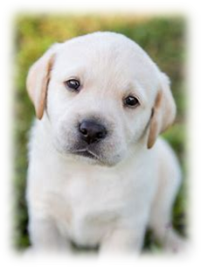
Singular
dog
cat
bird
hat
table
Plural

Slide 17
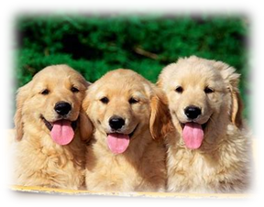
Singular
dog
cat
bird
hat
table
Plural

Slide 18
Singular
dog
cat
bird
hat
table
Plural
dogs

Slide 19
Singular
dog
cat
bird
hat
table
Plural
dogs
cats

Slide 20
Singular
dog
cat
bird
hat
table
Plural
dogs
cats
birds

Slide 21
Singular
dog
cat
bird
hat
table
Plural
dogs
cats
birds
hats

Slide 22
Singular
dog
cat
bird
hat
table
Plural
dogs
cats
birds
hats
tables

Slide 23
Let’s review
Parts of speech

Slide 24
The dog barked loudly.

Slide 25
The dog barked loudly.
The cat walked slowly.

Slide 26
The dog barked loudly.
The cat walked slowly.

Slide 27
The dog barked loudly.
The cat walked slowly.

Slide 28
The dog barked loudly.
The cat walked slowly.

Slide 29
The dogs barked loudly.
The cats walked slowly.

Slide 30
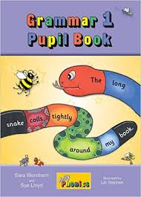
Activity Page:

Slide 31
singular
plural
dish
wish
church
catch
kiss
class
fox
box

Slide 32
singular
plural
dish
wish
dishes
wishes
church
catch
kiss
class
fox
box

Slide 33
singular
plural
dish
wish
dishes
wishes
church
catch
kiss
class
fox
box

Slide 34
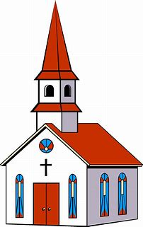
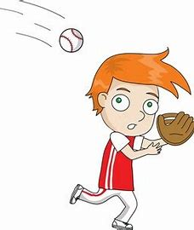
singular
plural
dish
wish
dishes
wishes
church
catch
kiss
class
fox
box

Slide 35
singular
plural
dish
wish
dishes
wishes
church
catch
churches
catches
kiss
class
fox
box

Slide 36
singular
plural
dish
wish
dishes
wishes
church
catch
churches
catches
kiss
class
kisses
classes
fox
box

Slide 37
singular
plural
dish
wish
dishes
wishes
church
catch
churches
catches
kiss
class
kisses
classes
fox
box
foxes
boxes

Slide 38
singular
plural
sh
dish
wish
dishes
wishes
church
catch
churches
catches
kiss
class
kisses
classes
fox
box
foxes
boxes

Slide 39
singular
plural
sh
dish
wish
dishes
wishes
ch
church
catch
churches
catches
kiss
class
kisses
classes
fox
box
foxes
boxes

Slide 40
singular
plural
sh
dish
wish
dishes
wishes
ch
church
catch
churches
catches
kiss
class
kisses
classes
s
fox
box
foxes
boxes

Slide 41
singular
plural
sh
dish
wish
dishes
wishes
ch
church
catch
churches
catches
kiss
class
kisses
classes
s
x
fox
box
foxes
boxes

Slide 42
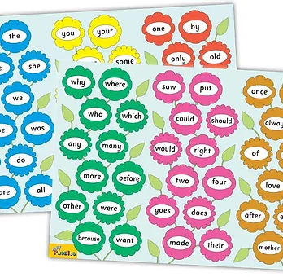
Tricky Words
^{5th} set

Slide 43
saw

Slide 44
put

Slide 45
could

Slide 46
should

Slide 47
would

Slide 48
would

Slide 49
right

Slide 50
right

Slide 51
two

Slide 52
four

Slide 53
goes

Slide 54
goes

Slide 55
does

Slide 56
made

Slide 57
their

Slide 58
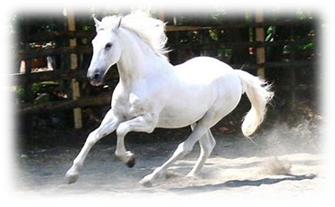
horse
/or/

Slide 59
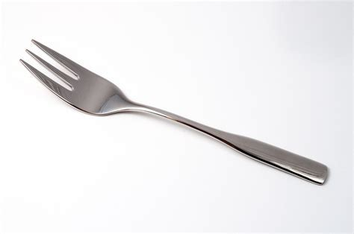
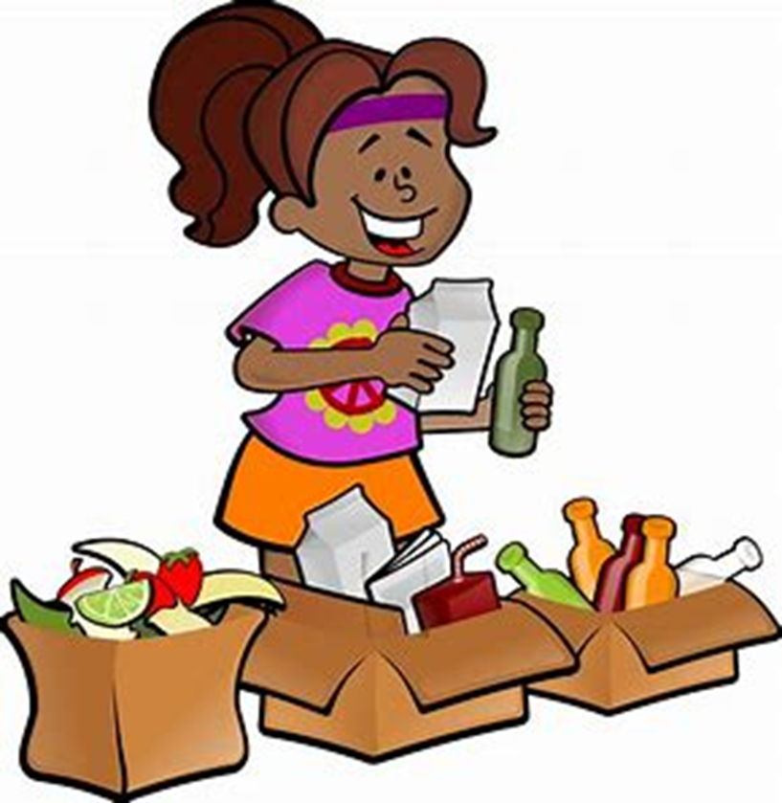
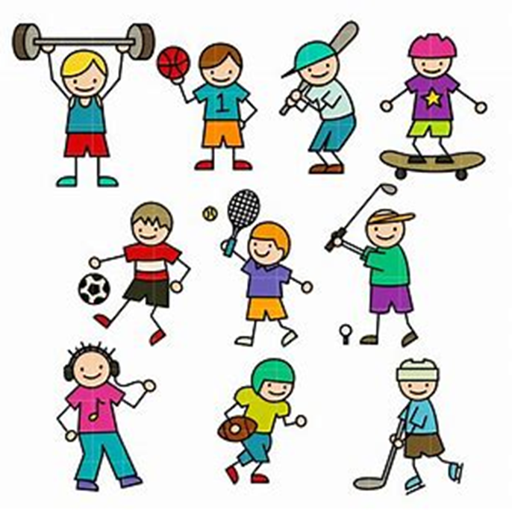
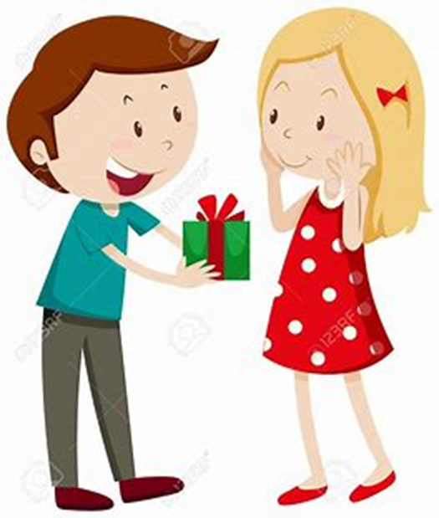
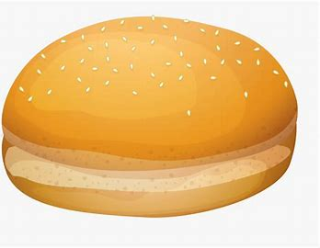
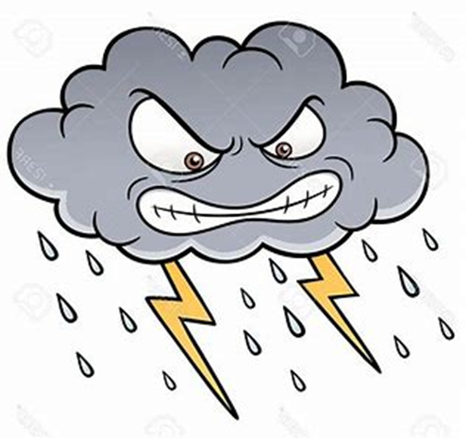
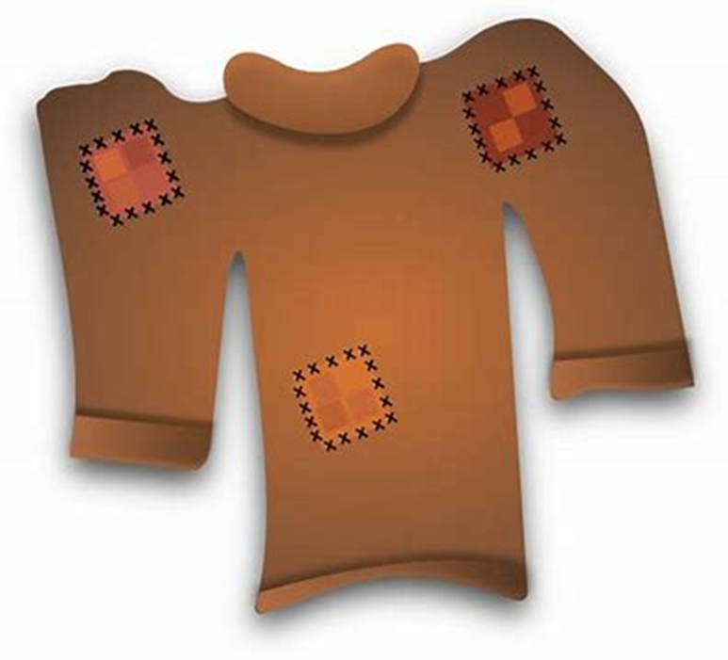
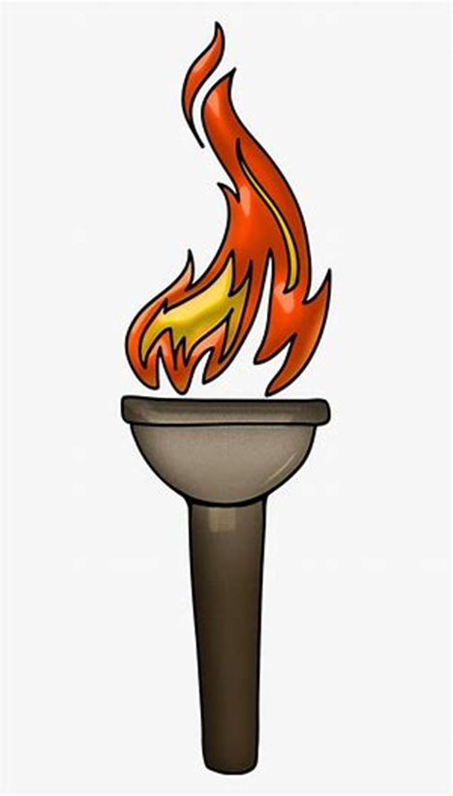
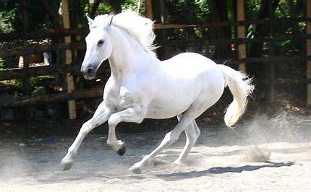
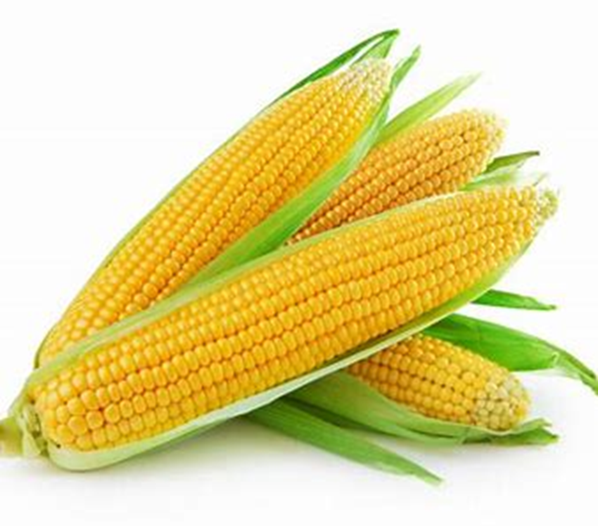
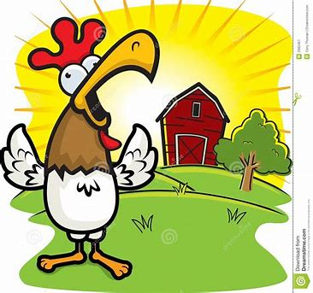
fork
sort
sport
for
got
bun
belt
fork
storm
horse
forty
goes
does
morning
storm
worn
torch
horse
forty
corn
morning

Slide 60
Activity page

Slide 61
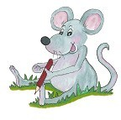
Dictation

Slide 62
corn

Slide 63
corn 2. sort

Slide 64
corn 2. sort 3. worn

Slide 65
corn 2. sort 3. worn
4.torch

Slide 66
corn 2. sort 3. worn
4.torch 5.for

Slide 67
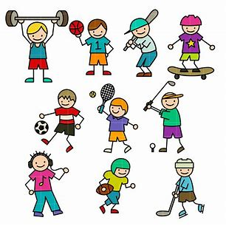
corn 2. sort 3. worn
4.torch 5.for 6. sport

Slide 68
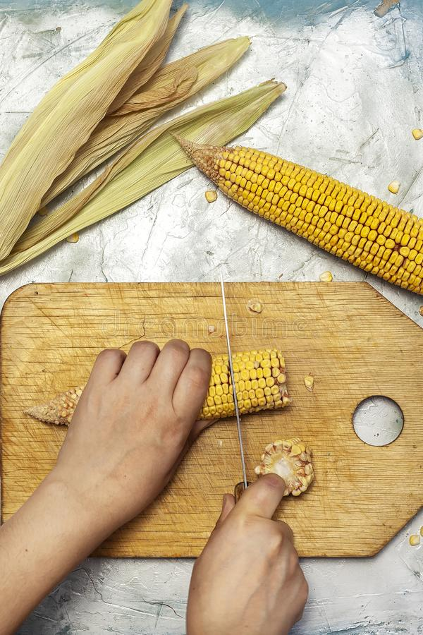
corn 2. sort 3. worn
4.torch 5.for 6. sport
7. We cut the corn.

Slide 69
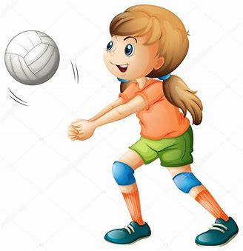
corn 2. sort 3. worn
4.torch 5.for 6. sport
7. We cut the corn.
8. She is good at sports.

Slide 70
corn 2. sort 3. worn
4.torch 5.for 6. sport
7. We cut the corn.
8. She is good at sports.
9. There was a storm this morning.

Slide 71
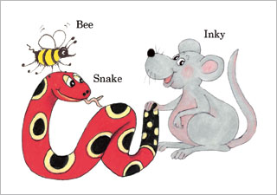
Homework

Slide 72
Thank you! See you next time.

