Slide 1
Jolly Grammar 1-28

Slide 2
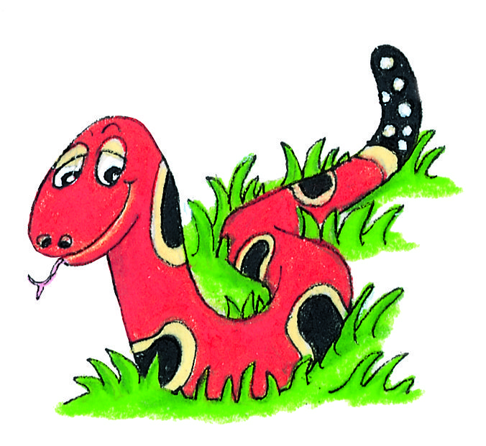
Spelling Test 27

Slide 3
bug

Slide 4
bug
had

Slide 5
bug
had
film

Slide 6
bug
had
film
oil

Slide 7
bug
had
film
oil
coin

Slide 8
bug
had
film
oil
coin
6. noisy

Slide 9
bug
had
film
oil
coin
6. noisy
7. toil

Slide 10
bug
had
film
oil
coin
6. noisy
7. toil
8. would

Slide 11
bug
had
film
oil
coin
6. noisy
7. toil
8. would
9. right

Slide 12
bug
had
film
oil
coin
6. noisy
7. toil
8. would
9. right
10.boiling

Slide 13
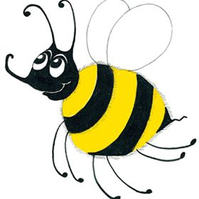
Let’s review
Verbs & Adverbs

Slide 14
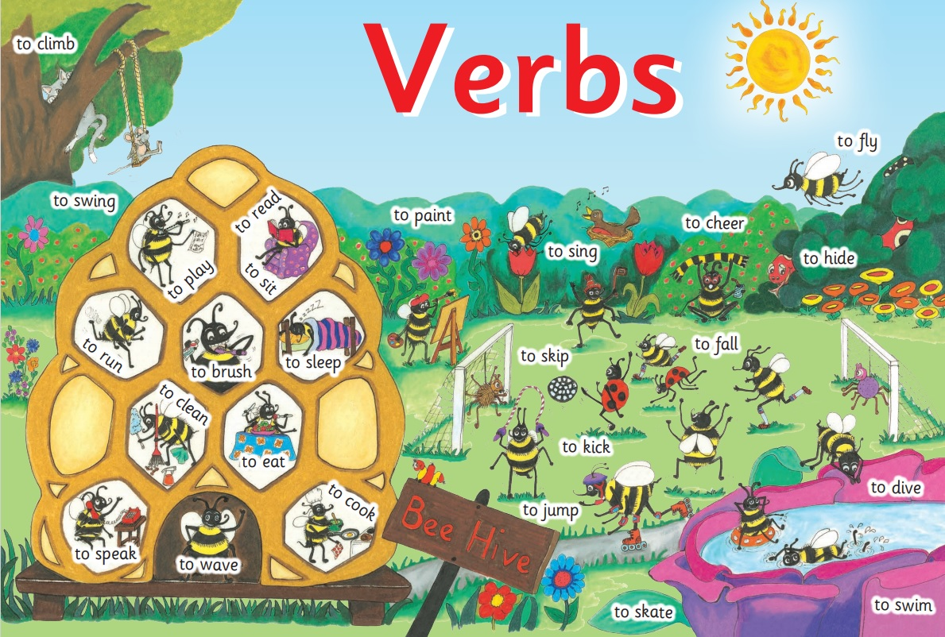

Slide 15
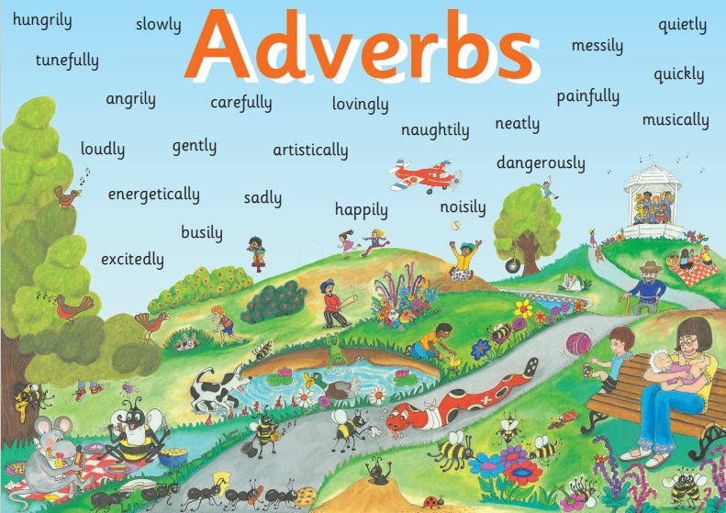

Slide 16
loudly soon suddenly
happily quickly slowly

Slide 17
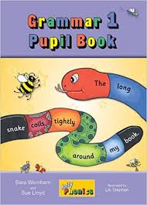
Activity Page:

Slide 18
Bee’s Busy Day
Bee woke up ,
and traipsed down
the hive to have breakfast.
She buzzed as she
flew to the farm. She
collected as much pollen as she
could, and flew back to
the hive. She smiled to
herself. Bee, and her friends Inky
and Snake, had planned a day out.
loudly
soon
suddenly
happily
quickly
slowly

Slide 19
Bee’s Busy Day
Bee woke up suddenly ,
and traipsed down
the hive to have breakfast.
She buzzed as she
flew to the farm. She
collected as much pollen as she
could, and flew back to
the hive. She smiled to
herself. Bee, and her friends Inky
and Snake, had planned a day out.
loudly
soon
suddenly
happily
quickly
slowly

Slide 20
Bee’s Busy Day
Bee woke up suddenly ,
and traipsed slowly down
the hive to have breakfast.
She buzzed as she
flew to the farm. She
collected as much pollen as she
could, and flew back to
the hive. She smiled to
herself. Bee, and her friends Inky
and Snake, had planned a day out.
loudly
soon
suddenly
happily
quickly
slowly

Slide 21
Bee’s Busy Day
Bee woke up suddenly ,
and traipsed slowly down
the hive to have breakfast.
She buzzed loudly as she
flew to the farm. She
collected as much pollen as she
could, and flew back to
the hive. She smiled to
herself. Bee, and her friends Inky
and Snake, had planned a day out.
loudly
soon
suddenly
happily
quickly
slowly

Slide 22
Bee’s Busy Day
Bee woke up suddenly ,
and traipsed slowly down
the hive to have breakfast.
She buzzed loudly as she
flew to the farm. She soon
collected as much pollen as she
could, and flew back to
the hive. She smiled to
herself. Bee, and her friends Inky
and Snake, had planned a day out.
loudly
soon
suddenly
happily
quickly
slowly

Slide 23
Bee’s Busy Day
Bee woke up suddenly ,
and traipsed slowly down
the hive to have breakfast.
She buzzed loudly as she
flew to the farm. She soon
collected as much pollen as she
could, and flew quickly back to
the hive. She smiled to
herself. Bee, and her friends Inky
and Snake, had planned a day out.
loudly
soon
suddenly
happily
quickly
slowly

Slide 24
Bee’s Busy Day
Bee woke up suddenly ,
and traipsed slowly down
the hive to have breakfast.
She buzzed loudly as she
flew to the farm. She soon
collected as much pollen as she
could, and flew quickly back to
the hive. She smiled happily to
herself. Bee, and her friends Inky
and Snake, had planned a day out.
loudly
soon
suddenly
happily
quickly
slowly

Slide 25
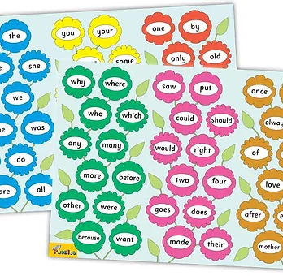
Tricky Words
^{5th} set

Slide 26
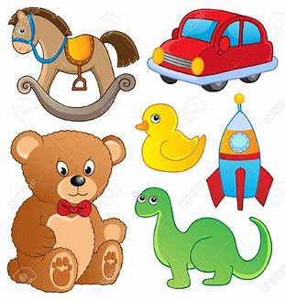
toy
/oi/

Slide 27
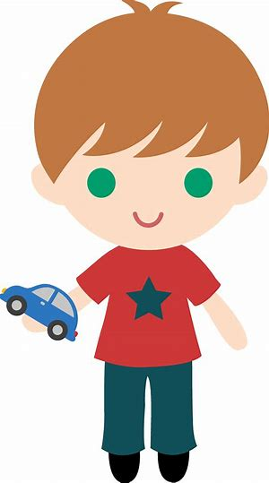
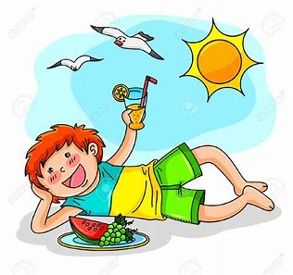
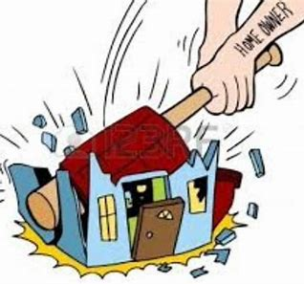
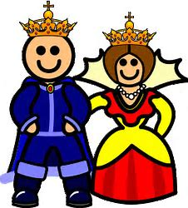
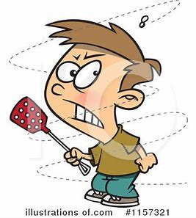
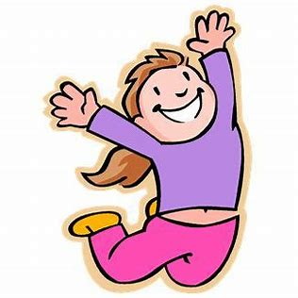
boy
enjoy
destroy
jet
dig
help
boy
toy
enjoy
annoy
two
four
destroy
toy
royal
annoy
joy

Slide 28
Activity page

Slide 29
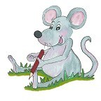
Dictation

Slide 30
boy

Slide 31
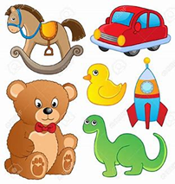
boy 2. toy

Slide 32
boy 2. toy 3. joy

Slide 33
boy 2. toy 3. joy
4. enjoy

Slide 34
boy 2. toy 3. joy
4. enjoy 5.royal

Slide 35
boy 2. toy 3. joy
4. enjoy 5.royal 6. annoy

Slide 36
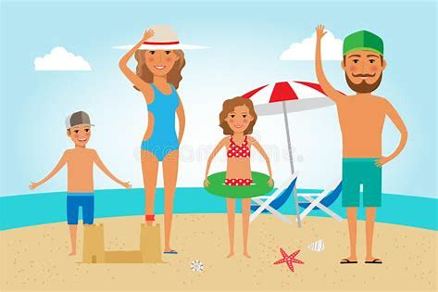
boy 2. toy 3. joy
4. enjoy 5.royal 6. annoy
7. They enjoyed the trip.

Slide 37
boy 2. toy 3. joy
4. enjoy 5.royal 6. annoy
7. They enjoyed the trip.
8. The fly was annoying
the boy.

Slide 38
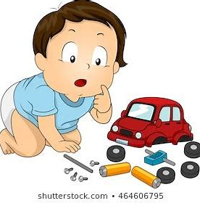
boy 2. toy 3. joy
4. enjoy 5.royal 6. annoy
7. They enjoyed the trip.
8. The fly was annoying
the boy.
9. His toy car had a crash.

Slide 39
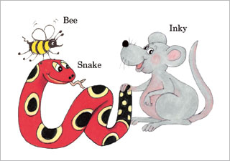
Homework

Slide 40
Thank you! See you next time.

