Slide 1
Jolly Grammar
5a-29

Slide 2
Let’s review
Prepositional phrases.

Slide 3
at
on
past
along
before
through
in
to
under
around
across
during

Slide 4
Let’s review
suffixes.

Slide 5
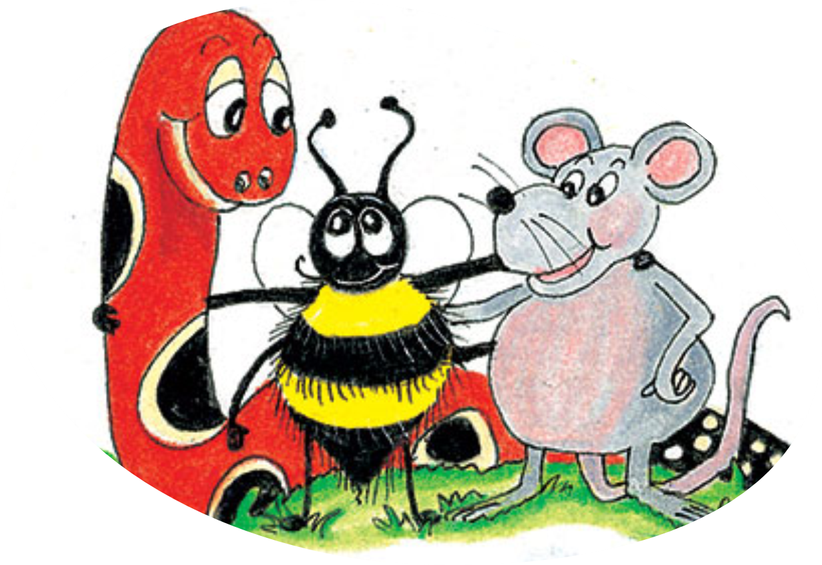
action
mansion
question
conversion
competition
collision

Slide 6
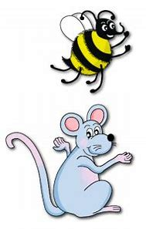
Spelling Point
<ssion>

Slide 7
express
admit

Slide 8
expression
admission

Slide 9
Spelling List
<ssion>

Slide 10
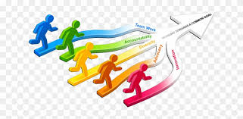
session passion mission
permission submission admission

Slide 11
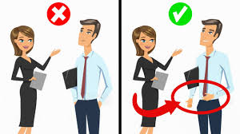
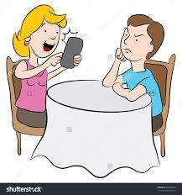
expression impression profession
aggression progression obsession

Slide 12
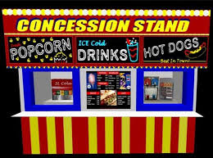
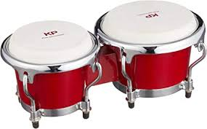
discussion depression succession
concession omission percussion

Slide 13
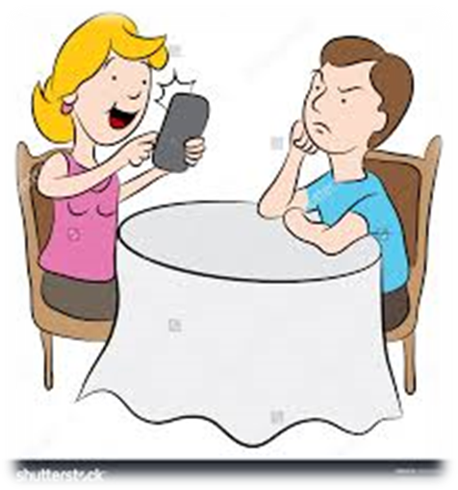
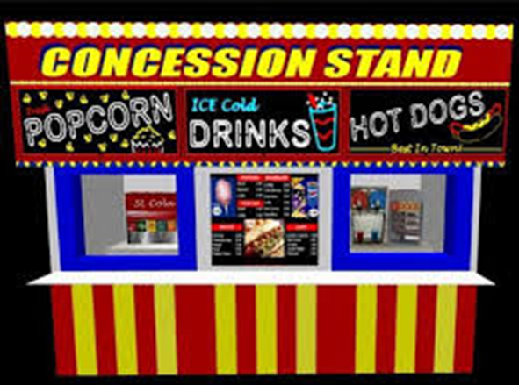
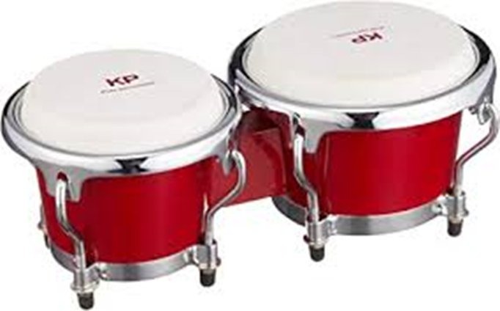

Slide 14
Activity Page:
Spelling
<ssion>

Slide 15
Which words have “mission”?

Slide 16
permission

Slide 17
permission
submission

Slide 18
permission
submission
admission

Slide 19
permission
submission
admission
omission

Slide 20
Root verbs

Slide 21
permission

Slide 22
permission
admission

Slide 23
permission
admission
impression

Slide 24
permission
admission
impression
obsession

Slide 25
permission
admission
impression
obsession
depression

Slide 26
permission
admission
impression
obsession
depression
concession

Slide 27
permission
admission
impression
obsession
depression
concession
submission

Slide 28
permission
admission
impression
obsession
depression
concession
submission
expression

Slide 29
permission
admission
impression
obsession
depression
concession
submission
expression
progression

Slide 30
permission
admission
impression
obsession
depression
concession
submission
expression
progression
discussion

Slide 31
permission
admission
impression
obsession
depression
concession
submission
expression
progression
discussion
succession

Slide 32
permission
admission
impression
obsession
depression
concession
submission
expression
progression
discussion
succession
omission

Slide 33
Prefixes

Slide 34
depression

Slide 35
depression
expression

Slide 36
depression
expression
submission

Slide 37
Parsing & Sentence Walls

Slide 38
The percussion player was wearing
a determined expression.
Subject
player
The percussion
Verb
was wearing
Object
expression
a determined

Slide 39
Dictation

Slide 41
We had a long discussion about all the options.

Slide 42
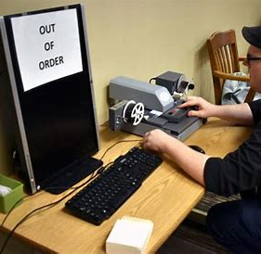

Slide 43
The spy hid the microfilm during his mission.

Slide 44
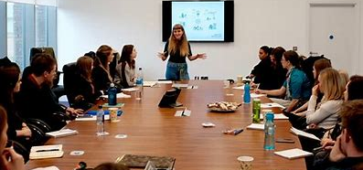

Slide 45
“You need permission to leave the session early,” he explained.

Slide 46
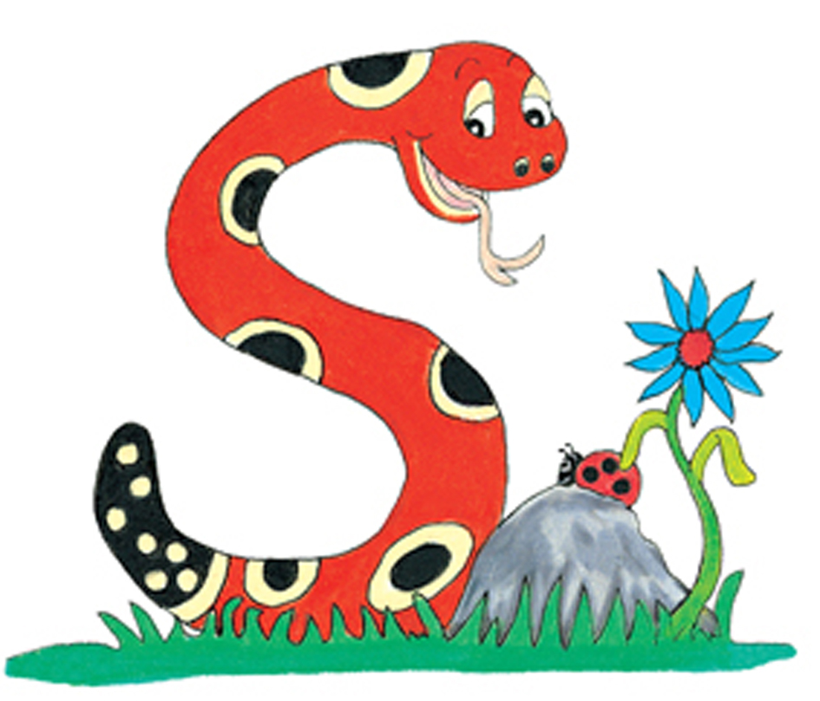
Thank you.
See you
next time!

