Slide 1
Jolly Grammar
5a-27

Slide 2
Let’s review
Tenses.

Slide 3
Let’s review
prefixes

Slide 4
post-
cent(i)-
milli-
super-
mega-
micro-
auto-
multi-
after / behind
hundred
thousand
above / beyond
great
small
self
many / more than one

Slide 5
Parsing & Sentence Walls

Slide 6
The rich landowner had recently built a huge mansion.
Subject
landowner
The rich
Verb
had built
recently
Object
mansion
a huge

Slide 7
Spelling Point
<-sion>

Slide 8
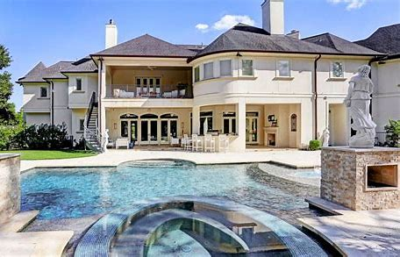
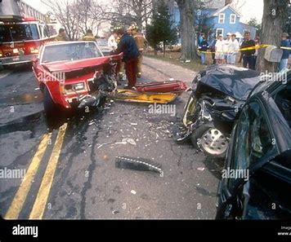
mansion
collision
Suffix <-sion> is added to verbs ending in <s> <se> <d> <de>.

Slide 9
Spelling List
<-sion>

Slide 10
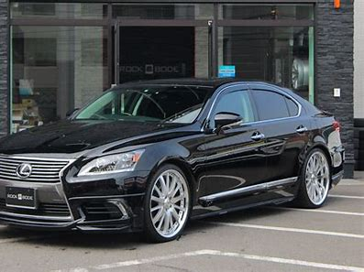
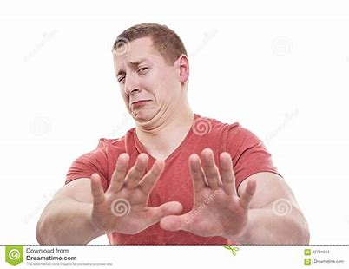
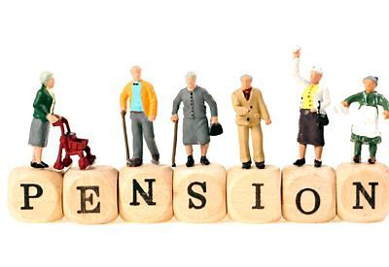
version
mansion
tension
pension
aversion
pretension

Slide 11
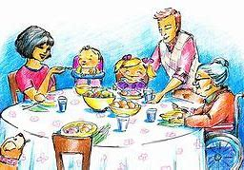
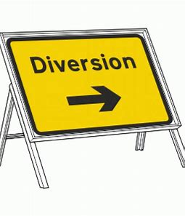
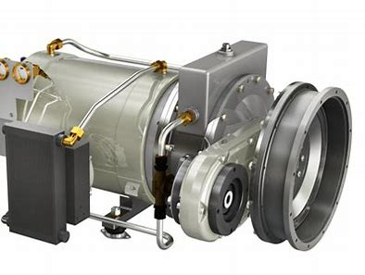
occasion
compulsion
conversion
diversion
propulsion
extension

Slide 12
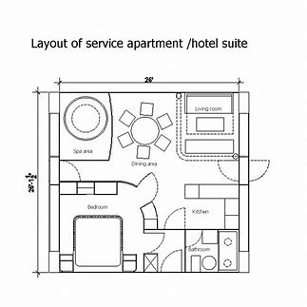
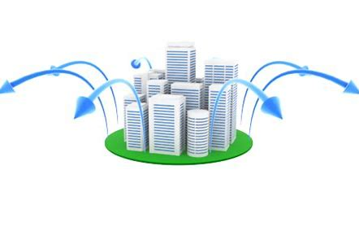
dimension
collision
expansion
apprehension
comprehension
misapprehension

Slide 14
Activity Page:
Spelling
<-sion>

Slide 15
Dictation

Slide 17
Her apprehension was causing a lot of tension.

Slide 19
They examined the wreckage after the collision.

Slide 21
“I need the exact dimensions of the room,” replied the builder.

Slide 22
Thank you.
See you
next time!

