Slide 1
Jolly Grammar
5a-26

Slide 2
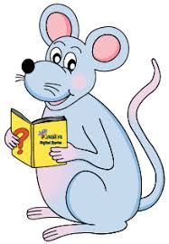
Spelling Test 12

Slide 3
option

Slide 4
option
position

Slide 5
option
position
action

Slide 6
option
position
action
section

Slide 7
option
position
action
section
mention

Slide 8
option
position
action
section
mention
question

Slide 9
option
position
action
section
mention
question
direction

Slide 10
option
position
action
section
mention
question
direction
suggestion

Slide 11
option
position
action
section
mention
question
direction
suggestion
infection

Slide 12
option
position
action
section
mention
question
direction
suggestion
infection
10. rejection

Slide 13
option
position
action
section
mention
question
direction
suggestion
infection
10. rejection
11. condition

Slide 14
option
position
action
section
mention
question
direction
suggestion
infection
10. rejection
11. condition
12. function

Slide 15
option
position
action
section
mention
question
direction
suggestion
infection
10. rejection
11. condition
12. function
13. competition

Slide 16
option
position
action
section
mention
question
direction
suggestion
infection
10. rejection
11. condition
12. function
13. competition
14. contribution

Slide 17
option
position
action
section
mention
question
direction
suggestion
infection
10. rejection
11. condition
12. function
13. competition
14. contribution
15. introduction

Slide 18
option
position
action
section
mention
question
direction
suggestion
infection
10. rejection
11. condition
12. function
13. competition
14. contribution
15. introduction
16. opposition

Slide 19
option
position
action
section
mention
question
direction
suggestion
infection
10. rejection
11. condition
12. function
13. competition
14. contribution
15. introduction
16. opposition
17. production

Slide 20
option
position
action
section
mention
question
direction
suggestion
infection
10. rejection
11. condition
12. function
13. competition
14. contribution
15. introduction
16. opposition
17. production
18. connection

Slide 21
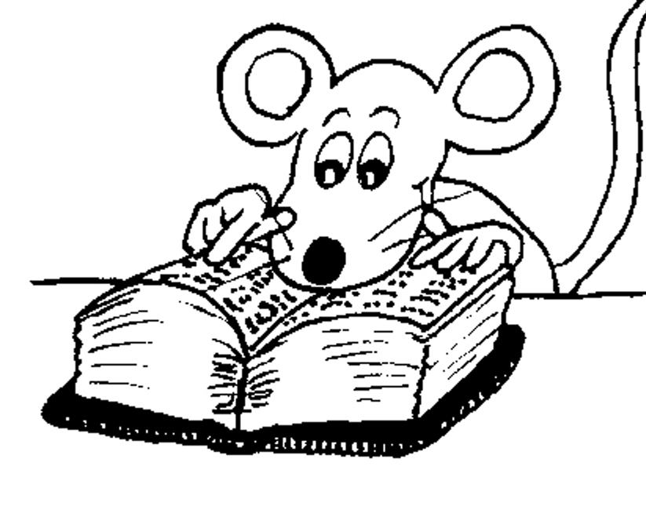
Let’s Review Parts of Speech

Slide 22
Sally was running quickly along the hedge when she saw a large herd of cows in a muddy field.

Slide 23
Sally was running quickly along the hedge when she saw a large herd of cows in a muddy field.

Slide 24
Sally was running quickly along the hedge when she saw a large heard of cows in a muddy field.

Slide 25
Sally was running quickly along the hedge when she saw a large heard of cows in a muddy field.

Slide 26
Sally was running quickly along the hedge when she saw a large heard of cows in a muddy field.

Slide 27
Sally was running quickly along the hedge when she saw a large heard of cows in a muddy field.

Slide 28
Sally was running quickly along the hedge when she saw a large heard of cows in a muddy field.

Slide 29
Sally was running quickly along the hedge when she saw a large heard of cows in a muddy field.

Slide 30
Sally was running quickly along the hedge when she saw a large heard of cows in a muddy field.

Slide 31
Sally was running quickly along the hedge when she saw a large herd of cows in a muddy field.

Slide 32
Sally was running quickly along the hedge when she saw a large heard of cows in a muddy field.

Slide 33
Sally was running quickly along the hedge when she saw a large heard of cows in a muddy field.

Slide 34
Sally was running quickly along the hedge when she saw a large heard of cows in a muddy field.

Slide 35
Sally was running quickly along the hedge when she saw a large heard of cows in a muddy field.

Slide 36
Sally was running quickly along the hedge when she saw a large heard of cows in a muddy field.

Slide 37
Sally was running quickly along the hedge when she saw a large heard of cows in a muddy field.

Slide 38
Preposition
Preposition is a word that describes where it is or where it is moving towards.

Slide 39
Pre… before
Position…place
Preposition → placed before

Slide 40
Only ‘place’?

Slide 41
Sally ran in the morning.
Sally ran during the race.
Sally ran throughout the summer.

Slide 42
Sally ran in the morning.
Sally ran during the race.
Sally ran throughout the summer.
‘place’, ‘direction’, ‘time’, ‘event’

Slide 43
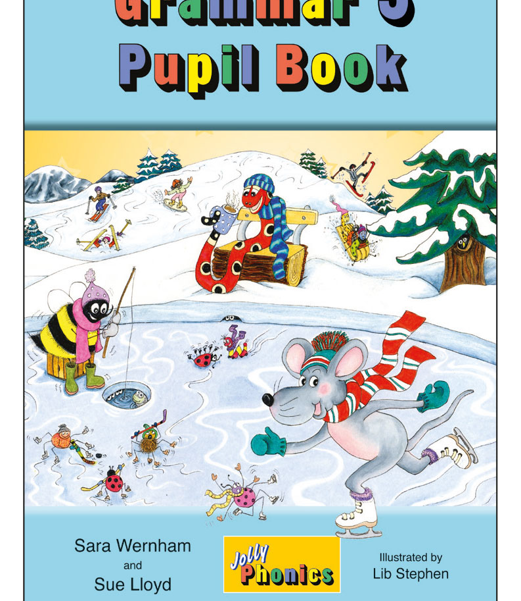
Activity Page
Prepositions

Slide 44
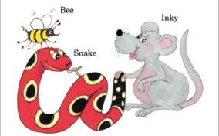
See you
next time!

