Slide 1
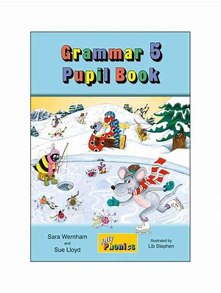
Jolly Grammar
5a-25

Slide 2
Let’s review
contraction

Slide 3
●Contraction●
I have

Slide 4
●Contraction●
I have
↓
I’ve

Slide 5
I’ve
I have
they’d
they had
he’ll have
he will have
it’s
it has
she’d
she had
you’ve
you have
you’d
you had
I’d
I had
we’ve
we have

Slide 6
she has
she’s
it had
they’d
we have
we’ll have
they have
they’ve
we had
we’d
I shall have
I’ll have
you had
you’d
he will have
he’ll have
he had
he’d

Slide 7
Let’s review
prefixes

Slide 8
post-
cent(i)-
milli-
super-
mega-
micro-
auto-
multi-

Slide 9
post-
cent(i)-
milli-
super-
mega-
micro-
auto-
multi-
after / behind

Slide 10
post-
cent(i)-
milli-
super-
mega-
micro-
auto-
multi-
after / behind
hundred

Slide 11
post-
cent(i)-
milli-
super-
mega-
micro-
auto-
multi-
after / behind
hundred
thousand

Slide 12
post-
cent(i)-
milli-
super-
mega-
micro-
auto-
multi-
after / behind
hundred
thousand
above / beyond

Slide 13
post-
cent(i)-
milli-
super-
mega-
micro-
auto-
multi-
after / behind
hundred
thousand
above / beyond
great

Slide 14
post-
cent(i)-
milli-
super-
mega-
micro-
auto-
multi-
after / behind
hundred
thousand
above / beyond
great
small

Slide 15
post-
cent(i)-
milli-
super-
mega-
micro-
auto-
multi-
after / behind
hundred
thousand
above / beyond
great
small
self

Slide 16
post-
cent(i)-
milli-
super-
mega-
micro-
auto-
multi-
after / behind
hundred
thousand
above / beyond
great
small
self
many / more than one

Slide 17
station
relation
infection
producetion
competeition
suggestion /ch/

Slide 18
Parsing & Sentence Walls

Slide 19
The store detective has questioned
the customers thoroughly.
Subject
detective
The store
Verb
has questioned
thoroughly
Object
costomers
the

Slide 20
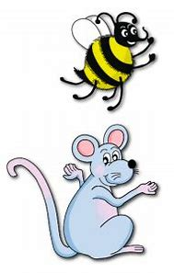
Spelling Point
<-tion>

Slide 21
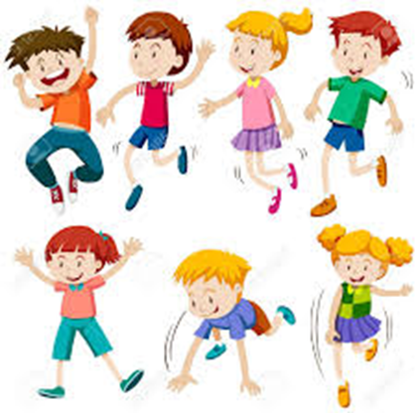
act
action
reject
rejection
connect
connection

Slide 22
act
action
reject
rejection
connect
connection
verb → noun

Slide 23
Spelling List
<-tion>

Slide 24
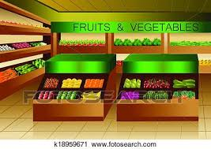
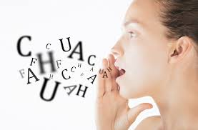
option
section
position
mention
action
question

Slide 25
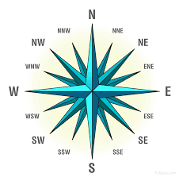
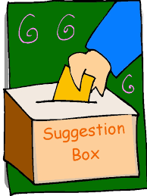
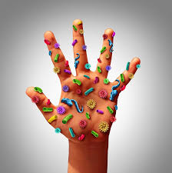
direction
rejection
suggestion
condition
infection
function

Slide 26
contribution
production
introduction
connection
competition
opposition

Slide 27
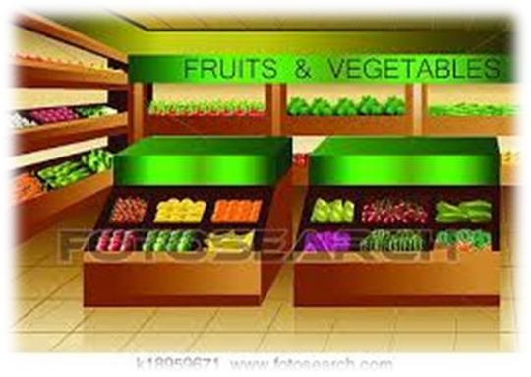
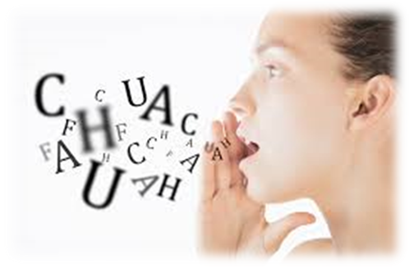
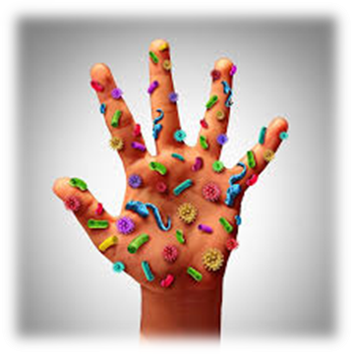

Slide 28
Activity Page:
Spelling
<-tion>

Slide 29
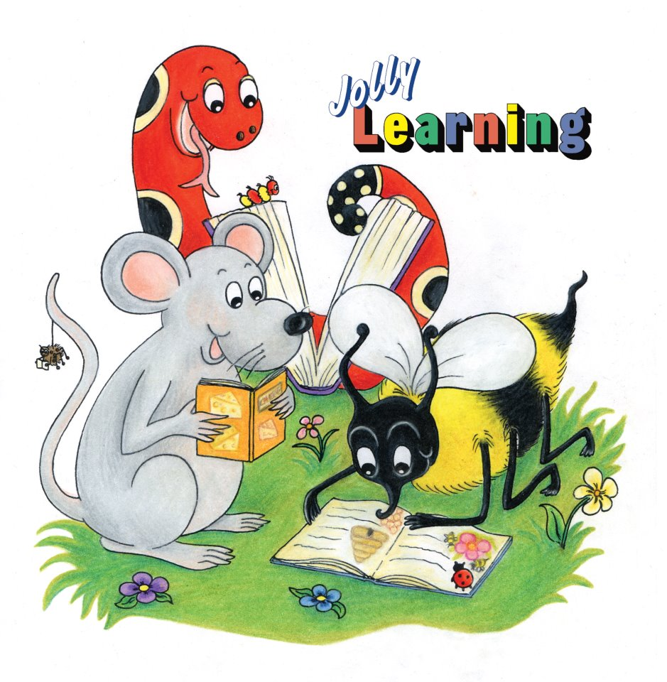
Dictation

Slide 30
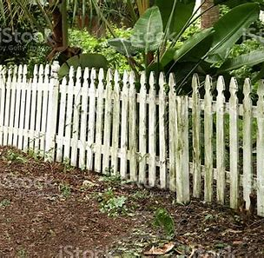

Slide 31
A section of the fence is in bad condition.

Slide 33
Did I mention my suggestion to have a competition?

Slide 34
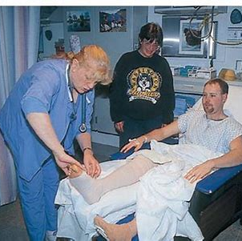

Slide 35
“You have a post-operative infection,” remarked the doctor.

Slide 36
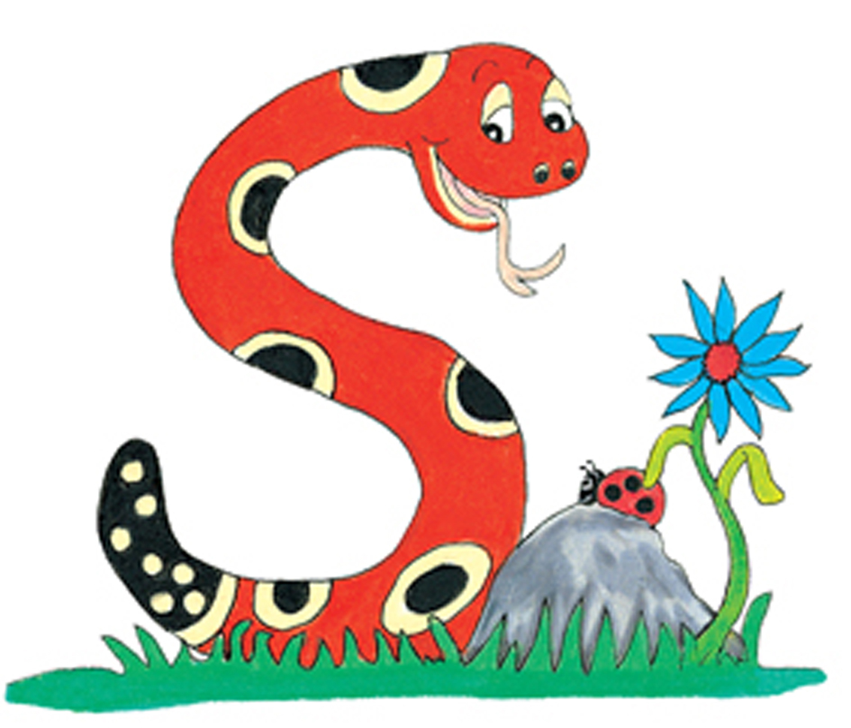
Thank you.
See you
next time!

