Slide 1
Jolly Grammar
5a-24

Slide 2
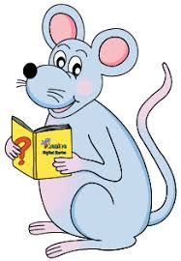
Spelling Test 12

Slide 3
post

Slide 4
post
postcard

Slide 5
post
postcard
posture

Slide 6
post
postcard
posture
postpone

Slide 7
post
postcard
posture
postpone
postwar

Slide 8
post
postcard
posture
postpone
postwar
postdate

Slide 9
post
postcard
posture
postpone
postwar
postdate
postscript

Slide 10
post
postcard
posture
postpone
postwar
postdate
postscript
postnatal

Slide 11
post
postcard
posture
postpone
postwar
postdate
postscript
postnatal
posterity

Slide 12
post
postcard
posture
postpone
postwar
postdate
postscript
postnatal
posterity
10. posterior

Slide 13
post
postcard
posture
postpone
postwar
postdate
postscript
postnatal
posterity
10. posterior
11. postmodern

Slide 14
post
postcard
posture
postpone
postwar
postdate
postscript
postnatal
posterity
10. posterior
11. postmodern
12. postmaster

Slide 15
post
postcard
posture
postpone
postwar
postdate
postscript
postnatal
posterity
10. posterior
11. postmodern
12. postmaster
13. posthumous

Slide 16
post
postcard
posture
postpone
postwar
postdate
postscript
postnatal
posterity
10. posterior
11. postmodern
12. postmaster
13. posthumous
14. postmortem

Slide 17
post
postcard
posture
postpone
postwar
postdate
postscript
postnatal
posterity
10. posterior
11. postmodern
12. postmaster
13. posthumous
14. postmortem
15. post-operative

Slide 18
post
postcard
posture
postpone
postwar
postdate
postscript
postnatal
posterity
10. posterior
11. postmodern
12. postmaster
13. posthumous
14. postmortem
15. post-operative
16. postponement

Slide 19
post
postcard
posture
postpone
postwar
postdate
postscript
postnatal
posterity
10. posterior
11. postmodern
12. postmaster
13. posthumous
14. postmortem
15. post-operative
16. postponement
17. postgraduate

Slide 20
post
postcard
posture
postpone
postwar
postdate
postscript
postnatal
posterity
10. posterior
11. postmodern
12. postmaster
13. posthumous
14. postmortem
15. post-operative
16. postponement
17. postgraduate
18. post-haste

Slide 21
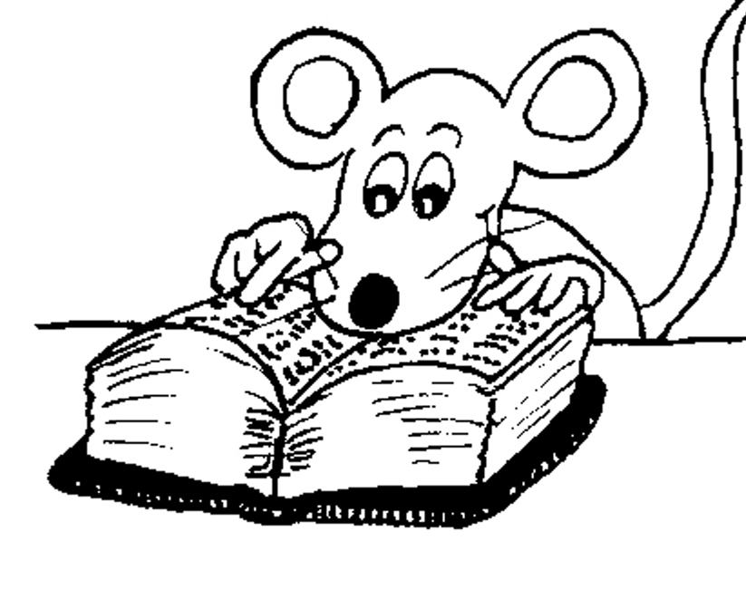
Let’s Review Parts of Speech

Slide 22
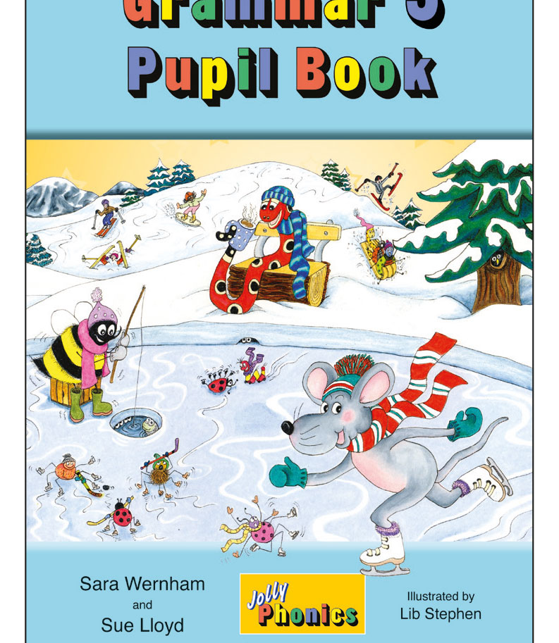
Proofreading

Slide 23
They were singing in the school concert.

Slide 24
He drove the car very quickly around the corner.

Slide 25
The microphone was not working properly.

Slide 26
She is running down the street when she tripped over.

Slide 27
The snail disappeared into its shell.

Slide 28
I had eaten an egg sandwich.

Slide 29
The boy has a new pencil case.

Slide 30
Where are the apples from the supermarket?

Slide 31
We postponed the race due to the bad weather.

Slide 33
Sally was running quickly along the hedge when she saw a large herd of cows in a muddy field.

Slide 34
Sally was running quickly along the hedge when she saw a large herd of cows in a muddy field.

Slide 35
Sally was running quickly along the hedge when she saw a large heard of cows in a muddy field.

Slide 36
Sally was running quickly along the hedge when she saw a large heard of cows in a muddy field.

Slide 37
Sally was running quickly along the hedge when she saw a large heard of cows in a muddy field.

Slide 38
Sally was running quickly along the hedge when she saw a large heard of cows in a muddy field.

Slide 39
Sally was running quickly along the hedge when she saw a large heard of cows in a muddy field.

Slide 40
Sally was running quickly along the hedge when she saw a large heard of cows in a muddy field.

Slide 41
Sally was running quickly along the hedge when she saw a large heard of cows in a muddy field.

Slide 42
Sally was running quickly along the hedge when she saw a large herd of cows in a muddy field.

Slide 43
Sally was running quickly along the hedge when she saw a large heard of cows in a muddy field.

Slide 44
Sally was running quickly along the hedge when she saw a large heard of cows in a muddy field.

Slide 45
Sally was running quickly along the hedge when she saw a large heard of cows in a muddy field.

Slide 46
Sally was running quickly along the hedge when she saw a large heard of cows in a muddy field.

Slide 47
Sally was running quickly along the hedge when she saw a large heard of cows in a muddy field.

Slide 48
Sally was running quickly along the hedge when she saw a large heard of cows in a muddy field.

Slide 49
Preposition
Preposition is a word that describes where it is or where it is moving towards.

Slide 50
Pre… before
Position…place
Preposition → placed before

Slide 51
Only ‘place’?

Slide 52
Sally ran in the morning.
Sally ran during the race.
Sally ran throughout the summer.

Slide 53
Sally ran in the morning.
Sally ran during the race.
Sally ran throughout the summer.
‘place’, ‘direction’, ‘time’, ‘event’

Slide 54
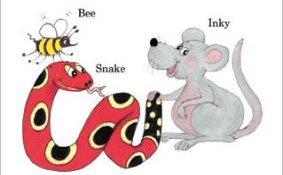
See you
next time!

