Slide 1
Jolly Grammar
5a-22

Slide 2
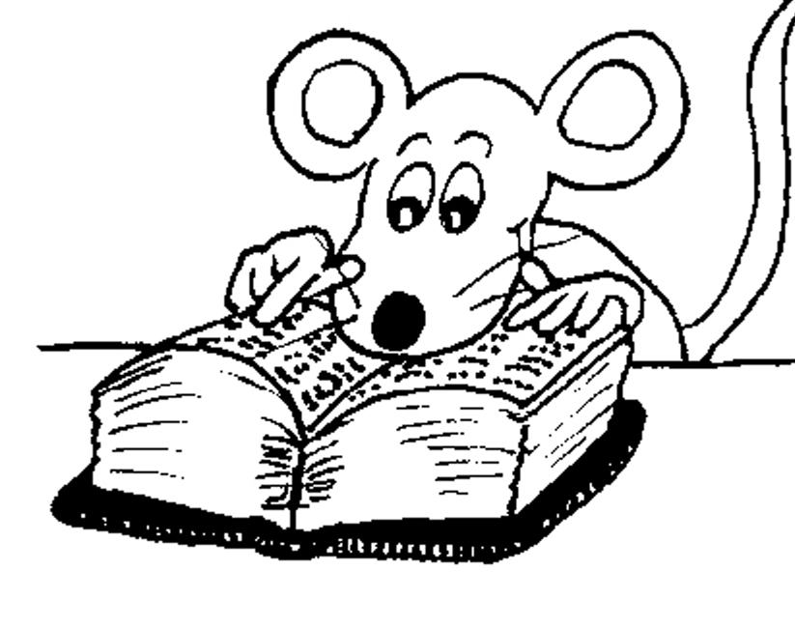
Let’s review
ADVERBS

Slide 3
He drove carefully around the corner.
verb and adverb?

Slide 4
He drove carefully around the corner.
verb and adverb?

Slide 5
He drove carefully around the corner.

Slide 6
He drove carefully around the corner.
He carefully drove around the corner.

Slide 7
He drove carefully around the corner.
He carefully drove around the corner.
He drove around the corner carefully.

Slide 8
He drove carefully around the corner.
He carefully drove around the corner.
He drove around the corner carefully.
Carefully, he drove around the corner.

Slide 9
She only grazed her knee.
She grazed only her knee.

Slide 10
Activity Page

Slide 11
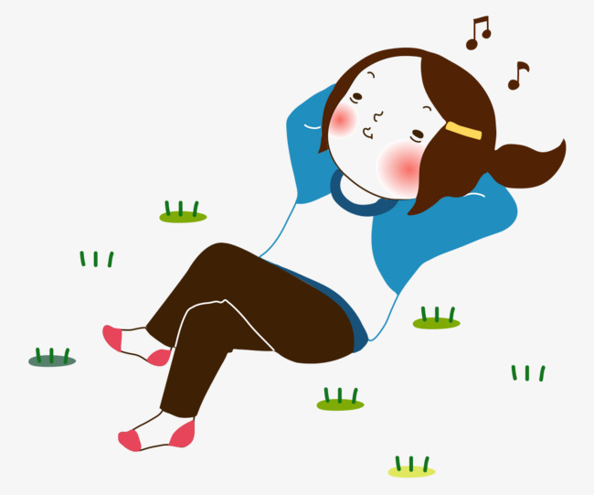
A girl was humming the tune quietly.

Slide 12
A girl was humming the tune quietly.

Slide 13
They enjoyed the flowers’ fragrance enormously.

Slide 14
They enjoyed the flowers’ fragrance enormously.

Slide 15
The weather has gradually improved during the day.

Slide 16
The weather has gradually improved during the day.

Slide 17
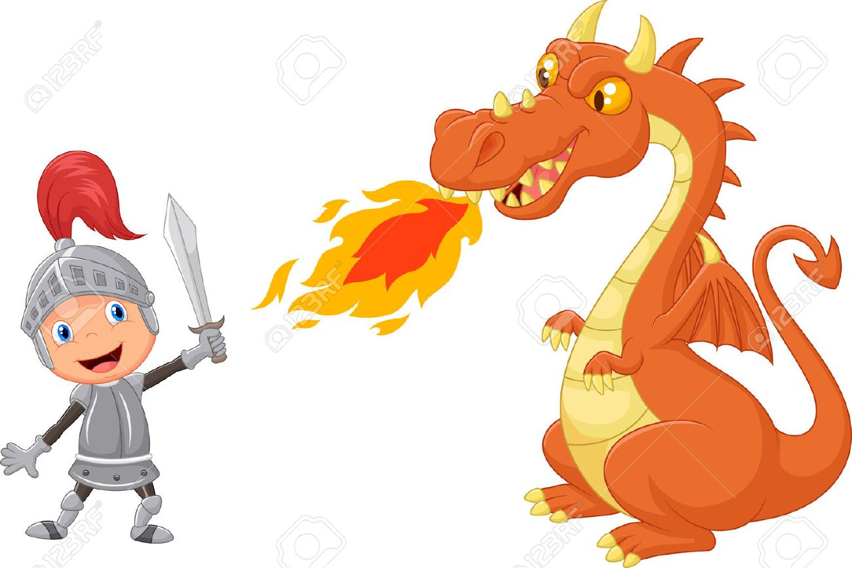
The knight had courageously fought the fierce dragon.

Slide 18
The knight had courageously fought the fierce dragon.

Slide 19
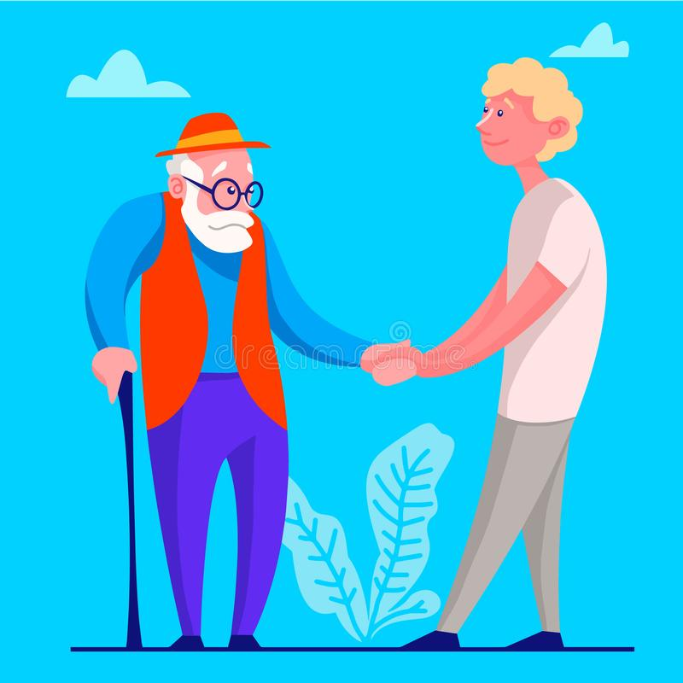
Grudgingly, he offered his assistance to the old man.

Slide 20
Grudgingly, he offered his assistance to the old man.

Slide 21
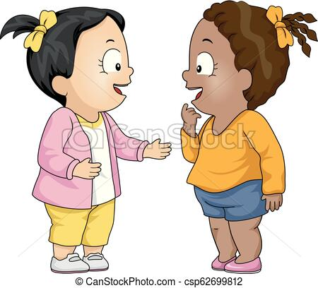
She is finally meeting her pen pal from Australia.

Slide 22
She is finally meeting her pen pal from Australia.

Slide 23
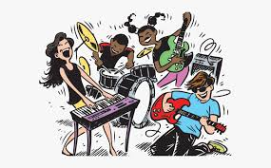
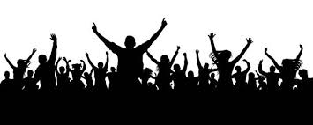
The audience were loudly applauding the band.

Slide 24
The audience were loudly applauding the band.

Slide 25
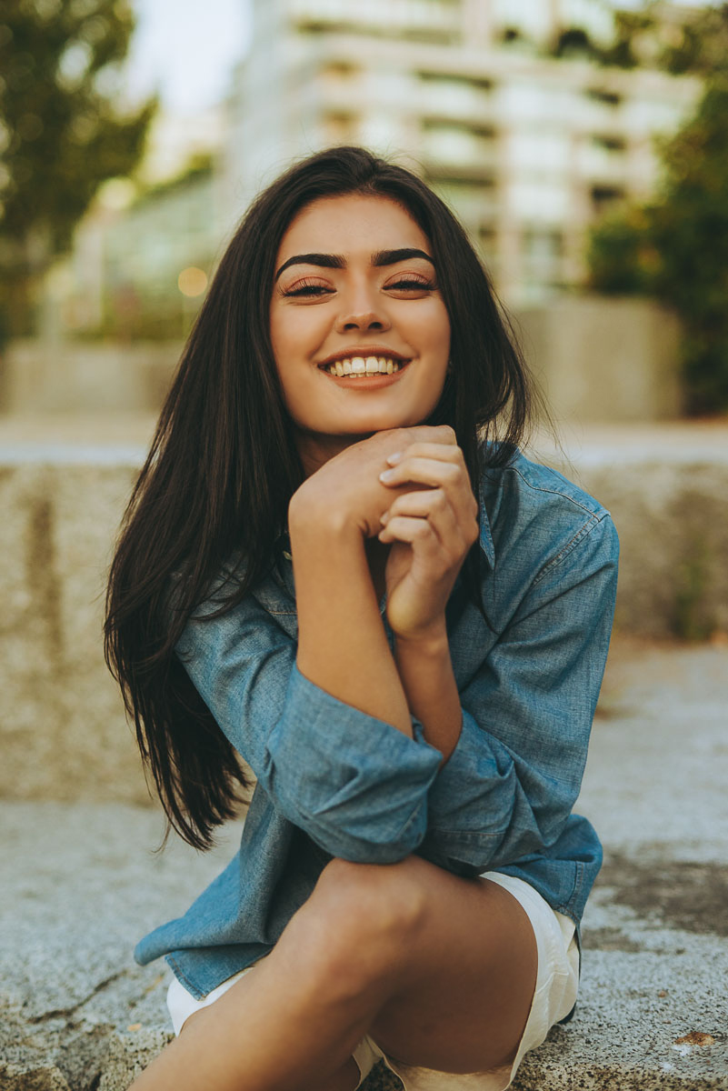
The supermodel has written her autobiography.

Slide 26
The supermodel has not written her autobiography.

Slide 27
He is improving his fluency in the language.

Slide 28
He is not improving his fluency in the language.

Slide 29
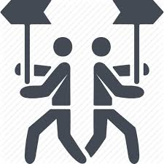
We had noticed a discrepancy in
the numbers.

Slide 30
We had not noticed a discrepancy in the numbers.

Slide 31
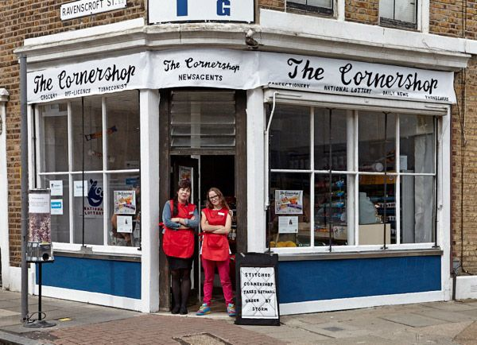
I am working at the agency around
the corner.

Slide 32
I am not working at the agency around the corner.

Slide 33
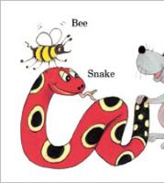
See you
next time!

