Slide 1
Jolly Grammar
5a-21

Slide 2
Let’s review
prefixes

Slide 3
unafraid
unpleasant
unpopular
displease
discomfort
disapprove

Slide 4
superman
supermarket

Slide 5
Parsing & Sentence Walls

Slide 6
Her naughty daughter had broken the tenth-century Chinese vase.
Subject
daughter
Her naughty
Verb
had broken
Object
vase
the tenth-century Chinse vase

Slide 7
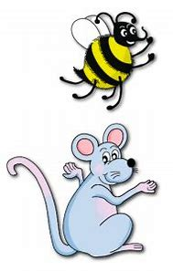
Spelling Point
<cent->
<kilo->
<milli->

Slide 8
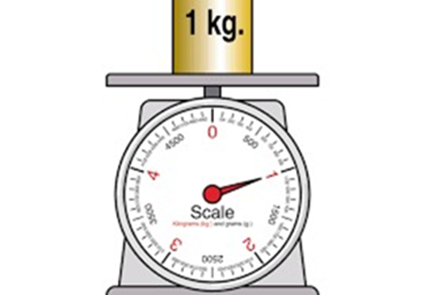
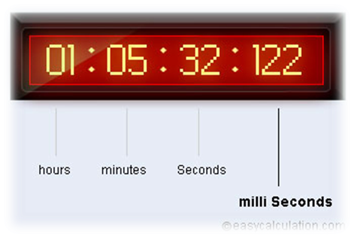
century
kilogram
millisecond
100
1000
1,000,000

Slide 9
century
kilogram
millisecond

Slide 10
century
kilogram
millisecond
100
1000
1,000,000

Slide 11
Spelling List
<cent->
<kilo->
<milli->

Slide 12
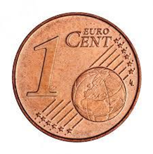
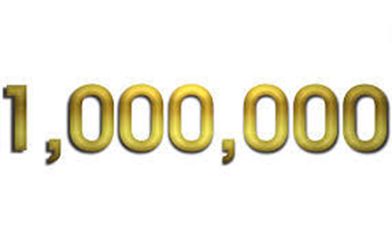
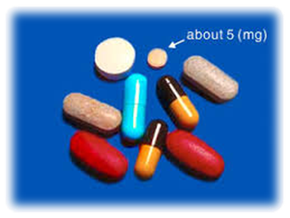
cent century kilo
million kilogram milligram

Slide 13
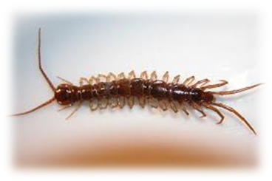
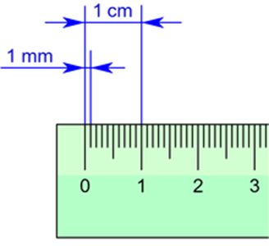
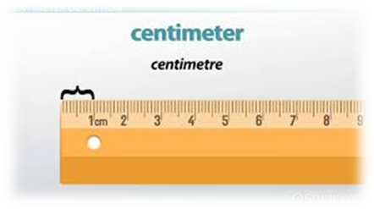
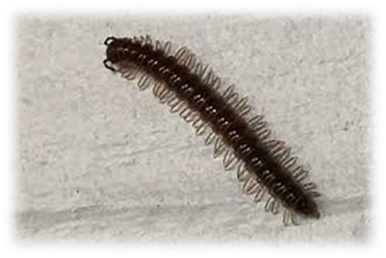
centigrade centipede millisecond
centimetre millimetre millipede

Slide 14
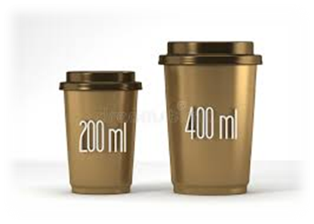
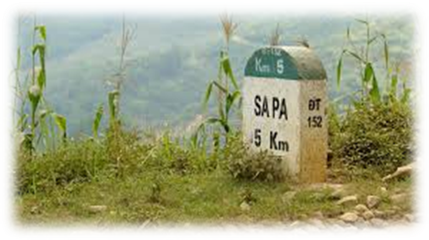
centenarian centennial centenary
kilometre millilitre millionth

Slide 15
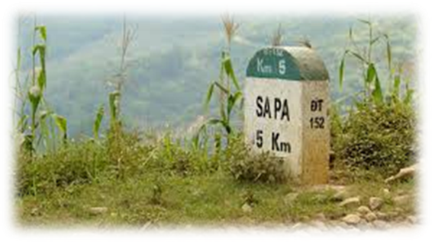

Slide 16
Activity Page:
Spelling
<cent->
<kilo->
<milli->

Slide 17
I have one cent.
My grandpa will live one century.
My house to school is about one kilometers.
Millipedes have millions of legs.
This iron weighs one kilogram.

Slide 18
My eraser is one milligram.
Today is 42 degrees centigrade.
The centipede is disgusting.
Every millisecond, a person dies.
An ant is one centimeter long.

Slide 19
A mosquito is 5-7 millimeter long.
My sister saw a millipede and wanted to catch it (Mao).

Slide 20
Dictation

Slide 21
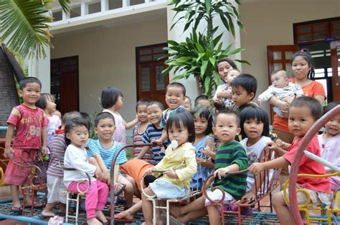
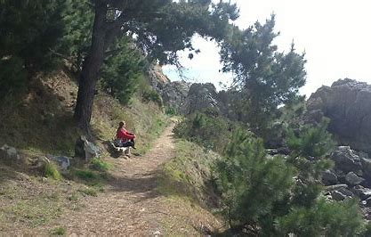

Slide 22
“The orphanage is ten kilometres away,” said Miss Smith.

Slide 23
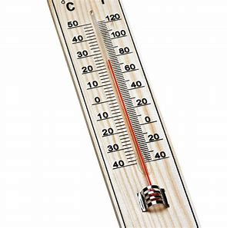
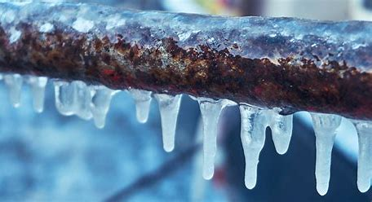

Slide 24
Fresh water freezes at zero degrees centigrade.

Slide 25
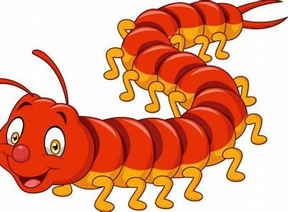

Slide 26
Does a millipede really have one thousand legs?

Slide 27
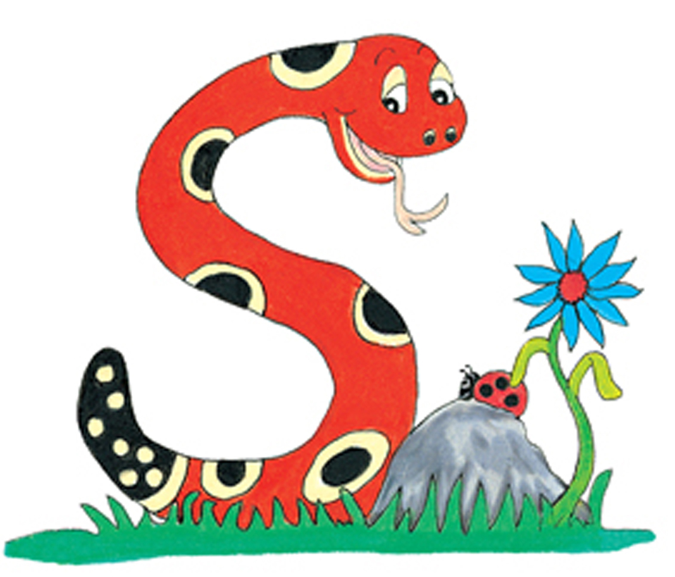
Thank you.
See you
next time!

