Slide 1
Jolly Grammar
5-20

Slide 2
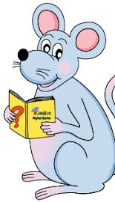
Spelling Test 10

Slide 3
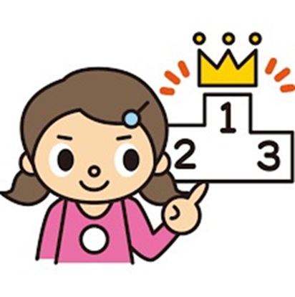
super

Slide 4
super
superb

Slide 5
super
superb
superstar

Slide 6
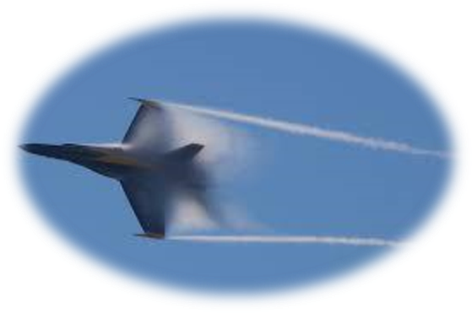
super
superb
superstar
supersonic

Slide 7
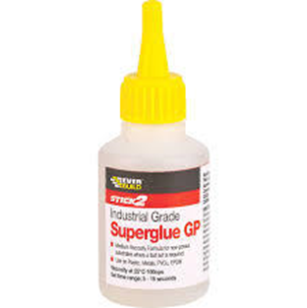
super
superb
superstar
supersonic
superglue

Slide 8
super
superb
superstar
supersonic
superglue
supermodel

Slide 9
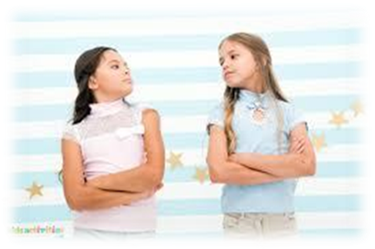
super
superb
superstar
supersonic
superglue
supermodel
superior

Slide 10
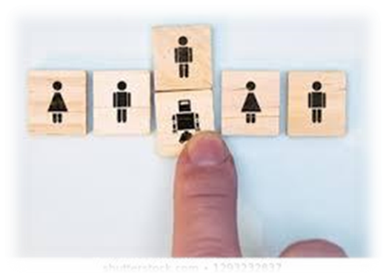
super
superb
superstar
supersonic
superglue
supermodel
superior
supersede

Slide 11
super
superb
superstar
supersonic
superglue
supermodel
superior
supersede
superimpose

Slide 12
super
superb
superstar
supersonic
superglue
supermodel
superior
supersede
superimpose
10. superpower

Slide 13
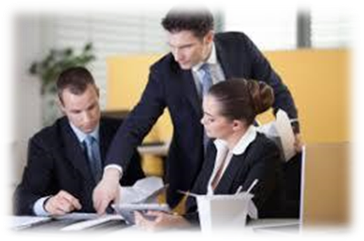
super
superb
superstar
supersonic
superglue
supermodel
superior
supersede
superimpose
10. superpower
11. supervise

Slide 14
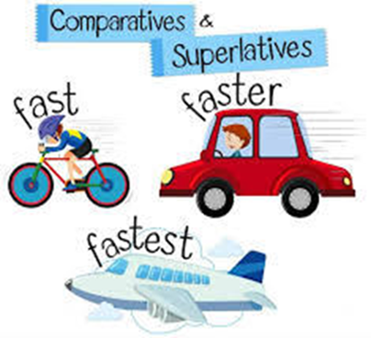
super
superb
superstar
supersonic
superglue
supermodel
superior
supersede
superimpose
10. superpower
11. supervise
12. superlative

Slide 15
super
superb
superstar
supersonic
superglue
supermodel
superior
supersede
superimpose
10. superpower
11. supervise
12. superlative
13. superiority

Slide 16
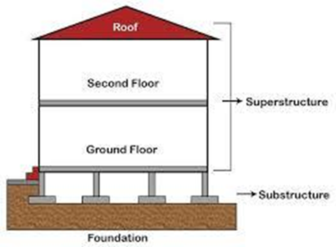
super
superb
superstar
supersonic
superglue
supermodel
superior
supersede
superimpose
10. superpower
11. supervise
12. superlative
13. superiority
14. superstructure

Slide 17
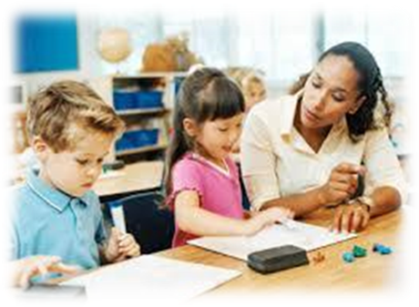
super
superb
superstar
supersonic
superglue
supermodel
superior
supersede
superimpose
10. superpower
11. supervise
12. superlative
13. superiority
14. superstructure
15. supervision

Slide 18
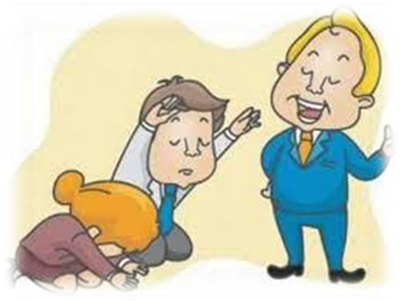
super
superb
superstar
supersonic
superglue
supermodel
superior
supersede
superimpose
10. superpower
11. supervise
12. superlative
13. superiority
14. superstructure
15. supervision
16. supercilious

Slide 19
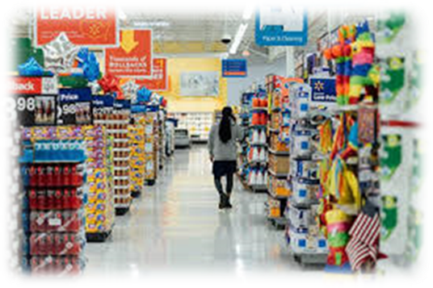
super
superb
superstar
supersonic
superglue
supermodel
superior
supersede
superimpose
10. superpower
11. supervise
12. superlative
13. superiority
14. superstructure
15. supervision
16. supercilious
17. supermarket

Slide 20
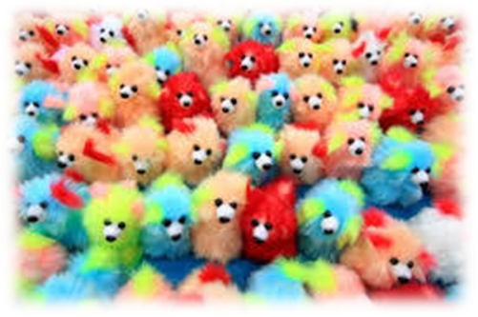
super
superb
superstar
supersonic
superglue
supermodel
superior
supersede
superimpose
10. superpower
11. supervise
12. superlative
13. superiority
14. superstructure
15. supervision
16. supercilious
17. supermarket
18. superfluous

Slide 21
Let’s review tenses.

Slide 22
to unlock

Slide 23
He will be unlocking the gate
at eight o’clock on the board.

Slide 24
He will be unlocking the gate
at eight o’clock on the board.

Slide 25
He will be unlocking the gate
at eight o’clock on the board.
Future continuous

Slide 26
He had unlocked the gate
at eight o’clock on the board.

Slide 27
He had unlocked the gate
at eight o’clock on the board.
Past perfect

Slide 28
Activity Page

Slide 29
I am balancing on a ball like an acrobat.
Present continuous

Slide 30
The rats were scavenging for food.
Past continuous

Slide 31
A truck has damaged the fence post.
Present perfect

Slide 32
He will be going to college next year.
Future continuous

Slide 33
We change our minds all the time.
Simple Present

Slide 34
You will have written the story by then.
Future Perfect

Slide 35
Her confidence had grown over the years.
Past Perfect

Slide 36
A butterfly will emerge from the chrysalis.
Simple Future

Slide 37
She received a strange message yesterday.
Simple past

Slide 38
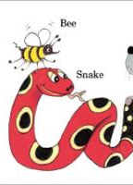
See you
next time!

