Slide 1
Jolly Grammar
5a-19

Slide 2
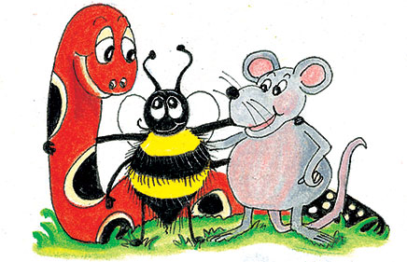
Let’s review
Irregular past participle

Slide 3
tear
wake
break
forget
wear
freeze
steal
choose
speak
swear

Slide 4
tear
wake
break
forget
wear
freeze
steal
choose
speak
swear
tore
torn

Slide 5
tear
wake
break
forget
wear
freeze
steal
choose
speak
swear
tore
woke
torn
woken

Slide 6
tear
wake
break
forget
wear
freeze
steal
choose
speak
swear
tore
woke
broke
torn
woken
broken

Slide 7
tear
wake
break
forget
wear
freeze
steal
choose
speak
swear
tore
woke
broke
forgot
torn
woken
broken
forgotten

Slide 8
tear
wake
break
forget
wear
freeze
steal
choose
speak
swear
tore
woke
broke
forgot
wore
torn
woken
broken
forgotten
worn

Slide 9
tear
wake
break
forget
wear
freeze
steal
choose
speak
swear
tore
woke
broke
forgot
wore
froze
torn
woken
broken
forgotten
worn
frozen

Slide 10
tear
wake
break
forget
wear
freeze
steal
choose
speak
swear
tore
woke
broke
forgot
wore
froze
stole
torn
woken
broken
forgotten
worn
frozen
stolen

Slide 11
tear
wake
break
forget
wear
freeze
steal
choose
speak
swear
tore
woke
broke
forgot
wore
froze
stole
chose
torn
woken
broken
forgotten
worn
frozen
stolen
chosen

Slide 12
tear
wake
break
forget
wear
freeze
steal
choose
speak
swear
tore
woke
broke
forgot
wore
froze
stole
chose
spoke
torn
woken
broken
forgotten
worn
frozen
stolen
chosen
spoken

Slide 13
tear
wake
break
forget
wear
freeze
steal
choose
speak
swear
tore
woke
broke
forgot
wore
froze
stole
chose
spoke
swore
torn
woken
broken
forgotten
worn
frozen
stolen
chosen
spoken
sworn

Slide 14
Parsing & Sentence Walls

Slide 15
The strict granny was supervising her lively grandchildren.
Subject
granny
The strict
Verb
was supervising
Object
grandchildren
her lively

Slide 16
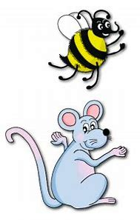
Let’s review
prefixes.

Slide 17
unafraid

Slide 18
unafraid
unpleasant

Slide 19
unafraid
unpleasant
unpopular

Slide 20
unafraid
unpleasant
unpopular
displease

Slide 21
unafraid
unpleasant
unpopular
displease
discomfort

Slide 22
unafraid
unpleasant
unpopular
displease
discomfort
disapprove

Slide 23
Spelling Point
<super->

Slide 24
superman
supermarket

Slide 25
Spelling List
<super->

Slide 26
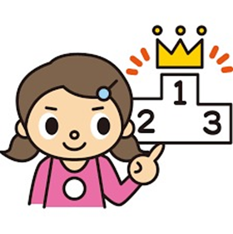
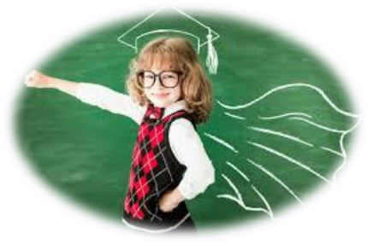
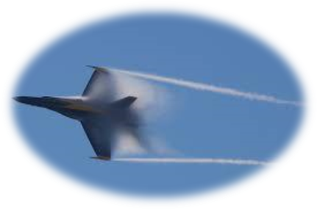
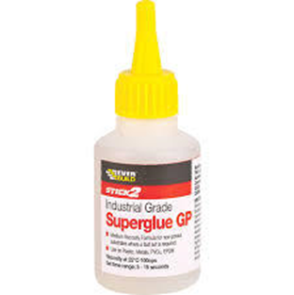
super superb superstar
supersonic superglue supermodel

Slide 27
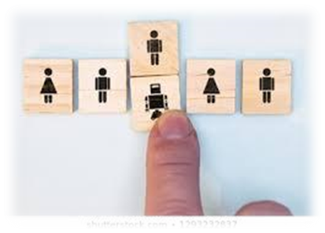
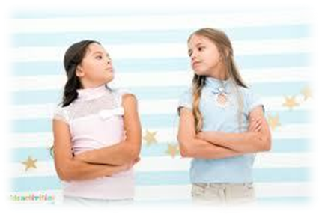
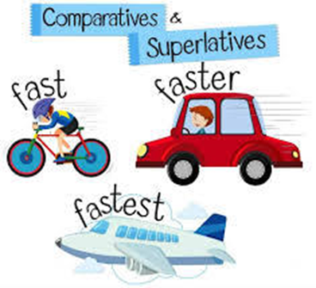
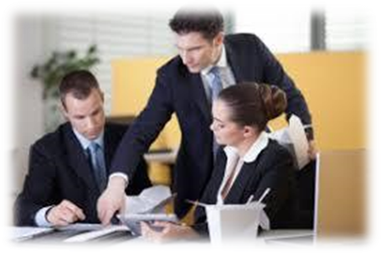
superior supersede superimpose
superpower supervise superlative

Slide 28
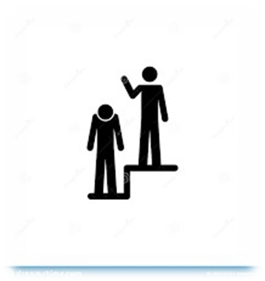
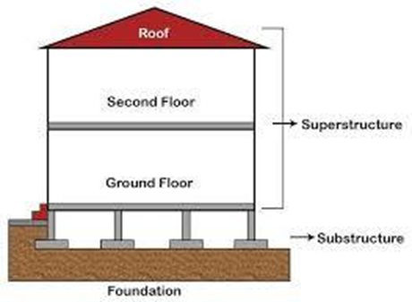
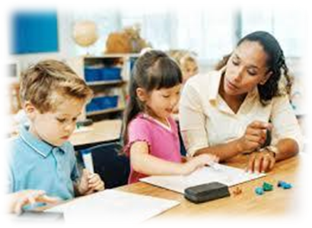
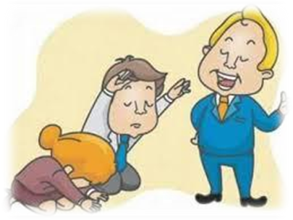
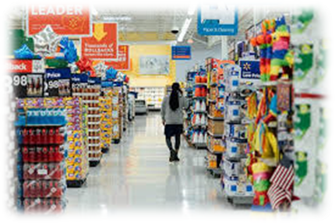
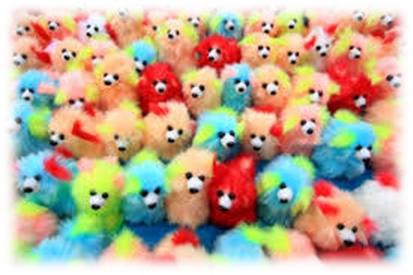
superiority superstructure supervision
supercilious supermarket superfluous

Slide 29
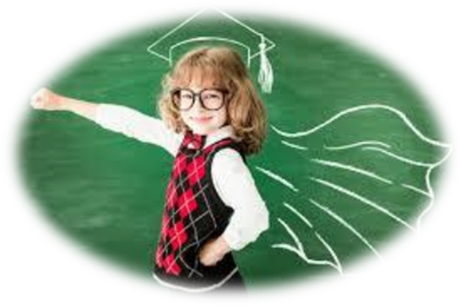
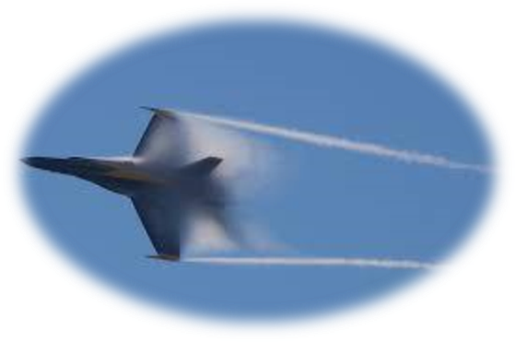
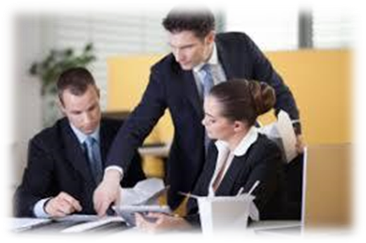
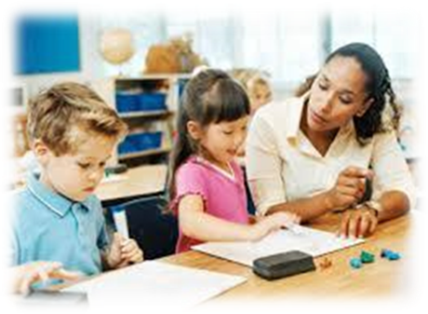

Slide 30
Activity Page:
Spelling
<super->

Slide 31
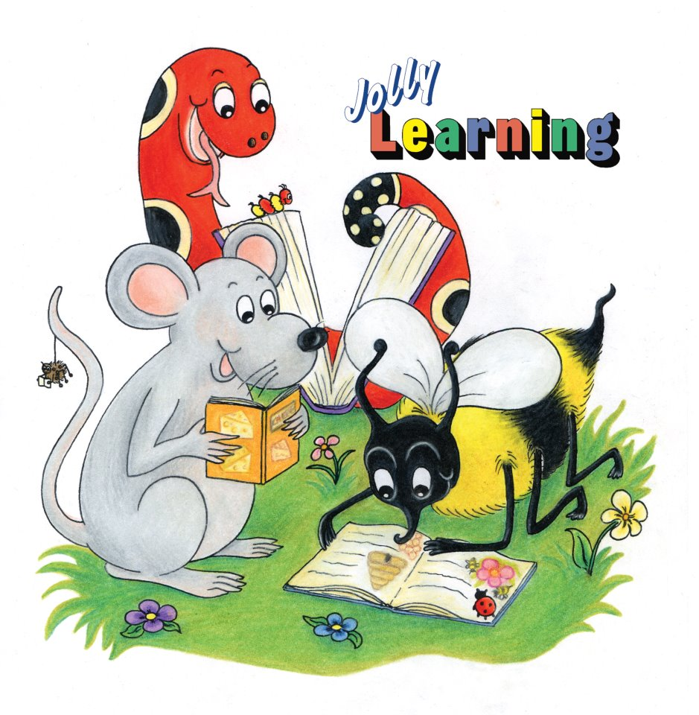
Dictation

Slide 32
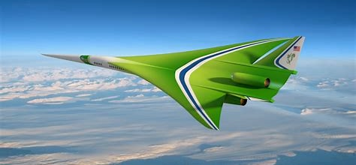
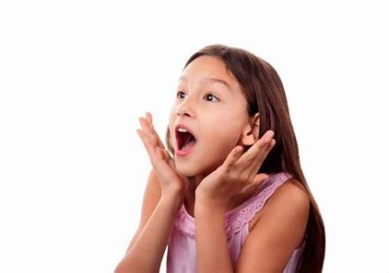

Slide 33
“Is it a supersonic plane？” asked the girl.

Slide 34
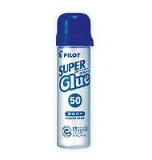
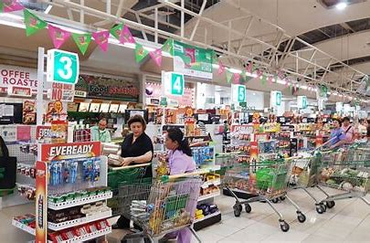

Slide 35
I bought some superglue at the supermarket.

Slide 36
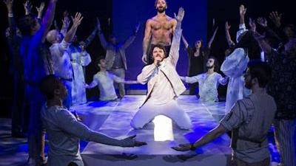

Slide 37
The superstar gave a superb performance.

Slide 38
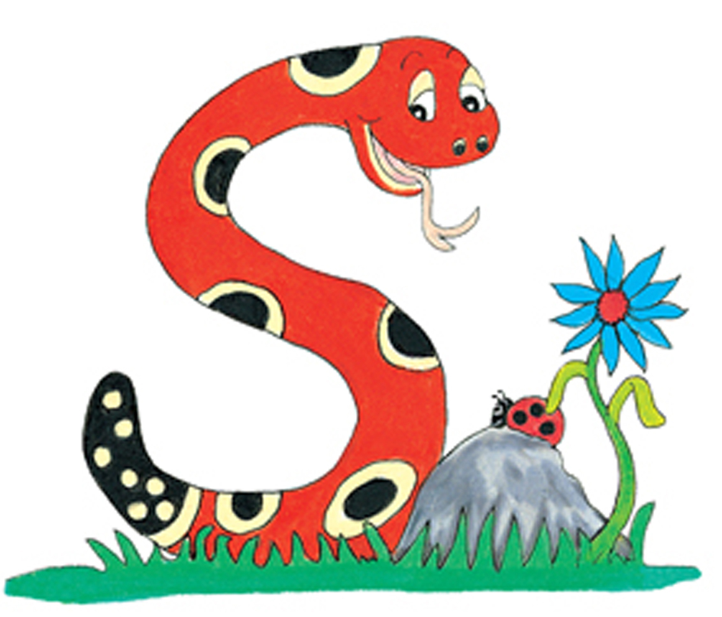
Thank you.
See you
next time!

