Slide 1
Jolly Grammar
5a-17

Slide 2
Zack plays on his computer.
●Past perfect
Zack had played on his computer.
●Present perfect
Zack has played on his computer.
●Future perfect
Zack will have played on his computer.

Slide 3
The children copy the dance steps.
●Past perfect
The children had copied the dance steps.
●Present perfect
The children have copied the dance steps.
●Future perfect
The children will have copied the dance steps.

Slide 4
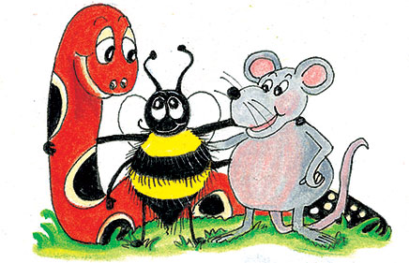
Parsing & Sentence Walls

Slide 5
The college student previously studied microbiology.
Subject
student
The college
Verb
studied
previously
Object
microbiology

Slide 6
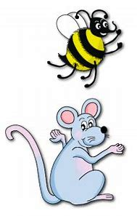
Let’s review
prefixes.

Slide 7
unafraid

Slide 8
unafraid
unpleasant

Slide 9
unafraid
unpleasant
unpopular

Slide 10
unafraid
unpleasant
unpopular
displease

Slide 11
unafraid
unpleasant
unpopular
displease
discomfort

Slide 12
unafraid
unpleasant
unpopular
displease
discomfort
disapprove

Slide 13
Spelling Point
<mega->
<micro->

Slide 14
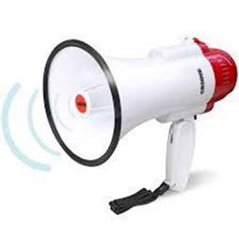
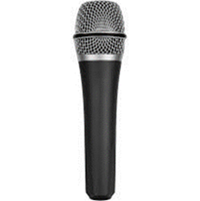
megaphone
microphone

Slide 15
Spelling List
<mega->
<micro->

Slide 16
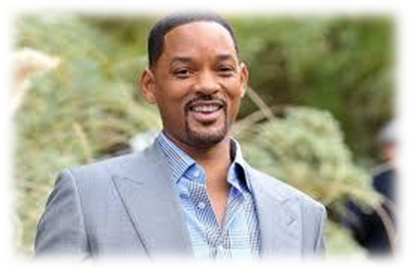
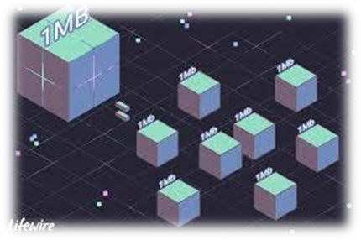
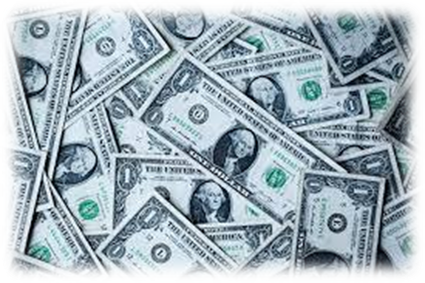
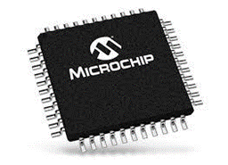
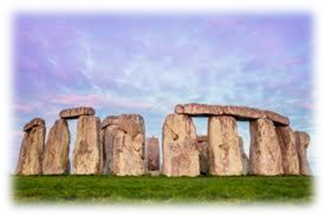
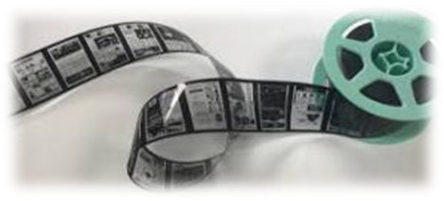
megastar megabit megabucks
microchip microfilm megalith

Slide 17
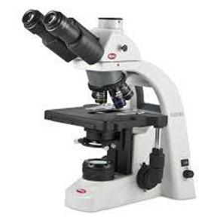
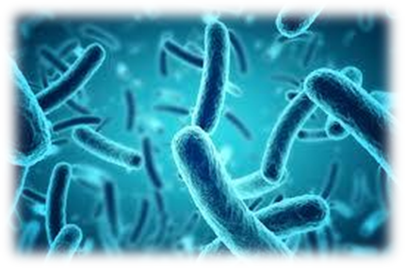
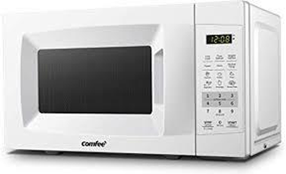
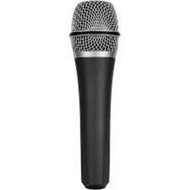
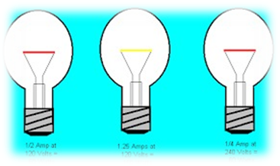
microscope microbe microwave
microphone megaphone megawatt

Slide 18
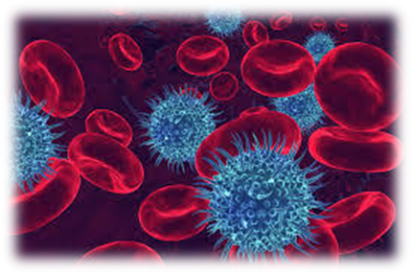
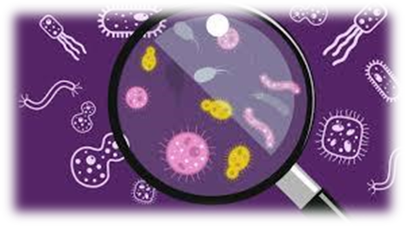
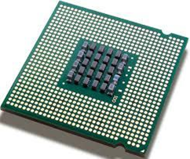
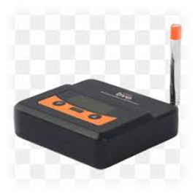
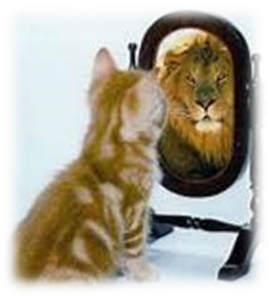
microscopic microbiology microprocessor
megabyte megahertz megalomania

Slide 19
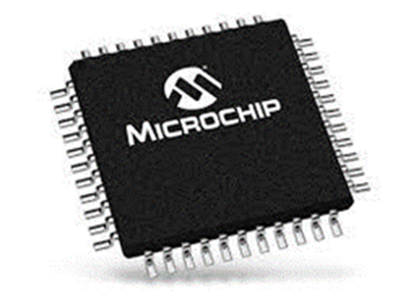
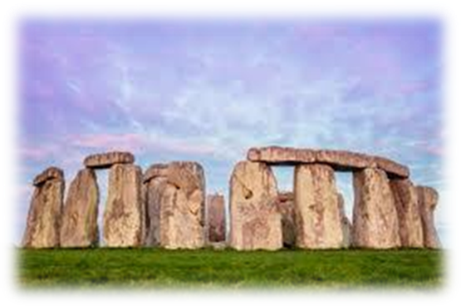
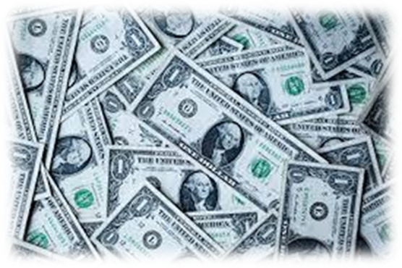
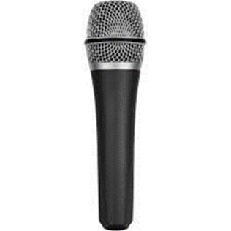

Slide 20
Activity Page:
Spelling
<mega->
<micro->

Slide 21
Dictation

Slide 22
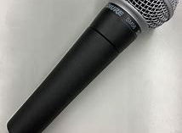
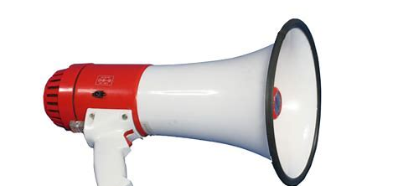

Slide 23
“Can I exchange the megaphone for a microphone?” asked Jane.

Slide 25
The multitalented megastar has written his autobiography.

Slide 26
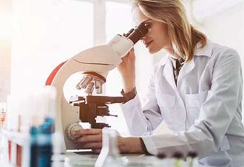
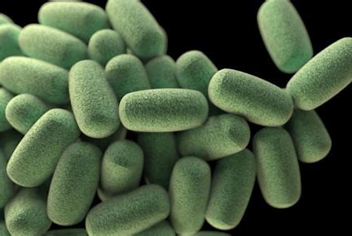

Slide 27
The microbiologist looked at the microbes down the microscope.

Slide 28
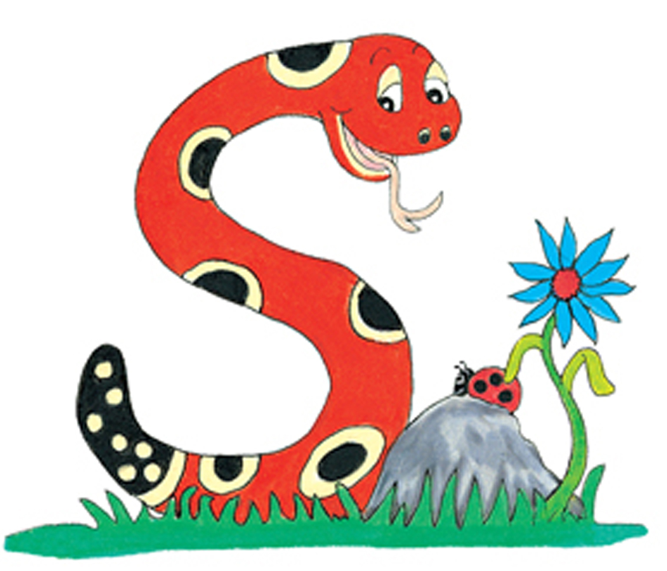
Thank you.
See you
next time!

