Slide 1
Jolly Grammar
5a-16

Slide 2
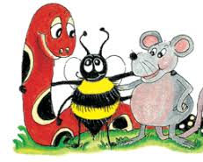
Spelling Test 8

Slide 3
auto

Slide 4
auto
2. automatic

Slide 5
auto
2. automatic
3. autonomy

Slide 6
auto
2. automatic
3. autonomy
automated

Slide 7
auto
2. automatic
3. autonomy
automated
automaton

Slide 8
auto
2. automatic
3. autonomy
automated
automaton
autopilot

Slide 9
auto
2. automatic
3. autonomy
automated
automaton
autopilot
7. automation

Slide 10
auto
2. automatic
3. autonomy
automated
automaton
autopilot
7. automation
8. automobile

Slide 11
auto
2. automatic
3. autonomy
automated
automaton
autopilot
7. automation
8. automobile
9. autograph

Slide 12
auto
2. automatic
3. autonomy
automated
automaton
autopilot
7. automation
8. automobile
9. autograph
10. automotive

Slide 13
auto
2. automatic
3. autonomy
automated
automaton
autopilot
7. automation
8. automobile
9. autograph
10. automotive
11. autopsy

Slide 14
auto
2. automatic
3. autonomy
automated
automaton
autopilot
7. automation
8. automobile
9. autograph
10. automotive
11. autopsy
12. autocrat

Slide 15
auto
2. automatic
3. autonomy
automated
automaton
autopilot
7. automation
8. automobile
9. autograph
10. automotive
11. autopsy
12. autocrat
13. autoimmune

Slide 16
auto
2. automatic
3. autonomy
automated
automaton
autopilot
7. automation
8. automobile
9. autograph
10. automotive
11. autopsy
12. autocrat
13. autoimmune
14. autofocus

Slide 17
auto
2. automatic
3. autonomy
automated
automaton
autopilot
7. automation
8. automobile
9. autograph
10. automotive
11. autopsy
12. autocrat
13. autoimmune
14. autofocus
15. autocracy

Slide 18
auto
2. automatic
3. autonomy
automated
automaton
autopilot
7. automation
8. automobile
9. autograph
10. automotive
11. autopsy
12. autocrat
13. autoimmune
14. autofocus
15. autocracy
16. autonomous

Slide 19
auto
2. automatic
3. autonomy
automated
automaton
autopilot
7. automation
8. automobile
9. autograph
10. automotive
11. autopsy
12. autocrat
13. autoimmune
14. autofocus
15. autocracy
16. autonomous
17. automatically

Slide 20
auto
2. automatic
3. autonomy
automated
automaton
autopilot
7. automation
8. automobile
9. autograph
10. automotive
11. autopsy
12. autocrat
13. autoimmune
14. autofocus
15. autocracy
16. autonomous
17. automatically
18. autobiography

Slide 21
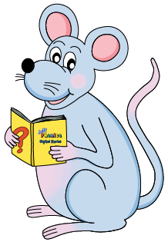
Let’s review
The verb
“to have”

Slide 22
Simple Present Conjugation
I have a ball.
you have a ball.
he a ball.
she a ball.
it a ball.
we have a ball.
you have a ball.
they have a ball.

Slide 23
Simple Present Conjugation
I have a ball.
you have a ball.
he has a ball.
she has a ball.
it has a ball.
we have a ball.
you have a ball.
they have a ball.

Slide 24
Present Continuous Conjugation
I am having a ball.

Slide 25
Present Continuous Conjugation
I am having a ball.
you

Slide 26
Present Continuous Conjugation
I am having a ball.
you are having a ball.
he

Slide 27
Present Continuous Conjugation
I am having a ball.
you are having a ball.
he is having a ball.
she

Slide 28
Present Continuous Conjugation
I am having a ball.
you are having a ball.
he is having a ball.
she is having a ball.
it

Slide 29
Present Continuous Conjugation
I am having a ball.
you are having a ball.
he is having a ball.
she is having a ball.
it is having a ball.
we

Slide 30
Present Continuous Conjugation
I am having a ball.
you are having a ball.
he is having a ball.
she is having a ball.
it is having a ball.
we are having a ball.
you

Slide 31
Present Continuous Conjugation
I am having a ball.
you are having a ball.
he is having a ball.
she is having a ball.
it is having a ball.
we are having a ball.
you are having a ball.
they

Slide 32
Present Continuous Conjugation
I am having a ball.
you are having a ball.
he is having a ball.
she is having a ball.
it is having a ball.
we are having a ball.
you are having a ball.
they are having a ball.

Slide 33
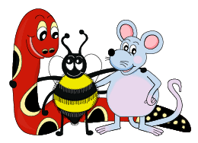
Identify Verbs

Slide 34
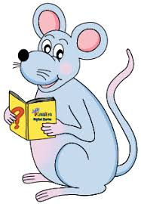
“Identify the verb in each sentence.”
He has big feet.

Slide 35
Identify the verb in each sentence.
He has big feet.

Slide 36
Identify the verb in each sentence.
He has big feet.
I had a large lunch.

Slide 37
Identify the verb in each sentence.
He has big feet.
I had a large lunch.

Slide 38
Identify the verb in each sentence.
He has big feet.
I had a large lunch.
We will be having a rest soon.

Slide 39
Identify the verb in each sentence.
He has big feet.
I had a large lunch.
We will be having a rest soon.

Slide 40
Identify the verb in each sentence.
He has big feet.
I had a large lunch.
We will be having a rest soon.
She is taller than me.

Slide 41
Identify the verb in each sentence.
He has big feet.
I had a large lunch.
We will be having a rest soon.
She is taller than me.

Slide 42
Identify the verb in each sentence.
He has big feet.
I had a large lunch.
We will be having a rest soon.
She is taller than me.
You were being very good.

Slide 43
Identify the verb in each sentence.
He has big feet.
I had a large lunch.
We will be having a rest soon.
She is taller than me.
You were being very good.

Slide 44
Identify the verb in each sentence.
He has big feet.
I had a large lunch.
We will be having a rest soon.
She is taller than me.
You were being very good.
They will be late for school.

Slide 45
Identify the verb in each sentence.
He has big feet.
I had a large lunch.
We will be having a rest soon.
She is taller than me.
You were being very good.
They will be late for school.

Slide 46
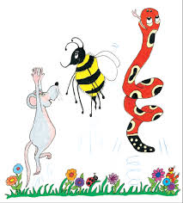
Remember
Perfect Tense?

Slide 47
Perfect Tenses
I had walked to school.
I have walked to school.
I will have walked to school.

Slide 48
Perfect Tenses
I had walked to school.
I have walked to school.
I will have walked to school.
main verb?

Slide 49
Perfect Tenses
I had walked to school.
I have walked to school.
I will have walked to school.
main verb

Slide 50
Perfect Tenses
I had walked to school.
I have walked to school.
I will have walked to school.
have →auxiliary verb

Slide 51
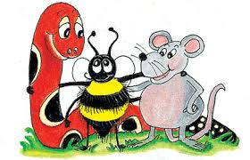
When
speaking to someone?

Slide 52
Perfect Tenses
I had walked to school.
I have walked to school.
I will have walked to school.

Slide 53
Perfect Tenses
I had walked to school.
I have walked to school.
→ I’ve walked to school.
I will have walked to school.

Slide 54
Perfect Tenses
I had walked to school.
→ I’d walked to school.
I have walked to school.
→ I’ve walked to school.
I will have walked to school.

Slide 55
Perfect Tenses
I had walked to school.
→ I’d walked to school.
I have walked to school.
→ I’ve walked to school.
I will have walked to school.
→ I’ll have walked to school.

Slide 56
past perfect (had) | present perfect (have / has) | future perfect (shall / will have)
I’d walked | I’ve walked | I’ll have walked

Slide 57
past perfect (had) | present perfect (have / has) | future perfect (shall / will have)
I’d walked | I’ve walked | I’ll have walked
 | you’ve walked
he’d walked
 | she’s walked
 |  | it’ll have walked
 | we’ve walked
you’d walked
 |  | they’ll have walked

Slide 58
past perfect (had) | present perfect (have / has) | future perfect (shall / will have)
I’d walked | I’ve walked | I’ll have walked
you’d walked | you’ve walked | you’ll have walked
he’d walked | he’s walked | he’ll have walked
she’d walked | she’s walked | she’ll have walked
it’d walked | it’s walked | it’ll have walked
we’d walked | we’ve walked | we’ll have walked
you’d walked | you’ve walked | you’ll have walked
they’d walked | they’ve walked | they’ll have walked

Slide 59
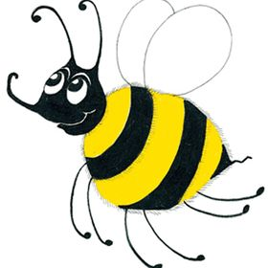
he’s
she’s
it’s
① He’s walked to school.

Slide 60
he’s
she’s
it’s
① He’s walked to school.
→He has walked to school.

Slide 61
he’s
she’s
it’s
① He’s walked to school.
→He has walked to school.
② He’s walking to school.

Slide 62
he’s
she’s
it’s
① He’s walked to school.
→He has walked to school.
② He’s walking to school.
→He is walking to school.

Slide 63
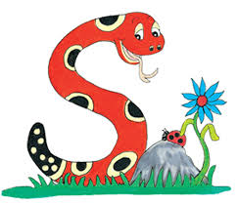
“have” as a main verb
I have a sister.
×I’ve a sister.
He has blue eyes.
×He‘s blue eyes.

Slide 64
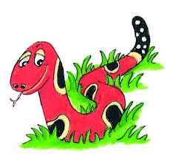
Activity Page

Slide 65
“We have prepared a lovely picnic for lunch,” said Meg.

Slide 66
“We have prepared a lovely picnic for lunch,” said Meg.
They’d visited the museum several times before.

Slide 67
“We have prepared a lovely picnic for lunch,” said Meg.
They’d visited the museum several times before.
Dad grumbled, “I do not think you will have finished by then.”

Slide 68
“We have prepared a lovely picnic for lunch,” said Meg.
They’d visited the museum several times before.
Dad grumbled, “I do not think you will have finished by then.”
Tina was tired because she’d jogged all the way to the park.

Slide 69
“We have prepared a lovely picnic for lunch,” said Meg.
They’d visited the museum several times before.
Dad grumbled, “I do not think you will have finished by then.”
Tina was tired because she’d jogged all the way to the park.
“It has stopped raining now,” called Ben.

Slide 70
“We have prepared a lovely picnic for lunch,” said Meg.
They’d visited the museum several times before.
Dad grumbled, “I do not think you will have finished by then.”
Tina was tired because she’d jogged all the way to the park.
“It has stopped raining now,” called Ben.
By the end of today, I‘ll have painted the fence.

