Slide 1
Jolly Grammar
5a-15

Slide 2
Parsing & Sentence Walls

Slide 3
The experienced captain has used
the plane’s autopilot.
Subject
captain
The experienced
Verb
has used
Object
autopilot
the plane’s

Slide 4
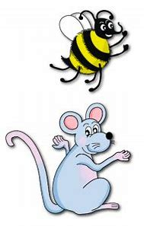
Let’s review
prefixes.

Slide 5
unafraid

Slide 6
unafraid
unpleasant

Slide 7
unafraid
unpleasant
unpopular

Slide 8
unafraid
unpleasant
unpopular
displease

Slide 9
unafraid
unpleasant
unpopular
displease
discomfort

Slide 10
unafraid
unpleasant
unpopular
displease
discomfort
disapprove

Slide 11
Spelling Point
<auto->

Slide 12
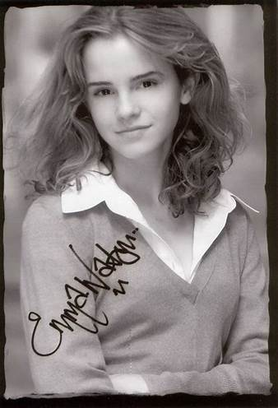
autograph

Slide 13
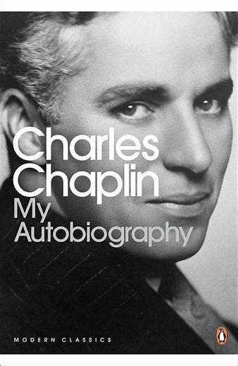
autograph
autobiography

Slide 14
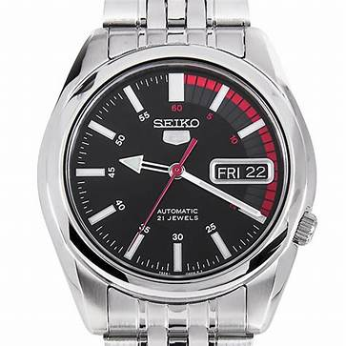
autograph
autobiography
automatic

Slide 15
Spelling List
<auto->

Slide 16
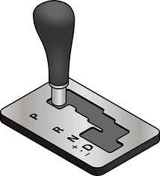
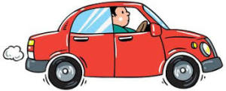
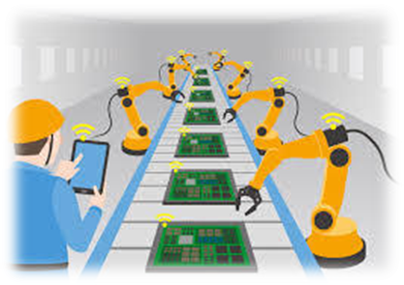
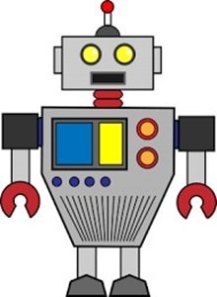
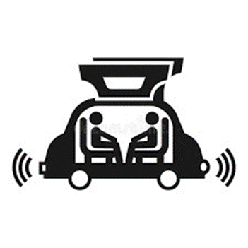
auto automatic autonomy
automated automaton autopilot

Slide 17
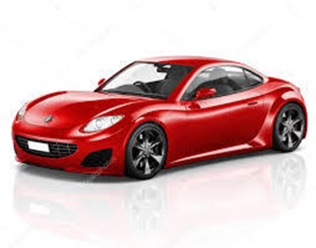
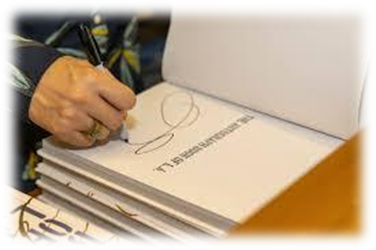
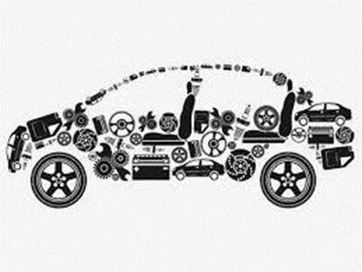
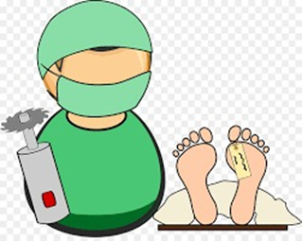
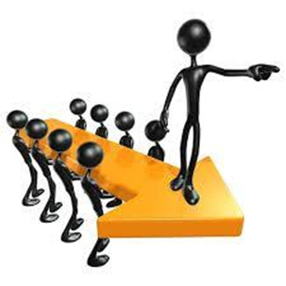
automation automobile autograph
automotive autopsy autocrat

Slide 18
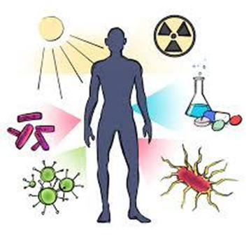
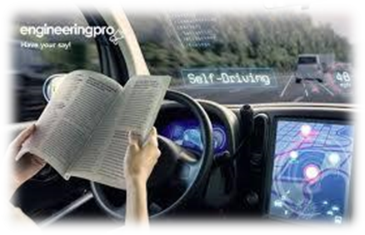
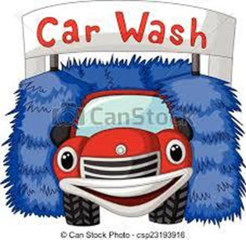
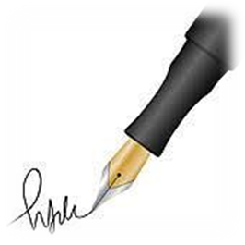
autoimmune autofocus autocracy
autonomous automatically autobiography

Slide 19
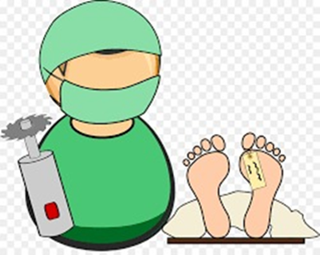
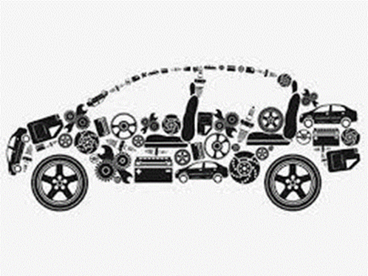

Slide 20
Activity Page:
Spelling
<auto->

Slide 21
Dictation

Slide 22
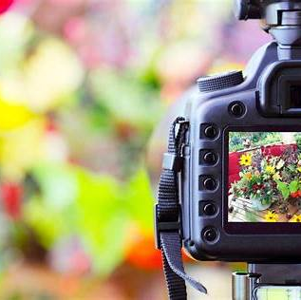

Slide 23
“This camera has autofocus,” explained the assistant.

Slide 24
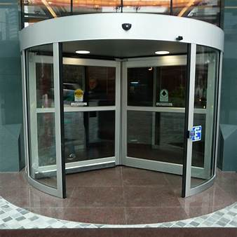
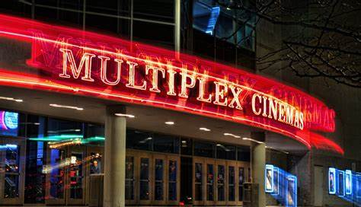

Slide 25
The door opened automatically as we reached the multiplex.

Slide 26
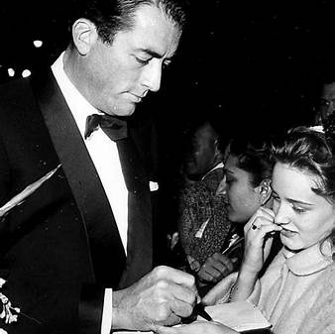

Slide 27
She was confident she could get the actor’s autograph.

Slide 28
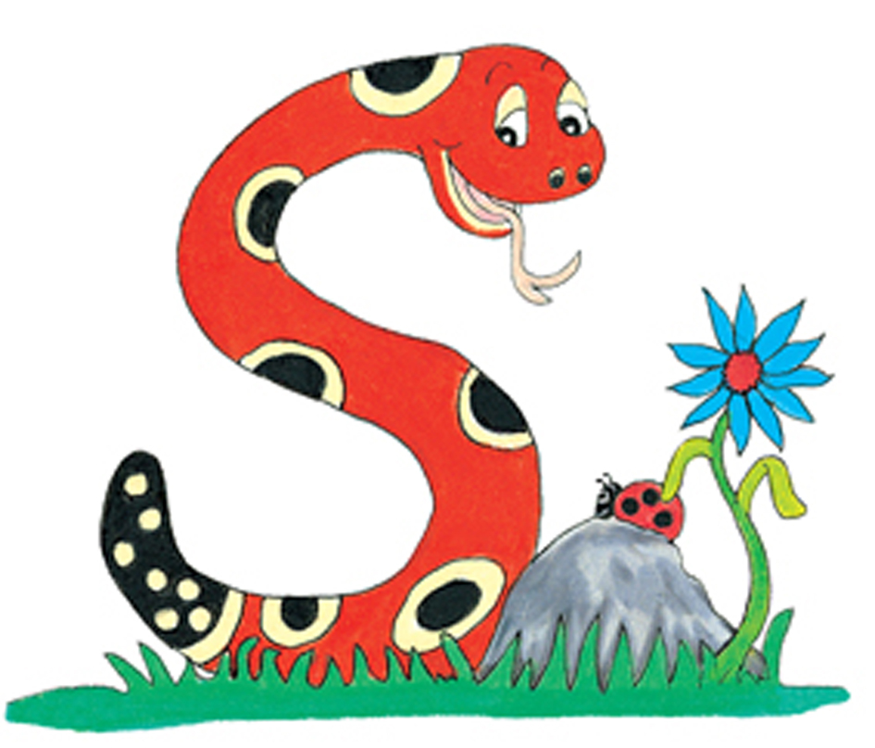
Thank you.
See you
next time!

