Slide 1
Jolly Grammar
5-14

Slide 2
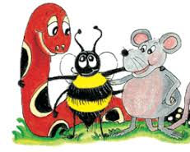
Spelling Test 7

Slide 3
multitask

Slide 4
multitask
2. multipack

Slide 5
multitask
2. multipack
3. multiplayer

Slide 6
multitask
2. multipack
3. multiplayer
4. multiplex

Slide 7
multitask
2. multipack
3. multiplayer
4. multiplex
5. multiply

Slide 8
multitask
2. multipack
3. multiplayer
4. multiplex
5. multiply
6. multitude

Slide 9
multitask
2. multipack
3. multiplayer
4. multiplex
5. multiply
6. multitude
7. multiple

Slide 10
multitask
2. multipack
3. multiplayer
4. multiplex
5. multiply
6. multitude
7. multiple
8. multimedia

Slide 11
multitask
2. multipack
3. multiplayer
4. multiplex
5. multiply
6. multitude
7. multiple
8. multimedia
9. multilayered

Slide 12
multitask
2. multipack
3. multiplayer
4. multiplex
5. multiply
6. multitude
7. multiple
8. multimedia
9. multilayered
10. multicoloured

Slide 13
multitask
2. multipack
3. multiplayer
4. multiplex
5. multiply
6. multitude
7. multiple
8. multimedia
9. multilayered
10. multicoloured
11. multitalented

Slide 14
multitask
2. multipack
3. multiplayer
4. multiplex
5. multiply
6. multitude
7. multiple
8. multimedia
9. multilayered
10. multicoloured
11. multitalented
12. multipurpose

Slide 15
multitask
2. multipack
3. multiplayer
4. multiplex
5. multiply
6. multitude
7. multiple
8. multimedia
9. multilayered
10. multicoloured
11. multitalented
12. multipurpose
13. multiplicity

Slide 16
multitask
2. multipack
3. multiplayer
4. multiplex
5. multiply
6. multitude
7. multiple
8. multimedia
9. multilayered
10. multicoloured
11. multitalented
12. multipurpose
13. multiplicity
14. multiplication

Slide 17
multitask
2. multipack
3. multiplayer
4. multiplex
5. multiply
6. multitude
7. multiple
8. multimedia
9. multilayered
10. multicoloured
11. multitalented
12. multipurpose
13. multiplicity
14. multiplication
15. multimillionaire

Slide 18
multitask
2. multipack
3. multiplayer
4. multiplex
5. multiply
6. multitude
7. multiple
8. multimedia
9. multilayered
10. multicoloured
11. multitalented
12. multipurpose
13. multiplicity
14. multiplication
15. multimillionaire
16. multinational

Slide 19
multitask
2. multipack
3. multiplayer
4. multiplex
5. multiply
6. multitude
7. multiple
8. multimedia
9. multilayered
10. multicoloured
11. multitalented
12. multipurpose
13. multiplicity
14. multiplication
15. multimillionaire
16. multinational
17. multicultural

Slide 20
multitask
2. multipack
3. multiplayer
4. multiplex
5. multiply
6. multitude
7. multiple
8. multimedia
9. multilayered
10. multicoloured
11. multitalented
12. multipurpose
13. multiplicity
14. multiplication
15. multimillionaire
16. multinational
17. multicultural
18. multisyllabic

Slide 21
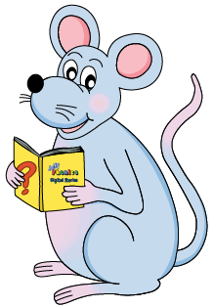
Let’s review
Verb Tenses

Slide 22
Verb Tenses
 | Simple Present
 | I play the flute.

Slide 23
Verb Tenses
Simple Past | Simple Present
 | I play the flute.

Slide 24
Verb Tenses
Simple Past | Simple Present
I played the flute. | I play the flute.

Slide 25
Verb Tenses
Simple Past | Simple Present | Simple Future
I played the flute. | I play the flute.

Slide 26
Verb Tenses
Simple Past | Simple Present | Simple Future
I played the flute. | I play the flute. | I shall/will play the flute.

Slide 27
Verb Tenses
Simple Past | Simple Present | Simple Future
I played the flute. | I play the flute. | I shall/will play the flute.
 | Present Continuous

Slide 28
Verb Tenses
Simple Past | Simple Present | Simple Future
I played the flute. | I play the flute. | I shall/will play the flute.
 | Present Continuous
 | I am playing the flute.

Slide 29
Verb Tenses
Simple Past | Simple Present | Simple Future
I played the flute. | I play the flute. | I shall/will play the flute.
Past Continuous | Present Continuous
 | I am playing the flute.

Slide 30
Verb Tenses
Simple Past | Simple Present | Simple Future
I played the flute. | I play the flute. | I shall/will play the flute.
Past Continuous | Present Continuous
I was playing the flute. | I am playing the flute.

Slide 31
Verb Tenses
Simple Past | Simple Present | Simple Future
I played the flute. | I play the flute. | I shall/will play the flute.
Past Continuous | Present Continuous | Future Continuous
I was playing the flute. | I am playing the flute.

Slide 32
Verb Tenses
Simple Past | Simple Present | Simple Future
I played the flute. | I play the flute. | I shall/will play the flute.
Past Continuous | Present Continuous | Future Continuous
I was playing the flute. | I am playing the flute. | I shall/will be playing the flute.

Slide 33
I have walked to school.

Slide 34
I had walked to school.
I have walked to school.

Slide 35
I had walked to school.
I have walked to school.
I will have walked to school.

Slide 36
Perfect Tenses
I had walked to school.
I have walked to school.
I will have walked to school.

Slide 37
Perfect Tenses → Completed action
I had walked to school.
I have walked to school.
I will have walked to school.

Slide 38
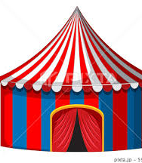
Activity Page

Slide 39
Present Perfect
I have finished
you have finished
he has finished
she has finished
it has finished
we have finished
you have finished
they have finished

Slide 40
Past Perfect
I had finished
you had finished
he had finished
she had finished
it had finished
we had finished
you had finished
they had finished

Slide 41
Future Perfect
I shall/will have finished
you will have finished
he will have finished
she will have finished
it will have finished
we shall/will have finished
you will have finished
they will have finished

Slide 42
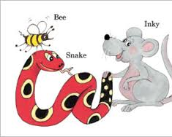
See you next week!

