Slide 1
Jolly Grammar
5a-13

Slide 2
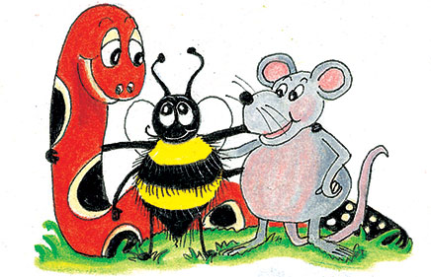
Parsing & Sentence Walls

Slide 3
I will visit the big new multiplex.

Slide 4
I will visit the big new multiplex.

Slide 5
I will visit the big new multiplex.
Subject
I
Verb
will visit
Object
multiplex
the big new

Slide 6
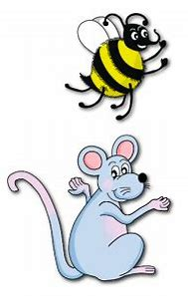
Let’s review
prefixes.

Slide 7
midday
midnight
midsummer
semicircle
semi-final
semiconscious

Slide 8
multitude
multiply
multipurpose

Slide 9
Spelling List
<multi->

Slide 10
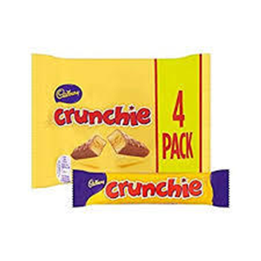
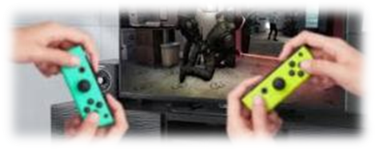
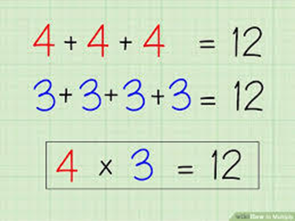
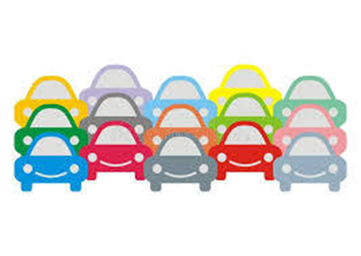
multitask multipack multiplayer
multiplex multiply multitude

Slide 11
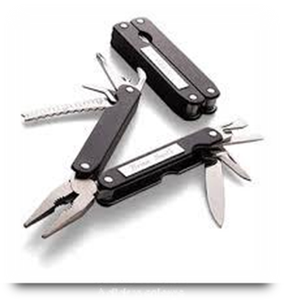
multiple multimedia multilayered
multicoloured multitalented multipurpose

Slide 12
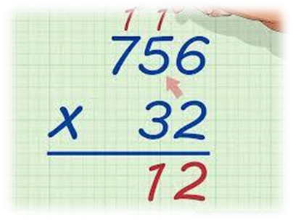
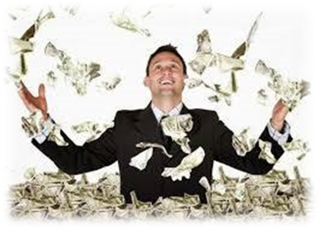
multiplicity multiplication multimillionaire
multinational multicultural multisyllabic

Slide 13
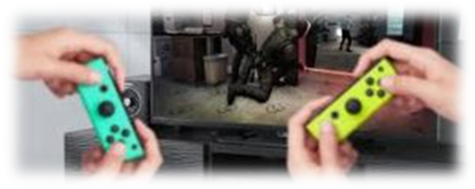
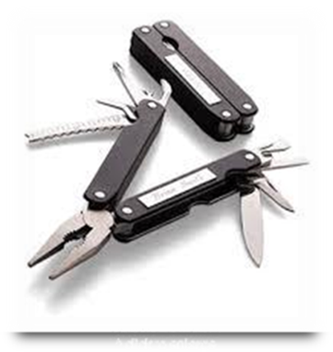

Slide 14
Activity Page:
Spelling
<multi->

Slide 15
Dictation

Slide 16
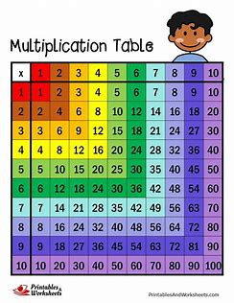

Slide 17
“I know my multiplication tables,” exclaimed the boy.

Slide 18
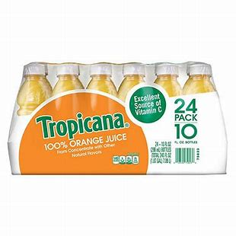

Slide 19
The convenience store sells multipacks of orange juice.

Slide 21
A multitude of stars were shining in the night sky.

Slide 22
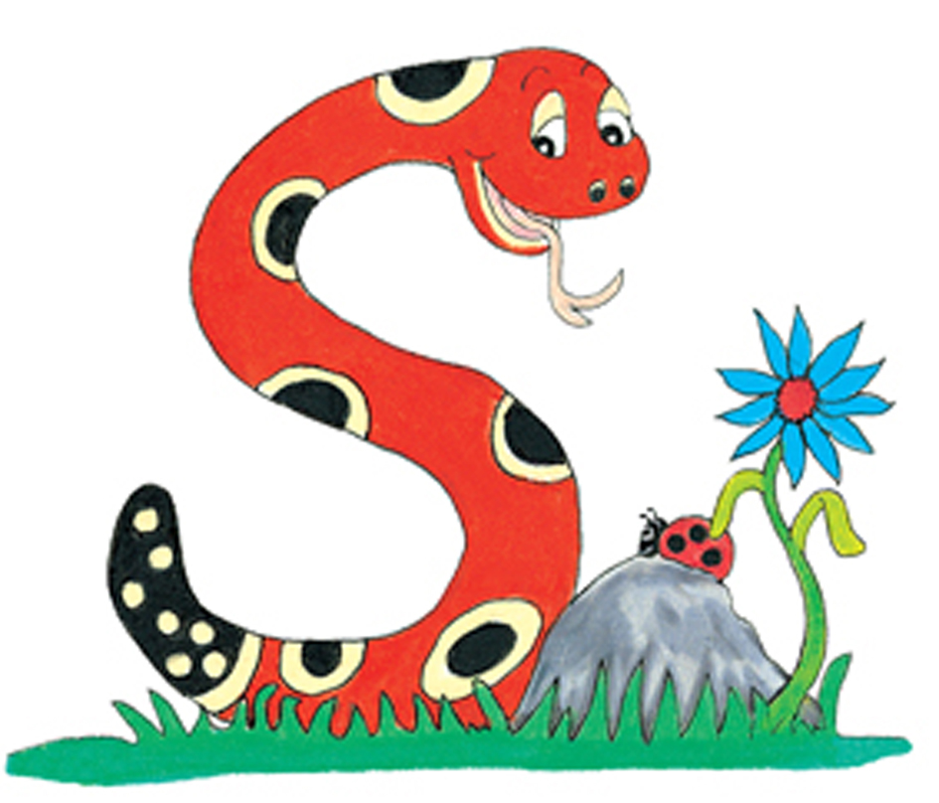
Thank you.
See you
next time!

